Slide 1

Bird’s Eye View
God’s Word

Slide 2
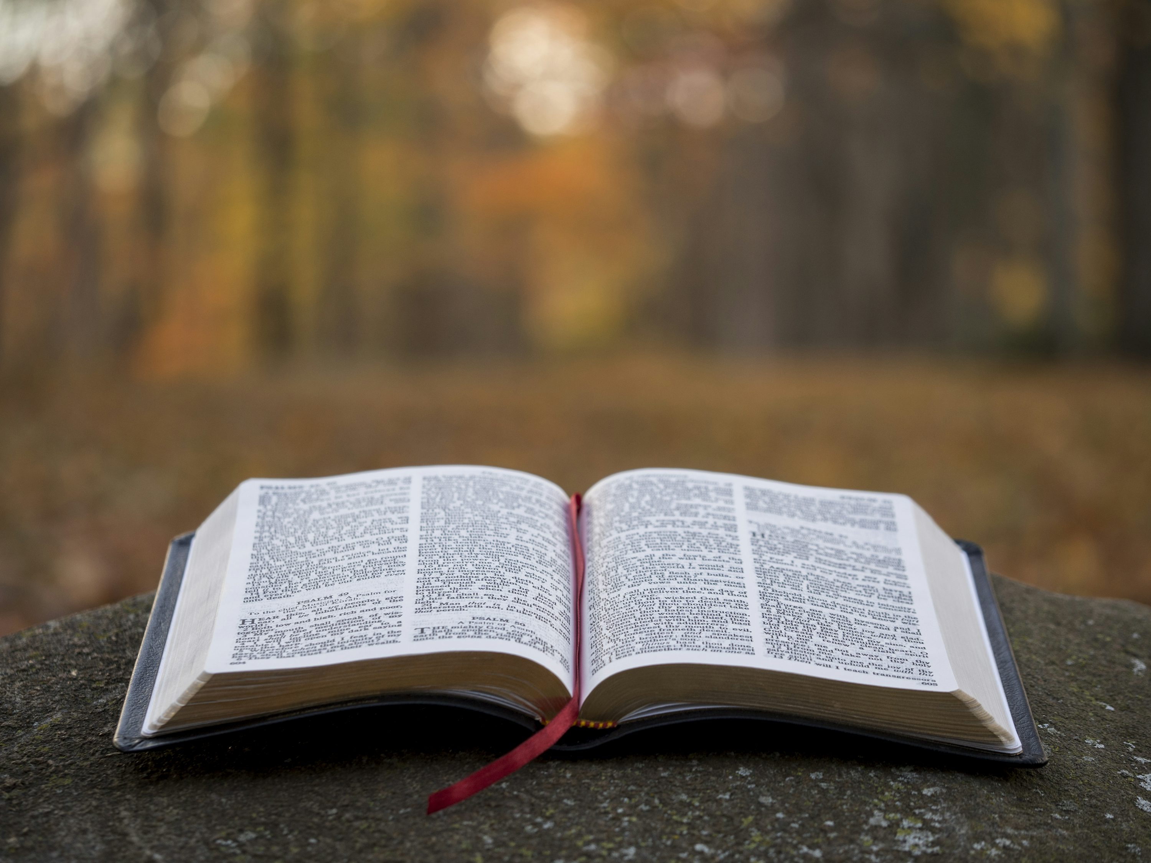
Holy Bible

Slide 3
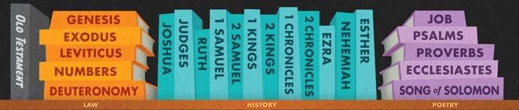
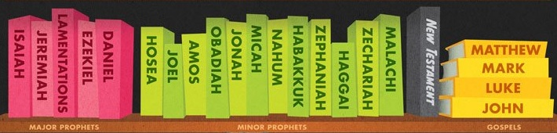
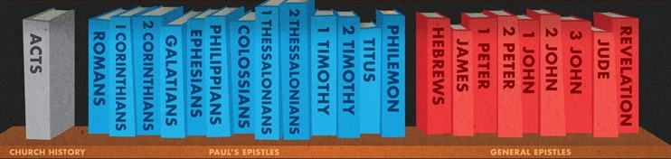
“All Scripture is inspired by God”
– 2 Timothy 3:16 GNT

Slide 4
“For no prophetic message ever came just from the human will, but people were under the control of the Holy Spirit as they spoke the message that came from God.”
– 2 Peeter 1:21 GNT

Slide 5
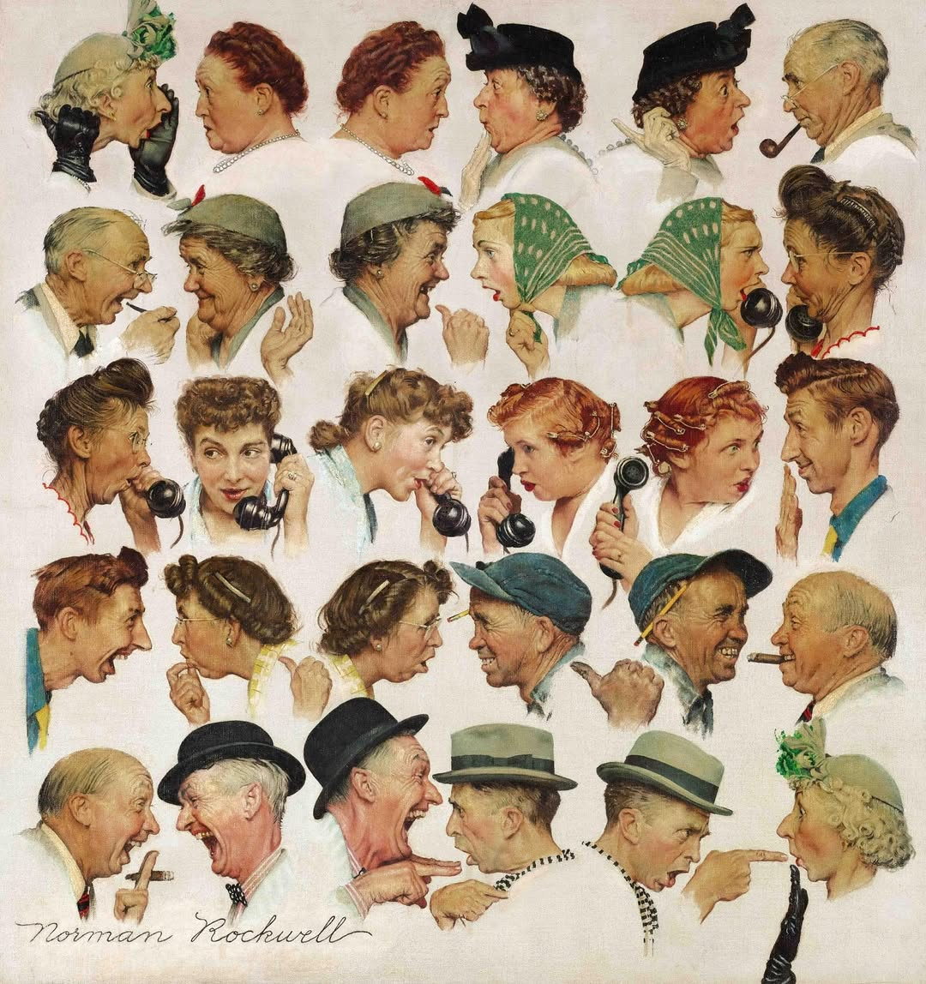

Slide 6
“For no prophetic message ever came just from the human will, but people were under the control of the Holy Spirit as they spoke the message that came from God.”
– 2 Peeter 1:21 GNT

Slide 7
“We know that Scripture is always true.”
– John 10:35 GNT

Slide 8
“All your words are true. All your laws are right. They last forever.”
– Psalm 119:160 NIRV

Slide 9
“In the beginning was the Word, and the Word was with God, and the Word was God. He [the Word] was in the beginning with God.”
– John 1:1, 2 NKJV

Slide 10
Who is the Word ?
So the Word became human and made his home among us. He was full of unfailing love and faithfulness. And we have seen his glory, the glory of the Father’s one and only Son.
– John 1:14 NLT

Slide 11
Remember Immanuel ?
“The virgin is going to have a baby. She will give birth to a son. And he will be called Immanuel.” (Isaiah 7:14) The name Immanuel means “God with us.”
– Matthew 1:23 NIRV

Slide 12
“In the beginning was the Word [Christ], and the Word [Christ] was with God [Father], and the Word [Christ] was God [divine]. He [the Word] was in the beginning with God [Father].”
– John 1:1, 2 NKJV
The Beginning
Eternity

Slide 13
“In the beginning God created the heavens and the earth.”
– Genesis 1:1 NKJV
The Beginning
Eternity

Slide 14
Genesis means the book of the beginnings, full of firsts.
First man
First woman
First marriage
First fall
First Seed promise
First baby son
First family
First brothers
First murder
First tower
First flood
First twin
First dream
First wrestling
So on ….

Slide 15
God also says, “Lord, in the beginning you made the earth, and your hands made the skies.
– Hebrews 1:10 NCV
The Beginning
Eternity

Slide 16
“And beginning at Moses and all the Prophets, He [Jesus] expounded to them in all the Scriptures the things concerning Himself [Jesus].”
– Luke 24:27 NKJV
The Beginning
Eternity

Slide 17
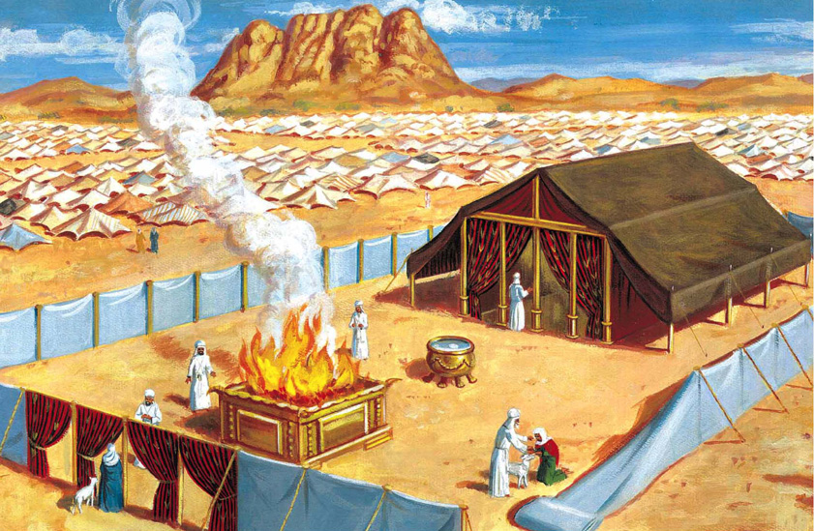
Plan
Plan: the Plan of Salvation
Blueprint ~ Floor Layout ~ Model
The Courtyard
Two Apartments
Six Furnitures
Seven Annual Feasts
Ultimate Goal: God Dwell Among Us and Reveal the Solution of the Sin Problem
Sanctuary

Slide 18
“I [Jesus] am the Alpha and the Omega, the Beginning and the End, the First and the Last.”
– Revelation 22:13 NKJV
The Beginning
The End
Time
Eternity
Eternity
A
A
Z
Z
Alpha
Omega

Slide 19
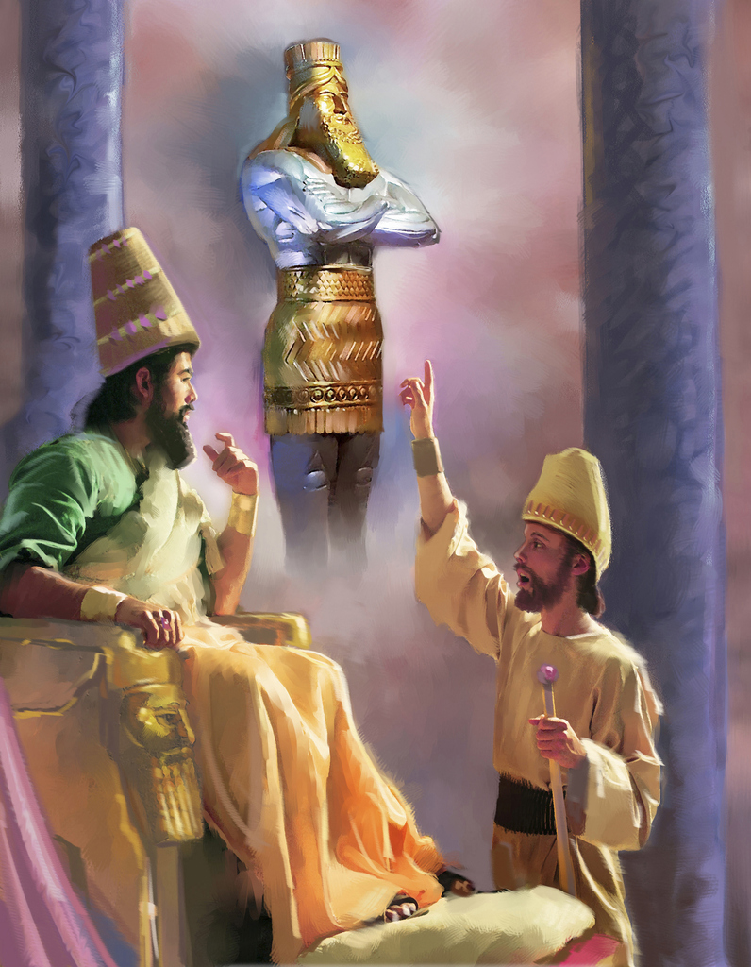
7 weeks
Plan
Time
Sanctuary
DANIEL
605 BC
490 days
31 AD
2300 days
1260 days
27 AD
70 weeks
42 months
A time, times and half times
62 weeks
457 BC
34 AD

Slide 20
“The things [events] I [God] predicted have now come true. Now I [God] will tell you of new things [events] even before they begin to happen.”
– Isaiah 42:9 GNT
The Beginning
The End
Time
Eternity
Eternity
A
Z
Alpha
Omega

Slide 21
“In the beginning, I [God] told you what would happen in the end. A long time ago, I [God] told you things [events] that have not happened yet. When I [God] plan something, it happens. I [God] do whatever I [God] want to do.”
– Isaiah 46:10 ERV
The Beginning
The End
Time
Eternity
Eternity
A
Z
Alpha
Omega

Slide 22
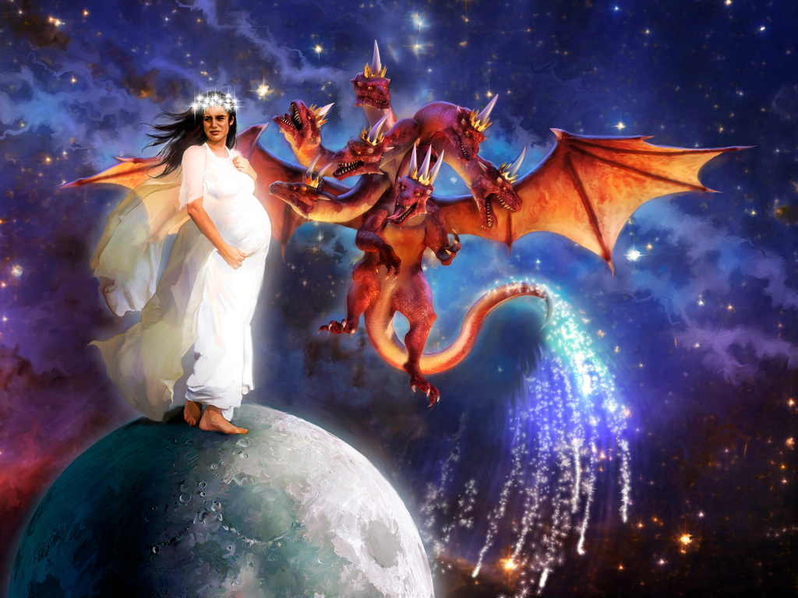
Plan
Time
Event
Sanctuary
DANIEL
Revelation

Slide 23
Revelations end time focus
Rev. 1:20,13,20; 2:1,5 | Lampstands | Holy
Rev. 4:2ff | God’s Throne | Most Holy
Rev. 6:9 | Altar of incense | Holy
Rev. 8:3 | Incense & prayer | Holy
Rev. 9:13 | Horns of altar | Holy
Rev. 11:1 | Measure Temple | Most Holy
Rev. 11:19 | Ark of Covenant | Most Holy
Rev. 14:15,17 | Angel from Temple | Most Holy
Rev. 15:5,6; 16:1 | Temple opened | Most Holy
Rev. 20:11 | White Throne | Most Holy
Rev. 22:1 | Throne of God | Most Holy

Slide 24
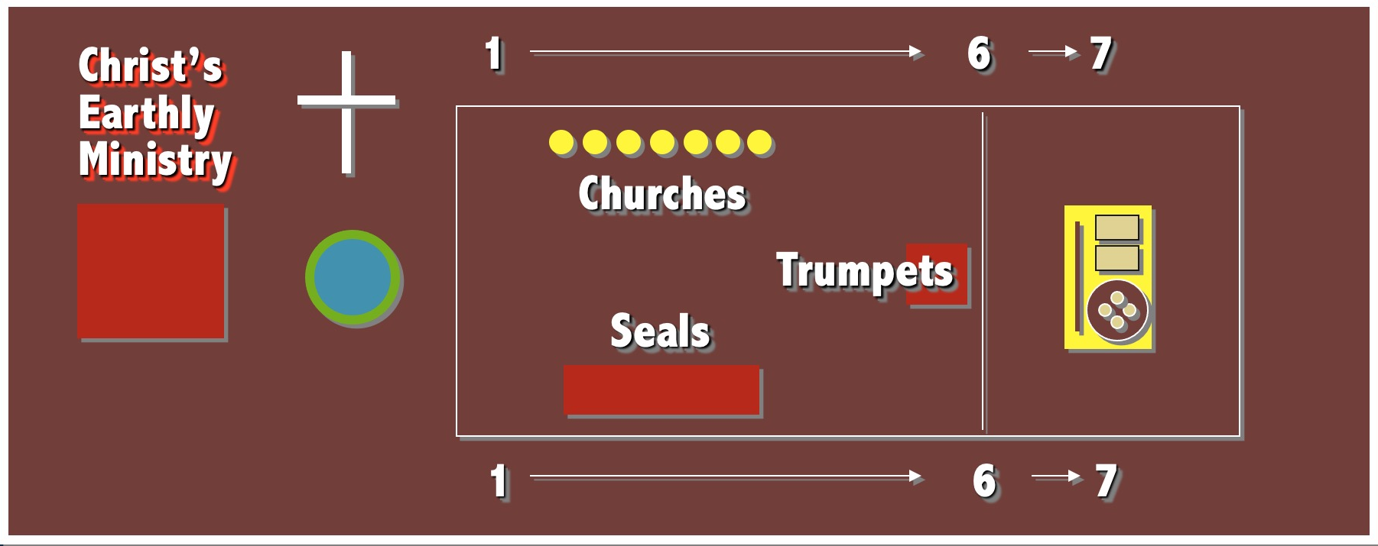
Revelation’s Sanctuary Outline
31 AD
1844 AD
Revelation
1-11
Revelation
12-22

Slide 25
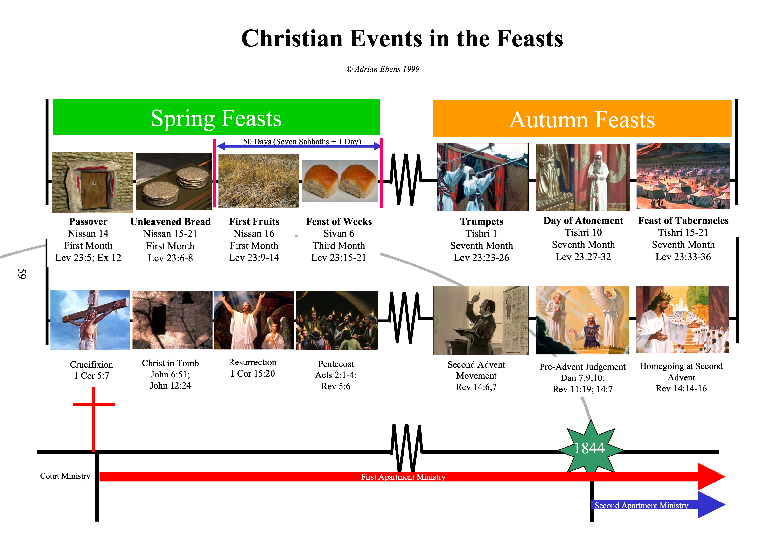

Slide 26
“When He, the Spirit of truth, has come, He will guide you into all truth; for He will not speak on His own authority, but whatever He hears He will speak; and He will tell you things [events] to come.” – John 16:13 NKJV
The Beginning
The End
Time
Eternity
Eternity
A
Z
Alpha
Omega

Slide 27
Plan
Time
Event
Sanctuary
DANIEL
Revelation
?

Slide 28
– Romans 4:5 ERV
“But people cannot do any work that will make them right with God. So they must trust in him [Jesus]. Then he [Jesus] accepts their faith, and that makes them right with him [Jesus]. He [Jesus] is the one who makes even evil people right.”
The Beginning
The End
Time
Eternity
Eternity
A
Z
Alpha
Omega

Slide 29
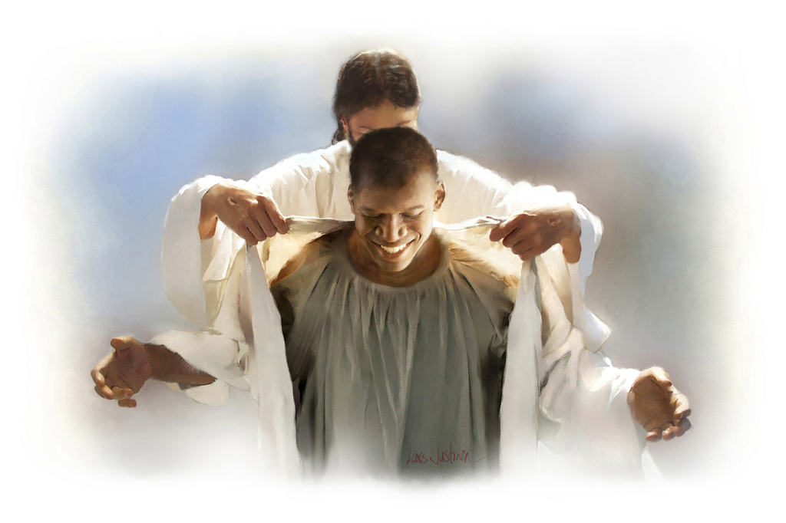
Character
Plan
Time
Event
Righteousness by Faith
Sanctuary
DANIEL
Revelation
?

Slide 30
The Beginning
The End
Time
Eternity
Eternity
A
Z
Alpha
Omega

Slide 31
GENESIS
REVELATION
The Beginning
The End
Time
Eternity
Eternity
A
Z
Alpha
Omega

Slide 32
GENESIS
REVELATION
Creation of the heavens and earth.
The Tree of Life in the Garden.
A river runs through the Garden.
The first marriage: Adam and Eve.
The beginning of the career of Satan.
Death enters.
Man lost privileges because of sin.
Beginning of sorrow, pain and death.
The first murder.
The beginning of Babylon.
A new heaven and a new earth.
The Tree of Life in the New Jerusalem.n
A river runs through the New Jerusalem.nn
The last marriage: The last Adam to the church.nnn
The end of Satan’s career: The Lake of Fire.nnnn
Death is destroyed.nnnnn
Man regains privileges beacusennnnnn of Christ’s payment for sin.nnnnnn
Christ wipes away all tears.nnnnnnn
No more death.nnnnnnnn
Babylon destroyed.nnnnnnnnn

Slide 33
The Beginning
The End
Time
Eternity
Eternity
A
Z
Alpha
Omega

Slide 35
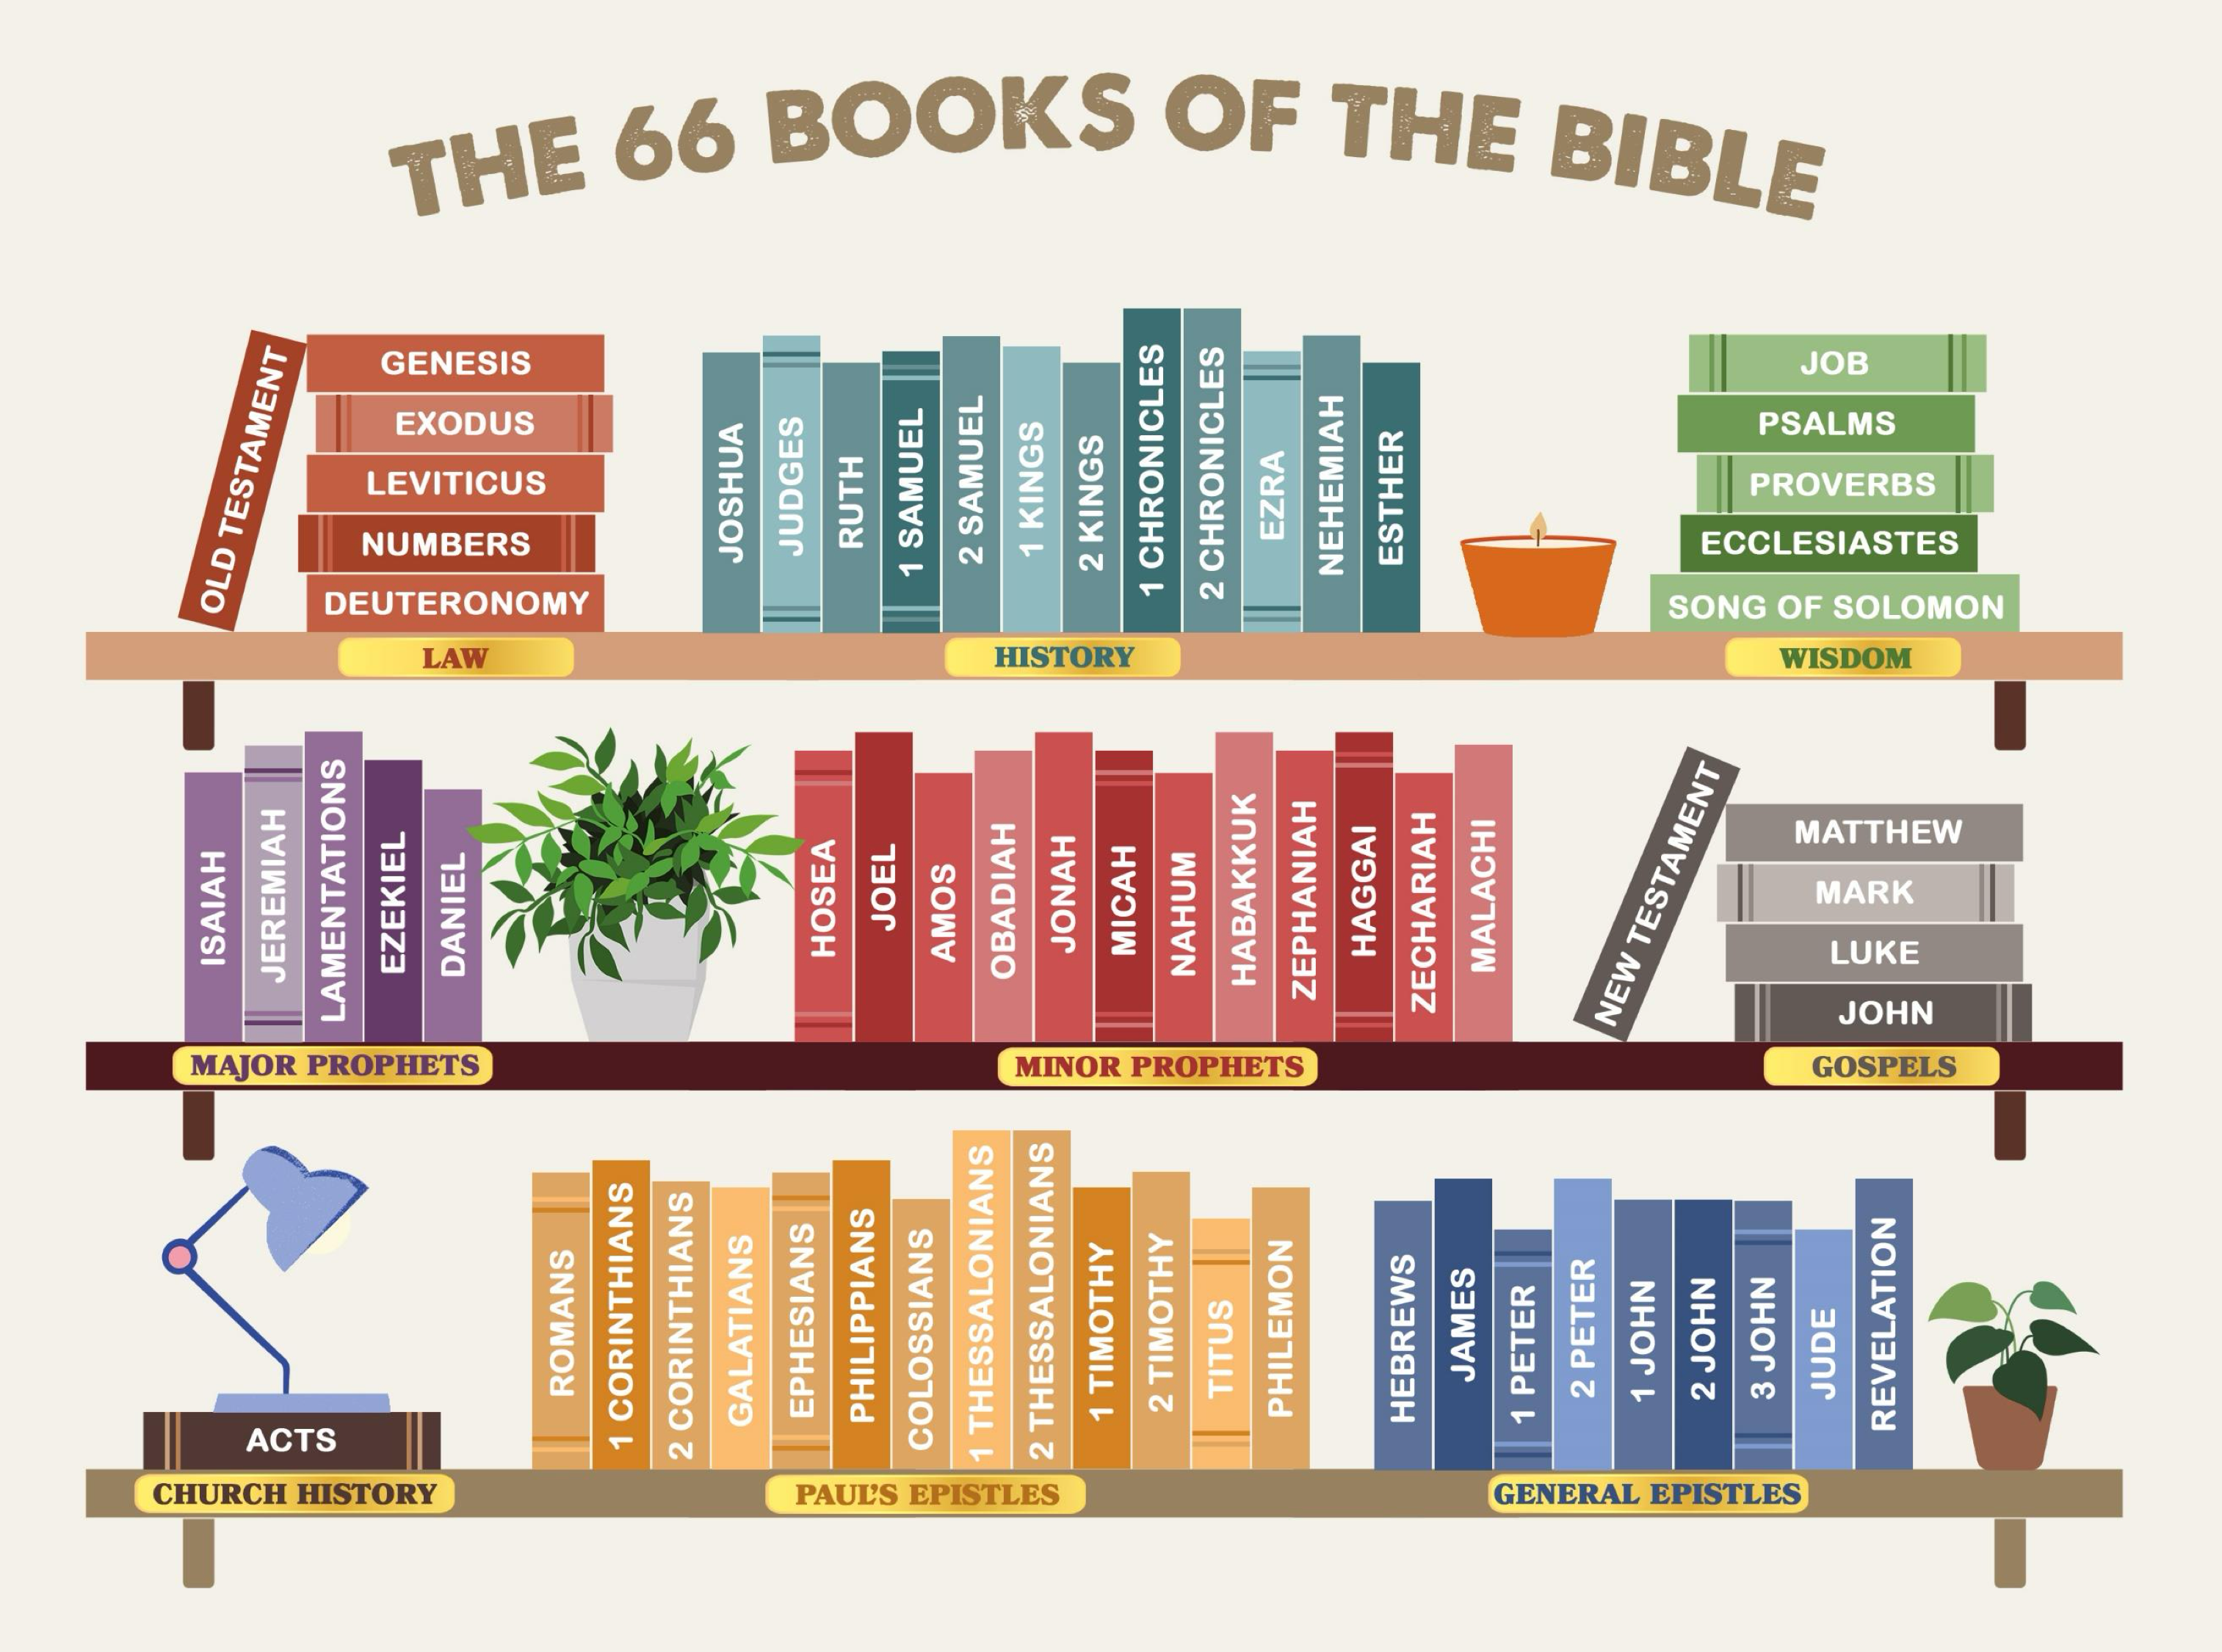

Slide 36
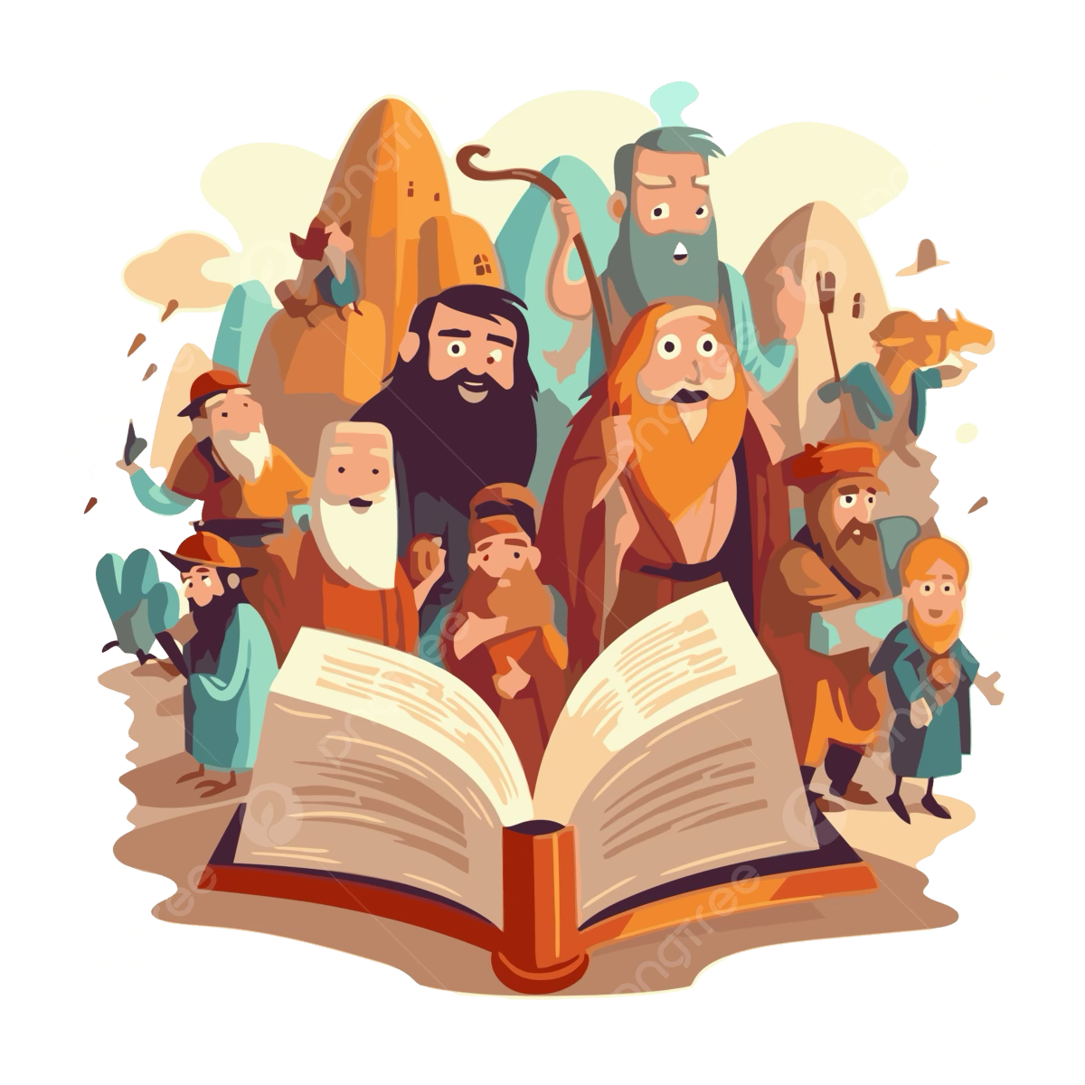
Amazing Bible Facts
Total 66 books
Written by about 40 authors
Over A Period Of 1,500 Years
Written In Three Languages: Hebrew, Greek and Aramaic

Slide 37
Amazing Bible Facts And Statistics
The Number Of Books In The Bible Are 66
The Bible Was Written By Approximately 40 Authors
The Bible Was Written Over A Period Of 1,600 Years
The Bible Was Written Over 40 Generations
The Bible Was Written In Three Languages: Hebrew, Greek And Aramaic
The Bible Was Written On Three Continents: Europe, Asia And Africa
There Are 8,674 Different Hebrew Words In The Bible,
5,624 Different Greek Words, And
12,143 Different English Words In The King James Version.
The Number Of Books In The Bible Are 66

Slide 38
Amazing Bible Facts And Statistics
The Number Of Chapters In The Bible Are 1,189
The Number Of Verses In The Bible Are 31,101
The Number Of Words In The Bible Are 783,137
The Letters In The Bible Are 3,566,480
The Number Of Promises Given In The Bible Are 1,260
The Number Of Questions In The Bible Is 3,294 Verses
The Longest Name In The Bible Is Mahershalalhashbaz (Isaiah 8:1)
The Longest Verse In The Bible Is Esther 8:9 (78 Words)
The Shortest Verse In The Bible Is John 11:35 (2 Words: “Jesus Wept”)
The Middle Books Of The Bible Are Micah And Nahum

Slide 39
Amazing Bible Facts And Statistics
The Middle Chapter Of The Bible Is Psalm 117
The Longest Book In The Bible Is Psalms (150 Chapters)
The Shortest Book In The Bible Is 3 John (By Number Of Words)
The Longest Chapter In The Bible Is Psalm 119 (176 Verses)
The Shortest Chapter In The Bible Is Psalm 117 (By Number Of Words)
The Number Of Times The Word “God” Appears In The Bible Is 3,358
The Number Of Times The Word “Lord” Appears In The Bible Is 7,736
The Bible Has Been Translated Into Over 1,200 Languages
The Bible Was Written In Different Locations: Wilderness, Dungeon, Palace, Prison, In Exile, At Home

Slide 40
Amazing Bible Facts And Statistics
The Bible Was Written By Men From All Occupations: Kings, Peasants, Doctors, Fishermen, Tax Collectors, Scholars, Etc.
The Bible Was Written In Different Times: War, Peace, Poverty, Prosperity, Freedom And Slavery
The Bible Was Written In Different Moods: Heights Of Joy To The Depths Of Despair
The Bible Was Written In Harmonious Agreement On A Widely Diverse Range Of Subjects And Doctrines

Slide 41

Is History Important?

Slide 42
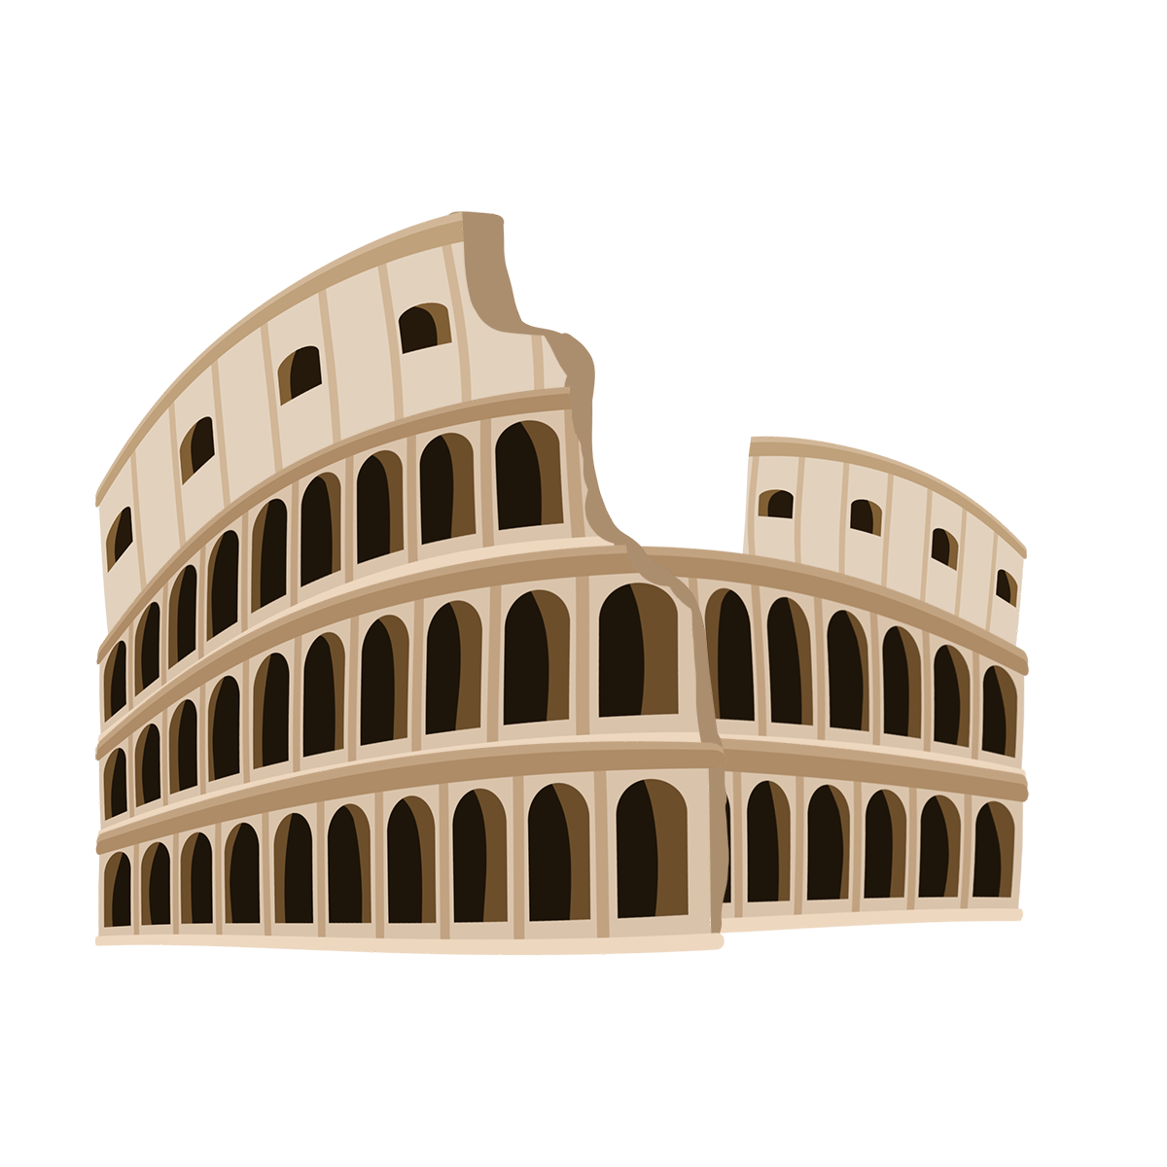
How History Is Made
World history is being made because of
the Great Controversy between Christ and Satan.

Slide 43
prophetic message
“For no prophetic message ever came just from the human will, but people were under the control of the Holy Spirit as they spoke the message that came from God.”
– 2 Peter 1:21 GNT
The Beginning
The End
Time
Eternity
Eternity
A
Z
Alpha
Omega

Slide 44
Prophecy
The Holy Bible contains hundreds of prophecies revealed through visions and dreams. These prophecies are an important foundation of our faith. Why? Because they show that God knows the future and always does exactly what He says He will do.
When a prophecy comes true, it becomes history. In other words, fulfilled prophecy is history.

Slide 45
Prophecy is
history written in advance.

Slide 46
Jesus in All
66 Books of the Bible

Slide 47
Genesis: Jesus is the Seed of the woman.
Exodus: Jesus is the Passover Lamb.
Leviticus: Jesus is our Great High Priest.
Numbers: Jesus is the bronze serpent lifted up.
Deuteronomy: Jesus is the Prophet like Moses.
Joshua: Jesus is the Captain of our salvation.
Judges: Jesus is our righteous Judge and Deliverer.
Ruth: Jesus is our Kinsman-Redeemer.

Slide 48
1 Samuel: Jesus is the true Anointed King.
2 Samuel: Jesus is the everlasting King.
1 Kings: Jesus is greater than Solomon.
2 Kings: Jesus is the faithful King to come.
1 Chronicles: Jesus is the promised Son of David.
2 Chronicles: Jesus is the rightful King of Judah.
Ezra: Jesus is the Restorer.
Nehemiah: Jesus is the Rebuilder of broken lives.

Slide 49
Esther: Jesus is our Advocate.
Job: Jesus is our living Redeemer.
Psalms: Jesus is the Good Shepherd.
Proverbs: Jesus is the Wisdom of God.
Ecclesiastes: Jesus is our true Satisfaction.
Song of Solomon: Jesus is the Bridegroom.
Isaiah: Jesus is the Suffering Servant.
Jeremiah: Jesus is the Righteous Branch.

Slide 50
Lamentations: Jesus is our hope.
Ezekiel: Jesus is the Good Shepherd.
Daniel: Jesus is the Son of Man.
Hosea: Jesus is the faithful Bridegroom.
Joel: Jesus is the Baptizer with the Holy Spirit.
Amos: Jesus is the Burden Bearer.
Obadiah: Jesus is our Mighty Savior.
Jonah: Jesus is the Risen One.

Slide 51
Micah: Jesus is the Ruler born in Bethlehem.
Nahum: Jesus is the Avenger of God’s people.
Habakkuk: Jesus is the Holy One.
Zephaniah: Jesus is the Mighty One who saves.
Haggai: Jesus is the Desire of all nations.
Zechariah: Jesus is the Pierced Messiah.
Malachi: Jesus is the Sun of Righteousness.

Slide 52
Matthew: Jesus is the Promised Messiah.
Mark: Jesus is the Servant King.
Luke: Jesus is the Son of Man.
John: Jesus is the Son of God.
Acts: Jesus is the risen Lord building His church.
Romans: Jesus is our Righteousness.
1 Corinthians: Jesus is our Resurrection.
2 Corinthians: Jesus is our Comfort.

Slide 53
Galatians: Jesus is our freedom.
Ephesians: Jesus is the Head of the Church.
Philippians: Jesus is our joy.
Colossians: Jesus is supreme over all.
1 Thessalanions: Jesus is our coming King.
2 Thessalanions: Jesus is the righteous Judge.
1 Timothy: Jesus is the one Mediator.
2 Timothy: Jesus is the faithful Savior.

Slide 54
Titus: Jesus is our blessed hope.
Philemon: Jesus is our Reconciler.
Hebrews: Jesus is our perfect High Priest.
James: Jesus is the Lord of glory.
1 Peter: Jesus is the Chief Shepherd.
2 Peter: Jesus is the coming King.
1 John: Jesus is eternal life.
2 John: Jesus is the truth.

Slide 55
3 John: Jesus is our Example in Truth and Love.
Jude: Jesus is able to keep us from falling.
Revelation: Jesus is the Alpha and the Omega,
the King of Kings and Lord of Lords.

Slide 56
Closing Summary

Slide 57
Isaiah 8:20
To the law and to the testimony!
If they do not speak according to this word,
it is because there is no light in them.

Slide 58
Romans 15:4
For whatever things were written before were written
for our learning, that we through the patience and
comfort of the Scriptures might have hope.

Slide 59
Acts 17:11
They received the word with all readiness,
and searched the Scriptures daily.

Slide 60
2 Timothy 3:15-17
From childhood you have known the Holy Scriptures, which are able to make you wise for salvation through faith which is in Christ Jesus.
All Scripture is given by inspiration of God, and is profitable for doctrine, for reproof, for correction,
for instruction in righteousness, that the man of God
may be complete, thoroughly equipped for every good work.

