Slide 1
Adapted by Bob Plubell
Are the DEAD surely dead?
Credited to ClearBibleAnswers.org
Screen 16:9 Display 1080p
Reduce Visual Noise • Better Readability

Slide 2

Are the DEAD surely dead?

Slide 3
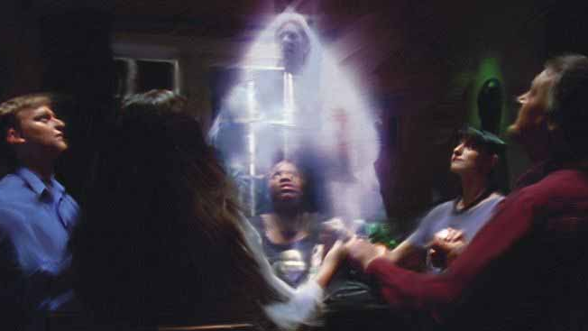

Slide 4
Are the DEAD surely dead?

Slide 5

Genesis 2:17 NKJV
But of the tree of the knowledge of good and evil you shall not eat, for in the day that you eat of it you shall surely die.”

Slide 6

Genesis 3:4 GNT
The snake replied, “That's not true; you will not die.”

Slide 8
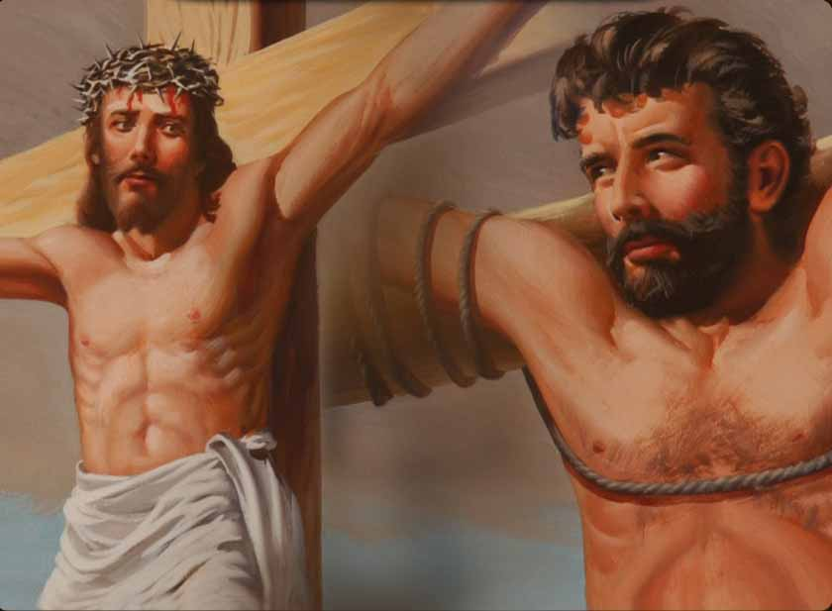
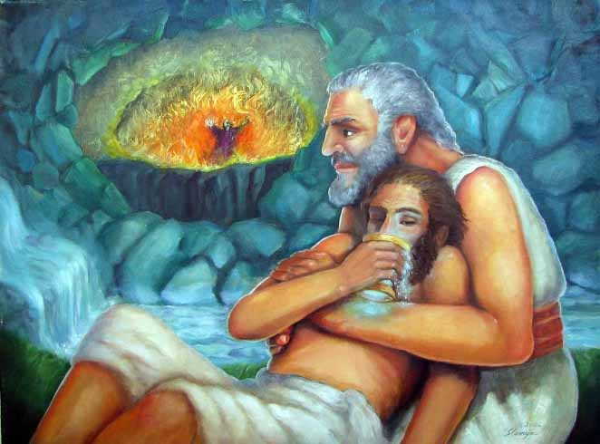
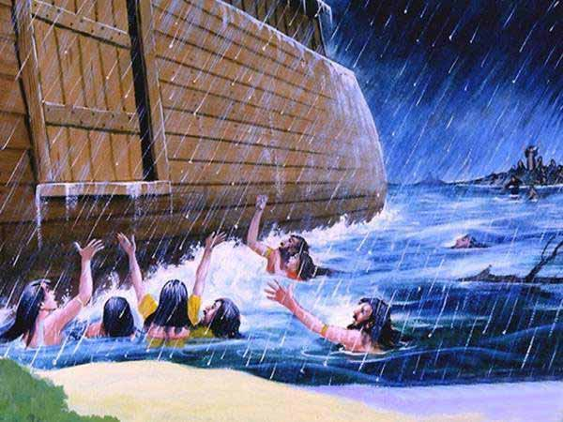
The thief on the Cross
Rich man and Lazarus
Spirits in prison of Noah’s days

Slide 9
Are the DEAD surely dead?

Slide 10
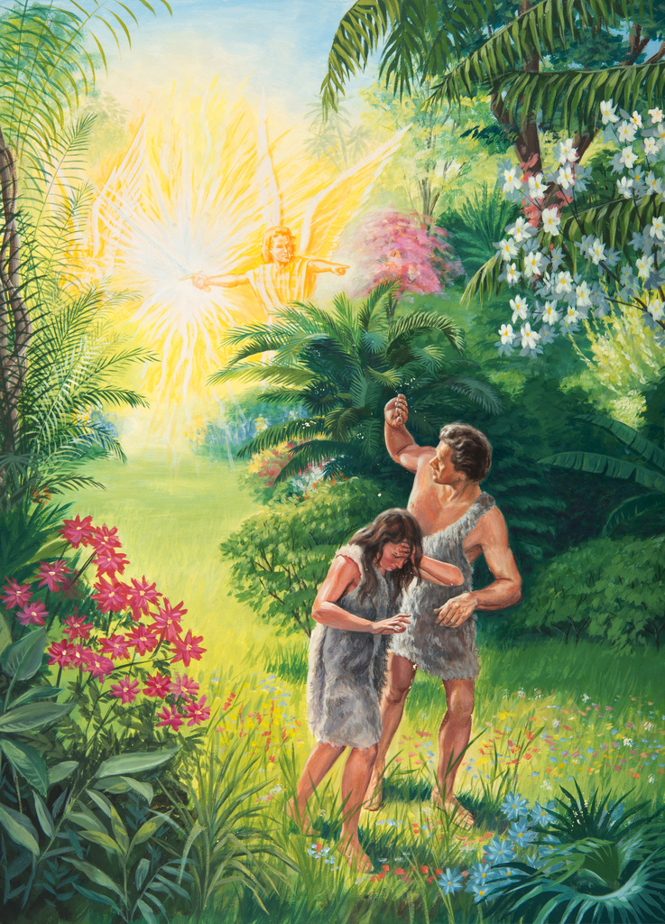
“Now these human beings have become like one of us and have knowledge of what is good and what is bad. They must not be allowed to take fruit from the tree that gives life, eat it, and live forever.” ²³ So the Lord God sent them out of the Garden of Eden
Genesis 3:22, 23 GNT

Slide 11
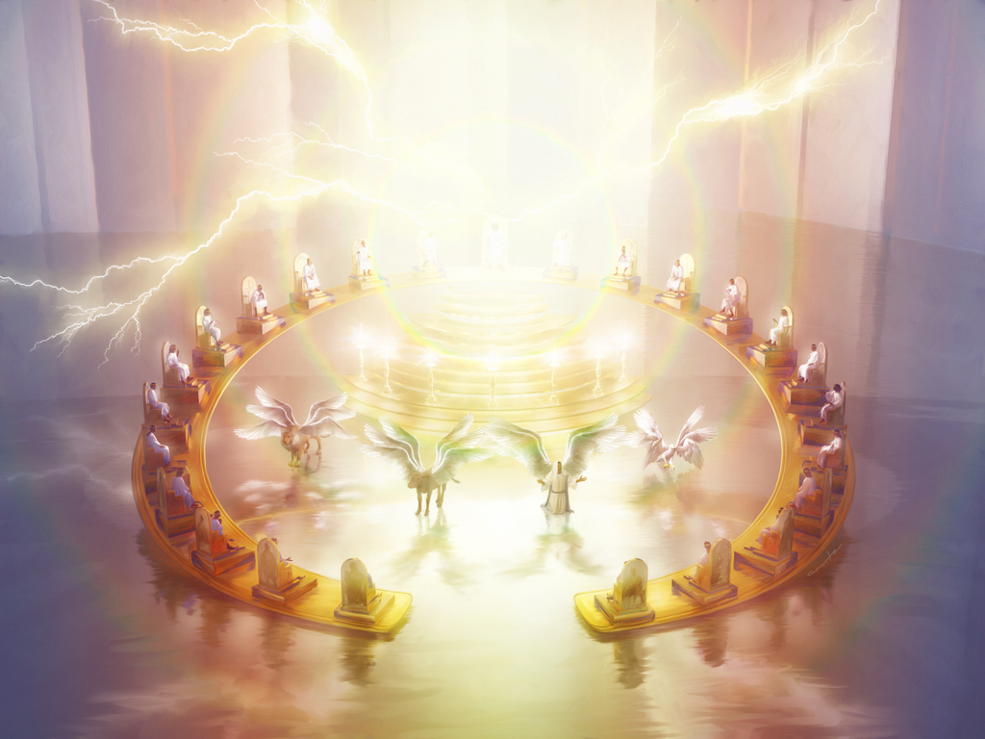
1 Timothy 6:16 NKJV
“who alone has
immortality, …”
immortality = can never die

Slide 12
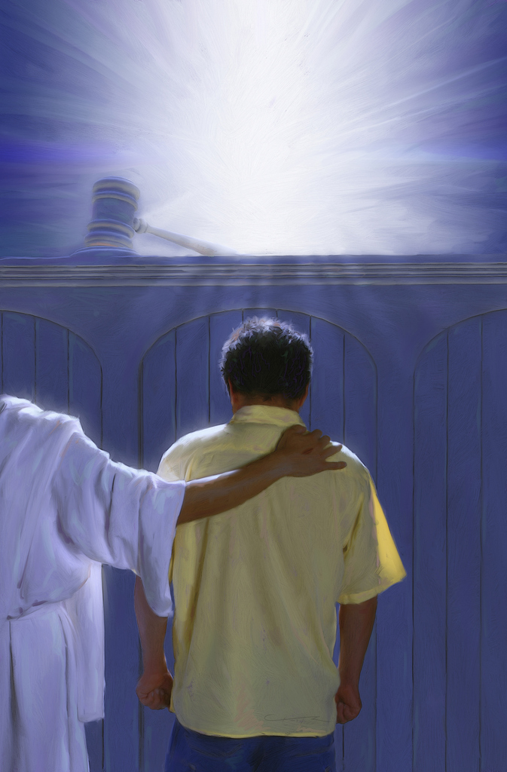
Job 4:17 NKJV
“‘Can a mortal be more righteous than God? Can a man be more pure than his Maker?”
mortal = humans as being subject to death

Slide 13
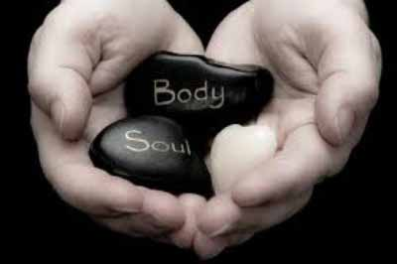
The soul who sins shall die.
Ezekiel 18:20 NKJV
Ezekiel 18:4 NKJV

Slide 14
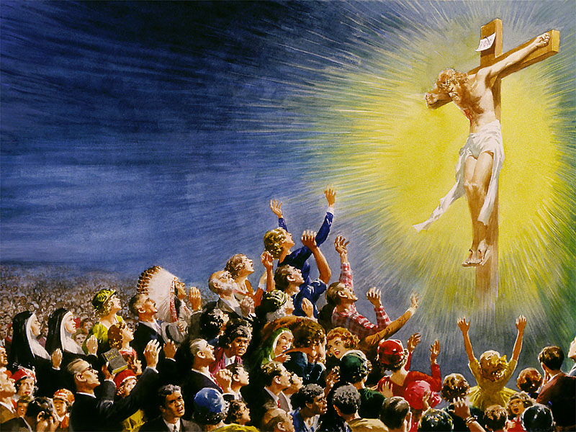
Romans 2:7 KJV
“seek for glory and honour and immortality, eternal life”

Slide 15
John 3:16 ESV
“For God so loved the world, that he gave his only Son, that whoever believes in him should not perish but have eternal life.”

Slide 16


Slide 17
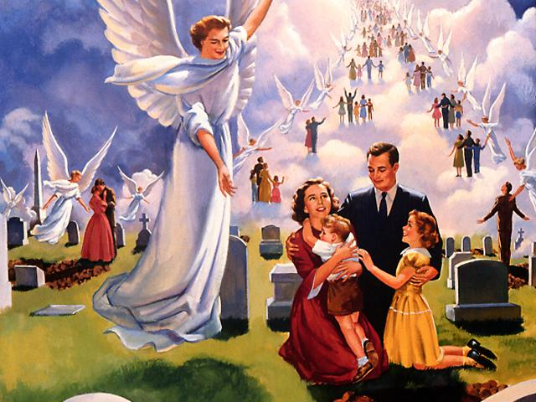
1 Corinthians 15:52, 53 ESV
“in a moment, in the twinkling of an eye, at the last trumpet. For the trumpet will sound, and the dead will be raised imperishable, and we shall be changed. ⁵³ “For this perishable body must put on the imperishable, and this mortal body must put on immortality.

Slide 18
SOUL

Slide 19
Ezekiel 18:4 NKJV
The soul who sins shall die.
“nephesh”= a breathing creature; life

Slide 20
Genesis 1:21 NKJV
“And God created great whales, and every living creature [nephesh] that moveth, which the waters brought forth abundantly, after their kind, and every winged fowl after his kind.”

Slide 21
Genesis 1:24 NKJV
“Then God said, “Let the earth bring forth the living creature [nephesh] according to its kind: cattle and creeping thing and beast of the earth, each according to its kind”; and it was so.”

Slide 22
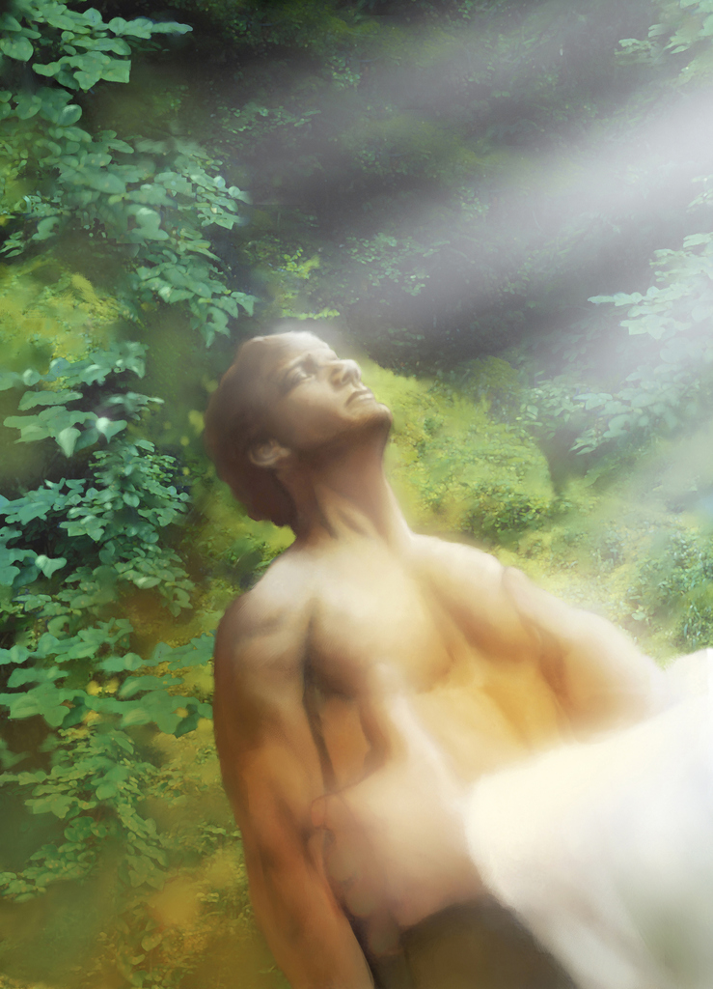
Genesis 2:7 NKJV
“And the LORD God formed man of the dust of the ground, and breathed into his nostrils the breath of life; and man became a living soul [nephesh].”

Slide 23
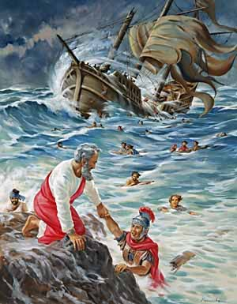
Acts 27:37 NKJV
“And we were in all in the ship two hundred threescore and sixteen souls [psuche].”

Slide 24
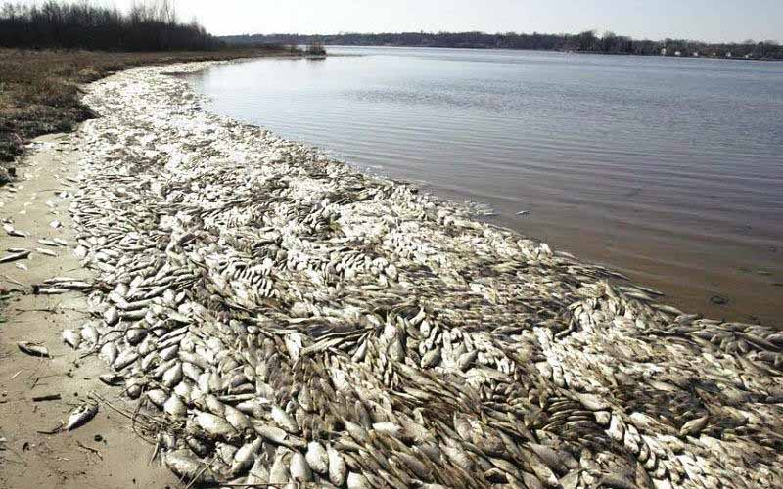
Revelation 16:3 NKJV
“… and every living soul
died in the sea.”

Slide 25

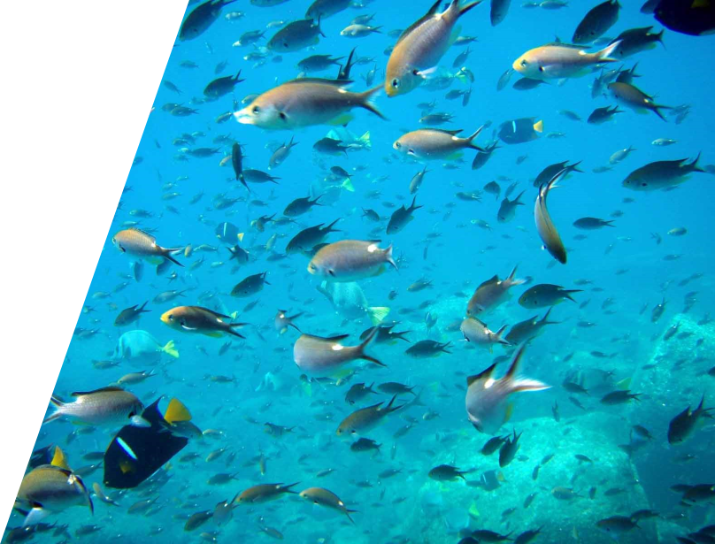
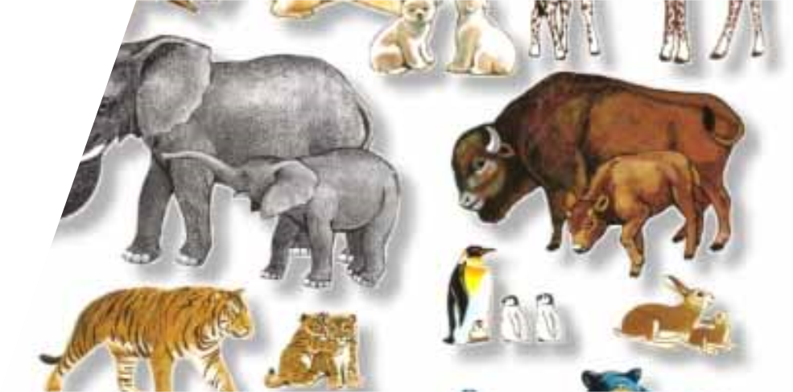
These are SOULS

Slide 26
AFTER DEATH,
WHERE?

Slide 27
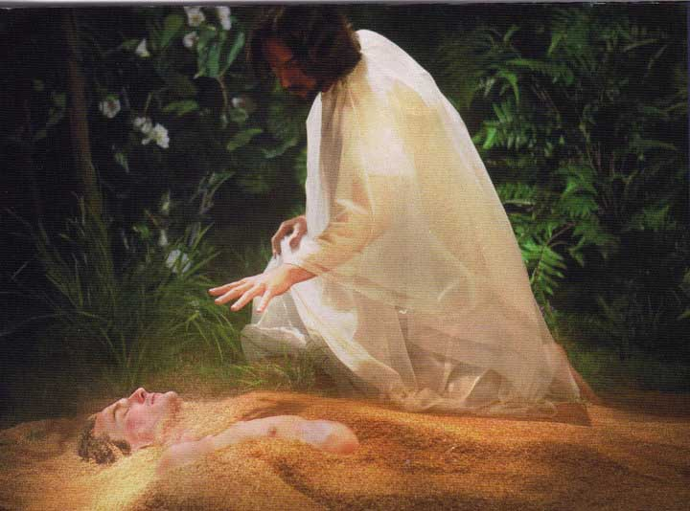
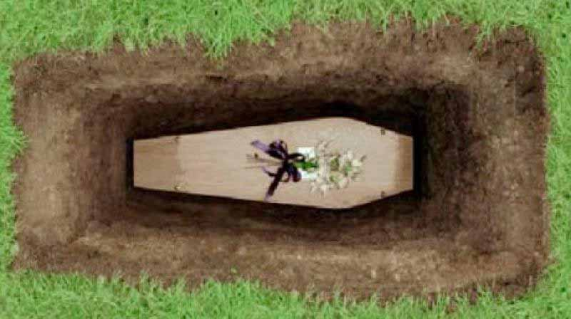
Genesis 3:19 NKJV
For you were made from dust,
and to dust you will return.”

Slide 28
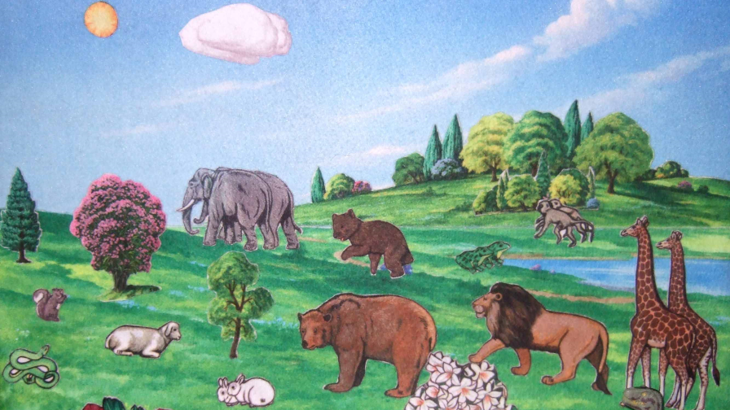
Genesis 2:19 NKJV
“So the LORD God formed from the ground all the wild animals and all the birds of the sky.”

Slide 29
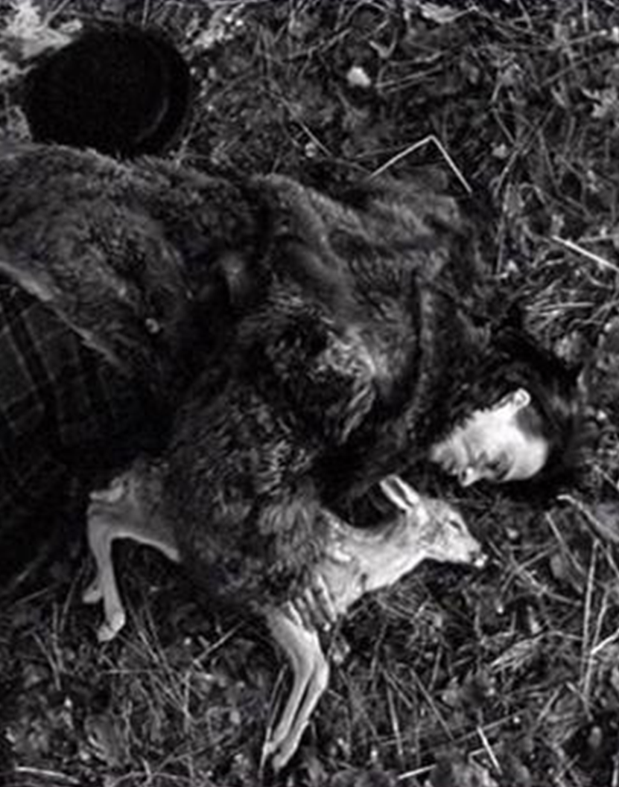
Ecclesiastes 3:19, 20 NKJV
“For people and animals share the same fate—both breathe and both must die. So people have no real advantage over the animals. How meaningless! ²⁰ Both go to the same place—they came from dust and they return to dust.

Slide 30
Genesis 1:24 NKJV
“Then God said, “Let the earth bring forth the living creature [nephesh] according to its kind: cattle and creeping thing and beast of the earth, each according to its kind”; and it was so.”

Slide 31
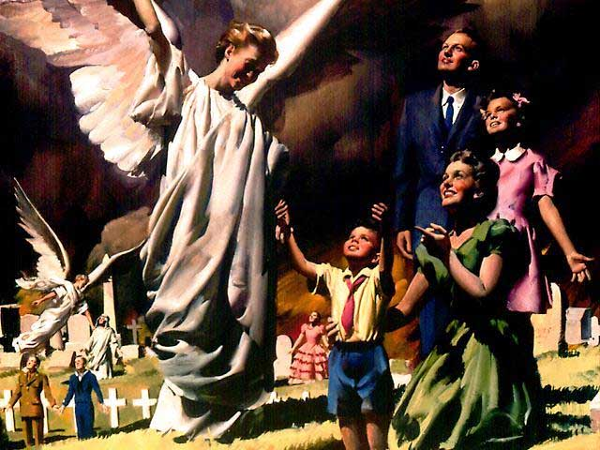

Slide 32
DEATH,
An UNconscious sleep?

Slide 33
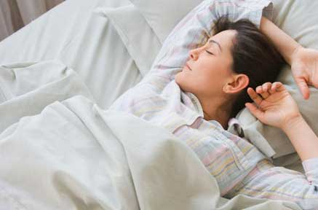
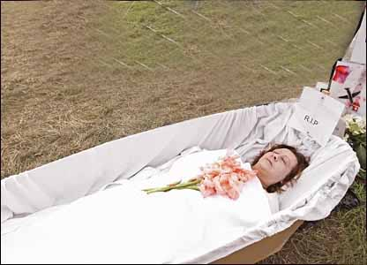
Psalm 13:3 NKJV
“sleep of death”
Daily Sleep

Slide 34
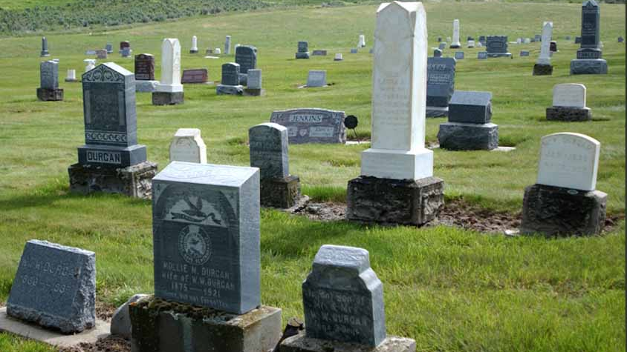
Job 17:13 NKJV
“If I wait for the grave as my house,
if I make my bed in the darkness,

Slide 35
John 11:11 NLT
“Then he said, “Our friend Lazarus has fallen asleep, but now I will go and wake him up.”

Slide 36
John 11:14 NLT
So he told them plainly, “Lazarus is dead.”

Slide 37
John 11:43 NLT
Then Jesus shouted, “Lazarus, come out!”

Slide 38
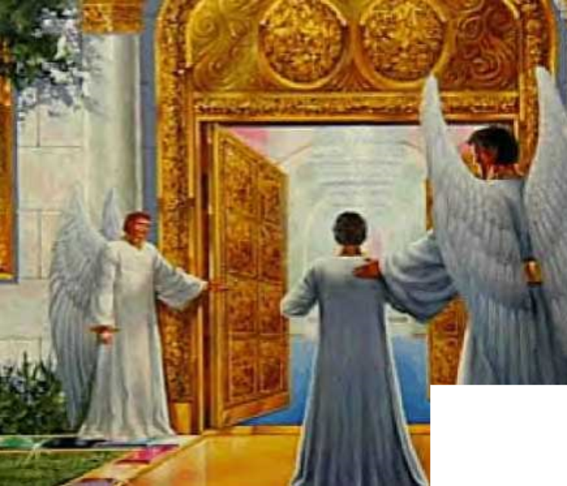
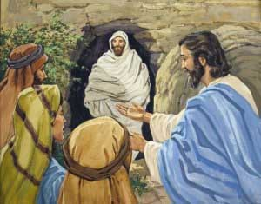
Notes:
NOW……. “THINK about THIS.”
IF………… “LAZARUS WENT to HEAVEN……...for THOSE 4 DAYS………he SHOULD have TOLD …………SOMETHING about HEAVEN.”
AND………. He WOULD have…….. SURELY “been UPSET”….with Jesus….from “BRINGING HIM BACK from”….heaven TO earth!
But He SAYS……….NOTHING about HEAVEN……….BECAUSE He was NOT……….in HEAVEN……..those 4 DAYS.
(This greatest miracle……would have been……the “GREATEST CURSE” for Lazarus—if he was “in HEAVEN”)

Slide 39
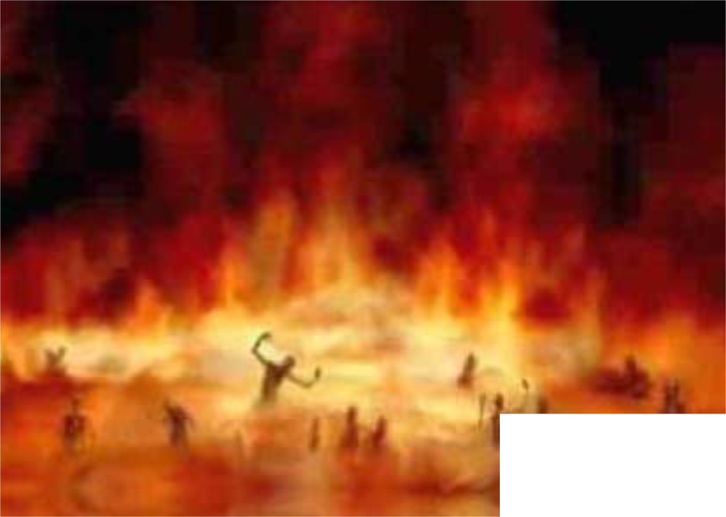
John 11:11 NLT
“Our friend Lazarus has fallen asleep”
Notes:
IF…………. “LAZARUS were in HELL”……….. for 4 DAY…..he “WOULD have TOLD“……… “SOMETHING about HELL FIRE“.
And he WOULD have……… “surely THANKED Jesus“….for “PULLING HIM OUT“………. of the “FIRES of hell“.
BUT……… “Lazarus SAID NOTHING“…..because he was ……… “SLEEPING FOR 4 DAYS”……..AS JESUS HIMSELF SAID……… (click)

Slide 40
Ecclesiastes 9:10 NLT
“Whatever you do, do well. For when
you go to the grave, there will be
no work or planning or knowledge or wisdom.

Slide 41
Psalm 146:4 KJV
“His breath goeth forth,
he returneth to his earth;
in that very day his thoughts perish.

Slide 42
Psalm 115:17 NLT
“The dead cannot sing praises
to the LORD, for they have gone
into the silence of the grave.

Slide 43
Ecclesiastes 9:6 NLT
“Whatever they did in their
lifetime—loving, hating, envying—is
all long gone. They no longer play
a part in anything here on earth.

Slide 44
Ecclesiastes 9:5 NLT
“The living at least know they will die,
but the dead know nothing.

Slide 45
Acts 24:15 NKJV
“… a resurrection of the dead,
both of the just and the unjust.

Slide 46
John 5:28, 29 NKJV
“Don’t be so surprised! Indeed, the time is coming
when all the dead in their graves will hear the
voice of God’s Son, ²⁹ and they will rise again.
Those who have done good will rise to experience eternal life, and those who have continued in evil
will rise to experience judgment.

Slide 47
Christ and Apostles
Taught the Same Truth

Slide 48
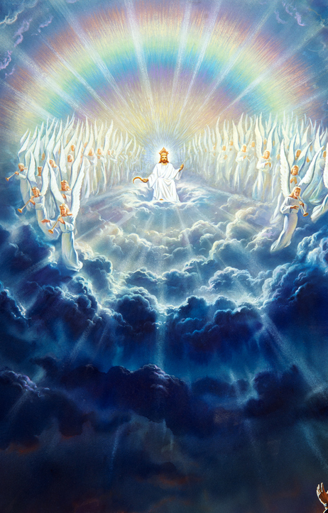
Revelation 22:12 BSB
“Behold, I am coming soon, and My reward is with Me, to give to each one according to what he has done.”

Slide 49
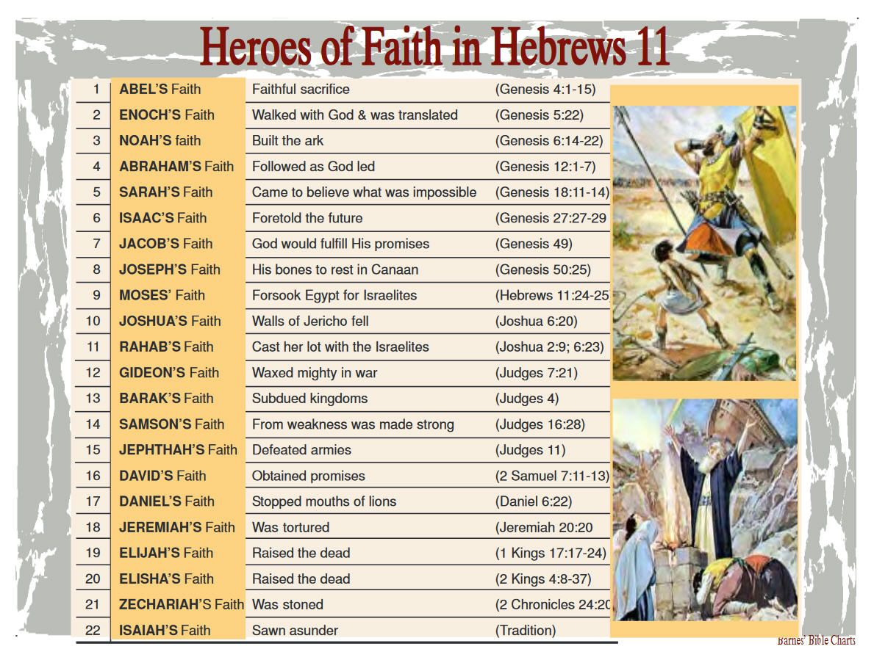
Hebrews 11:39 NLT
“All these people earned a good
reputation because of their faith,
yet none of them received all
that God had promised.

Slide 50
Acts 2:34 NLT
“Dear brothers, think about this! You can be sure that the patriarch David wasn’t referring to himself, for he died and was buried, and his tomb is still here among us.”

Slide 51
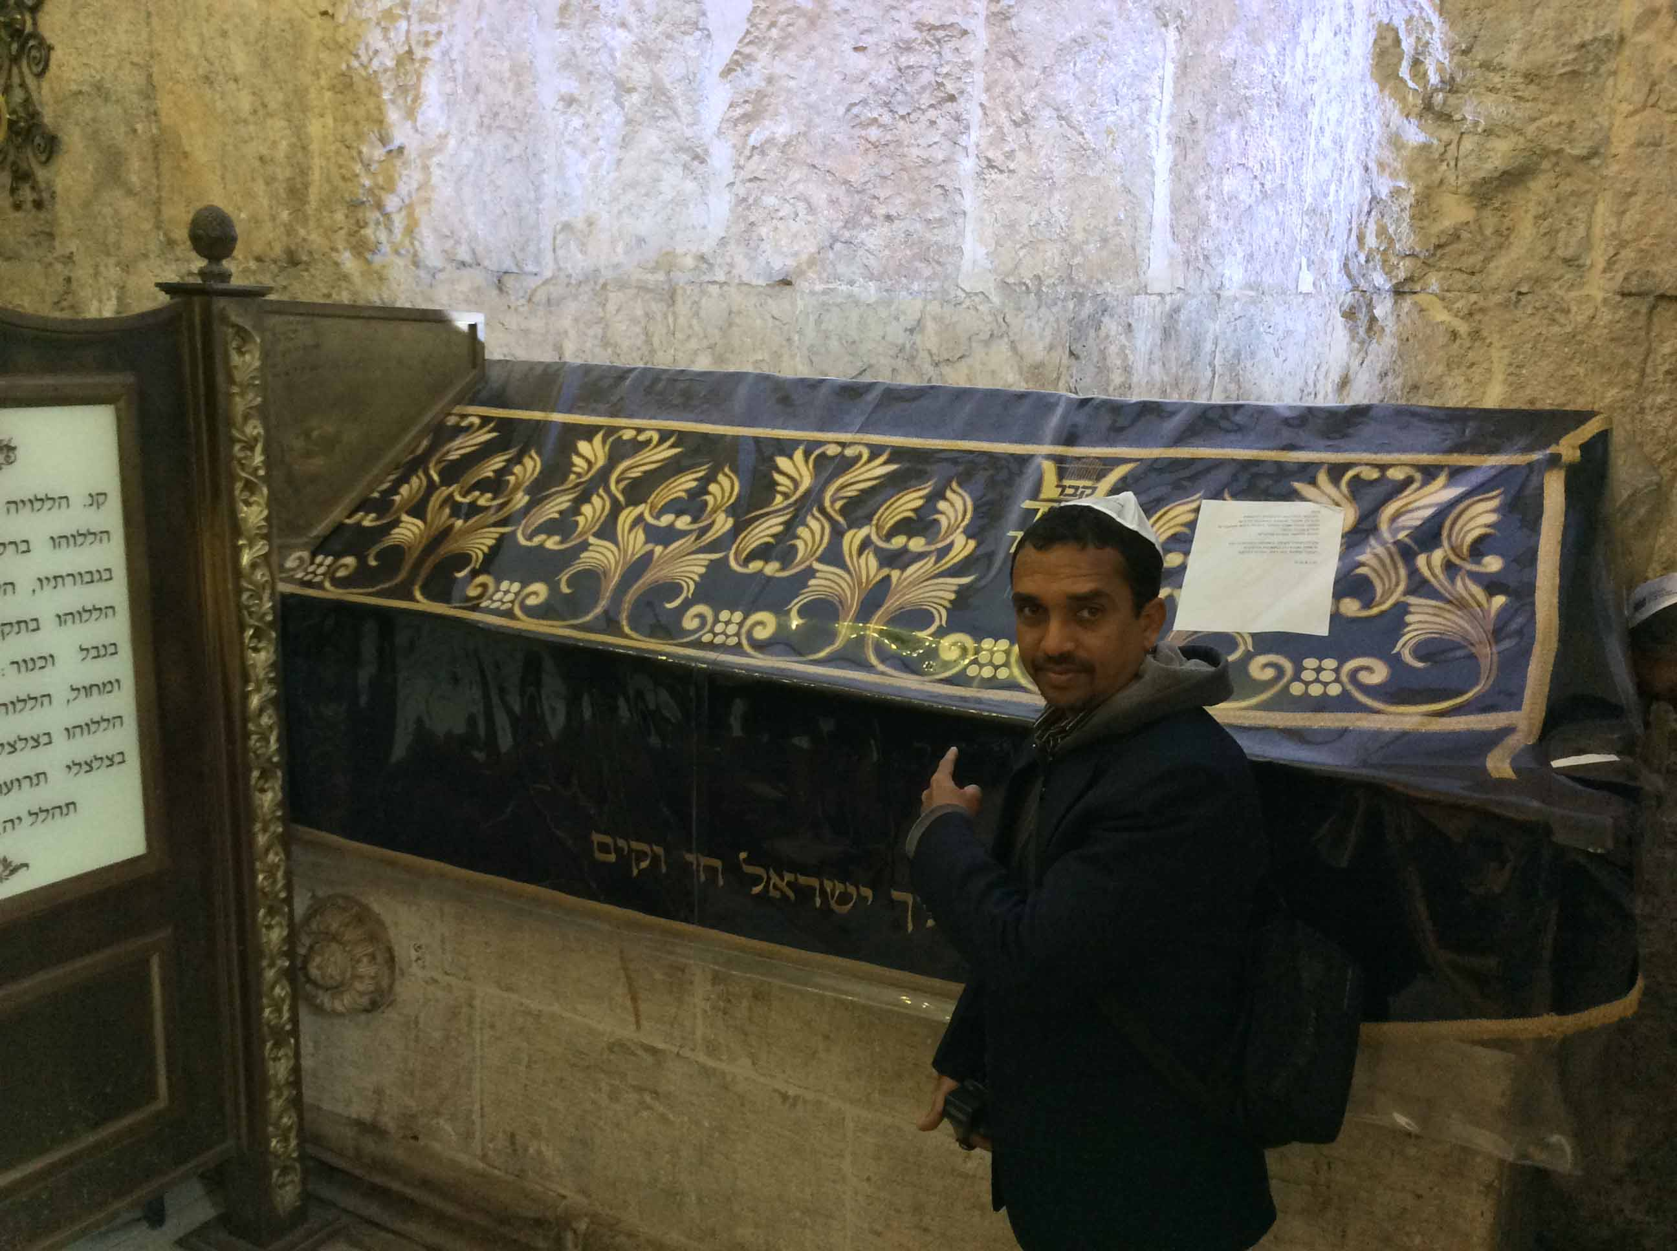

Slide 52
Acts 2:34 NLT
“For David himself never ascended into heaven, …”

Slide 53
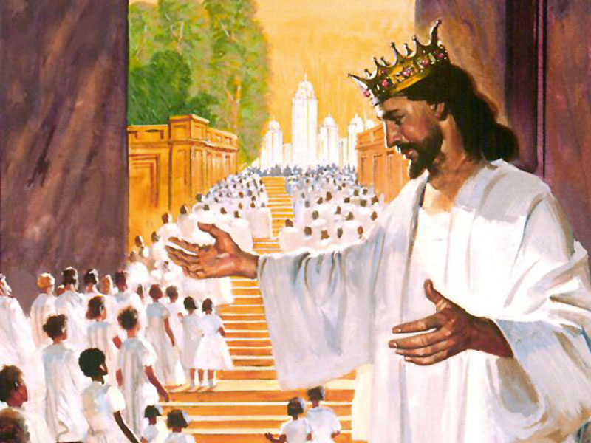
John 14:2, 3 NKJV
“In My Father’s house are many mansions; if it were not so, I would have told you. I go to prepare a place for you. ³ And if I go and prepare a place for you, I will come again and receive you to Myself; that where I am, there you may be also.

Slide 54
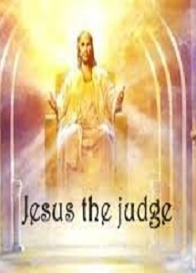
2 Timothy 4:1 NKJV
“I charge you therefore before God and the Lord Jesus Christ, who will judge the living and the dead at His appearing and His kingdom”

Slide 56
1 Thessalonians 4:16, 17 NKJV
“ For the Lord Himself will descend from heaven with a shout, with the voice of an archangel, and with the trumpet of God. And the dead in Christ will rise first. ¹⁷ Then we who are alive and remain shall be caught up together with them in the clouds to meet the Lord in the air. And thus we shall always be with the Lord.

Slide 57
Are the DEAD surely dead?
The End

Slide 58
Are the DEAD surely dead?
The End

