Slide 1
BIBLE STUDY SERIES: DANIEL
Central Valley Deaf Ministries - Fresno Central SDA Church
DAN_09_20260321

Slide 3
  Daniel 9
Always on Time!

Slide 4
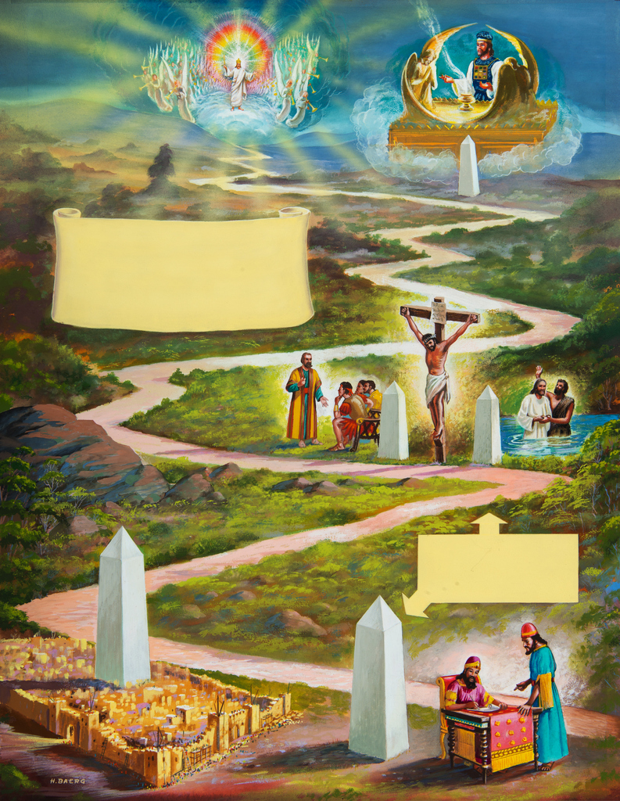
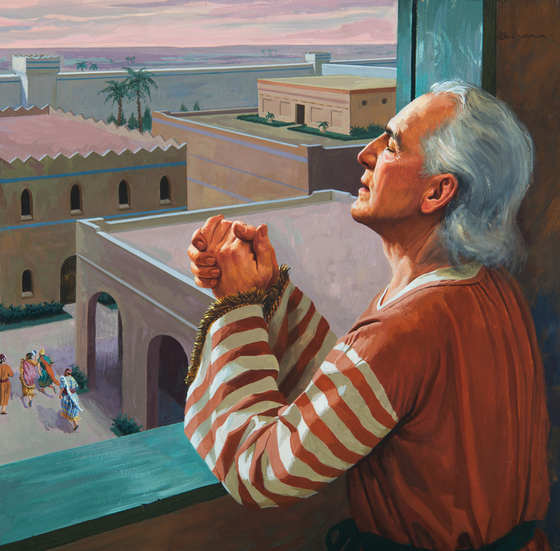
              Daniel 9
Three sections —
Verses 1-19
— Daniel’s Prayer
Verses 20-23
— Gabriel’s Answer
Verses 24-27
— Vision of 70 Weeks

Slide 5
Daniel 8:1 NLT
During the third year of King Belshazzar’s reign, I, Daniel, saw another vision, following the one that had already appeared to me.

Slide 6
Daniel 9:23 NLT
The moment you began praying, a command was given. And now I am here to tell you what it was, for you are very precious to God. Listen carefully so that you can understand the meaning of your vision.

Slide 7

Puzzle

Slide 8
Puzzle

Slide 9
English - Greek - Hebrew
English: love
      Greek: eros
      agape
      philos
      …
English: vision
      Hebrew: chazon
      mareh

Slide 10
Daniel 8:1 NLT
During the third year of King Belshazzar’s reign, I, Daniel, saw another vision, following the one that had already appeared to me.
vision = chazon … full vision
Daniel 8 is all about 2300 years prophecy

Slide 11
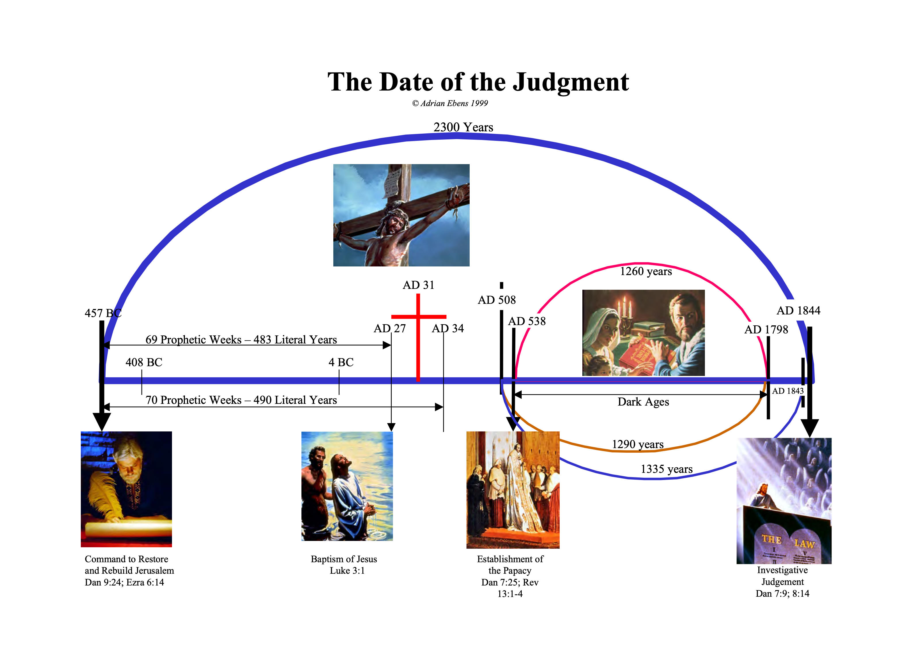
chazon

Slide 12
Daniel 9:23 NLT
The moment you began praying, a command was given. And now I am here to tell you what it was, for you are very precious to God. Listen carefully so that you can understand the meaning of your vision.
vision = mareh … partial vision
Daniel 9 is all about the schedule of the atonement.
The first coming of Messiah

Slide 13
mareh

Slide 14
Daniel 9:24-27

Slide 15
Daniel 9:24 NKJV
“Seventy weeks are determined [cut off from full vision] for your people [Jews] and for your holy city [Jerusalem],
  70 prophetic weeks
x 7 days per week
490 prophetic days

Slide 16
Ezekiel 4:6 NKJV
“… I have laid on you a day for each year.”
490
prophetic
days
490
literal
years
=
one prophetic day = one literal year

Slide 17
2300 Days Prophecy
2300 Years
490 Years

Slide 18
Daniel 9:24 NKJV
“Seventy weeks are determined [cut off from full vision] for your people [Jews] and for your holy city [Jerusalem], [1] To finish the transgression, [2] To make an end of sins, [3] To make reconciliation for iniquity, [4] To bring in everlasting righteousness, [5] To seal up vision and prophecy, And [6] to anoint the Most Holy.

Slide 19
Six Messianic Accomplishments
[1] To finish the transgression
To put an end to Israel’s transgression.
[2] To make an end of sins
To lead Israel to put away their sin. – Hebrews 10:18
[3] To make reconciliation for iniquity
To bring Israel back to union with God. – Romans 5:10

Slide 20
[4] To bring in everlasting righteousness
Jesus’ perfect righteousness which He is willing to give to all who believe. – 2 Corinthians 5:21
[5] To seal up vision and prophecy
By rejecting the Messiah, the Jewish nation brought the vision of the 70 weeks to an end.
[6] To anoint the Most Holy
Jesus ascended to heaven to begin His heavenly ministry as the High Priest. – Hebrews 9:11

Slide 21
Daniel 9:25 NKJV
“Know therefore and understand, that from the going forth of the command to restore and build Jerusalem until Messiah the Prince, there shall be seven weeks and sixty-two weeks; the street shall be built again, and the wall, even in troublesome times.

Slide 22
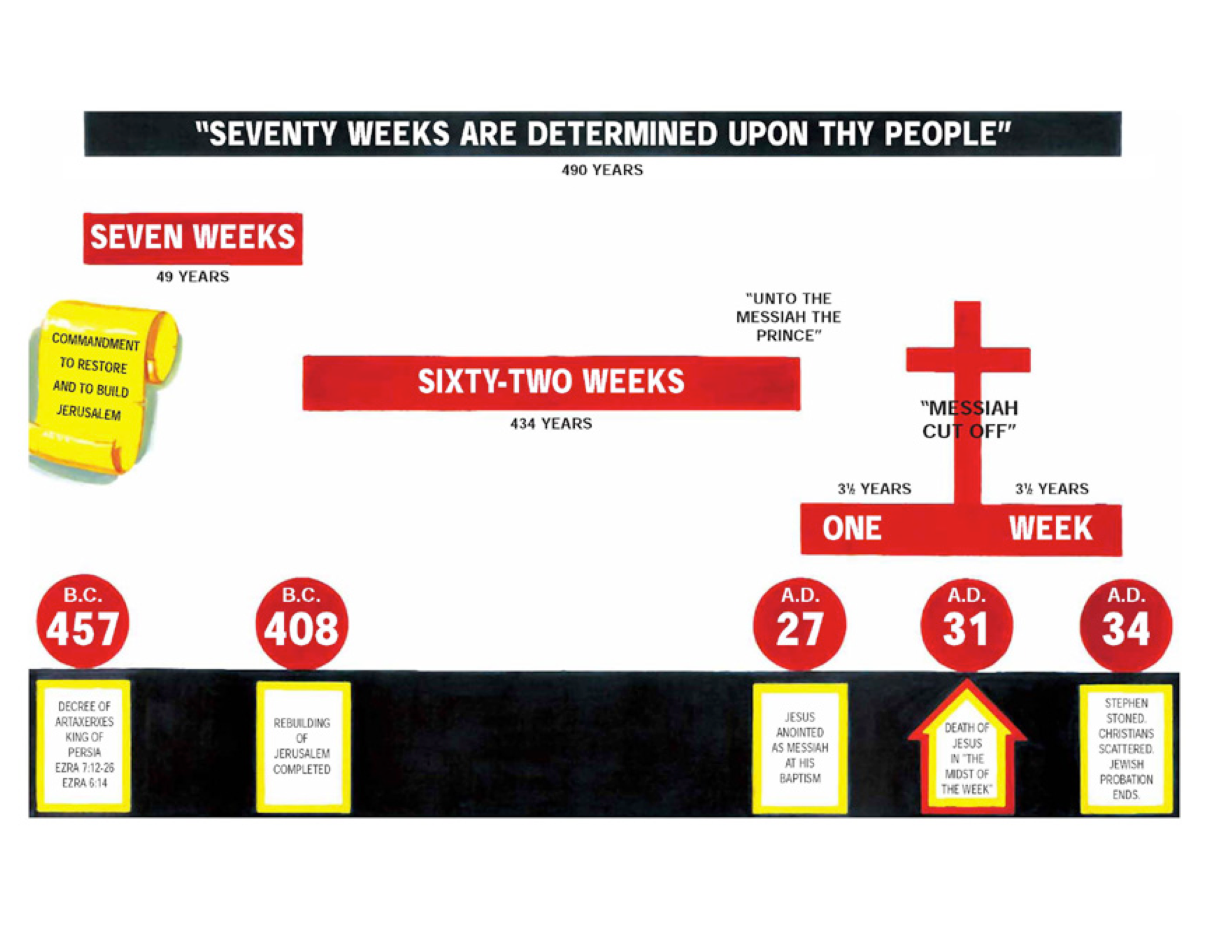

Slide 23
Daniel 9:26 NKJV
“And after the sixty-two weeks Messiah [Jesus Christ] shall be cut off [crucify], but not for Himself [die for us]; and the people of the prince who is to come shall destroy the city and the sanctuary [Jerusalem destroyed 70 AD]. The end of it shall be with a flood, and till the end of the war desolations are determined.

Slide 24
Daniel 9:26 Notes
Note: This text makes it clear that the Messiah would be killed and His death would be vicarious. Isaiah 53:5. What Jesus died, and His death was not for Himself but rather for us.
Note: This is the precise sequence of Daniel 9:26:
The prince comes
The prince is cut off
The city and the temple are destroyed

Slide 25
Daniel 9:27 NKJV
“Then he [the Prince who is to come] shall confirm a [the,
properly translated] [strong] covenant with many for one week; But in the middle of the week [3.5 years after He was anointed] He [the Prince] shall bring an end to sacrifice and offering. and on the wing of abominations shall be one who makes desolate, even until the consummation, which is determined, is poured out [wrath is poured out from
the cup] on the desolate.”

Slide 26
Daniel 9:27 Notes
Note: Thus there was no sacrifice or offering in the temple the day that Jesus died. The Jews should have understood the typology. They should have ceased their sacrifices then and there but they continued them even though in the sight of God they had come to an end and were worthless.

Slide 28
mareh

Slide 29
chazon
mareh

Slide 30
Daniel 8, 9
2300 Years
490 Years
Literal Israel
Spiritual Israel

Slide 32
Puzzle

Slide 33
Puzzle

