Slide 1

The Power of Forgiveness

Slide 2
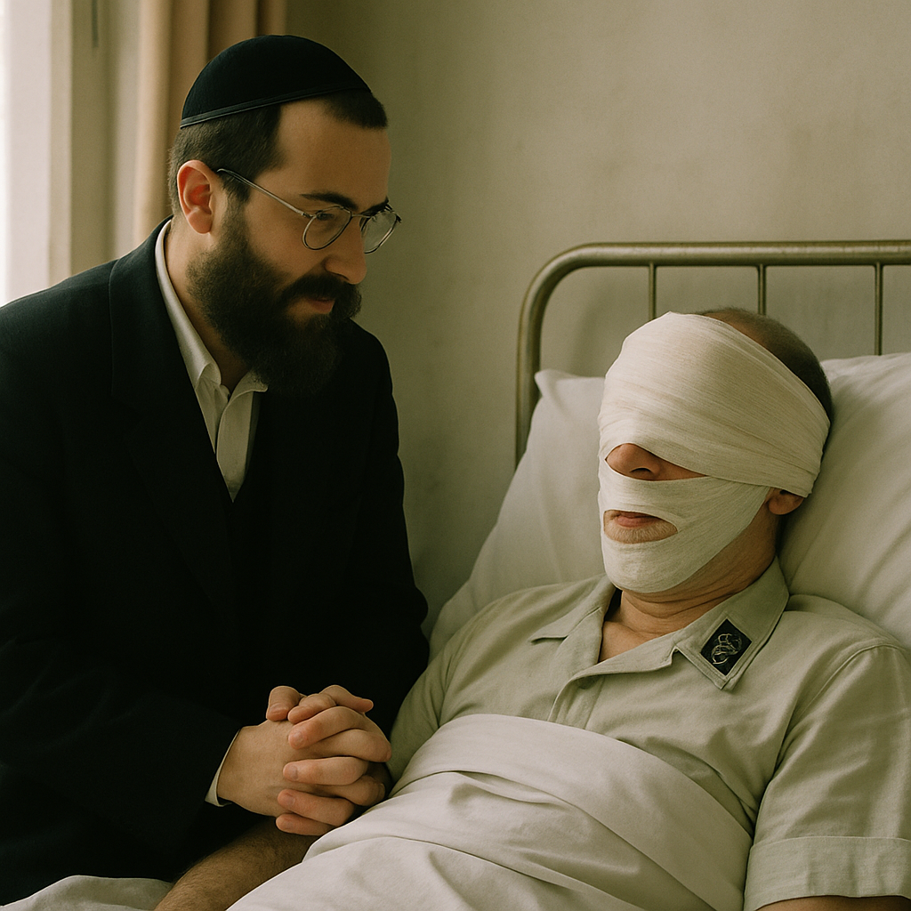
The Story of
a Jew and
a former SS Soldier

Slide 3
Matthew 18:21-22
²¹ Then Peter came to him and asked, “Lord, how often should I forgive someone who sins against me? Seven times?” ²² “No, not seven times,” Jesus replied, “but seventy times seven!

Slide 4
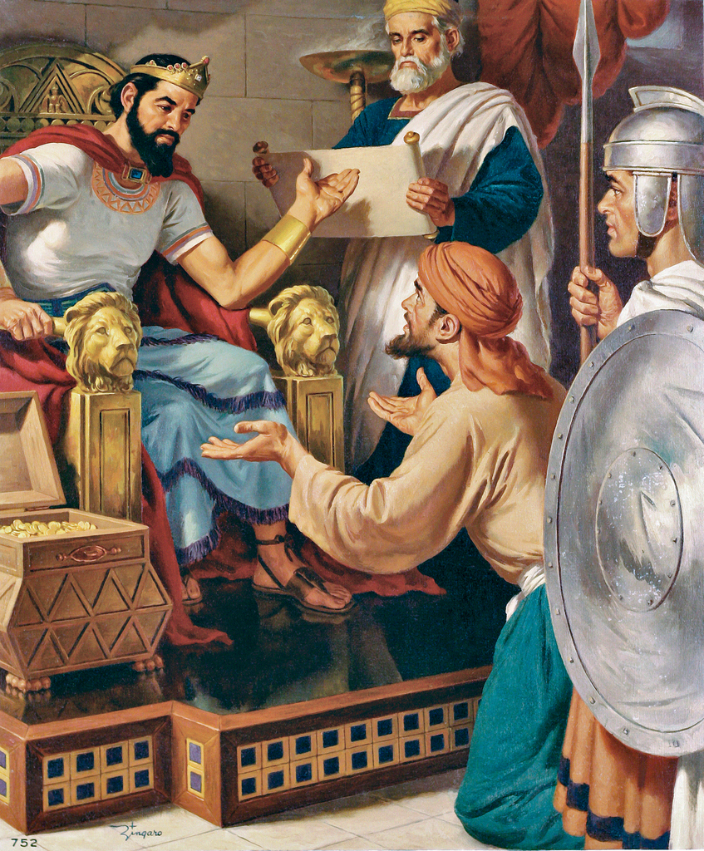
The Parable of
a Unforgiving Servant
  Matthew 18:23-35

Slide 5
²³ “The kingdom of heaven is like a king who decided to collect the money his servants owed him. ²⁴ When the king began to collect his money, a servant who owed him several million dollars was brought to him. ²⁵ But the servant did not have enough money to pay his master, the king. So the master ordered that everything the servant owned should be sold, even the servant’s wife and children. Then the money would be used to pay the king what the servant owed.

Slide 6
²⁶ “But the servant fell on his knees and begged, ‘Be patient with me, and I will pay you everything I owe.’ ²⁷ The master felt sorry for his servant and told him he did not have to pay it back. Then he let the servant go free.
²⁸ “Later, that same servant found another servant who owed him a few dollars. The servant grabbed him around the neck and said, ‘Pay me the money you owe me!’

Slide 7
²⁹ “The other servant fell on his knees and begged him, ‘Be patient with me, and I will pay you everything I owe.’
³⁰ “But the first servant refused to be patient. He threw the other servant into prison until he could pay everything he owed. ³¹ When the other servants saw what had happened, they were very sorry. So they went and told their master all that had happened.

Slide 8
³² “Then the master called his servant in and said, ‘You evil servant! Because you begged me to forget what you owed, I told you that you did not have to pay anything. ³³ You should have showed mercy to that other servant, just as I showed mercy to you.’ ³⁴ The master was very angry and put the servant in prison to be punished until he could pay everything he owed.

Slide 9
³⁵ “This king did what my heavenly Father will do to you if you do not forgive your brother or sister from your heart.”

Slide 10
Thought Point 1
³³ You should have showed mercy to that other servant, just as I showed mercy to you.

Slide 11
Analysis
³³ You [the wicked servant] should have showed mercy to that other servant, just as I [the king] showed mercy to you [the wicked servant].

Slide 12
Three Parties Relationship
King
Wicked Servant
Fellow Servant

Slide 13
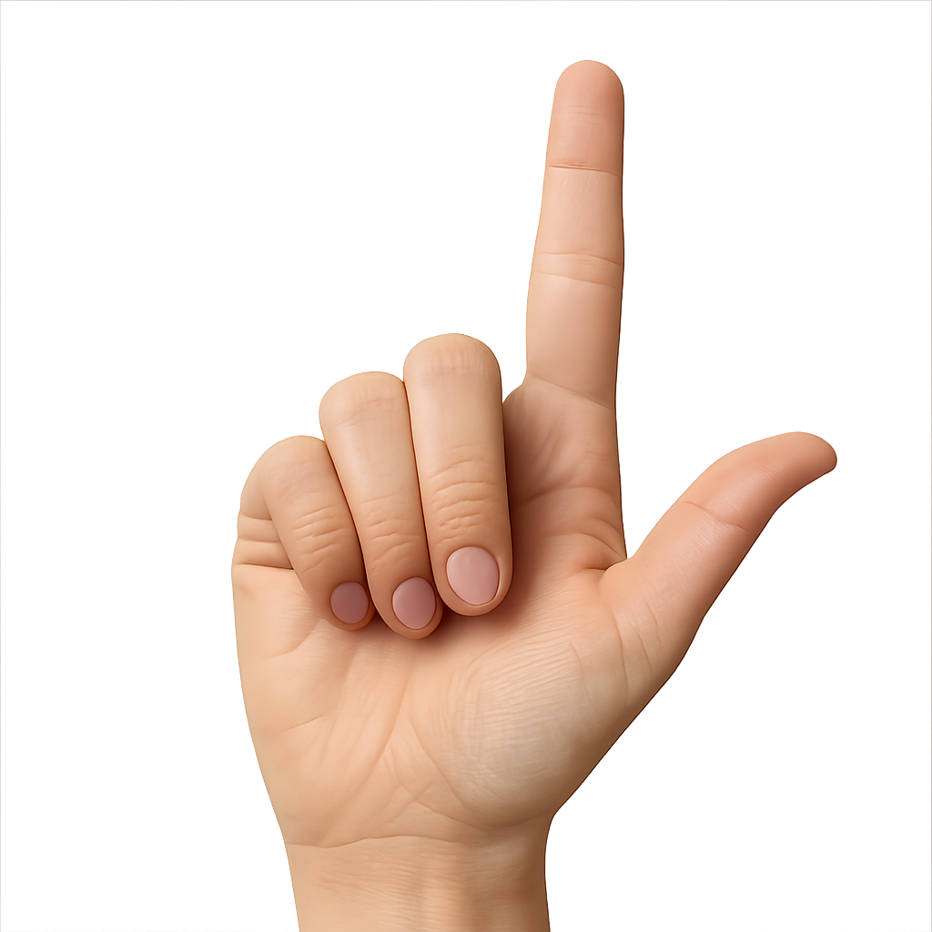
Three Parties Relationship
God
King
OVE
You
Neighbor
Wicked Servant
Fellow Servant

Slide 14
Matthew 6:12 NKJV
¹² “Forgive us our debts,
as we forgive our debtors.”
God
You
Neighbor

Slide 15
Matthew 6:12 NKJV
¹² “Forgive us our debts,
as we forgive our debtors.”
God
You
Debtor

Slide 16
Thought Point 2
Jesus illustrates that the unforgiveness of wicked servant results in the loss of the king’s forgiveness.

Slide 17
Illustration of the Christmas Lights
If a single Christmas light bulb burns out, it causes the entire circuit to go dark.

Slide 18
Forgiveness Circuit
God
Me
Person Who Hurts Me
When I cut off forgiveness
from those who hurt me,
I cut off God’s forgiveness to me.
When I cut off forgiveness from those who hurt me,

Slide 19
Nelson Mandela
“The first lesson is forgiveness, you must not allow hate to fester [injure and worsen] in your brain. You can never allow racism, hatred, and bitterness to rent space in your head.”

Slide 20
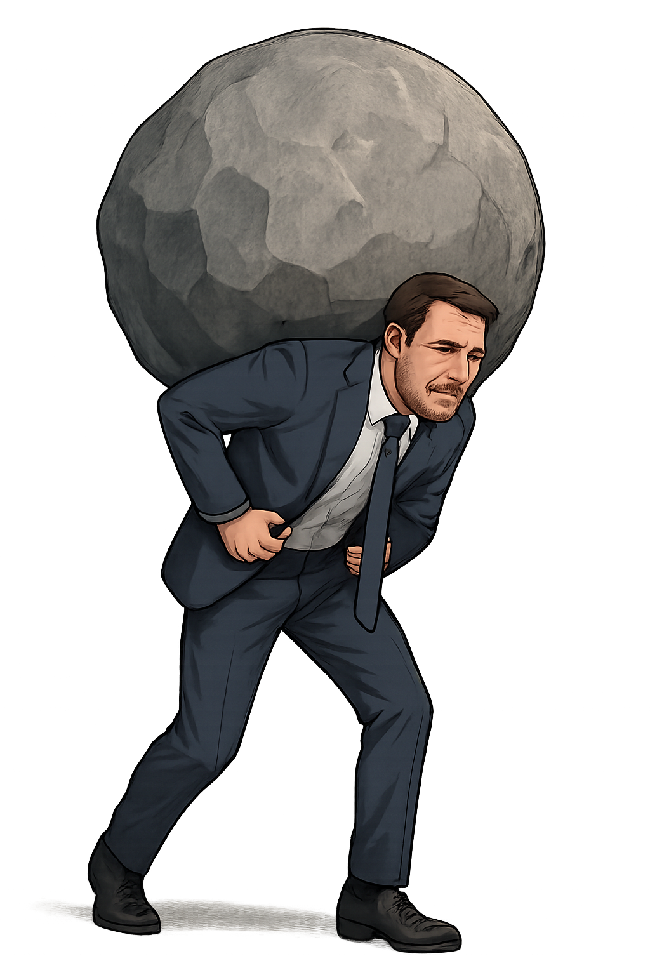

Slide 21
Romans 12:19 CEB
¹⁹ Don’t try to get revenge for yourselves, my dear friends, but leave room for God’s wrath. It is written, Revenge belongs to me; I will pay it back, says the Lord.
[Deuteronomy 32:35]

Slide 22
Holding onto unforgiveness can harm your emotional, physical, mental, and spiritual well-being.

Slide 23
Matthew 11:29
²⁹ Take My yoke upon you and learn from Me, for I am gentle and lowly in heart, and you will find rest for your souls. ³⁰ For My yoke is easy and My burden is light.

Slide 24
Matthew 11:29
²⁹ Take My yoke upon you and learn from Me, for I am gentle and lowly in heart, and you will find rest for your souls. ³⁰ For My yoke is easy and My burden is light.

Slide 25
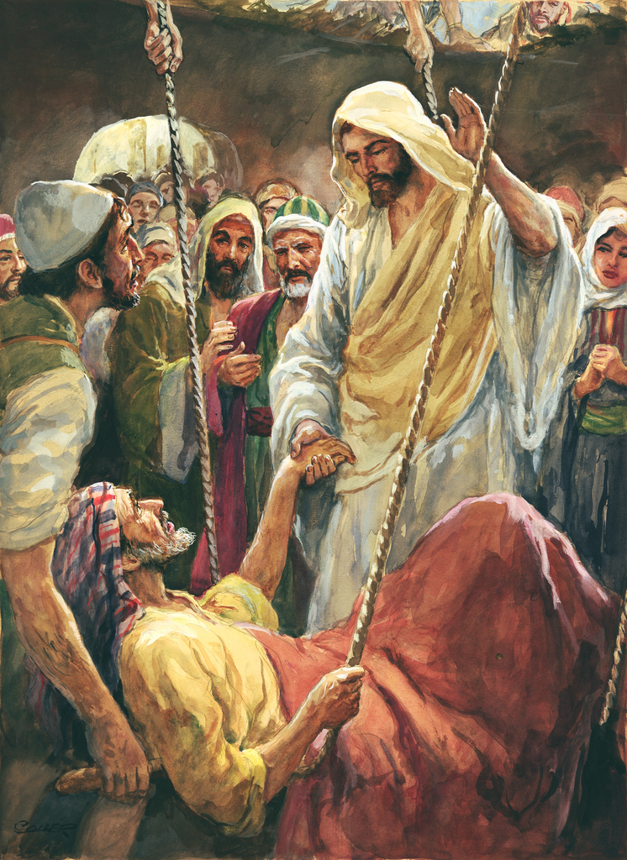
Jesus Forgives and Heals
a Crippled Man
  Mark 2:1-12

Slide 26
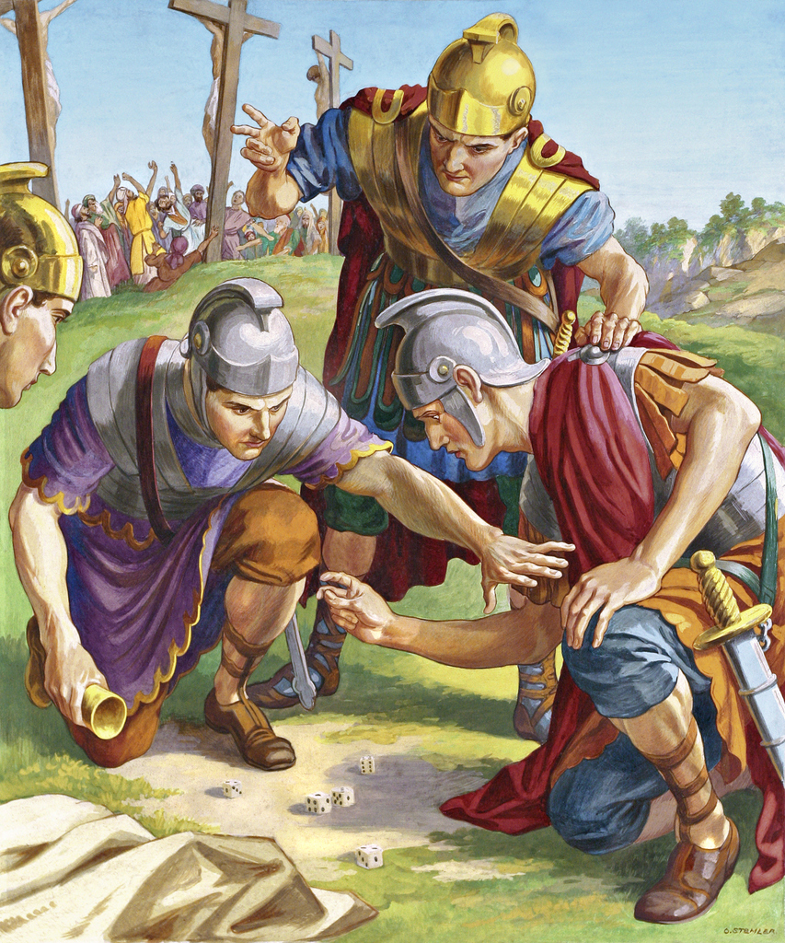
One of the
Seven Sayings
of Jesus
  Luke 23:32
  John 19:23

Slide 27
Luke 23:32 NKJV
³² Then Jesus said, “Father, forgive them, for they do not know what they do.” And they divided His garments and cast lots.

Slide 28
John 19:23 NKJV
²³ Then the soldiers, when they had crucified Jesus, took His garments and made four parts, to each soldier a part, and also the tunic. Now the tunic was without seam, woven from the top in one piece.

Slide 29
Colossians 3:12-17 GNT

Slide 30
Colossians 3:13 GNT
¹³ Be tolerant with one another and forgive one another whenever any of you has a complaint against someone else. You must forgive one another just as the Lord has forgiven you.

Slide 31
Ephesians 4:32 GNT
³² Be kind and tender-hearted to one another, and forgive one another, as God has forgiven you through Christ.

Slide 33

Forgiveness
Slide Extras

Slide 34
Principle 1:
I will be forgiven as I forgive
“Forgive us our debts as we also have forgiven our debtors.”
— Matthew 6:12

Slide 35
Principle 2:
If I don’t forgive, my worship is unacceptable to God
“If you are offering your gift at the altar and there remember that your brother has something against you, leave your gift there in front of the altar. First go and be reconciled to your brother; then come and offer your gifts.”
— Matthew 5:23, 24

Slide 36
Principle 3:
Forgiveness is for everyone, not just for those who “deserve” it

Slide 37
Principle 4:
It is easier to forgive when there has been a confession

Slide 38
Principle 5:
Forgiveness can elicit [draw out] repentance [from soneome]

Slide 39
Principle 6:
The freedom of knowing the “truth”
“You will know the truth, and the truth will make you free.”
— John 8:32 NRSV

Slide 40
Principle 7:
“Seventy times seven”
“How often should I forgive?”
— Matthew 18:20 NRSV

Slide 41
Principle 8:
There is no such thing as a “Christian” vengeance [revenge]

Slide 42
Principle 9:
Healing always accompanies [go along with] forgiveness

Slide 43
Making the Forgiveness Promise Stick

Slide 44
I will not think about or focus on this incident [problem].
I will not bring up this incident again and use it against you.
I will not talk to others about this incident.
I will not allow this incident to stand between us or to hinder [create difficult] our personal relationship.

Slide 46
