Slide 1
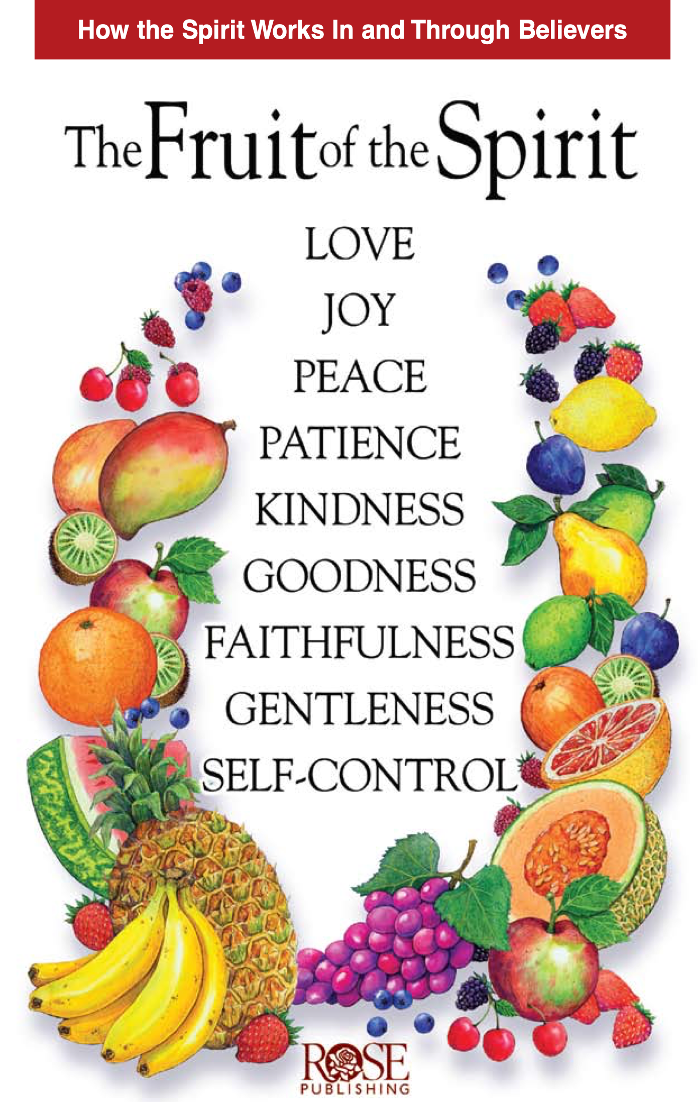
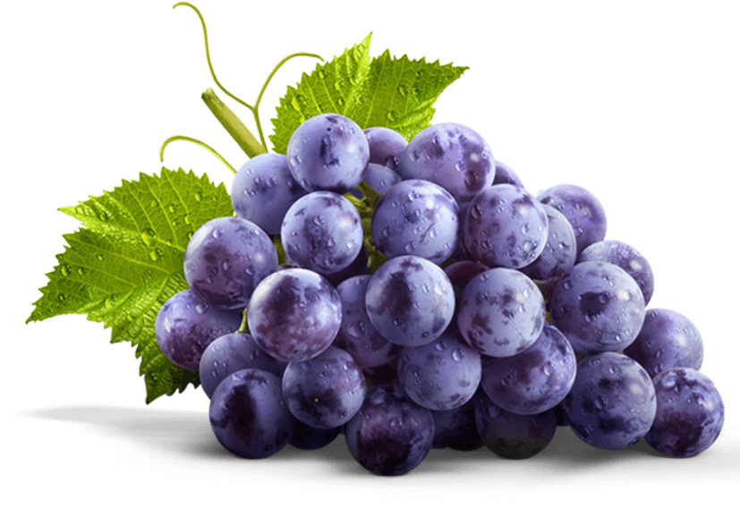
The Fruit of
the Spirit
Galatians 5:22-23

Slide 2
²² But the fruit of the Spirit is love, joy, peace, longsuffering, kindness, goodness, faithfulness, ²³ gentleness, self-control. Against such there is no law.
Galatians 5:22-23 NKJV

Slide 3
²² But the Holy Spirit produces this kind of fruit in our lives: love, joy, peace, patience, kindness, goodness, faithfulness, ²³ gentleness, and self-control. There is no law against these things!
Galatians 5:22-23 NLT

Slide 4
²⁰ If you speak words that help people, they are like good food.
Speech is the fruit of the mouth.
Proverbs 18:20 EASY

Slide 5
¹⁶ She looks carefully at a field, and she decides to buy it. She uses her own money to plant a vineyard.
Work is the fruit of the hand.
Proverbs 31:16 EASY

Slide 6
¹⁶ You can identify them by their fruit, that is, by the way they act.
Matthew 7:16 NLT

Slide 7
² Some branches that are part of me may have no fruit on them. My Father completely removes all those branches. But other branches do have fruit. My Father cuts all those branches to make them better. Then they will be good and make more fruit. ³ The words that I have spoken to you have made you good already. ⁴ Continue to live in me, and I will continue to live in you. A branch cannot make fruit by itself. It can make fruit only if it continues to be part of the vine. You are like that. You cannot make fruit unless you continue to live in me.
⁵ I am the vine, and you are the branches. You must continue to live in me and I must continue to live in you. Only if you do that will you make plenty of fruit. That is because you can do nothing without me. ⁶ If anyone does not remain in me, that person is like a dead branch. The gardener will throw that branch away and it will die. People throw all those dead branches into the fire so that they burn.
John 15:2-6 EASY

Slide 8
² Some branches that are part of me may have no fruit on them. My Father completely removes all those branches. But other branches do have fruit. My Father cuts all those branches to make them better. Then they will be good and make more fruit. ³ The words that I have spoken to you have made you good already. ⁴ Continue to live in me, and I will continue to live in you. A branch cannot make fruit by itself. It can make fruit only if it continues to be part of the vine. You are like that. You cannot make fruit unless you continue to live in me.
⁵ I am the vine, and you are the branches. You must continue to live in me and I must continue to live in you. Only if you do that will you make plenty of fruit. That is because you can do nothing without me. ⁶ If anyone does not remain in me, that person is like a dead branch. The gardener will throw that branch away and it will die. People throw all those dead branches into the fire so that they burn.
John 15:2-6 EASY

Slide 9
Virtue is a moral quality or trait that is considered good and desirable. It refers to habits of character that help a person act rightly and live a good life.
Honesty | Justice
Courage | Patience
Kindness | Orderliness
Neatness | Simplicity

Slide 10
 | Love | Joy | Peace
 | Patience | Kindness | Goodness
 | Faithfulness | Gentleness | Self-Control

Slide 11
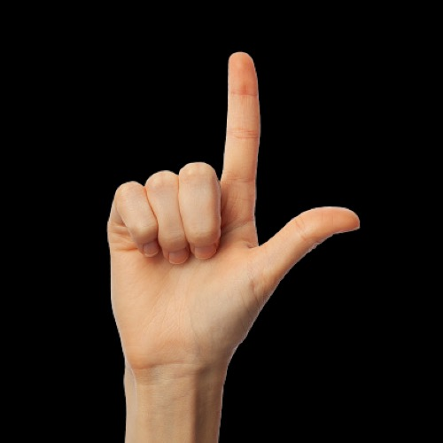
Ove

Slide 12
Matthew 22:37 NKJV
Jesus said to him, “‘You shall love the Lord your God with all your heart, with all your soul, and with all your mind.’

Slide 13
Matthew 22:39 NKJV
And the second is like it: ‘You shall love your neighbor as yourself.’

Slide 14
The Lord your God
Ove
Your neighbor
and you

Slide 15
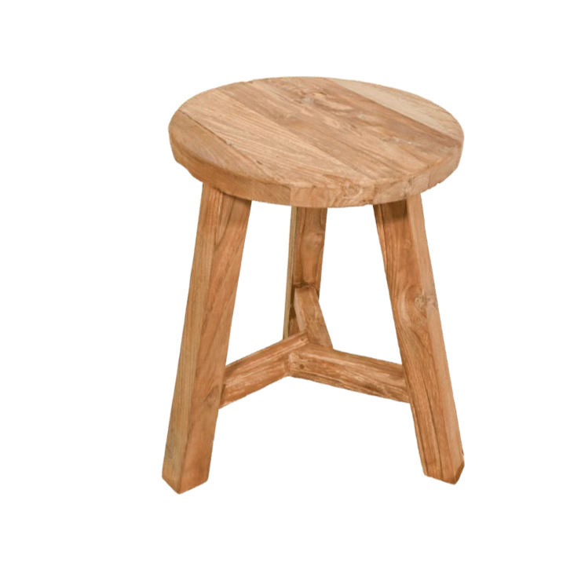
 | Love | Joy | Peace
The first triad consists of love, joy, peace;
and is primarily concerned with the Christian’s personal relationship to God.

Slide 16
 | Patience | Kindness | Goodness
The second triad, patience, kindness, goodness, particularly relates to the Christian’s personal relationship to other human beings.

Slide 17
 | Faithfulness | Gentleness | Self-Control
The third triad is faithfulness, gentleness, self-control. This triad has to do with the Christian’s personal life and character.

Slide 18
 | Love | Joy | Peace
 | Patience | Kindness | Goodness
 | Faithfulness | Gentleness | Self-Control

Slide 19
Where Does the Fruit of the Spirit Come From?

Slide 21
