Slide 1
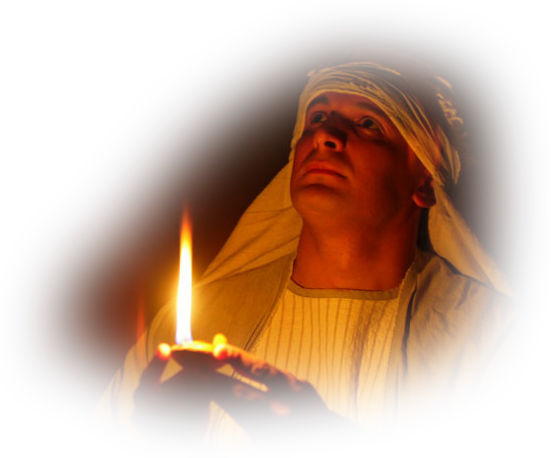
10. Holiness to the Lord
Secrets and Mysteries of the Lost Ark: A Bible Adventure

Slide 2
What visible sign of holiness was part of the priest’s garment?
  “Holiness to the Lord.”
Secrets and Mysteries of the Lost Ark: A Bible Adventure

Slide 3
What does it mean to be holy?
  To be set apart, sanctified, righteous, perfect.
Secrets and Mysteries of the Lost Ark: A Bible Adventure

Slide 4
How did God begin to reveal His plan of holiness to the people through Moses?
  By the burning bush experience.
Secrets and Mysteries of the Lost Ark: A Bible Adventure

Slide 5
How did God set forth this ideal before the people as a whole?
  By calling them to be a nation of priests, and by reminding them of the Sabbath.
Secrets and Mysteries of the Lost Ark: A Bible Adventure

Slide 6
What experience on the journey to Canaan underlined the urgency of the concept of holiness?
  The slaying of the sons of Aaron, when they offered “strange fire” on the altar.
Secrets and Mysteries of the Lost Ark: A Bible Adventure

Slide 7
In what other way was holiness to be reflected in their lifestyle?
  They were to observe special carefulness in the dietary choices.
Secrets and Mysteries of the Lost Ark: A Bible Adventure

Slide 8
God challenges us to holiness in every area of our lives, such as:
  Our lifestyle in general.
  Our sexual powers.
  Our money.
Secrets and Mysteries of the Lost Ark: A Bible Adventure

Slide 9
What can we learn about the concept of holiness in the Old and New Testaments?
  God always holds high the standard of holiness. What if He didn’t?!
Secrets and Mysteries of the Lost Ark: A Bible Adventure

Slide 10
What medieval theology obliterated the “priesthood of the believer” and became an issue in the Protestant Reformation?
  An institutionalized priesthood, the mass, indulgences for sin, Mary as our mediator, and the confessional booth.
Secrets and Mysteries of the Lost Ark: A Bible Adventure

Slide 11
What happened to the priesthood when Christ died?
  Christ became our only Mediator, our High Priest, in the heavenly sanctuary.
Secrets and Mysteries of the Lost Ark: A Bible Adventure

Slide 12
In what sense do we serve as “priests” today?
  We can all be “under shepherds” as we point people to Christ and engage in intercessory prayer.
Secrets and Mysteries of the Lost Ark: A Bible Adventure

Slide 13
What postmodern concept has blurred the distinction between the holy and the unholy?
  Relativism! “I’m OK, you’re OK.”
Secrets and Mysteries of the Lost Ark: A Bible Adventure

Slide 14
What perspective will help us dedicate our lives completely to God?
  Relativism! “I’m OK, you’re OK.”
Secrets and Mysteries of the Lost Ark: A Bible Adventure

Slide 15
How does the Lord counsel us to put life in perspective and put Him first, so that by association with Him we can become holy?
  Do not love the world.
  Know that all these things will be dissolved.
Secrets and Mysteries of the Lost Ark: A Bible Adventure

Slide 16

Secrets and Mysteries of the Lost Ark:
A Bible Adventure
by James R. Hoffer
© 2014, James R. Hoffer
Graphics courtesy of Bible Graphics Studio.
Used by permission.

