Slide 1
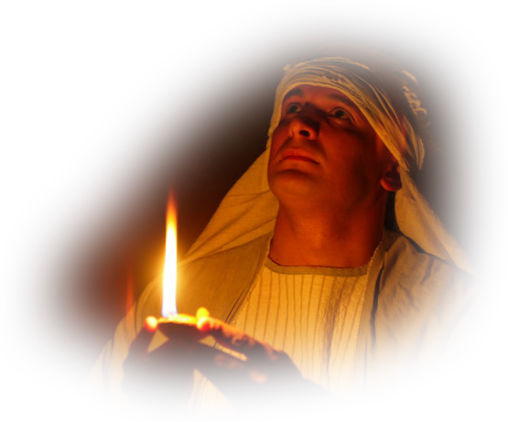
11. Heavenly Mediation
Secrets and Mysteries of the Lost Ark: A Bible Adventure

Slide 2
The lost sheep was “free”—or was he?
  He was headed for disaster, but didn’t know it.
Secrets and Mysteries of the Lost Ark: A Bible Adventure

Slide 3
What was Jesus’ mission while on earth?
  To save the lost sheep. Without Jesus we are hopelessly confused and lost.
Secrets and Mysteries of the Lost Ark: A Bible Adventure

Slide 4
Jesus’ mediation began while on earth. For whom did He intercede?
  For His disciples, and for us!
Secrets and Mysteries of the Lost Ark: A Bible Adventure

Slide 5
What is the only way to be truly free?
  The Jews felt that they were free, but they were not. We cannot trust our feelings! We need a standard (the Bible) and a Savior.
Secrets and Mysteries of the Lost Ark: A Bible Adventure

Slide 6
What does the sanctuary teach us about Jesus, our Savior and Mediator?
  Jesus died for us; He was the sacrificial lamb.
  Jesus lives for us; He is our Mediator.
  Jesus will return to earth to take us to heaven.
Secrets and Mysteries of the Lost Ark: A Bible Adventure

Slide 7
What qualifies Christ to be our Mediator?
  He lived a perfect life down here in this sin-sick world, and He knows from personal experience what it is like to be a human being.
Secrets and Mysteries of the Lost Ark: A Bible Adventure

Slide 8
What do the Scriptures teach us regarding the mediation of Christ?
  There is only one Mediator—Jesus.
  He is the Mediator of the new covenant, by which we may receive salvation.
Secrets and Mysteries of the Lost Ark: A Bible Adventure

Slide 9
If Jesus is mediating for us in the heavenly sanctuary, who is here on earth helping us?
  The Holy Spirit.
Secrets and Mysteries of the Lost Ark: A Bible Adventure

Slide 10
What is the Holy Spirit’s work?
  To convict us of sin, righteousness, and judgment, and to lead us into all truth.
Secrets and Mysteries of the Lost Ark: A Bible Adventure

Slide 11
What qualifies us to benefit from the Holy Spirit’s work?
  Obedience! Only the obedient enjoy a full relationship with Him.
Secrets and Mysteries of the Lost Ark: A Bible Adventure

Slide 12
How can we find this truth?
  Only through Jesus and His Word. This means that we surrender our personal concepts of “freedom” and find in Him the only true freedom—a full relationship with Him and His Word.
Secrets and Mysteries of the Lost Ark: A Bible Adventure

Slide 13
What is the Holy Spirit’s role when we pray?
  The Holy Spirit is also referred to as an Intercessor.
Secrets and Mysteries of the Lost Ark: A Bible Adventure

Slide 14
How does the Holy Spirit empower us to serve others?
  He gives us spiritual gifts.
Secrets and Mysteries of the Lost Ark: A Bible Adventure

Slide 15
How do Christ and the Holy Spirit open the doors of heaven for us right now?
  Through prayer we have access to the very throne room of God!
Secrets and Mysteries of the Lost Ark: A Bible Adventure

Slide 16
All the truths we have studied emanate from the sanctuary. How did the psalmists express their joy regarding God’s house?
  They took great delight in going into God’s house.
Secrets and Mysteries of the Lost Ark: A Bible Adventure

Slide 17
What happened in the days of King Josiah when the Scriptures were rediscovered?
  There was a great revival and reformation.
Secrets and Mysteries of the Lost Ark: A Bible Adventure

Slide 18
When Huldah the prophetess was consulted, what did she say, especially to the young king?
  Josiah’s sincere repentance was accepted, and the calamities were delayed until after his day.
Secrets and Mysteries of the Lost Ark: A Bible Adventure

Slide 19

Secrets and Mysteries of the Lost Ark:
A Bible Adventure
by James R. Hoffer
© 2014, James R. Hoffer
Graphics courtesy of Bible Graphics Studio.
Used by permission.

