Slide 1
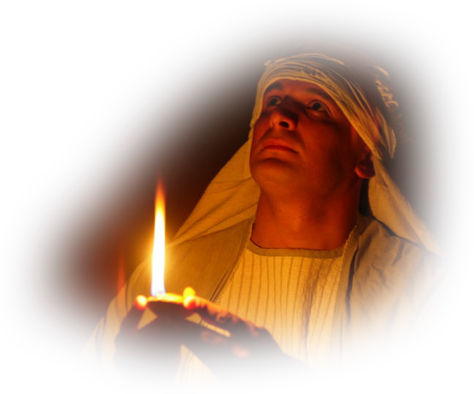
12. The Ark of Safety
Secrets and Mysteries of the Lost Ark: A Bible Adventure

Slide 2
Secrets and Mysteries of the Lost Ark: A Bible Adventure
What earthly system prevailed during the Dark Ages, and what means did it use to draw attention to itself and away from Christ?
  God gave a detailed design to Moses, and Moses directed the construction.

Slide 3
Secrets and Mysteries of the Lost Ark: A Bible Adventure
What are the main characteristics that help us identify this power?
  Geographical and historical timing, self-exaltation against the Prince of the host, taking away the daily sacrifices, casting down the place of the sanctuary, casting down truth, persecuting the saints.

Slide 4
Secrets and Mysteries of the Lost Ark: A Bible Adventure
When would this false system be unmasked?
  In connection with the events of 1844.

Slide 5
Secrets and Mysteries of the Lost Ark: A Bible Adventure
Who is the Prince of the host?
  Jesus, the very one whom Satan hates and whose ministry he tried to obscure.

Slide 6
Secrets and Mysteries of the Lost Ark: A Bible Adventure
In what specific ways did the little horn’s theology succeed in replacing Jesus’ ministry?
  A wrong priesthood.
  A false mediatorial system.
  A false religious system—the mass and all its trappings.

Slide 7
Secrets and Mysteries of the Lost Ark: A Bible Adventure
What are some of the major Bible teachings given us in the sanctuary message?
  Salvation through the blood of Christ, and Christ’s mediation.
  The “great controversy” theme and the character of God.
  The second coming of Christ and the state of man in death.

Slide 8
Secrets and Mysteries of the Lost Ark: A Bible Adventure
What are some of the major Bible teachings given us in the sanctuary message?
  End-time prophecy, including the judgment hour message.
  God’s covenant of love, and the 10 Commandments, including the Sabbath.
There is no church that teaches the sanctuary message other than the Seventh-day Adventist church!

Slide 9
Secrets and Mysteries of the Lost Ark: A Bible Adventure
Is “church” really a necessity in the believer’s life?
  Yes, absolutely. Christ Himself established the church.

Slide 10
Secrets and Mysteries of the Lost Ark: A Bible Adventure
Does Jesus love the church?
  Yes—He died for it, and watches over it yet today.

Slide 11
Secrets and Mysteries of the Lost Ark: A Bible Adventure
How was the early church set up, which serves as our pattern today?
  Elders and deacons, and even council meetings.

Slide 12
Secrets and Mysteries of the Lost Ark: A Bible Adventure
How were members added to the church?
  Through baptism.

Slide 13
Secrets and Mysteries of the Lost Ark: A Bible Adventure
There were only eight people saved on Noah’s ark. What does Peter say is the antitype that now saves us?
  Symbolically, they were “baptized” as they passed through the waters.

Slide 14

Secrets and Mysteries of the Lost Ark:
A Bible Adventure
by James R. Hoffer
© 2014, James R. Hoffer
Graphics courtesy of Bible Graphics Studio.
Used by permission.

