Slide 1
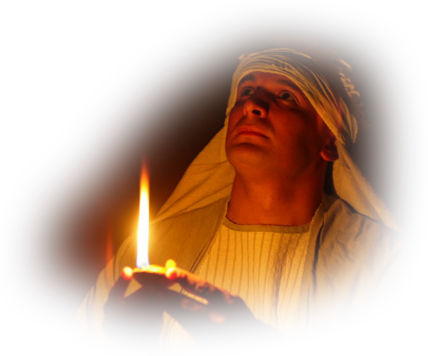
2. Jesus in the Sanctuary
Secrets and Mysteries of the Lost Ark: A Bible Adventure

Slide 2
Why is it important to understand the message of the sanctuary?
  It answers the “big questions” about the existence of evil and the problem of human suffering.
Secrets and Mysteries of the Lost Ark: A Bible Adventure

Slide 3
What was Jesus’ first encounter with the temple?
  His dedication as a baby.
Secrets and Mysteries of the Lost Ark: A Bible Adventure

Slide 4
When did He next go to the temple?
  When He was a boy of 12.
Secrets and Mysteries of the Lost Ark: A Bible Adventure

Slide 5
What must He have thought when He observed the animal sacrifices?
  That He was the Lamb of God.
Secrets and Mysteries of the Lost Ark: A Bible Adventure

Slide 6
When was the sacrificial system introduced and for what purpose?
  God Himself introduced the sacrificial system, at first by individuals and families; after the Exodus He enshrined it in the sanctuary services. The sacrifices were to symbolize that the penalty of sin is death.
Secrets and Mysteries of the Lost Ark: A Bible Adventure

Slide 7
Jesus was often found in the temple in Jerusalem during His ministry. How did He use the sanctuary services to explain something about Himself?
  He was the water of life and the light of the world.
Secrets and Mysteries of the Lost Ark: A Bible Adventure

Slide 8
How does the sanctuary message reveal God’s true character?
  The “great controversy” and the disposition of sin and Satan are fully portrayed and illustrated through the sanctuary.
Secrets and Mysteries of the Lost Ark: A Bible Adventure

Slide 9
What event in Christ’s ministry especially portrayed His respect for the sanctuary?
  Casting out the money changers.
Secrets and Mysteries of the Lost Ark: A Bible Adventure

Slide 10
What happened at Christ’s death that graphically showed how the earthly sanctuary services had met their fulfillment and would now completely lose their validity?
  The temple veil was torn from top to bottom by an unseen hand.
Secrets and Mysteries of the Lost Ark: A Bible Adventure

Slide 11
What is Christ’s relationship with the heavenly sanctuary?
  Christ is our High Priest in the heavenly sanctuary.
Secrets and Mysteries of the Lost Ark: A Bible Adventure

Slide 12
Notice how the sanctuary message holds the key to understanding the book of Revelation.
The seven churches—Christ’s great love for His people.
The seven seals—the majesty of God as Creator, and his right to send judgments on the earth.
The seven trumpets—the ark of the covenant will play a significant role in the final events.
The seven last plagues—God’s judgments emanate from the heavenly sanctuary.
Finally, no more temple!
Secrets and Mysteries of the Lost Ark: A Bible Adventure

Slide 13

Secrets and Mysteries of the Lost Ark:
A Bible Adventure
by James R. Hoffer
© 2014, James R. Hoffer
Graphics courtesy of Bible Graphics Studio.
Used by permission.

