Slide 1
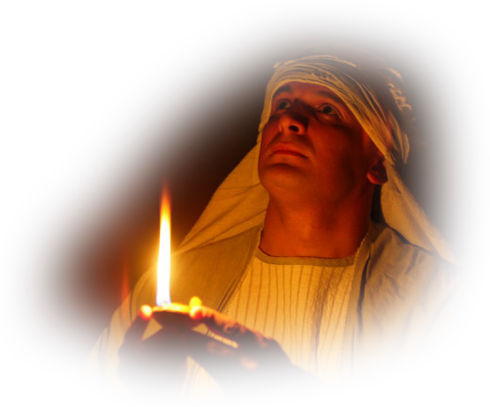
8. The Contents of the Ark
Secrets and Mysteries of the Lost Ark: A Bible Adventure

Slide 2
How was the ark to be constructed?
  Its size – about 45 by 27 by 27 inches.
  Its materials – acacia wood, covered with gold.
  Its means of transport – long poles set in rings.
  Its contents – the Ten Commandments.
  On its top – the mercy seat and the cherubim.
  Its activity – God would meet with Moses there.
Secrets and Mysteries of the Lost Ark: A Bible Adventure

Slide 3
What other items would be added to the ark?
A pot of manna, and Aaron’s rod that budded.
Secrets and Mysteries of the Lost Ark: A Bible Adventure

Slide 4
What did all this represent, in terms of God’s character?
The Ten Commandments – holiness, purity, justice, law.
The manna – providence, goodness.
Aaron’s rod – authority.
The mercy seat – mercy, grace, forgiveness, love.
The cherubim – worship, reverence.
Secrets and Mysteries of the Lost Ark: A Bible Adventure

Slide 5
Why is it important for us to have a true picture of God?
  Because of the “great controversy” and Satan’s attacks on God’s character.
Secrets and Mysteries of the Lost Ark: A Bible Adventure

Slide 6
What insight does Jesus’ statement to the disciples give us about the blind man and his suffering?
  Jesus combated people’s false ideas of the relationship between sin and disease.
Secrets and Mysteries of the Lost Ark: A Bible Adventure

Slide 7
What did the apostle Paul say about his struggle with infirmity and the role Satan played?
  It was Satan who caused his personal affliction, not God.
Secrets and Mysteries of the Lost Ark: A Bible Adventure

Slide 8
What does the story of Job teach us about Satan’s involvement on this earth?
  That his problems and trials were caused directly by Satan.
Secrets and Mysteries of the Lost Ark: A Bible Adventure

Slide 9
What are the two basic salvation principles that the ark teaches us?
  The Ten Commandments – justice and righteousness, God’s holy ideal for us.
  The mercy seat – grace and forgiveness; power over the penalty of sin, and power to live victoriously over sin.
Secrets and Mysteries of the Lost Ark: A Bible Adventure

Slide 10
How did God present Himself to Moses?
  Merciful and gracious, longsuffering, abundant in goodness and truth—a perfect blend!
Secrets and Mysteries of the Lost Ark: A Bible Adventure

Slide 11
What other important characteristic of God is highlighted in the Bible?
  His power to create, and the uselessness of the false gods.
Secrets and Mysteries of the Lost Ark: A Bible Adventure

Slide 12
Is there anything in the Ark of the Covenant that alludes to God as our Creator?
  The fourth commandment.
Secrets and Mysteries of the Lost Ark: A Bible Adventure

Slide 13
What do the following texts teach us about the Sabbath day?
  It was instituted and given to mankind, thousands of years before there was a Jew.
  Jesus, our Creator, called Himself Lord of the Sabbath.
  It was known by the Jews before the law was given on Mt. Sinai.
  Nehemiah championed the Sabbath during the return of the Jews.
  Paul observed the Sabbath, even among the Gentiles.
  The book of Hebrews affirmed the Sabbath, late in the first century.
Secrets and Mysteries of the Lost Ark: A Bible Adventure

Slide 14
If keeping the law doesn’t actually save us, what good is it?
  It is like a mirror; it reveals our sins, and drives us to the cross to obtain forgiveness.
Secrets and Mysteries of the Lost Ark: A Bible Adventure

Slide 15

Secrets and Mysteries of the Lost Ark:
A Bible Adventure
by James R. Hoffer
© 2014, James R. Hoffer
Graphics courtesy of Bible Graphics Studio.
Used by permission.

