Slide 1
GROWING UP IN CHRIST
Seven Levels of Moral Decision Making
Timothy R. Jennings, MD, DFAPA
www.comeandreason.com

Slide 2
Overview
This seminar is designed for everyone, regardless of denomination.
Notes:
This seminar is designed for everyone, regardless of denominational background.

Slide 3
Overview
This seminar is designed for everyone, regardless of denomination.
Paul, an Apostle to the Gentiles, had a great longing for his fellow Jews
Notes:
But Paul, who was an Apostle to the Gentiles and presented truths for everyone, had a special love in his heart for the people of his childhood faith. He would often tie things back to his childhood faith to help reach those people.

Slide 4
Overview
This seminar is designed for everyone, regardless of denomination.
Paul, an Apostle to the Gentiles, had a great longing for his fellow Jews
I was raised in the SDA tradition and while I present Christian truths for everyone, have a great longing in my heart for those in the SDA tradition
Notes:
I was raised in the Seventh-Day Adventist tradition and have a particular love in my heart for the Seventh-Day Adventist people.

Slide 5
Overview
This seminar is designed for everyone, regardless of denomination.
Paul, an Apostle to the Gentiles, had a great longing for his fellow Jews
I was raised in the SDA tradition and while I present Christian truths for everyone, have a great longing in my heart for those in the SDA tradition
For their benefit, I will provide periodic historical quotes
Notes:
I will tie some historical quotes to these Bible truths for their benefit as we go through this program today.

Slide 6
Have You Ever Been One of the First to
Know Something was Wrong?
Have you ever had the difficulty of identifying a problem when someone in leadership already concluded that no problem exists?
Notes:
A patient presented in my second year of residency, putting me in such a bind. A young man was admitted to my team on the psychiatry ward for odd and peculiar behavior. After taking a detailed history, his presentation didn’t “feel” right. Sure, he had a strange look in his eye; his thoughts seemed disconnected and confused, and his wife reported extreme swings in his moods with anger and aggressive outbursts. He would also wake up in the living room after sleeping in his bed, but with no recollection of moving from the bedroom. He had subtle, but not specific, physical findings suggestive of a neurological brain problem. So, I ordered an MRI of the brain.
The problem was that the chief of neurology had already evaluated him, had an EEG and CT scan of the brain, and was cleared by the senior neurologist in the hospital as not having a neurological problem. In those days, MRIs were new and very expensive and required the approval of the chief of neurology to obtain. When I requested the MRI for my patient, it was denied because the neurologist had already examined my patient, looked at the EEG and CT scan, and believed the MRI was not warranted. Further, because I was a second-year resident, my assessment was not viewed as being as diagnostically accurate and reliable as that of the chief of neurology.
So, what was I to do? This young man was in my care, and I was convinced he had a brain problem, not a psychiatric problem, but I was not taken seriously. My faculty supported the need for diagnostic clarity and spoke to the chief of neurology about getting an MRI, but he wouldn’t budge. This put everyone in a bind. But I wouldn’t relent and kept pressing to get the MRI. My faculty struggled with what to do. Should they believe the neurologist or me? Should they order me to let the matter go or support me and potentially offend the neurologist by going over his head to the hospital commander?
My conviction was so firm, and my concern for the welfare of my patient was so great that I kept pressing my request until I convinced my supervisor there really was something neurologically wrong with my patient. Thankfully, she finally went to the hospital commander, who ordered the MRI. When the MRI was done, it revealed a massive tumor invading both sides of my patient’s brain. Reexamination of the CT scan, with the MRI findings in mind, showed the tumor was there but was so large it was missed by both the radiologist and neurologist. My patient was immediately transferred from psychiatry to oncology and neurosurgery.

Slide 7
There Is Something Wrong in Christianity
Domestic violence rates - No different
Notes:
Well, I believe there is something wrong with Christianity. Domestic violence rates in Christian homes are no different than in non-Christian homes,

Slide 8
There Is Something Wrong in Christianity
Domestic violence rates - No different
Child abuse rates - No different
Notes:
child abuse rates in Christian homes are no different than in non-Christian homes,

Slide 9
There Is Something Wrong in Christianity
Domestic violence rates - No different
Child abuse rates - No different
Alcohol / drug addiction rates - No different
Notes:
alcohol and drug addiction rates are no different,

Slide 10
There Is Something Wrong in Christianity
Domestic violence rates - No different
Child abuse rates - No different
Alcohol / drug addiction rates - No different
Pornography use - No different
Notes:
and pornography use is no different.

Slide 11
There Is Something Wrong in Christianity
Domestic violence rates - No different
Child abuse rates - No different
Alcohol / drug addiction rates - No different
Pornography use - No different
Disunity and fragmentation with 34,000 different groups
Notes:
If you look at Christianity as a whole, it's fragmented into 34,000 different Christian groups, often arguing once over who's got the truth.

Slide 12
2 Timothy 3:1-5 NIV
¹ But mark this: There will be terrible times in the last days. ² People will be lovers of themselves, lovers of money, boastful, proud, abusive, disobedient to their parents, ungrateful, unholy, ³ without love, unforgiving, slanderous, without self-control, brutal, not lovers of the good, ⁴ treacherous, rash, conceited, lovers of pleasure rather than lovers of God— ⁵ having a form of godliness but denying its power.
Notes:
Paul wrote to Timothy and said, there will be terrible times in the last days when people will be lovers of themselves, lovers of money, boastful, proud, abusive, disobedient to their parents, ungrateful, unholy, without love, unforgiving, slanderous, without self-control, brutal, not lovers of the good, treacherous, rash, conceited, lovers of pleasure rather than lovers of God—having a form of godliness but denying its power.

Slide 13
There Is Something Wrong in Christianity
In this seminar, we will:
Notes:
There's something wrong with Christianity. In this seminar, we will

Slide 14
There Is Something Wrong in Christianity
In this seminar, we will:
Expose an infection of thought / distortion of belief that keeps good people trapped in addiction and violence cycles
Notes:
expose an infection of thoughts, a distortion of belief that keeps good people trapped in addiction and violent cycles,

Slide 15
There Is Something Wrong in Christianity
In this seminar, we will:
Expose an infection of thought / distortion of belief that keeps good people trapped in addiction and violence cycles
Present a Remedy to bring healing and prepare people to meet Jesus
Notes:
and we will present a remedy to bring healing and prepare people to meet Jesus.

Slide 16
How Do You Determine
What Is Right And Wrong?
Do you look to a higher authority – parent, teacher, political leader, pastor, priest or deity – to tell you?
Notes:
So, how do you determine whether something is right or wrong, known as moral decision-making? Do you look for a higher authority, a parent, a teacher, a political leader, a priest, or someone to tell you?

Slide 17
How Do You Determine
What Is Right And Wrong?
Do you look to a higher authority – parent, teacher, political leader, pastor, priest or deity – to tell you?
Do you look for a consensus among peers, or perhaps a code of rules or system of established laws?
Notes:
Do you look for a consensus amongst your peers? Well, everybody else thinks this is the way it is, or do you have a code, a system of rules, to tell you?

Slide 18
How Do You Determine
What Is Right And Wrong?
Do you look to a higher authority – parent, teacher, political leader, pastor, priest or deity – to tell you?
Do you look for a consensus among peers, or perhaps a code of rules or system of established laws?
Or do you have another standard?
Notes:
Do you have some other mechanism that you use to determine right and wrong?

Slide 19
We Will Examine the 7 Levels so that…
“We shall all come together to that oneness in our faith and in our knowledge of the Son of God; we shall become mature people, reaching to the very height of Christ’s full stature. Then we shall no longer be children, carried by the waves and blown about by every shifting wind of the teaching of deceitful people, who lead others into error by the tricks they invent.”
— Ephesians 4:13,14 NIV
Notes:
I want to acknowledge Lawrence Kohlberg for groundbreaking research on the six levels of moral development. We've built on his research, expanded it with biblical truths to the seven levels of moral development, and tied it in with Bible perspectives because we will examine these seven levels so that we shall come together to the oneness in our faith and our knowledge of the Son of God we shall become mature people reaching the very height of Christ's full stature then we shall be no longer children carried by the waves and blown about by every shifting wind the teaching of deceitful people. That is our goal: to grow up and to mature.

Slide 20
Eric Wright
Notes:
Eric Wright was home one evening in June 2010, when he noticed his wife, Aline seemed to be suffering a stroke. Aline a nurse and Eric an EMT both worked at Erlanger Hospital, the regional stroke center and lived only about 6 miles from the hospital.
Aline’s face was drooping and her arm was numb and time was ciritical if permanent damage was to be avoided. Eric decided to drive his wife to the hospital rather than waste time waiting for an ambulance.
He quickly picked up his wife, and both in their pajamas, raced out of the house and into the car. He drove to the hospital – but the posted speed limit was 35 mph – what is the right action to take – break the speed limit, or follow the legally posted limit?

Slide 21
Eric Wright
What should he do?

Slide 22
Eric Wright
What should he do?
What is the RIGHT action to take?

Slide 23
Eric Wright
What should he do?
What is the RIGHT action to take?
Should he break the law?

Slide 24
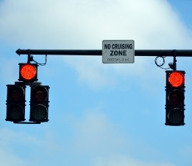
Eric Wright
What should he do?
What is the RIGHT action to take?
Should he break the law?

Slide 25
Eric Wright
What should he do?
What is the RIGHT action to take?
Should he break the law?

Slide 26
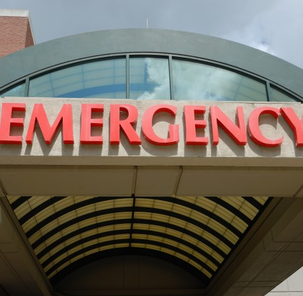
Eric Wright
What should he do?
What is the RIGHT action to take?
Should he break the law?

Slide 27
Eric was Arrested and Charged With
Assault on an police officer
Disorderly conduct
Reckless endangerment
Two counts of traffic signals violation
Expired registration

Slide 28
Did Eric Do Right or Wrong?
It all depends on your level of
Moral Development
Notes:
Did Eric do right or wrong? it all depends on your level of moral development

Slide 29
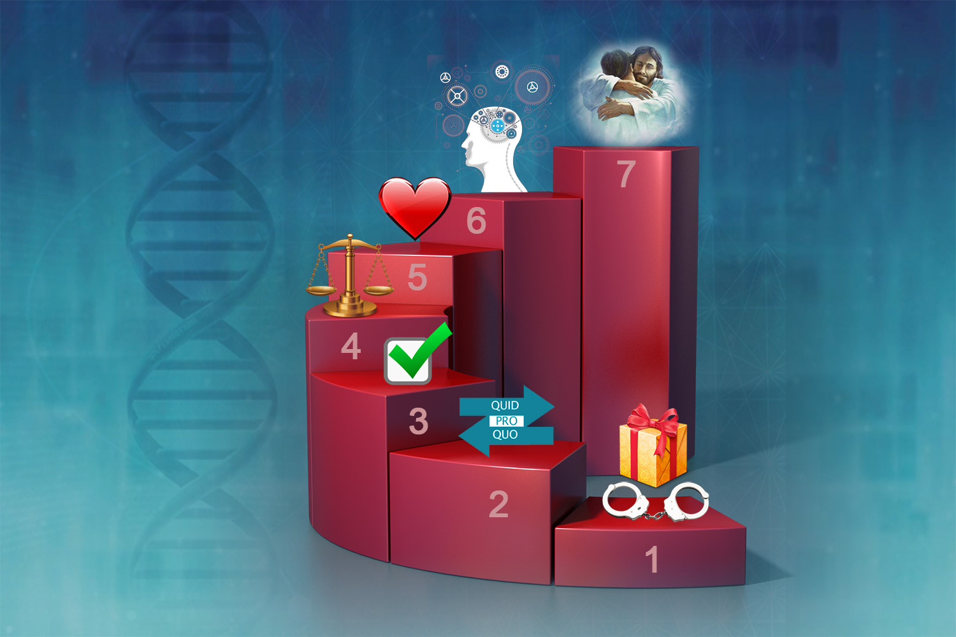
Seven Levels of Moral Development
ComeAndReason.com
Notes:
Let's go through the seven levels of moral development.

Slide 30
Level 1
Reward and Punishment
ComeAndReason.com
Notes:
Level one Reward and Punishment

Slide 31
Level 1: Reward and Punishment
The most basic level
Notes:
This is the most basic level of determining whether something is right or wrong.

Slide 32
Level 1: Reward and Punishment
The most basic level
Right – if rewarded
Notes:
Right is determined if you get a reward for it.

Slide 33
Level 1: Reward and Punishment
The most basic level
Right – if rewarded
Wrong – if punished
Notes:
Wrong is determined if you get punished for it.

Slide 34
Level 1: Reward and Punishment
The most basic level
Right – if rewarded
Wrong – if punished
Nazi soldiers
Notes:
This is the Nazi soldiers who would put people in the gas chamber because they would be court-martialed and punished so it was the right thing to do to avoid punishment. This is a slave mentality.

Slide 35
Level 1: Reward and Punishment
The most basic level
Right – if rewarded
Wrong – if punished
Nazi soldiers
Ancient Israel as slaves in Egypt
Notes:
This was ancient Israel, as slaves in Egypt did what they heard the master say to avoid the whip. Many people operate at this level, our emotion-based decision makers making decisions in the very moment simply based on what feels good or to avoid what feels bad.

Slide 36
Ruler Must Be Powerful
Rulers establish right to rule by powerful displays of might and vengeance on enemies
Notes:
Rulers at this level must be powerful.
A ruler establishes his right to rule by mighty displays of vengeance upon one's enemies.

Slide 37
Ruler Must Be Powerful
Rulers establish right to rule by powerful displays of might and vengeance on enemies
Mercy or failure to punish is viewed as weakness and immoral by level 1 thinkers
Notes:
Mercy or failure to punish is viewed as weakness by people operating at Level 1 standards.

Slide 38
Ruler Must Be Powerful
Rulers establish right to rule by powerful displays of might and vengeance on enemies
Mercy or failure to punish is viewed as weakness and immoral by level 1 thinkers
People at this level see a God of mercy, who doesn’t inflict punishment as a marshmallow God and insist God must use His power to inflict torment and death
Notes:
At this level people see a God of mercy, who doesn't inflict punishment as a marshmallow God and insist God must use His power in order to torture and kill.

Slide 39
God Meets People Where They Are
God took vengeance on the gods of Egypt
Notes:
God meets people where they are so in Egypt when they were slaves operating at Level 1.
God took vengeance upon the gods of Egypt

Slide 40
God Meets People Where They Are
God took vengeance on the gods of Egypt
God displayed power with 10 plagues to demonstrate the impotence of the Egyptian gods
Notes:
10 plagues came to show that the gods of Egypt were not God

Slide 41
God Meets People Where They Are
God took vengeance on the gods of Egypt
God displayed power with 10 plagues to demonstrate the impotence of the Egyptian gods
“I did this so that you might know that I am the Lord your God.” Deuteronomy 29:6
Notes:
The Scripture says in Deuteronomy 29:6, “I did this so that you might know that I am the Lord your God.”

Slide 42
Level 1 Is so Primitive
it Doesn’t Require a Brain
Thinking is completely sidelined
Notes:
Level 1 is so primitive it actually doesn't require a brain.
Thinking is completely sidelined.

Slide 43
Level 1 Is so Primitive
it Doesn’t Require a Brain
Thinking is completely sidelined
Animals, plants, and bacteria avoid painful stimuli and grow toward rewarding stimuli
Notes:
Animals, plants, bacteria even avoid painful stimuli and will grow towards rewarding stimuli.

Slide 44
Level 1 Is so Primitive
it Doesn’t Require a Brain
Thinking is completely sidelined
Animals, plants, and bacteria avoid painful stimuli and grow toward rewarding stimuli
This level of functioning is not worthy of human beings created in the image of God
Notes:
This level of functioning is not worthy of human beings created in the image of God.

Slide 45
Level 1 Is so Primitive
it Doesn’t Require a Brain
Thinking is completely sidelined
Animals, plants, and bacteria avoid painful stimuli and grow toward rewarding stimuli
This level of functioning is not worthy of human beings created in the image of God
It is Satan’s goal to reduce us to “brute beasts, creatures of instinct” operating at level one.
Notes:
And in fact it is Satan's goal to reduce us to brute beasts, creatures of instinct operating at Level 1.

Slide 46
Level 2
Marketplace Exchange
ComeAndReason.com
Notes:
Level two Marketplace Exchange

Slide 47
Level 2: Marketplace Exchange
Quid pro quo: You do something for me in return for something of agreed-upon value
Notes:
This is the quid pro quo. You do something for me in return for something of a greet upon value. You scratch my back, I'll scratch your back.

Slide 48
Level 2: Marketplace Exchange
Quid pro quo: You do something for me in return for something of agreed-upon value
As ancient Israel said when the law was read, “All the Lord has said WE will do.”
Notes:
This is ancient Israel when the law is written. What the Lord says, we’ll do it and then we'll get rewards from the Lord for doing what he says.

Slide 49
Level 2: Marketplace Exchange
“Eye for an eye, tooth for a tooth.”
Vengeance is a moral duty – to NOT pay someone back with equal amounts of pain and suffering is considered immoral.
Notes:
This is also the eye for an eye, tooth for a tooth mentality. At level 2, eye for an eye, tooth for tooth, vengeance is considered a moral duty to not pay back someone with equal amounts of pain and suffering is considered immoral. Sadly, many people in the world today, you see the news all the time, are still operating at this level.

Slide 50
Level 2: Marketplace Exchange
“Eye for an eye, tooth for a tooth.”
Vengeance is a moral duty – to NOT pay someone back with equal amounts of pain and suffering is considered immoral.
This is the health / wellness gospel
If you do these rituals or say this prayer for so many days, you will be blessed of God.
Notes:
This is also the health wellness gospel. The idea is that if you do certain rituals or say the certain prayer every day for 30 days then you get blessed. Your power gets extended and so forth and so on you do the right rituals. You get the right blessing.

Slide 51
Level 2 Barely Requires a Brain
Thinking at this level is minimal
Notes:
Level 2 barely requires the brain.
Thinking at this level is minimal.

Slide 52
Level 2 Barely Requires a Brain
Thinking at this level is minimal
Animals – dolphins, monkeys, dogs – can do things in exchange for a treat
Notes:
Animals, dolphins, monkeys, dogs can do things in exchange for a treat.

Slide 53
Level 2 Barely Requires a Brain
Thinking at this level is minimal
Animals – dolphins, monkeys, dogs – can do things in exchange for a treat
Motives remain self focused
Notes:
The motive remains itself focused.

Slide 54
Level 2 Barely Requires a Brain
Thinking at this level is minimal
Animals – dolphins, monkeys, dogs – can do things in exchange for a treat
Motives remain self focused
Not worthy of beings created in the image of God
Notes:
Again, not worthy of beings created in the image of God.

Slide 55
Level 3
Social Conformity
ComeAndReason.com

Slide 56
Level 3: Social Conformity
Everyone’s doing it
Notes:
Level 3 Social Conformity.
This is a young man that says, “Hey, everybody else is doing it.” It must be the right thing to do. Why can't I do it?

Slide 57
Level 3: Social Conformity
Everyone’s doing it
Right is determined by the consensus of one’s peers or community
Notes:
Right is determined by consensus of one's peers or community.

Slide 58
Level 3: Social Conformity
Everyone’s doing it
Right is determined by the consensus of one’s peers or community
Individual vengeance is not allowed, but group punishment is considered mandatory
Notes:
Individual vengeance is not allowed but group punishment is considered mandatory.

Slide 59
Level 3: Social Conformity
Everyone’s doing it
Right is determined by the consensus of one’s peers or community
Individual vengeance is not allowed, but group punishment is considered mandatory
Like ancient Israel when they wanted kings and when they collectively punished / stoned / ostracized
Notes:
This is ancient Israel when they wanted their kings, everybody's got kings. Well, we want kings - and when they would collectively punish.

Slide 60
Level 3 Doesn’t Require Thinking
Look to others to determine what is right
Notes:
Level 3 doesn't require thinking.
It looks outside of itself to a group consensus to get a consensus of what everyone else thinks is right and then you follow the crowd.

Slide 61
Level 3 Doesn’t Require Thinking
Look to others to determine what is right
Many herd animals follow the crowd, even if it is right over the cliff
Notes:
Many herd animals follow the crowd, even if it's right over the cliff.

Slide 62
Level 3 Doesn’t Require Thinking
Look to others to determine what is right
Many herd animals follow the crowd, even if it is right over the cliff
Again, not worthy of beings created in the image of God
Notes:
Again, not worthy beings created in the image of God.

Slide 63
Level 4
Law and Order
ComeAndReason.com

Slide 64
Level 4: Law and Order
Right and wrong determined by a codified system of rules, judges and imposed punishments
Notes:
Level 4 Law and Order
Right and wrong is determined by a codified system of rules, judges and imposed punishments

Slide 65
Level 4: Law and Order
Right and wrong determined by a codified system of rules, judges and imposed punishments
Judgment is deferred to properly elected or otherwise constituted authorities
Notes:
Judgment is deferred to the proper elected authorities an authority figures

Slide 66
Level 4: Law and Order
Right and wrong determined by a codified system of rules, judges and imposed punishments
Judgment is deferred to properly elected or otherwise constituted authorities
Authority figures rarely questioned: He must be right, he’s the judge, mayor, president, pastor, pope, God…
Notes:
At this level authority figures rarely questioned. He must be right. He’s the judge. He's the Pope. He's the pastor. He must be right. Who are we to question? He's got the authority.

Slide 67
Level 4: Law and Order
As ancient Israel at the time of Christ said, “We have a law…”
Notes:
Ancient Israel at the time of Christ said, “We have a law. You're breaking our law.”

Slide 68
Level 4: Law and Order
As ancient Israel at the time of Christ said, “We have a law…”
Much of the modern world with imposed laws, judicial systems and COERCIVE enforcement
Notes:
This is much of the modern world today with our judicial systems, imposed punishments and coercive pressure.

Slide 69
Level 4: Minimal Level of Thinking
At this level, one only has to think, “What are the rules?” “What is the law?”
Notes:
Thinking is minimal at this level. One only has to think, “what are the rules?” “What is the law?”

Slide 70
Level 4: Minimal Level of Thinking
At this level, one only has to think, “What are the rules?” “What is the law?”
Doesn’t have to understand why
Notes:
Don't have to understand why.

Slide 71
Level 4: Minimal Level of Thinking
At this level, one only has to think, “What are the rules?” “What is the law?”
Doesn’t have to understand why
Doesn’t have to consider variables – if the rule says it, one must do it
Notes:
Don't have to consider variables. If the rule says it, just do it.

Slide 72
Level 4: Minimal Level of Thinking
At this level, one only has to think, “What are the rules?” “What is the law?”
Doesn’t have to understand why
Doesn’t have to consider variables – if the rule says it, one must do it
Security is found in law-keeping – “I can’t be punished if I keep the rules” – OR in a legal loophole - substitutionary law-keeping, legal payments made to appease the legal authority.
Notes:
Security at this level is found in law-keeping. I can't be punished if I keep the law or in legal loophole, substitutionary law keeping legal payment made to take care of your legal breaches.

Slide 73
Level 5
Love for Others
ComeAndReason.com

Slide 74
Level 5: Love for Others
Right is determined by doing what is actually beneficial for others
Notes:
Level 5 Love for Others
Rright is determined by doing what's actually in the best interest of others.

Slide 75
Level 5: Love for Others
Right is determined by doing what is actually beneficial for others
People have value regardless of the “law” (i.e. African Americans have value regardless of Jim Crow laws)
Notes:
People have value regardless of the law thus African Americans have value and we love them regardless of the Jim Crow laws.

Slide 76
Level 5: Love for Others
Right is determined by doing what is actually beneficial for others
People have value regardless of the “law” (i.e. African Americans have value regardless of Jim Crow laws)
Right is determined, NOT by checking rules, but by doing that which is actually good for another
Notes:
Right is determined not by a checklist of rules, but by doing what is actually good for other people.

Slide 77
Level 5: Love for Others
This was Jesus healing on the Sabbath, socializing with tax collectors and touching lepers. Also, the story of the Good Samaritan, Apostles picking grain on Sabbath, David and the showbread.
Notes:
This was Jesus healing on the Sabbath, socializing with tax collectors and touching lepers. Also the story of the Good Samaritan, the Apostles picking grain on Sabbath, David and the showbread. Every one of these breaking their laws but in harmony with the law of love.

Slide 78
Level 5 Requires Other-Centered Thinking
Level five is the first level that moves the decision making away from self to others
Notes:
Love for others. Level 5 requires thinking. It’s the first level that moves the motive away from self to others.

Slide 79
Level 5 Requires Other-Centered Thinking
Level five is the first level that moves the decision making away from self to others
Requires consideration of various options
Notes:
Requires consideration of various options.

Slide 80
Level 5 Requires Other-Centered Thinking
Level five is the first level that moves the decision making away from self to others
Requires consideration of various options
This level doesn’t require high cognitive intelligence, but does require some emotional intelligence with compassion and concern for others.
Notes:
This level does not require high cognitive intelligence, but does require some emotional intelligence, empathy, compassion, concern, love for others. Thus people with cognitive disabilities can still operate at level 5 because they love other people.

Slide 81
Level 5 Requires Other-Centered Thinking
Level five is the first level that moves the decision making away from self to others
Requires consideration of various options
This level doesn’t require high cognitive intelligence, but does require some emotional intelligence with compassion and concern for others.
It’s about right motive; NOT right answers
Notes:
It's about right motive; not right answers on a Bible quiz.

Slide 82
Level 5 Requires Other-Centered Thinking
Level five is the first level that moves the decision making away from self to others
Requires consideration of various options
This level doesn’t require high cognitive intelligence, but does require some emotional intelligence with compassion and concern for others.
It’s about right motive; NOT right answers
Except you become like little children…
Notes:
Except you become like little children. Jesus said you can't enter the kingdom and he was talking about becoming like little children, your capacity to love and trust.

Slide 83
Level 6
Principle Based
ComeAndReason.com

Slide 84
Level 6: Principle Based
Understands design law, right and wrong is determined by harmony with how life is actually constructed to operate
Notes:
Level six Principle Based
Living at this level. Right and wrong is determined by understanding how reality is actually designed to operate. The actual protocol is upon which the fabric the cosmos run.

Slide 85
Level 6: Principle Based
Understands design law, right and wrong is determined by harmony with how life is actually constructed to operate
One doesn’t do something “because the rule says so,” but because it actually works that way
Notes:
One doesn't do something because the rule says so, but because reality actually works that way

Slide 86
Level 6: Principle Based
Understands design law, right and wrong is determined by harmony with how life is actually constructed to operate
One doesn’t do something “because the rule says so,” but because it actually works that way
This was Jesus and the Apostles after Pentecost
Notes:
This was Jesus and the Apostles after Pentecost.

Slide 87
Level 6 Requires Thinking
Not only a concern for others but a realization of how God constructed life to operate
Notes:
We not only have concern for others but we realize how God is constructed life to operate and choose to operate in harmony with it

Slide 88
Level 6 Requires Thinking
Not only a concern for others but a realization of how God constructed life to operate
One reasons through cause and effect
Notes:
We reason from cause to effect

Slide 89
Level 6 Requires Thinking
Not only a concern for others but a realization of how God constructed life to operate
One reasons through cause and effect
Mature individuals don’t use illegal drugs, not because they are illegal, but because they violate the laws of health. Thus, even when made legal by the state, they still don’t use them.
Notes:
Mature individuals don't use illegal drugs, not because they're illegal. They don't use them because they're actually violating the laws of health. Illegal drugs are damaging so even when the states pass a law to make it legal. Mature individuals still won't use them. You see, states can pass laws to make drugs legal. They cannot pass laws to make them healthy.

Slide 90
Level 7
Understanding Friend of God
ComeAndReason.com

Slide 91
Level 7: Understanding Friend of God
Not only love for God and others
Notes:
Level seven Understanding Friend of God
Not only do we have love for others

Slide 92
Level 7: Understanding Friend of God
Not only love for God and others
Not only understands God’s design for life
Notes:
Not only do we understand God's design for life

Slide 93
Level 7: Understanding Friend of God
Not only love for God and others
Not only understands God’s design for life
But understands and intelligently participates in God’s purposes
Notes:
But at level seven we understand and intelligently participate in God's purposes

Slide 94
Level 7: Understanding Friend of God
Not only love for God and others
Not only understands God’s design for life
But understands and intelligently participates in God’s purposes
“I’m no longer calling you servants because servants don’t understand what their master is thinking and planning. No, I’ve named you friends because I’ve let you in on everything I’ve heard from the Father.”
John 15:15 The Message
Notes:
Jesus said in John 15:15, no longer call you servants, rather I call you friends because servants don't understand their master’s business and I've let you in on everything. He calls us into understanding service with him to understand His purposes and intelligently participate with them.

Slide 95
Level 7 Understand
God’s character and law of love
Notes:
Level seven Understand God's character and law of love

Slide 96
Level 7 Understand
God’s character and law of love
God’s design for life
Notes:
How things are designed.

Slide 97
Level 7 Understand
God’s character and law of love
God’s design for life
The origin of evil and the nature of sin
Notes:
They understand the origin of evil and the nature of sin

Slide 98
Level 7 Understand
God’s character and law of love
God’s design for life
The origin of evil and the nature of sin
The weapons of Satan
Notes:
Know the weapons of Satan

Slide 99
Level 7 Understand
God’s character and law of love
God’s design for life
The origin of evil and the nature of sin
The weapons of Satan
The original purpose for the creation of humanity
Notes:
The original purpose of the creation of humanity

Slide 100
Level 7 Understand
God’s character and law of love
God’s design for life
The origin of evil and the nature of sin
The weapons of Satan
The original purpose for the creation of humanity
The fall of humanity into sin
Notes:
The fall of humankind into sin

Slide 101
Level 7 Understand
God’s character and law of love
God’s design for life
The origin of evil and the nature of sin
The weapons of Satan
The original purpose for the creation of humanity
The fall of humanity into sin
God’s working through human history
Notes:
God's working through human history

Slide 102
Level 7 Understand
God’s character and law of love
God’s design for life
The origin of evil and the nature of sin
The weapons of Satan
The original purpose for the creation of humanity
The fall of humanity into sin
God’s working through human history
The purpose of the Cross
Notes:
The purpose of the Cross

Slide 103
Level 7 Understand
God’s character and law of love
God’s design for life
The origin of evil and the nature of sin
The weapons of Satan
The original purpose for the creation of humanity
The fall of humanity into sin
God’s working through human history
The purpose of the Cross
The ultimate cleansing of the universe from sin
Notes:
The ultimate cleansing of the universe from sin. They understand how reality is actually working.

Slide 104
Level 7
Jesus operated at this level
Notes:
Level seven is Jesus operated to this level.

Slide 105
Level 7
Jesus operated at this level
As will those who are ready for translation
Notes:
As well as those who are ready for translation.

Slide 106
Level 7
Jesus operated at this level
As will those who are ready for translation
The Scriptures describe those who are ready to meet Christ when He returns as:
Being sealed in their foreheads with the seal of God. Revelation 7:3
Those who do not love their lives so much as to shrink from death. Revelation 12:11
Notes:
The scripture describes that final group of people on earth as being sealed in their foreheads, being so settled into the reality of God in His kingdom. Nothing can move them and loving others so much that did not shrink from death. In other words, they don't love their lone life so much is that they would shrink from death. They're not into survival mode. They're into loving others mode. Understanding love is how God has designed life to work.

Slide 107
Love is the Basis of Life
This principle of other-centeredness leads to values of modesty, humility and wise stewardship of money
Notes:
That would lead to the principles of other centeredness of modesty and humility and wise stewardship of money.

Slide 108
Love is the Basis of Life
This principle of other-centeredness leads to values of modesty, humility and wise stewardship of money
Level 7 would have no problem avoiding expensive jewelry, or flashy cars, or clothes designed to promote self
Notes:
A person at level seven would have no problem avoiding expensive jewelry or flashy cars are buying clothes just to make themselves look better and bigger to bring attention to themselves.

Slide 109
Love is the Basis of Life
This principle of other-centeredness leads to values of modesty, humility and wise stewardship of money
Level 7 would have no problem avoiding expensive jewelry, or flashy cars, or clothes designed to promote self
But level 4 would make rules, such as no cosmetics or jewelry, but never notice the person who weekly buys an expensive coat or dress because that’s not one of the rules.
Notes:
But a person operating at level four might make up rules such as no jewelry or no cosmetics but never notice the person who buys a new suit every week or new dress every week because it's not on the list.

Slide 110
Why So Many Laws
Understanding people operating at level 4 and below gives insight as to why there are so many laws in the books of Moses.
Notes:
This also gives us insight into why so many laws in the Bible. People operating at level four and below require a rule for almost everything.

Slide 111
Why So Many Laws
Understanding people operating at level 4 and below gives insight as to why there are so many laws in the books of Moses.
Consider how many laws we have in our society. When people operate at level 4 and below, they need a law for every situation.
Notes:
Consider how many laws we have in our states, our counties, our municipalities, our federal government. How many piles and piles of books would we have if we had every law because when people operate a level four and below you need a rule for every circumstance in every situation

Slide 112
Why So Many Laws
But when people reach level 5 and above, it can be summed up in two:
Love God and Love each other.
Notes:
But when people reach level five and above it can be boiled down to to love the Lord your God with all your heart and to love your neighbor as yourself

Slide 113
Why So Many Laws
But when people reach level 5 and above, it can be summed up in two:
Love God and Love each other.
Rules are no longer needed because they are written upon the heart. Hebrews 8:10
Notes:
It's two rules are no longer needed because the heart motive is always to live in harmony with God and to be a blessing to those around us

Slide 114
Consider a Child Brushing his Teeth
through the 7 Levels
Level 1 - Reward and Punishment
It is wrong not to brush because mommy will be mad and the child will be punished. It is right to brush because the child will be praised.

Slide 115
Consider a Child Brushing his Teeth
through the 7 Levels
Level 2 - Marketplace Exchange
This is the child or parent who says,
“I’ll brush my teeth if you read me a bedtime story,”
or “Brush your teeth and I’ll read you a bedtime story.” Don’t brush, no story. Do brush, get the story.

Slide 116
Consider a Child Brushing his Teeth
through the 7 Levels
Level 3 - Social Conformity
It’s wrong not to brush at this level because one
will be teased at school, it’s right to brush
in order to be accepted

Slide 117
Consider a Child Brushing his Teeth
through the 7 Levels
Level 4 - Law and Order
At this level there is a family behavior contract,
with codified expectations and written consequences. Don’t brush and lose a prescribed privilege,
no cell phone for that day.
Do brush and maintain the privilege.

Slide 118
Consider a Child Brushing his Teeth
through the 7 Levels
Level 5 - Love for Others
Realizing it would inconvenience one’s parents
to take him to dentist and pay dental bills and, therefore, desiring to reduce burdens
on his parents, one brushes his teeth.

Slide 119
Consider a Child Brushing his Teeth
through the 7 Levels
Level 6 - Principles Based
The person at this level understands the second law
of thermodynamics (even if they can’t name it)
that if energy isn’t put into the system, it will decay. Therefore, one brushes because this is how things actually work best.

Slide 120
Consider a Child Brushing his Teeth
through the 7 Levels
Level 7 - Understanding friend of God

Slide 121
Consider a Child Brushing his Teeth
through the 7 Levels
Level 7 - Understanding friend of God
Not only loves others and understands God’s design

Slide 122
Consider a Child Brushing his Teeth
through the 7 Levels
Level 7 - Understanding friend of God
Not only loves others and understands God’s design
Also realizes made in God’s image and the body is the Spirit Temple.

Slide 123
Consider a Child Brushing his Teeth
through the 7 Levels
Level 7 - Understanding friend of God
Knows that failure to brush causes decay, increases sickness, and undermines one’s ability to fulfill God’s purpose.

Slide 124
Consider a Child Brushing his Teeth
through the 7 Levels
Level 7 - Understanding friend of God
Knows that failure to brush causes decay, increases sickness, and undermines one’s ability to fulfill God’s purpose.
So one brushes as a good steward to maintain one’s health in order to be of greatest usefulness in God’s cause, be a good witness to others, and demonstrate love for God and fellow human beings.

Slide 125
At All 7 Levels Teeth are Brushed
But only level 5 and above can be trusted

Slide 126
At All 7 Levels Teeth are Brushed
But only level 5 and above can be trusted
Level 4 and below require some external threat, some external oversight to enforce the behavior

Slide 127
At All 7 Levels Teeth are Brushed
But only level 5 and above can be trusted
Level 4 and below require some external threat, some external oversight to enforce the behavior
Level 4 and below have a selfish motivation – no heart change

Slide 128
At All 7 Levels Teeth are Brushed
But only level 5 and above can be trusted
Level 4 and below require some external threat, some external oversight to enforce the behavior
Level 4 and below have a selfish motivation – no heart change
Level 5 is the first level the law is internalized, where the law is written on the heart and the motive changes to love!

Slide 129
Imposed vs. Design Law
Level 1-4 views life through imposed law lens

Slide 130
Imposed vs. Design Law
Level 1-4 views life through imposed law lens
Level 5-7 views life through Design law lens

Slide 131

Hebrews 5:11-14 NIV
¹¹ We have much to say about this, but it is hard to explain because you are slow to learn. ¹² In fact, though by this time you ought to be teachers, you need someone to teach you the elementary truths of God’s word all over again. You need milk, not solid food! ¹³ Anyone who lives on milk, being still an infant, is not acquainted with the teaching about righteousness. ¹⁴ But solid food is for the mature, who by constant use have trained themselves to distinguish good from evil.

Slide 132
God wants us to Grow Up
Because staying as children, infants on milk MEANS:

Slide 133
God wants us to Grow Up
Because staying as children, infants on milk MEANS:
We are not yet righteous, i.e. we are not “set right” in our hearts / minds (justified)

Slide 134
God wants us to Grow Up
Because staying as children, infants on milk MEANS:
We are not yet righteous, i.e. we are not “set right” in our hearts / minds (justified)
Childlike Christianity requires ongoing supervision, oversight, and external threats to do what is right

Slide 135
God wants us to Grow Up
Because staying as children, infants on milk MEANS:
We are not yet righteous, i.e. we are not “set right” in our hearts / minds (justified)
Childlike Christianity requires ongoing supervision, oversight, and external threats to do what is right
Has a form of godliness but denies the power

Slide 136
Immature Christianity and Our Youth
Have you ever wondered why so many young people leave the church?

Slide 137
Immature Christianity and Our Youth
Have you ever wondered why so many young people leave the church?
Teaching level 4 and below is why many young people leave the church

Slide 138
Immature Christianity and Our Youth
Have you ever wondered why so many young people leave the church?
Teaching level 4 and below is why many young people leave the church
Remember the tooth brushing analogy and the descriptions of level 4 and below operations

Slide 139
Immature Christianity and Our Youth
Have you ever wondered why so many young people leave the church?
Teaching level 4 and below is why many young people leave the church
Remember the tooth brushing analogy and the descriptions of level 4 and below operations
We must help our young people grow up to understand God, His character of love, His methods and design for life!

Slide 140
So What Prevents Maturing?
Staying on Infant Formula

Slide 141
So What Prevents Maturing?
Staying on Infant Formula
And what is the theological formula of infants?

Slide 142
So What Prevents Maturing?
“Therefore let us move beyond the elementary teachings about Christ and be taken forward to maturity, not laying again the foundation of repentance from acts that lead to death, and of faith in God, instruction about cleansing rites [baptism/symbolic rituals], the laying on of hands, the resurrection of the dead, and eternal judgment.”
Hebrews 6:1,2

Slide 143
What is Infant Formula?
Do’s and don’ts, the commandments, behavioral / legal religion, keeping track of deeds and sins

Slide 144
What is Infant Formula?
Do’s and don’ts, the commandments, behavioral / legal religion, keeping track of deeds and sins
This is the starting point, the infant stage

Slide 145
What is Infant Formula?
Do’s and don’ts, the commandments, behavioral / legal religion, keeping track of deeds and sins
This is the starting point, the infant stage
We must be born in order to grow physically

Slide 146
What is Infant Formula?
Do’s and don’ts, the commandments, behavioral / legal religion, keeping track of deeds and sins
This is the starting point, the infant stage
We must be born in order to grow physically
We must be born again and repent, to grow spiritually

Slide 147
What is Infant Formula?
Do’s and don’ts, the commandments, behavioral / legal religion, keeping track of deeds and sins
This is the starting point, the infant stage
We must be born in order to grow physically
We must be born again and repent, to grow spiritually
The law initially convicts us so we know something is wrong

Slide 148
What is Infant Formula?
Freedom from guilt and shame is wonderful
Sadly many stay as babes with chronic conviction of sin and repentance from acts

Slide 149
Healthy Repentance
When we realize the truth of God’s design for life, His character of love, and our terminal condition, we surrender ourselves in trust to Jesus.

Slide 150
Healthy Repentance
When we realize the truth of God’s design for life, His character of love, and our terminal condition, we surrender ourselves in trust to Jesus.
This is David praying, search me and see the wicked way in me, create in me a clean heart, oh God!

Slide 151
What Prevents Growing Up?
Level 4 and below theologies with legal descriptions and legal solutions – for those who don’t leave the church – end up trapped in addiction and violence cycles. Why?

Slide 152
What Prevents Growing Up?
Level 4 and below theologies with legal descriptions and legal solutions – for those who don’t leave the church – end up trapped in addiction and violence cycles. Why?
Because they are told a false legal solution, which has a form of godliness, but no power to heal.

Slide 153
What is Infant Formula?
Haven’t brushed teeth, have cavities / pain

Slide 154
What is Infant Formula?
Haven’t brushed teeth, have cavities / pain
Seek help – from expert

Slide 155
What is Infant Formula?
Haven’t brushed teeth, have cavities / pain
Seek help – from expert
Told, accept the legal tooth brushing of your older brother or do a ritual / have intercession with the Dentist

Slide 156
What is Infant Formula?
Haven’t brushed teeth, have cavities / pain
Seek help – from expert
Told, accept the legal tooth brushing of your older brother or do a ritual / have intercession with the Dentist
Your older brother will be examined instead of you and the record of His perfect teeth will be recorded in your chart

Slide 157
What is Infant Formula?
You will be declared to have perfect teeth, even though you don’t. Just believe you do.

Slide 158
What is Infant Formula?
You will be declared to have perfect teeth, even though you don’t. Just believe you do.
You claim you believe it, but you continue to get worse.

Slide 159
Genuine Righteousness/Justification
Being set right in heart with God again

Slide 160
Genuine Righteousness/Justification
Being set right in heart with God again
Natural heart distrusts God / enmity Romans 8:7

Slide 161
Genuine Righteousness/Justification
Being set right in heart with God again
Natural heart distrusts God / enmity Romans 8:7
Abraham “trusted God and was recognized to be righteous” or set right Romans 4:3

Slide 162
Genuine Righteousness/Justification
Being set right in heart with God again
Natural heart distrusts God / enmity Romans 8:7
Abraham “trusted God and was recognized to be righteous” or set right Romans 4:3
His heart changed from distrust to trust

Slide 163
Genuine Righteousness/Justification
Being set right in heart with God again
Natural heart distrusts God / enmity Romans 8:7
Abraham “trusted God and was recognized to be righteous” or set right Romans 4:3
His heart changed from distrust to trust
In trust, open the heart and receive the indwelling Holy Spirit that takes Christ’s victory and reproduces it in us!

Slide 164
Infant Repentance
Childlike conviction of our bad deeds

Slide 165
Infant Repentance
Childlike conviction of our bad deeds
Feel guilty and ashamed of the bad things we have done

Slide 166
Infant Repentance
Childlike conviction of our bad deeds
Feel guilty and ashamed of the bad things we have done
Live in fear of punishment and rejection

Slide 167
Infant Repentance
Vulnerable to have our understanding of God distorted because

Slide 168
Infant Repentance
Vulnerable to have our understanding of God distorted because
  We feel bad about ourselves; we accept the lie that God is mad at us

Slide 169
Infant Repentance
Vulnerable to have our understanding of God distorted because
  We feel bad about ourselves; we accept the lie that God is mad at us
  We punish ourselves in our own minds; we believe the lie that God wants to punish us

Slide 170
Infant Repentance
Vulnerable to have our understanding of God distorted because
  We feel bad about ourselves; we accept the lie that God is mad at us
  We punish ourselves in our own minds; we believe the lie that God wants to punish us
  We want to do something to “make up” for our badness; we believe the lie that God needs something done to Him to make up for our badness.

Slide 171
Faith in God -
how is this infant formula?
Because faith or trust is also a starting point. It is in faith that we confess and repent.

Slide 172
Faith in God -
how is this infant formula?
Because faith or trust is also a starting point. It is in faith that we confess and repent.
But sadly, many don’t grow past this level. Life is all about repenting from acts and having faith that Jesus has paid the penalty.

Slide 173
Faith in God -
how is this infant formula?
They stay infants, unacquainted with righteousness, claiming faith in a legal payment made to protect us from God, rather than coming back to trust in God so they can say, like Jesus, Into your hands I trust my spirit.

Slide 174
Example
Teens who ask, “If God will forgive me, then why can’t I have sex before marriage?”

Slide 175
Example
Teens who ask, “If God will forgive me, then why can’t I have sex before marriage?”
This is level 1-4 thinking, believing the problem with sin is breaking rules and getting in trouble with the one in charge.

Slide 176
Example
Teens who ask, “If God will forgive me, then why can’t I have sex before marriage?”
This is level 1-4 thinking, believing the problem with sin is breaking rules and getting in trouble with the one in charge.
It is like asking, “If God will forgive me for smoking, what is wrong with smoking?”

Slide 177
Example
Teens who ask, “If God will forgive me, then why can’t I have sex before marriage?”
This is level 1-4 thinking, believing the problem with sin is breaking rules and getting in trouble with the one in charge.
It is like asking, “If God will forgive me for smoking, what is wrong with smoking?”
Level 5 and above realize God’s law is design law and deviations damage the deviant

Slide 178
Instructions about Baptism –
how is this infant stuff?
Again, it is a starting point; it is the beginning of the new life in Christ.

Slide 179
Instructions about Baptism –
how is this infant stuff?
Again, it is a starting point; it is the beginning of the new life in Christ.
It is not the experience of victory over self, the crucifying of the flesh, the establishment of mature character or the growth in wisdom and understanding.

Slide 180
Laying on of Hands –
how is this infant Formula?
Another elementary or starting point

Slide 181
Laying on of Hands –
how is this infant Formula?
Another elementary or starting point
After trust, repentance, surrendering self and publicly committing self to start your life anew as a newborn babe in Christ through baptism, then the laying on of hands to impart the Holy Spirit to nurture, enlighten, and help you grow – but this is, again, a starting point.

Slide 182
Resurrection of the Dead –
how is this infant stuff?
This is one of the basic teachings, that helps us overcome our fear and survival-of-the-fittest instinct of self-preservation.

Slide 183
Resurrection of the Dead –
how is this infant stuff?
This is one of the basic teachings, that helps us overcome our fear and survival-of-the-fittest instinct of self-preservation.
We are held captive to our fear of death Hebrews 2:14

Slide 184
Resurrection of the Dead –
how is this infant stuff?
This is one of the basic teachings, that helps us overcome our fear and survival-of-the-fittest instinct of self-preservation.
We are held captive to our fear of death Hebrews 2:14
This teaching gives us reassurance to overcome the fear of death and drive to seek our own solution

Slide 185
Eternal Judgment –
how is this infant formula?
Another basic teaching for the infants, who come all self-focused, wanting to be sure everything is “fair” and those who haven’t repented get what is due them.

Slide 186
Eternal Judgment –
how is this infant formula?
Another basic teaching for the infants, who come all self-focused, wanting to be sure everything is “fair” and those who haven’t repented get what is due them.
So, God gives them a basic teaching. There will be a final judgment; you can stop worrying, stop keeping score, stop holding resentments, forgive and trust me; I will settle up accounts in the end.
But as we mature, we realize the final judgment is nothing more than the accurate diagnosis of the character of each person. “Let him who is…”

Slide 187
What is Immaturity?
Level four and below

Slide 188
What is Immaturity?
Level four and below
Self-centered theologies, focus on:

Slide 189
What is Immaturity?
Level four and below
Self-centered theologies, focus on:
Avoiding punishment / getting reward

Slide 190
What is Immaturity?
Level four and below
Self-centered theologies, focus on:
Avoiding punishment / getting reward
Making a deal

Slide 191
What is Immaturity?
Level four and below
Self-centered theologies, focus on:
Avoiding punishment / getting reward
Making a deal
Getting approval / acceptance

Slide 192
What is Immaturity?
Level four and below
Self-centered theologies, focus on:
Avoiding punishment / getting reward
Making a deal
Getting approval / acceptance
Avoiding legal trouble, penal / legal theologies

Slide 193
Immaturity is Refusing
the Integrative, Evidence-Based Approach
Refusing to harmonize God’s three threads:

Slide 194
Immaturity is Refusing
the Integrative, Evidence-Based Approach
Refusing to harmonize God’s three threads:
Scripture: All Scripture is God-breathed and is useful for teaching, rebuking, correcting and training in righteousness. 2 Timothy 3:16

Slide 195
Immaturity is Refusing
the Integrative, Evidence-Based Approach
Scripture: All Scripture is God-breathed and is useful for teaching, rebuking, correcting and training in righteousness. 2 Timothy 3:16
Science: For since the creation of the world God’s invisible qualities—his eternal power and divine nature—have been clearly seen, being understood from what has been made, so that men are without excuse. Romans 1:20
Refusing to harmonize God’s three threads:

Slide 196
Immaturity is Refusing
the Integrative, Evidence-Based Approach
Scripture: All Scripture is God-breathed and is useful for teaching, rebuking, correcting and training in righteousness. 2 Timothy 3:16
Science: For since the creation of the world God’s invisible qualities—his eternal power and divine nature—have been clearly seen, being understood from what has been made, so that men are without excuse. Romans 1:20
Experience: Taste and see that the Lord is good. Psalm 34:8; Then he said to Thomas, ‘Put your finger here; see my hands. Reach out your hand and put it into my side. Stop doubting and believe.’ John 20:27
Refusing to harmonize God’s three threads:

Slide 197
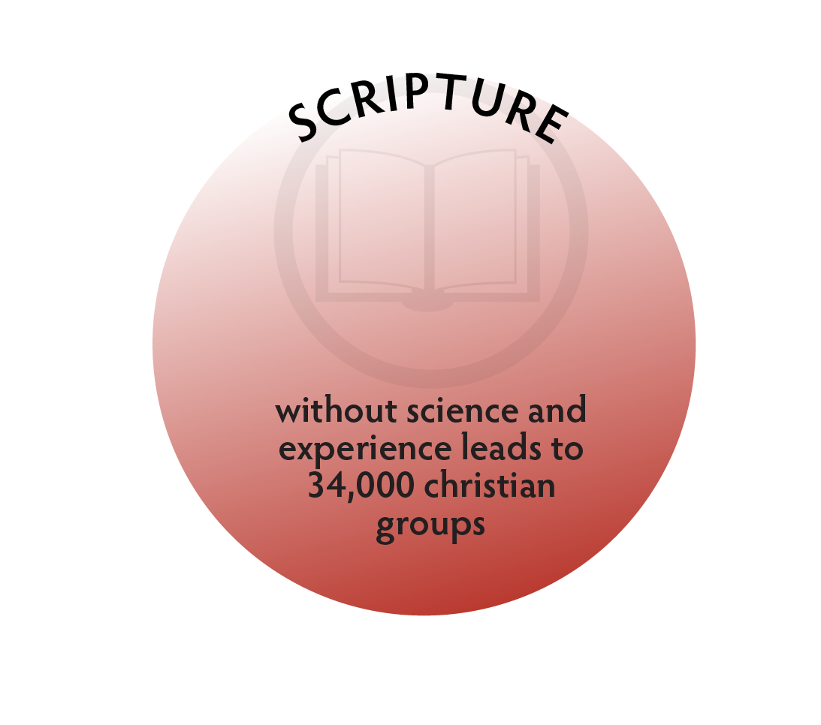
Immaturity is Sola Scriptura
God said it, I believe it, that settles it.

Slide 198
Immaturity is Sola Scriptura
God said it, I believe it, that settles it.
Thoughtless adherence to a rules-focused religion.

Slide 199
Immaturity is Sola Scriptura
God said it, I believe it, that settles it.
Thoughtless adherence to a rules-focused religion.
Inability to integrate Scripture into reality- based experiences and life principles.

Slide 200
Immaturity is Sola Scriptura
Cannot draw conclusions from evidence and require a declarative text or statement to believe.

Slide 201
Immaturity is Sola Scriptura
Cannot draw conclusions from evidence and require a declarative text or statement to believe.
Historically, those who refused to believe the world is round or not the center of the universe.

Slide 202
Immaturity is Sola Scriptura
Even though the Bible declares our need to mature, and demonstrates the progression through history of different levels, rejects this program because the 7 levels aren’t listed

Slide 203
What is Maturity?
Level five and above

Slide 204
What is Maturity?
Level five and above
Love / Other-Centered theologies, focus on:

Slide 205
What is Maturity?
Level five and above
Love / Other-Centered theologies, focus on:
Love for God and others

Slide 206
What is Maturity?
Level five and above
Love / Other-Centered theologies, focus on:
Love for God and others
Living in harmony with Design

Slide 207
What is Maturity?
Level five and above
Love / Other-Centered theologies, focus on:
Love for God and others
Living in harmony with Design
Fulfilling God’s purposes

Slide 209

Maturity Level 5
Love for others
Includes not only Scripture, but requires interpretations that harmonize with the experience of love

Slide 210
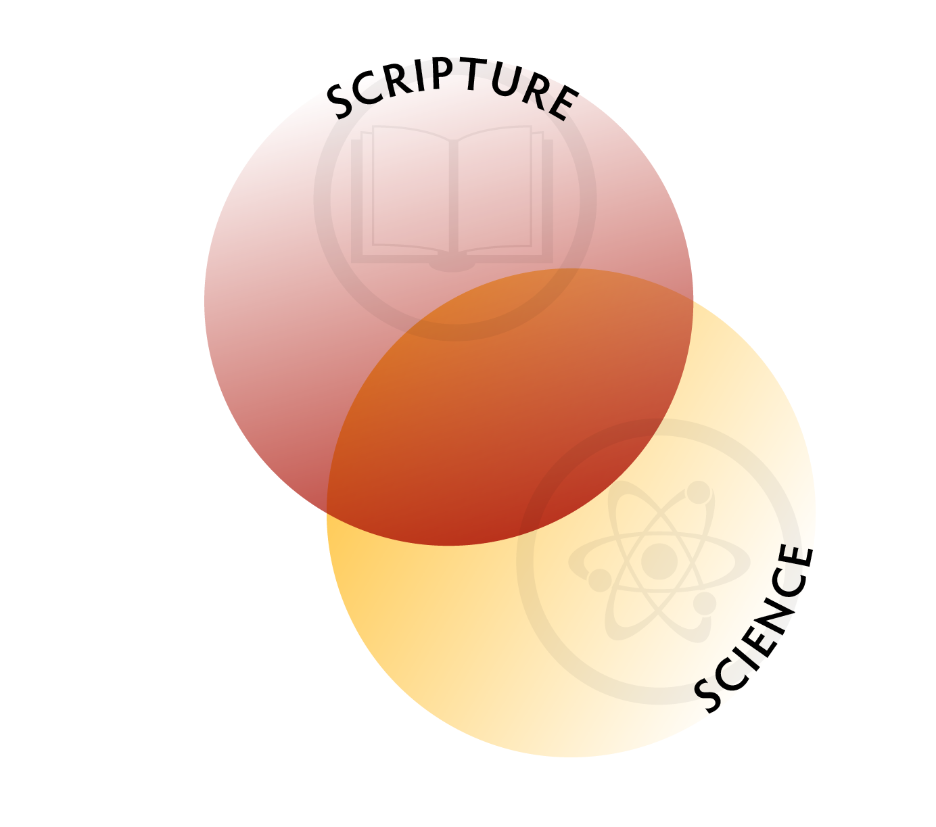
Maturity Level 6
Principle-based living
Includes not only Scripture, and love for others, but understands God’s design for life

Slide 211
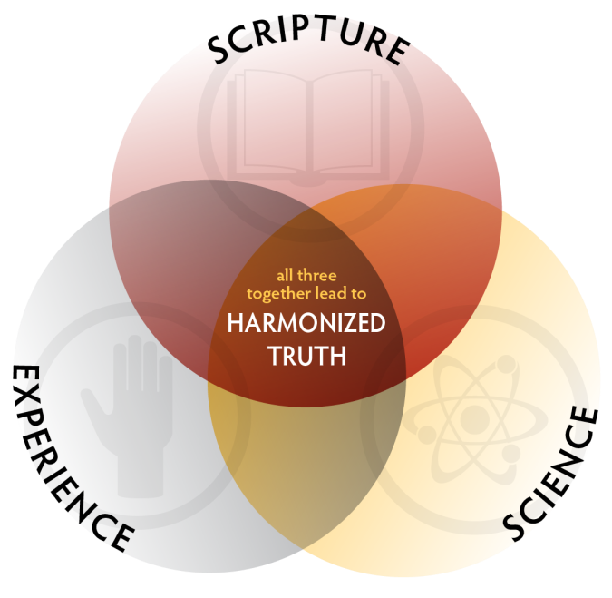
Maturity Level 7
Understanding God’s Purposes
Requires integration of Scripture, Science & Experience in the framework of the Great Controversy over God’s character

Slide 212
Historic View
The great storehouse of truth is the word of God—the written word, the book of nature, and the book of experience in God’s dealing with human life.
Christ’s Object Lessons, p. 125

Slide 213
Historic View
Jesus followed the divine plan of education... His education was gained directly from the Heaven-appointed sources; from useful work, from the study of the Scriptures and of nature, and from the experiences of life--God's lesson books.
Education, p. 77

Slide 214
Consider the Foods We Eat: How do you determine what is right or wrong to eat?
Level 1: God said it, I believe it, that settles it. God said don’t eat pork so we don't, because if we do God will punish.

Slide 215
Consider the Foods We Eat: How do you determine what is right or wrong to eat?
Level 1: God said it, I believe it, that settles it. God said don’t eat pork so we don't, because if we do God will punish.
Level 2: God promised if we eat the foods He tells us, He will keep us healthy, so we eat the foods He says and He will give us blessings.

Slide 216
Consider the Foods We Eat: How do you determine what is right or wrong to eat?
Level 3: Everyone in a culture agrees on what food God says is right to eat so we eat what everyone agrees is right. Orthodox Jews eat one thing, Muslims another, and Christians another.

Slide 217
Consider the Foods We Eat: How do you determine what is right or wrong to eat?
Level 3: Everyone in a culture agrees on what food God says is right to eat so we eat what everyone agrees is right. Orthodox Jews eat one thing, Muslims another, and Christians another.
Level 4: God has a law and His law prescribes what we eat. If we don’t follow the law, then justice requires we be punished.

Slide 218
Consider the Foods We Eat: How do you determine what is right or wrong to eat?
Level 5: We eat with concern for our weaker brother, not wanting to cause him to stumble and fall. We understand food offered to idols has the same nutritional quality, but if a brother would believe he is under the power of the idol for eating it, then we would refrain.

Slide 219
Consider the Foods We Eat: How do you determine what is right or wrong to eat?
Level 6: We understand God’s design for human life;
Just as we wouldn’t put water into the gas tank of our car because it wasn’t designed to run on water, we understand God didn’t design our bodies to run on certain foods.
While we know the ceremonial law was done away with at the cross, we also know the laws of health were not, thus we choose to move closer and closer to God’s design for the human being.

Slide 220
Consider the Foods We Eat: How do you determine what is right or wrong to eat?
Level 7: As friends of God we not only understand His original design for human physiology and thus don’t put things into the body He never intended.
We also understand our responsibility as stewards of God’s creation, to tend and protect it.

Slide 221
Consider the Foods We Eat: How do you determine what is right or wrong to eat?
Level 7: We understand that as God’s representatives on earth we treat lower life forms like Christ treats us; we protect them, we don’t exploit them for selfish benefit.
We do all we can to love God’s creatures and cause them as little harm as possible, moving ever closer to how we will live in the earth made new.

Slide 222
Sandi was torn, caught in conflicting emotions. She didn’t know what to do or where to turn. She went to her pastor.
Her pastor had had suspicions. Her quick glances to her deacon husband before answering questions, her half smiles in his presence and heavy make up. But her pastor had no idea the severity of the abuse.
Sandi taught grades one through three at the local denominational church school. She didn’t want to get her husband in trouble. She didn’t want to lose her marriage. She didn’t want people to find out how her husband beat her. But she knew she couldn’t go on like this.
When she finally told her pastor he immediately confronted her husband and in no uncertain terms told him this must stop. He admonished her husband to get help, to get counseling and encouraged Sandi to call the police if he hit her again. But no matter the pastor’s attempts, the abuse never stopped. So, after years of mistreatment, Sandi moved out and filed for divorce.
Her husband, hurt and angry, went to her church conference officials and complained that his wife was divorcing him without Biblical grounds. He argued she was unfit to teach in a Christian school for failing to uphold Bible standards on marriage, and the conference terminated her employment.

Slide 223
Moral Decision Making in the Real World
Sandi

Slide 224
Moral Decision Making in the Real World
Sandi
At what level was Sandi’s husband operating?

Slide 225
Moral Decision Making in the Real World
Sandi
At what level was Sandi’s husband operating?
Was Sandi’s decision to divorce right or wrong?

Slide 226
Moral Decision Making in the Real World
Sandi
At what level was Sandi’s husband operating?
Was Sandi’s decision to divorce right or wrong?
Did she have Biblical grounds?

Slide 227
Moral Decision Making in the Real World
Sandi
At what level was Sandi’s husband operating?
Was Sandi’s decision to divorce right or wrong?
Did she have Biblical grounds?
At what level were the conference officials operating – were they “right” or “wrong”?

Slide 228
Moral Decision Making in the Real World
Sandi
At what level was Sandi’s husband operating?
Was Sandi’s decision to divorce right or wrong?
Did she have Biblical grounds?
At what level were the conference officials operating – were they “right” or “wrong”?
Your answers reveal much about your developmental level.

Slide 229
Law of Love
Level 7 realizes God is love and built His universe to operate in harmony with Himself

Slide 230
Law of Love
Level 7 realizes God is love and built His universe to operate in harmony with Himself
Love is not self-seeking 1 Corinthians 13:5

Slide 231
Law of Love
Level 7 realizes God is love and built His universe to operate in harmony with Himself
Love is not self-seeking 1 Corinthians 13:5
Love gives – breathing

Slide 232
Law of Love
Level 7 realizes God is love and built His universe to operate in harmony with Himself
Love is not self-seeking 1 Corinthians 13:5
Love gives – breathing
Break the law in one point, break it in all points because all violations are failure to love

Slide 233
Law of Love
Level 7 realizes God is love and built His universe to operate in harmony with Himself
Love is not self-seeking 1 Corinthians 13:5
Love gives – breathing
Break the law in one point, break it in all points because all violations are failure to love
So beating your wife fails to love her, i.e. betrays her trust, which is adultery

Slide 234
Domestic Violence through the 7 Levels
Level 1 - Reward and Punishment
It isn’t wrong because he is stronger and as long as he isn’t punished for it, it is right. It is only wrong if it results in his being punished.

Slide 235
Domestic Violence through the 7 Levels
Level 2 - Marketplace Exchange
It isn’t wrong, it is just and proper to give a wife the beating she deserves when she doesn’t fulfill her side of the marital bargain. It would only be wrong if the husband beats her without proper cause.

Slide 236
Domestic Violence through the 7 Levels
Level 3 - Social Conformity
It is only wrong if my culture says it is wrong.

Slide 237
Domestic Violence through the 7 Levels
Level 4 - Law and Order
It isn’t wrong, because broken rules require punishment. God gave us rules and when they are broken, justice requires God punish. Jesus took our punishment, and if I want to be like God, I must punish my disobedient wife. This is how love teaches her to obey her husband.

Slide 238
Domestic Violence through the 7 Levels
Level 5 - Love for Others
It is wrong to beat your wife because it fails to love her, to treat her as a daughter of God, with value as a person.

Slide 239
Domestic Violence through the 7 Levels
Level 6 - Principle Based
It is wrong because it violates God’s design for life and love. It violates the law of liberty, one of God’s design protocols for healthy relationships. Love can only exist in an atmosphere of freedom.

Slide 240
Domestic Violence through the 7 Levels
Level 6 - Principle Based
It is wrong because it violates God’s design for life and love. It violates the law of liberty, one of God’s design protocols for healthy relationships. Love can only exist in an atmosphere of freedom.
Further, God designed husbands and wives as co-equals and husbands are to treat their wives as Christ treats the church, sacrificing himself for her.

Slide 241
Domestic Violence through the 7 Levels
Level 7 - Understand Friend of God
It is wrong because it not only violates God’s design.

Slide 242
Domestic Violence through the 7 Levels
Level 7 - Understand Friend of God
It is wrong because it not only violates God’s design.
It damages the mind, character, and conscience of the husband

Slide 243
Domestic Violence through the 7 Levels
Level 7 - Understand Friend of God
It is wrong because it not only violates God’s design.
It damages the mind, character, and conscience
of the husband
Destroys the individuality of the wife

Slide 244
Domestic Violence through the 7 Levels
Level 7 - Understand Friend of God
It is wrong because it not only violates God’s design.
It damages the mind, character, and conscience
of the husband
Destroys the individuality of the wife
Misrepresents God as dictatorial

Slide 245
Domestic Violence through the 7 Levels
Level 7 - Understand Friend of God
It is wrong because it not only violates God’s design.
Fails to understand the purpose in the creation of woman

Slide 246
Domestic Violence through the 7 Levels
Level 7 - Understand Friend of God
It is wrong because it not only violates God’s design.
Fails to understand the purpose in the creation of woman
Man was created in God’s image, and God said it is not good for man to be alone and a helper was made for him – a helper to do what?

Slide 247
Domestic Violence through the 7 Levels
Level 7 - Understand Friend of God
It is wrong because it not only violates God’s design.
Fails to understand the purpose in the creation of woman
Man was created in God’s image, and God said it is not good for man to be alone and a helper was made for him – a helper to do what?
To enter into the fullness of Godlike love

Slide 248
Why Did Christ have to Die?
The Atonement through the 7 Levels
Level 1 - Reward and Punishment
Because God said don’t do something, but they did and God got offended and responded with angry vengeance, taking the life of Jesus in our place.

Slide 249
Why Did Christ have to Die?
The Atonement through the 7 Levels
Level 2 - Marketplace Exchange
Because Satan now had rights to this earth and claimed the lives of the sons of Adam and daughters of Eve, and God struck a bargain with the devil to exchange the life of Christ for the life of humans.

Slide 250
Why Did Christ have to Die?
The Atonement through the 7 Levels
Level 3 - Social Conformity
Because everyone agrees sin must be punished, someone has to pay.

Slide 251
Why Did Christ have to Die?
The Atonement through the 7 Levels
Level 4 - Law and Order
To pay the legal penalty the law demanded and the heavenly judge imposed. The Law must be kept. Man broke the Law. Someone had to pay the penalty. Jesus paid that penalty. The integrity of the Law was maintained.

Slide 252
Why Did Christ have to Die?
The Atonement through the 7 Levels
Level 5 - Love for Others
Because He loved us too much to let us go and His death was the means to reach us with His love and restore us to trust in Him.

Slide 253
Why Did Christ have to Die?
The Atonement through the 7 Levels
Level 6 - Principle Based
It was the only means to fix what sin had done to God’s creation. When mankind sinned, they deviated from God’s design for life and their condition was terminal. Christ came to fix what sin did to this creation. Thus “he who knew no sin became sin for us so that we might become the righteousness of God.” 2 Corinthians 5:21

Slide 254
Why Did Christ have to Die?
The Atonement through the 7 Levels
Level 7 - Understanding Friend of God
Christ died to reveal truth to win us to trust (John 8:32), destroy death (2 Timothy 1:10), destroy sin and Satan (Hebrews 2:14), restore humanity back to God’s original ideal (1 John 3:8), and secure the universe unfallen in its innocence. “All things in heaven and in earth are reconciled to Christ at the cross.” (Colossians 1:20)

Slide 255
Why Did Christ have to Die?
The Atonement through the 7 Levels
Level 7 - Understanding Friend of God
Atonement is at-one-ment with God, having the law written on the heart, operating with the mind of Christ, partaking of the divine nature; restoring creation back to God’s original design.

Slide 256
Why Did Christ have to Die?
The Atonement through the 7 Levels
Level 7 - Understanding Friend of God
Doing right because it is right and right doing is pleasing to God.

Slide 257
Why Did Christ have to Die?
The Atonement through the 7 Levels
Level 7 - Understanding Friend of God
Doing right because it is right and right doing is pleasing to God.
Neither God, nor His law, defined as the eternal principles upon which He bases His government, change, but our understanding of His law changes, and the human species is changed to live in harmony with that law.

Slide 258
Why Did Christ have to Die?
The Atonement through the 7 Levels
Level 7 - Understanding Friend of God
We understand at this level that God speaks to people at each level of their understanding.

Slide 259
Why Did Christ have to Die?
The Atonement through the 7 Levels
Level 7 - Understanding Friend of God
We understand at this level that God speaks to people at each level of their understanding.
It is a mistake to stay stuck at earlier levels of understanding and refuse to mature, regardless of how valid and useful they were in their own context.

Slide 260
Conflict in Christianity
Level 4 people are anxious that the rules be kept

Slide 261
Conflict in Christianity
Level 4 people are anxious that the rules be kept
Level 4 are often in church adminstration – great concern for keeping rules, proper doctrinal definitions and protecting the institution

Slide 262
Conflict in Christianity
Levels 6 & 7 persons who want to discuss general principles are called "liberal”

Slide 263
Conflict in Christianity
Levels 6 & 7 persons who want to discuss general principles are called “liberal”
Level 5 people who seek to love others and show compasion to the “sinner” drug addict and homosexual, are seen as having loose standards by level 4 and below

Slide 264
Conflict in Christianity
Levels 6 & 7 persons may become very bored with legalistic sermons aimed at level 4, or with level 1, the fiery hell and damnation threats

Slide 265
Conflict in Christianity
Levels 6 & 7 persons may become very bored with legalistic sermons aimed at level 4, or with level 1, the fiery hell and damnation threats
Level 4 members feel threatened by questions which undermine their legal security or God as a dictator.

Slide 266
Conflict in Christianity
Some are attracted to level 2, the health wellness gospel: if you do the right rituals, keep the right rules then God will bless you, while others find such explanations fall short and get frustrated when they see bad things happen to good people

Slide 267
Growing Through the Stages
Growth through the levels is generally step wise

Slide 268
Growing Through the Stages
Growth through the levels is generally step wise
Distress that doesn’t fit one’s understanding motivates growth (rejoice in trials)

Slide 269
Growing Through the Stages
Growth through the levels is generally step wise
Distress that doesn’t fit one’s understanding motivates growth (rejoice in trials)
What matters is function, not explanation
Some individuals function at level 5 but explain theology at level 4

Slide 270
Growing Through the Stages
Can retain vestiges of previous levels
Law and order person could still demand vengeance, just via legal channels

Slide 271
Growing Through the Stages
Can retain vestiges of previous levels
Law and order person could still demand vengeance, just via legal channels
Can only understand one level beyond your current level

Slide 272
Growing Through the Stages
Can retain vestiges of previous levels
Law and order person could still demand vengeance, just via legal channels
Can only understand one level beyond your current level
Most people operate level 4 and below and persecute people operating at levels 5-7

Slide 273
The Groom and His Bride
Christ is returning for His Bride

Slide 274
The Groom and His Bride
Christ is returning for His Bride
But He is not coming back for a CHILD Bride – a Bride who lives in fear of the Groom…

Slide 275
The Groom and His Bride
Christ is returning for His Bride
But He is not coming back for a CHILD Bride – a Bride who lives in fear of the Groom…
He wants a mature Bride, one who has grown up and is ready to see Him face to face for we shall be like Him! 1 John 3:2

Slide 276
The Groom and His Bride
Christ is returning for His Bride
But He is not coming back for a CHILD Bride – a Bride who lives in fear of the Groom…
He wants a mature Bride, one who has grown up and is ready to see Him face to face for we shall be like Him! 1 John 3:2
I challenge you to leave the elementary teachings behind and move on to maturity!

