Slide 1
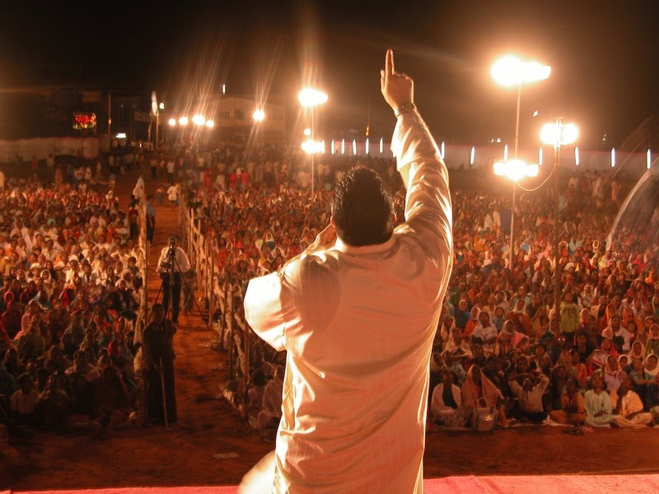
The
Gospel
COUNTERFEIT

Slide 2
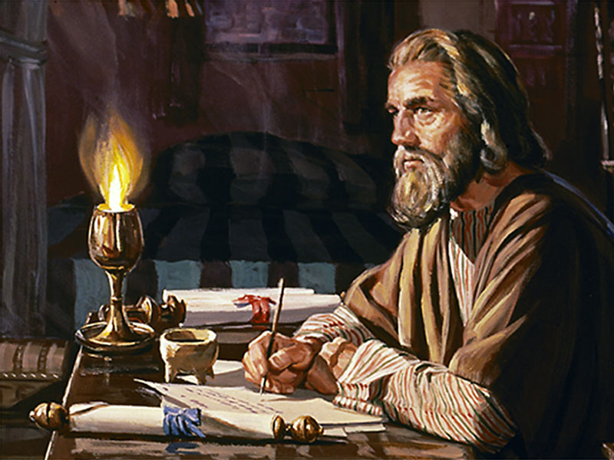
Romans 1:16 KJV
“For I am not ashamed of the gospel of Christ: for it is the power of God unto salvation to every one that believeth.”

Slide 3
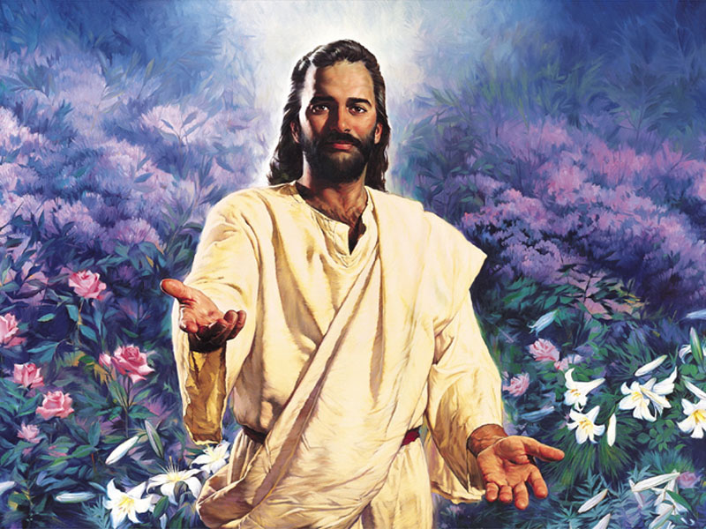
G
O
S
P
E
L
od
ur
aviour
resents
ternal
ife

Slide 4
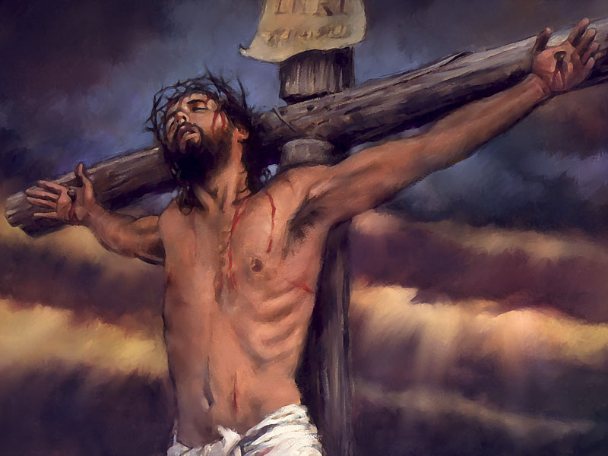
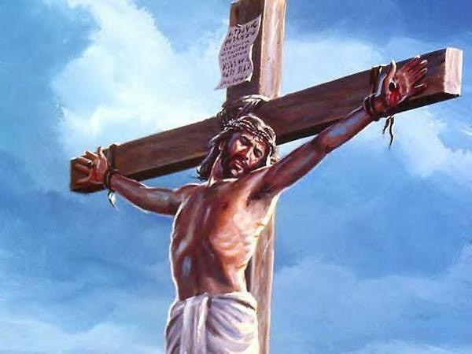
John 3:15 KJV
“That whosoever believeth in him should not perish, but have eternal life.”

Slide 5
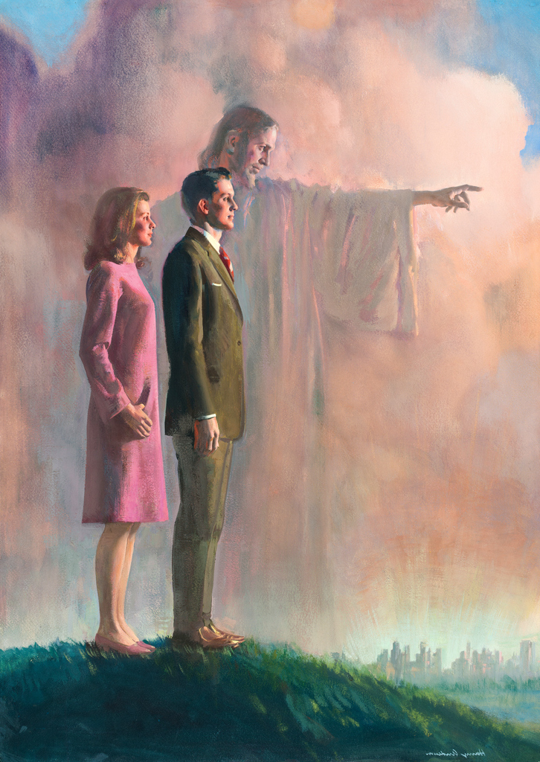
The Great Commission
Mark 16:15 KJV
“And he said unto them, Go ye into all the world, and preach the gospel to every creature.”

Slide 6
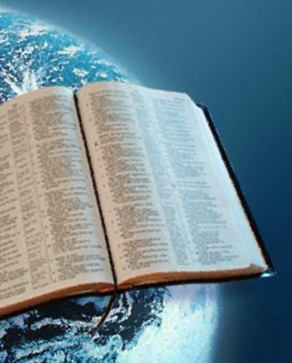
The Last Sign
Matthew 24:14 KJV
“And this gospel of the kingdom shall be preached in all the world for a witness unto all nations; and then shall the end come.”

Slide 7
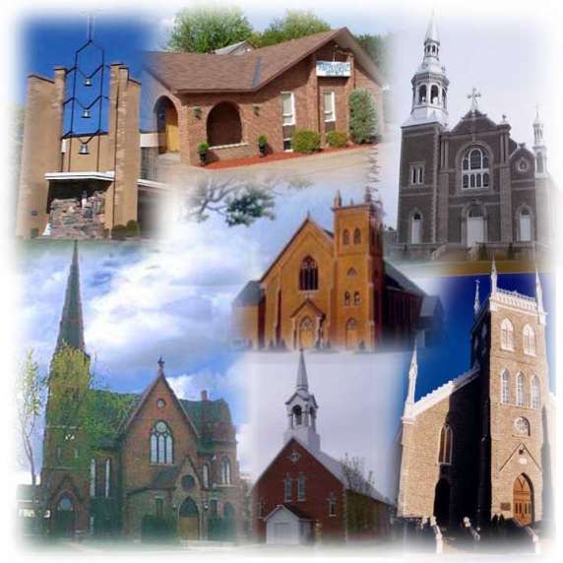
“There are approximately 38,000 Christian denominations in the world”
Christianity Today—General Statistics and Facts of Christianity

Slide 8
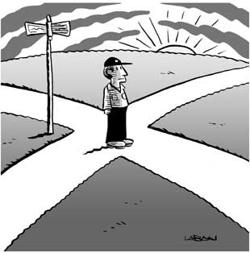
Each one is preaching
a different gospel!

Slide 9

Modern Christianity is called “Babylon” (Revelation 17: 5, 6) in the Bible. And Babylon means …
CONFUSION

Slide 10
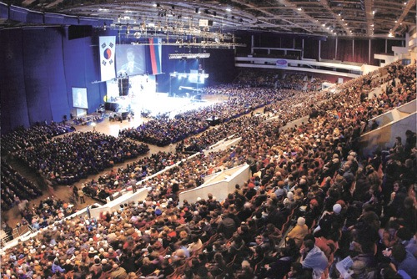
Matthew 24:11 KJV
“And many false prophets shall rise, and shall deceive many.”

Slide 11
Amidst all the false preaching of the gospel, Jesus promised that the true gospel will be preached as well.

Slide 12
Matthew 24:14 KJV
“And this gospel of the kingdom shall be preached in all the world for a witness unto all nations; and then shall the end come.”

Slide 13
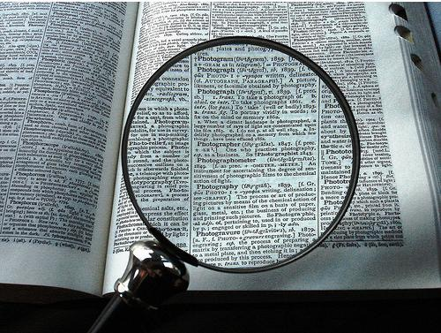
In the book of Revelation Jesus explains as to WHICH gospel is His gospel.

Slide 14
Matthew 24:14 KJV
“And this gospel of the kingdom shall be preached in all the world for a witness unto all nations; and then shall the end come.”
this gospel
preached
all
nations
Revelation 14:6 KJV
“And I saw another angel fly in the midst of heaven, having the everlasting gospel to preach unto them that dwell on the earth, and to every nation, and kindred, and tongue, and people”
the everlasting gospel
preach
every
nation

Slide 15
The everlasting gospel, which is the true gospel, according to the book of Revelation, is the gospel that is symbolically preached by the 3 angels.
The Three Angels’ Messages

Slide 16
First Angel’s
Message
Revelation14:7 KJV
“Saying with a loud voice, Fear God, and give glory to him; for the hour of his judgment is come: and worship him that made heaven, and earth, and the sea, and the fountains of waters.”

Slide 17
Second Angel’s
Message
Revelation14:8 KJV
“And there followed another angel, saying, Babylon is fallen, is fallen, that great city, because she made all nations drink of the wine of the wrath of her fornication.”

Slide 18
Third Angel’s
Message
Revelation14:9 KJV
“And the third angel followed them, saying with a loud voice, If any man worship the beast and his image, and receive his mark in his forehead, or in his hand…”

Slide 19
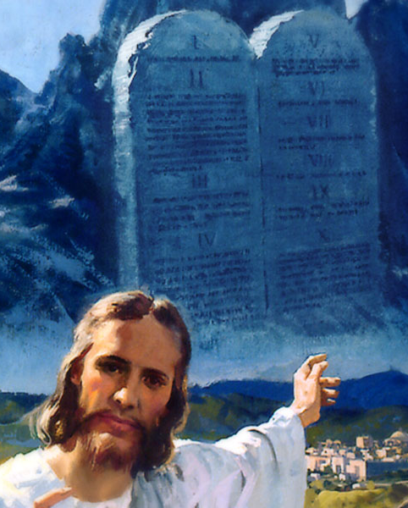
The RESULT of the Three Angels’ Messages
Revelation14:12 KJV
“Here is the patience of the saints: here are they that keep the commandments of God, and the faith of Jesus.”

Slide 20
The Culmination of
the Message
Matthew 24:14 KJV
“And this gospel of the kingdom shall be preached in all the world for a witness unto all nations; and then shall the end come.”

Slide 21
The Culmination of
the Message
Revelation 14:14 KJV
“And I looked, and behold a white cloud, and upon the cloud one sat like unto the Son of man, having on his head a golden crown, and in his hand a sharp sickle.”

Slide 22
Any gospel
that DOES NOT focus
on
“the faith of Jesus”
and the
“keeping of the commandments of God”
is a
COUNTERFEIT GOSPEL!

Slide 23
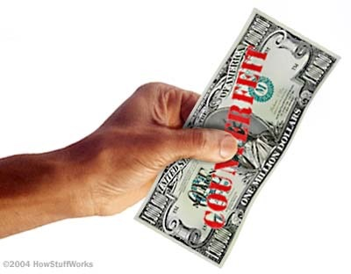
The True Gospel
COUNTERFEITED

Slide 24
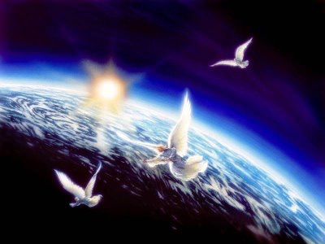

Revelation 14:6 KJV
“And I saw another angel fly in the midst of heaven, having the everlasting gospel to preach unto them that dwell on the earth, and to every nation, and kindred, and tongue, and people”
The True Gospel is called the
Three Angels’ Messages
These messages are coming
from heaven!

Slide 25
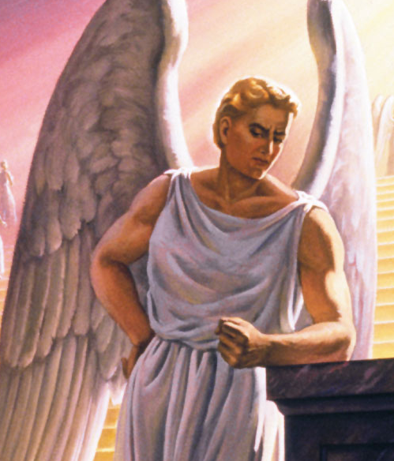
Satan COUNTERFEITS
the Three Angels’ Messages

Slide 26
Galatians 1:8 KJV KJV
“But though we, or an angel from heaven, preach any other gospel unto you than that which we have preached unto you, let him be accursed.”

Slide 27
Who is this angel from heaven?
2 Corinthians 11:14 KJV KJV
“And no marvel; for Satan himself is transformed into an angel of light.”

Slide 28
As The True Gospel Has 3 Distinct Messages
The False Gospel Has 3 Counterfeits As Well

Slide 29
Paul mentions the
Three Counterfeit
Gospel Messages

Slide 30

“pervert the gospel of Christ”
Galatians 1:7
“another gospel”
Galatians 1:6
“any other gospel” Galatians 1:8

Slide 31

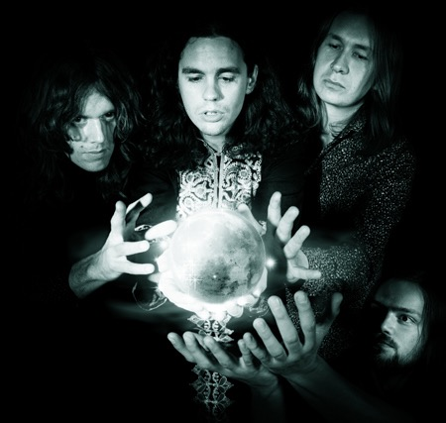
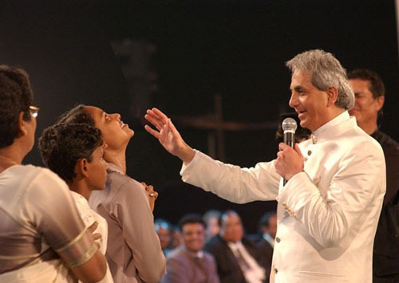
Revelation 16:13, 14 KJV
“And I saw three unclean spirits like frogs come out of the mouth of the dragon, and out of the mouth of the beast, and out of the mouth of the false prophet
Revelation specifies it
more clearly

Slide 32
People are attracted to the false gospels because of the MIRACLES performed in their midst.

Slide 33
Revelation 16:14 KJV KJV
“For they are the spirits of devils, working miracles, which go forth unto the kings of the earth and of the whole world, to gather them to the battle of that great day of God Almighty.”

Slide 34
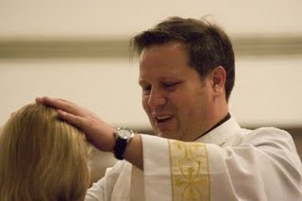
Matthew 24:24 KJV
“For there shall arise false Christs, and false prophets, and shall show great signs and wonders; insomuch that, if [it were] possible, they shall deceive the very elect.”

Slide 35
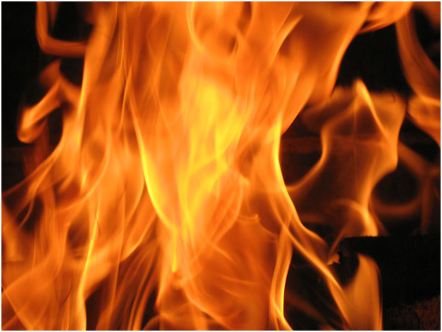
Revelation 13:13, 14 KJV
“And he doeth great wonders, so that he maketh fire come down from heaven on the earth in the sight of men, And deceiveth them that dwell on the earth by the means of those miracles which he had power to do.”

Slide 36
There is NO Salvation at all in believing the False gospels

Slide 37
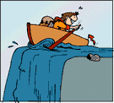
One might be sincerely following error. Our sincerity doesn’t save us. Truth saves us. To be sincerely following error is called deception. And to be deceived is to be lost eternally.

Slide 38
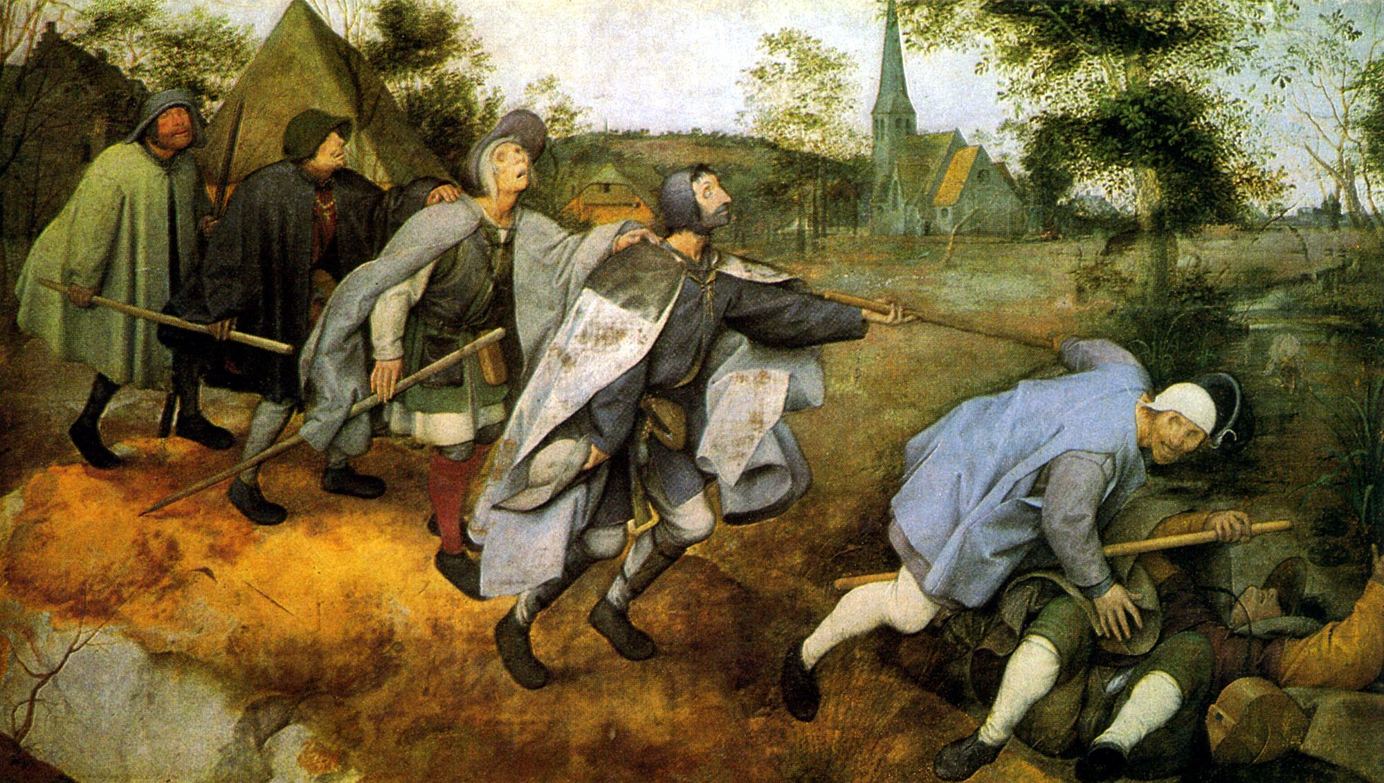
Matthew 15:14 KJV
“… And if the blind lead the blind, both shall fall into the ditch.”

Slide 39

Matthew 7:21 KJV
“Not every one that saith unto me, Lord, Lord, shall enter into the kingdom of heaven; but he that doeth the will of my Father which is in heaven.”

Slide 40
Matthew 7:22 KJV
“Many will say to me in that day, Lord, Lord, have we not prophesied in thy name? and in thy name have cast out devils? and in thy name done many wonderful works?”

Slide 41
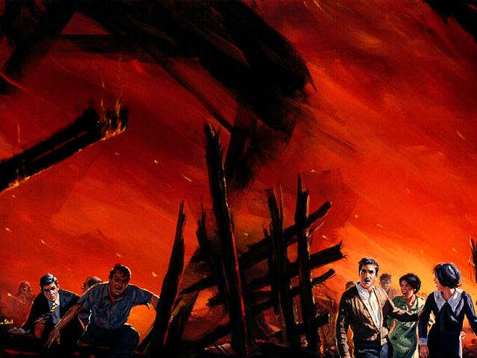
Matthew 7:23 KJV
“And then will I profess unto them, I never knew you: depart from me, ye that work iniquity.”

Slide 42
This will be the…
Biggest Shock ever!
Biggest Disappointment ever!

Slide 43

If we PREACH
the FALSE GOSPELS,
we shall be CURSED!

Slide 44
Galatians 1:9 KJV
“As we said before, so say I now again, If any man preach any other gospel unto you than that ye have received, let him be accursed.”

Slide 45
And if we DON’T PREACH
the TRUE GOSPEL
we will be CURSED too.

Slide 46
1 Corinthians 9:16 KJV
“… yea, woe is unto me,
if I preach not the gospel!”

Slide 47
Let us preach and believe and follow the true gospel and warn our loved ones who are believing and propagating a false gospel!

Slide 48
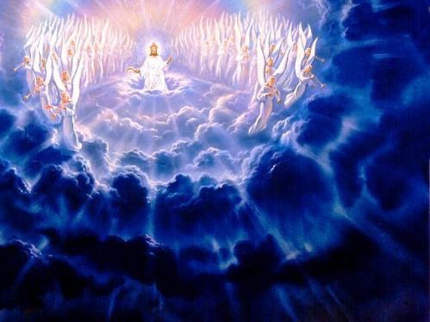
Matthew 24:14 KJV
“And this gospel of the kingdom shall be preached in all the world for a witness unto all nations; and then shall the end come.”

Slide 49
Adapted by Bob Plubell
Credited to ClearBibleAnswers.org

