Slide 1
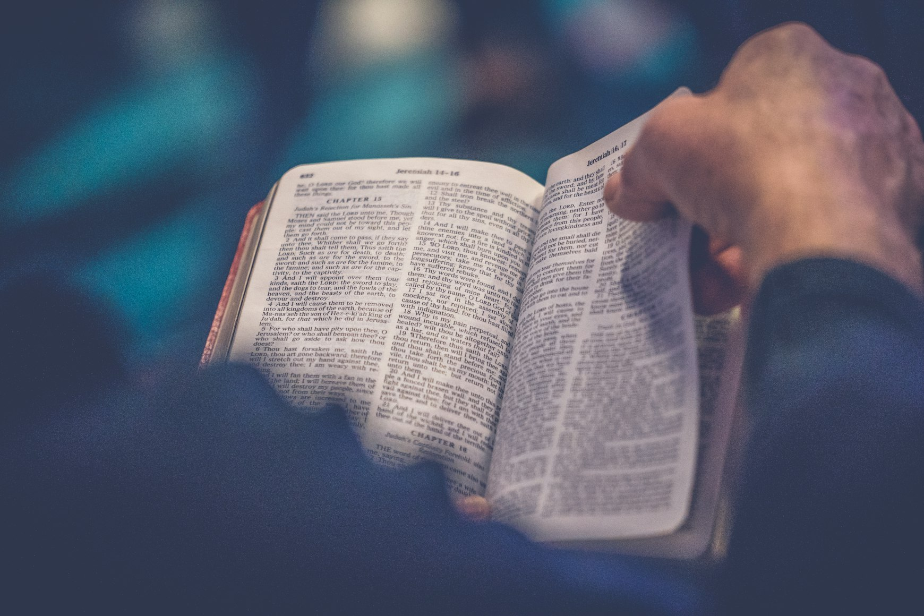
The Beatitudes
Matthew 5:1-10

Slide 2
Notes:
🎥 Scene 1 — Opening (Establish Time & Setting)
LONG-TIME-AGO (gesture far past)
BEFORE Jesus Christ BORN WHERE? → Bethlehem
ISRAEL PEOPLE GATHER WHERE? → Shechem VALLEY BEAUTIFUL
🎥 Scene 2 — The Proclamation
PRIESTS STAND MOUNTAIN BOTH-SIDES
VOICES LOUD PROCLAIM:
IF OBEY GOD → BLESSING
IF DISOBEY → CURSE
🎥 Scene 3 — Mount Gerizim Identified
ONE MOUNTAIN NAME → Mount Gerizim
MEANING → “BLESSING MOUNTAIN”
🎥 Scene 4 — The Shift (Important Turning Point)
BUT… (pause, shift body)
THAT NOT FINAL / NOT TRUE COMPLETE BLESSING
ISRAEL FAIL → NOT REACH GOD STANDARD
🎥 Scene 5 — Need for a Greater Leader
JOSHUA NOT ENOUGH
NEED SOMEONE ELSE (emphasize)
WHO? → Jesus Christ
HE LEAD PEOPLE → TRUE REST, TRUE FAITH

Slide 3
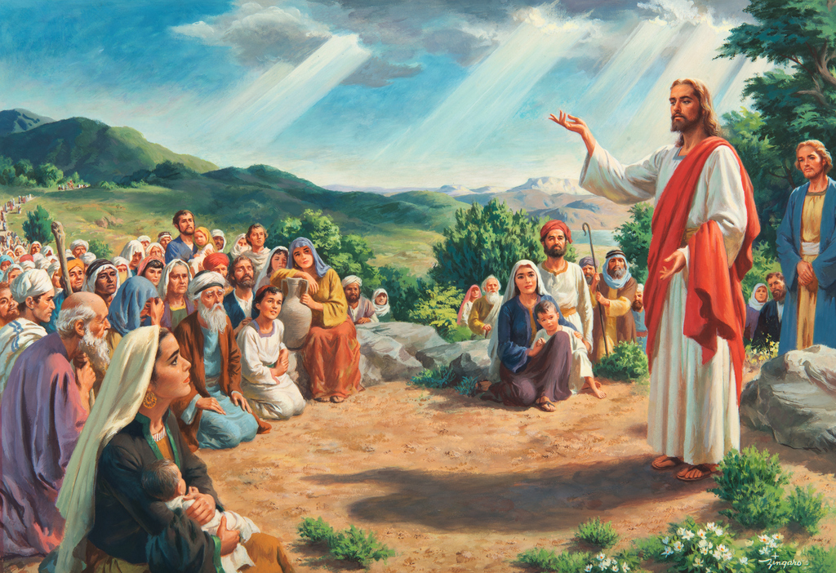
Notes:
🎥 Scene 6 — New Mountain (Climax)
NOT GERIZIM
NEW PLACE → NEAR Sea of Galilee
MOUNTAIN (unnamed)
THERE → JESUS SPEAK:
BLESSING
HOPE
TO DISCIPLES + MANY PEOPLE
🎥 Scene 7 — Closing Meaning
TRUE BLESSING NOT PLACE
TRUE BLESSING → JESUS MESSAGE
FOR SIN, SORROW WORLD → HOPE

Slide 4
Matthew 5:1-2 ESV
¹ Seeing the crowds, he went up on the mountain, and when he sat down, his disciples came to him.
² And He opened His mouth and taught them, saying:

Slide 5
Matthew 5:3 ESV
“Blessed are the poor in spirit,
for theirs is the kingdom of heaven.”

Slide 6
A New Kind of Teaching
The people heard something new and surprising
Jesus did not praise pride or self-importance
His words were:
    Gentle
    Refreshing
    Full of love
“Like rain upon the mown grass”

Slide 7
Jesus Understands the Heart
People felt Jesus truly understood them
He was kind and caring
Their hearts began to open
The Holy Spirit helped them learn truth

Slide 8
Two Different Attitudes
Proud Leaders:
  Thought they were spiritually rich
  Example: Pharisee (Luke 18:11)
Humble People:
  Felt their need
  Example: Peter (Luke 5:8)
  “I am a sinful man”

Slide 9
The Danger of Pride
  Those who think they are “rich” often:
      Do not seek Jesus
      Turn away from Him
  Pride closes the heart
  Feeling “full” leads to being empty

Slide 10
First Blessing
Matthew 5:3

Slide 11
Matthew 5:3 ESV
“Blessed are the poor in spirit,
for theirs is the kingdom of heaven.”

Slide 12
Blessed Are the Poor in Spirit
  Those who know they need help
  Those who cannot save themselves
  Jesus says:
      They are blessed
      They are ready to receive Him

Slide 13
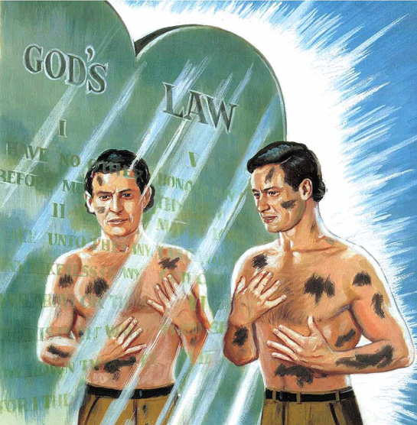
True Repentance
  Jesus helps us see our sin
  The Holy Spirit shows what is wrong
  Example prayer:
      “God, be merciful to me a sinner” (Luke 18:13)

Slide 14
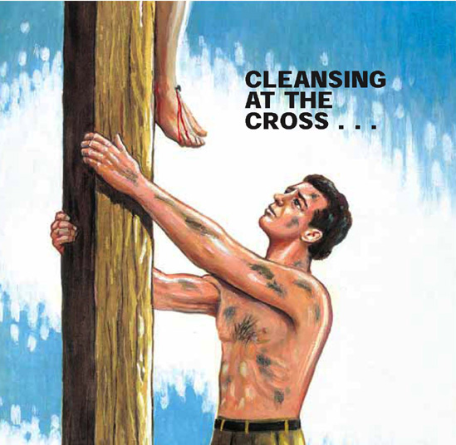
The Gift of Forgiveness
  Jesus forgives and cleanses
  “Lamb of God… takes away sin” (John 1:29)
  Promise:
      Sins made white (Isaiah 1:18)
      A new heart (Ezekiel 36:26–27)

Slide 15
The Kingdom of Heaven
  Not an earthly kingdom
  A spiritual kingdom
  Filled with:
      Love
      Grace
      Goodness
  People are:
      Humble
      Gentle
      Faithful

Slide 16
A Growing Change
  Change begins now
  Not yet complete
  Prepares us for:
      “Inheritance of the saints” (Colossians 1:12)

Slide 17
Jesus’ Invitation
  “Come unto Me…” (Matthew 11:28)
  Trade:
      Our weakness → His strength
  Come just as you are

Slide 18
Christ Our Defender
  Jesus stands for us before the Father
  He took the sinner’s place
  His sacrifice speaks louder than accusations

Slide 19
Our Righteousness in God
  “In the Lord have I righteousness and strength” (Isaiah 45:24–25)
  We are:
      Justified
      Made strong through Him

Slide 20
Closing Thoughts
  Pride closes the heart
  Humility opens it
  Those who feel their need:
      Receive grace
      Receive forgiveness
      Receive the kingdom

