Slide 1
The Path Back to God
Forgiveness → Repentance → Reconciliation

Slide 2
The Path Back to God
Three Critical Components of Restoration
Forgiveness → Repentance → Reconciliation
God does not merely want to remove our guilt.
He wants to restore our relationship with Him.

Slide 3
The Problem: Sin Breaks the Relationship
Sin creates separation.
Sin produces guilt.
Sin damages our relationship with God.
Sin creates a need for restoration.

Slide 4
Isaiah 59:2 EASY
But the wrong things that you have done
have made you separate from your God.
Your sins have caused him to turn away from you,
so that he does not listen to your prayers.

Slide 5
The question is …
How does God bring us back?

Slide 6
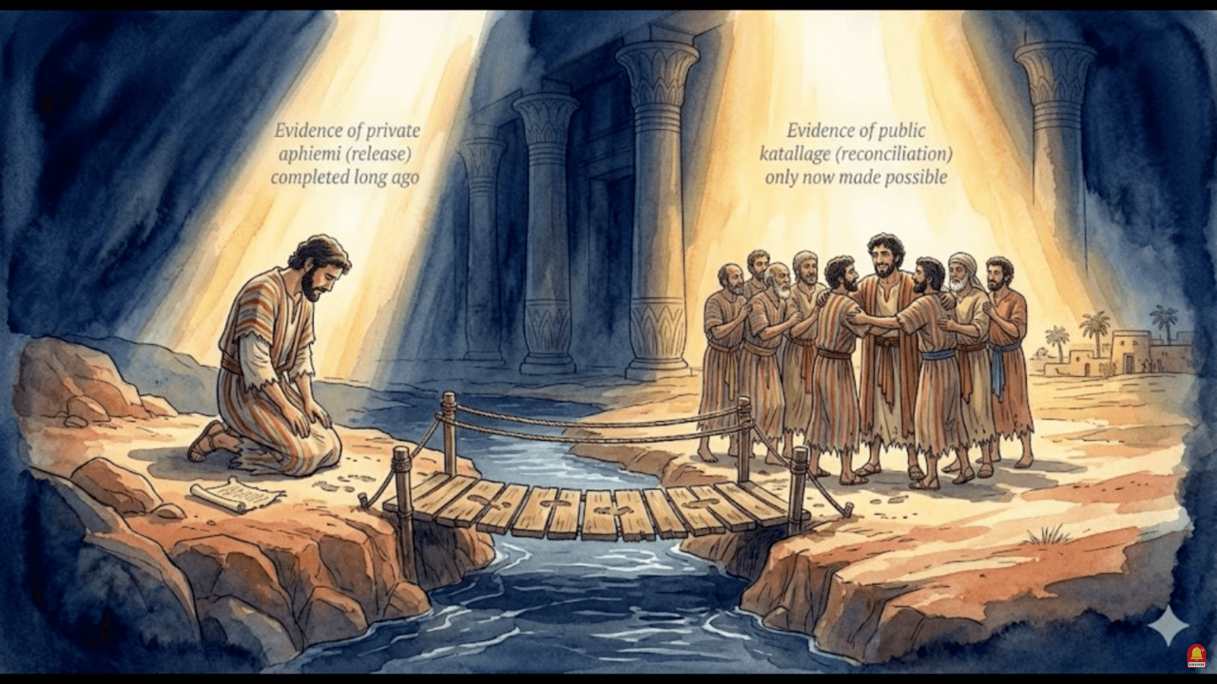

Slide 7
Three Critical Components
FORGIVENESS
God removes the guilt of sin.
↓
REPENTANCE
We turn away from sin and turn toward God.
↓
RECONCILIATION
The broken relationship is restored.

Slide 8
Forgiveness deals with the guilt.
Repentance deals with the direction.
Reconciliation deals with the relationship.

Slide 9
PART 1
FORGIVENESS

Slide 10
What is Forgiveness?
Forgiveness means releasing a person from the guilt and debt of an offense.
Biblical forgiveness involves:
God no longer holding our sin against us.
The debt of sin being dealt with.
The sinner receiving mercy instead of condemnation.

Slide 11
Psalm 103:12 EASY
How far is the east from the west?
The Lord has taken our sins further away than that!
He no longer says that we are guilty.

Slide 12
Forgiveness says …
“Your sin does not have to
remain your permanent record.”

Slide 13
The Action of Forgiveness
Forgiveness is not pretending that sin never happened.
It is dealing with sin without allowing it to have the final word.
God's action:
He provides forgiveness.
He removes guilt.
He offers mercy.
He restores our standing before Him.
Our response:
Receive God's forgiveness.
Confess our sin.
Trust God's promise.

Slide 14
1 John 1:9 NKJV
If we confess our sins, He is faithful and just to forgive us our sins and to cleanse us from all unrighteousness.

Slide 15
1 John 1:9 EASY
Instead, we should agree that we have done wrong things and tell that to God. Then God will forgive us for our sins. He always does what he has promised to do. He always does what is right. He will forgive us and he will make us clean again, whatever bad things we may have done.

Slide 16
PART 2
REPENTANCE

Slide 17
What is Repentance?
Repentance is more than feeling sorry.
Repentance means:
Recognize → Turn → Return
Recognize — I acknowledge that I have gone the wrong way.
Turn — I turn away from the wrong direction.
Return — I turn back toward God.

Slide 18
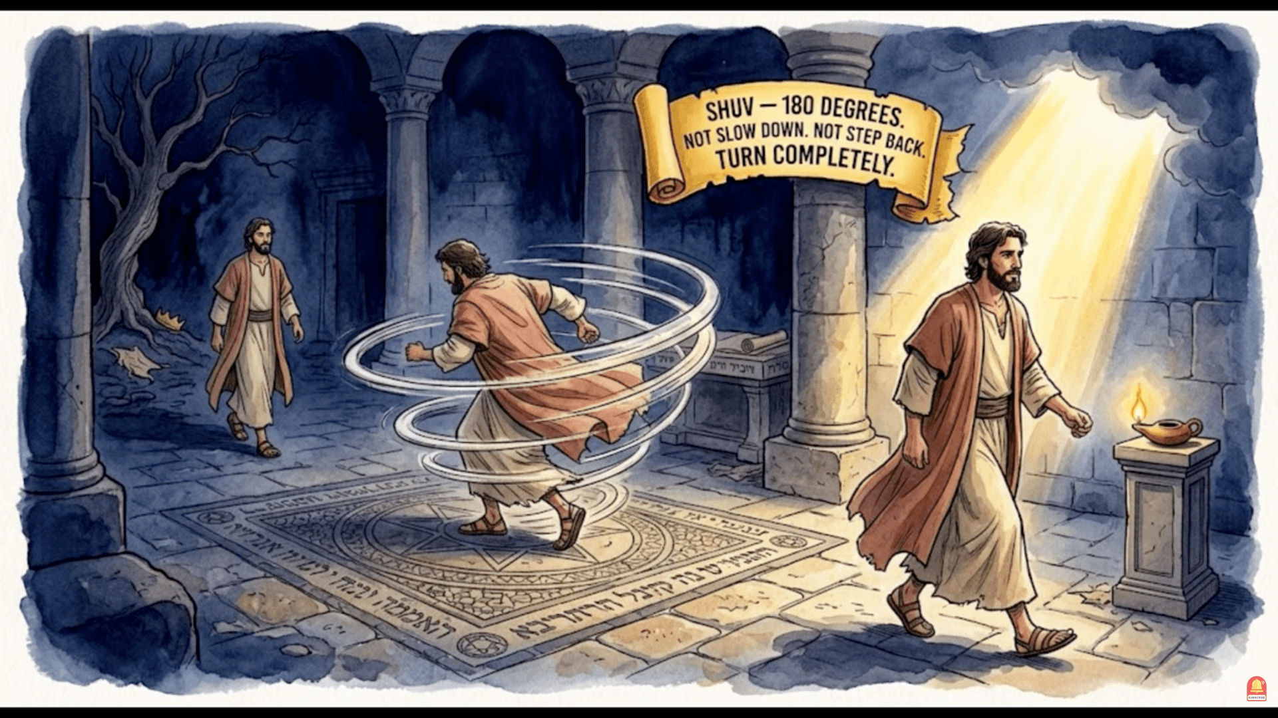

Slide 19
Repentance is a change of mind
that produces a change of direction.

Slide 20
The Action of Repentance
Forgiveness is not pretending that sin never happened.
It is dealing with sin without allowing it to have the final word.
God's action:
He provides forgiveness.
He removes guilt.
He offers mercy.
He restores our standing before Him.
Our response:
Receive God's forgiveness.
Confess our sin.
Trust God's promise.

Slide 21
Repentance requires action.
Not merely:
“I am sorry.”
But:
“I am turning around.”

Slide 22
Acts 3:19 NCV
So you must change your hearts and lives! Come back to God, and he will forgive your sins.

Slide 23
A repentant person asks:
What must I leave behind?
Where must I turn?
How can I walk with God again?

Slide 24
Forgiveness vs. Repentance
FORGIVENESS
Deals with guilt
Receives mercy
God releases the debt
“I am forgiven.”
Forgiveness removes the burden.
REPENTANCE
Deals with direction
Changes direction
We turn from sin
“I am turning back.”
Repentance changes the direction.

Slide 25
And both point toward something greater:
RELATIONSHIP RESTORED

Slide 26
PART 3
RECONCILIATION

Slide 27
What is Reconciliation?
Reconciliation means restoring a broken relationship.
It is more than having the debt removed.

Slide 28
Imagine two people who have been separated.
Forgiveness:
“The offense has been dealt with.”
Repentance:
“I turn away from what caused the separation.”
Reconciliation:
“We are together again.”

Slide 29
The Action of Reconciliation
Reconciliation brings relationship back to the center.
2 Corinthians 5:18 NKJV
Now all things are of God, who has reconciled us to Himself through Jesus Christ, and has given us the ministry of reconciliation.

Slide 30
2 Corinthians 5:18 NCV
All this is what God does for us. Because of what Christ has done, God has brought us back to himself, as his friends. Now he wants us to bring other people to be his friends too. That is the job that he has given to us.

Slide 31
God's purpose is not merely:
“Your sins are forgiven.”
It is also:
“Come home.”
The ultimate goal is restored fellowship with God.

Slide 32
The Prodigal Son: A Picture of Restoration
Luke 15
The story illustrates all three:

Slide 33
The Prodigal Son: A Picture of Restoration
FORGIVENESS
The father does not hold the son's past over him.
↓
REPENTANCE
The son recognizes his condition and gets up and goes home.
↓
RECONCILIATION
The father receives his son back into the family.

Slide 34
He was lost.
He was found.
He was home again.

Slide 35
The Complete Picture
FORGIVENESS
The guilt is removed.
↓
REPENTANCE
The direction is changed.
↓
RECONCILIATION
The relationship is restored.
God doesn't merely want to erase your past.
He wants to restore your relationship with Him.

Slide 36
The Cross Makes It Possible
At the center of all three is Jesus Christ.
The Cross deals with our sin.
Forgiveness — our guilt can be removed.
Repentance — our hearts can be changed.
Reconciliation — our relationship with God can be restored.

Slide 37
2 Corinthians 5:19 EASY
“God's message is this: By Christ's death, God was bringing people of the world back to himself, as his friends. He would no longer keep their sins in his thoughts. This is the message that God wants us to tell people.”

Slide 38
Final statement
Forgiveness removes the guilt.
Repentance changes the direction.
Reconciliation restores the relationship.

Slide 39
The Invitation
Where are you on the path?

Slide 40
The Invitation
Do you need forgiveness?
Receive God's mercy.

Slide 41
The Invitation
Do you need repentance?
Turn back to God.

Slide 42
The Invitation
Do you need reconciliation?
Come home.

Slide 43
The Invitation
God's goal is not simply to forgive you.
His goal is to bring you home.
Forgiven → Turned → Restored

Slide 45
REPENTANCE
PART 1

Slide 46
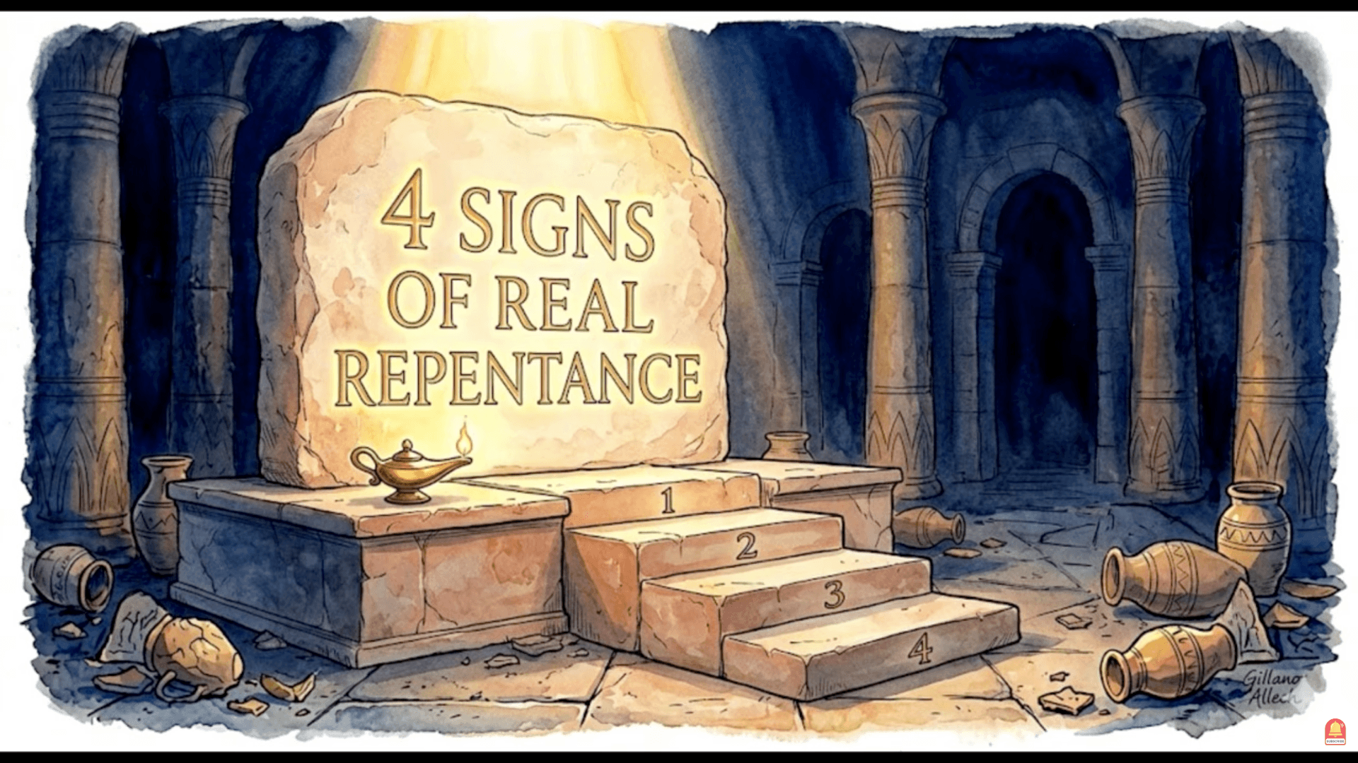

Slide 47
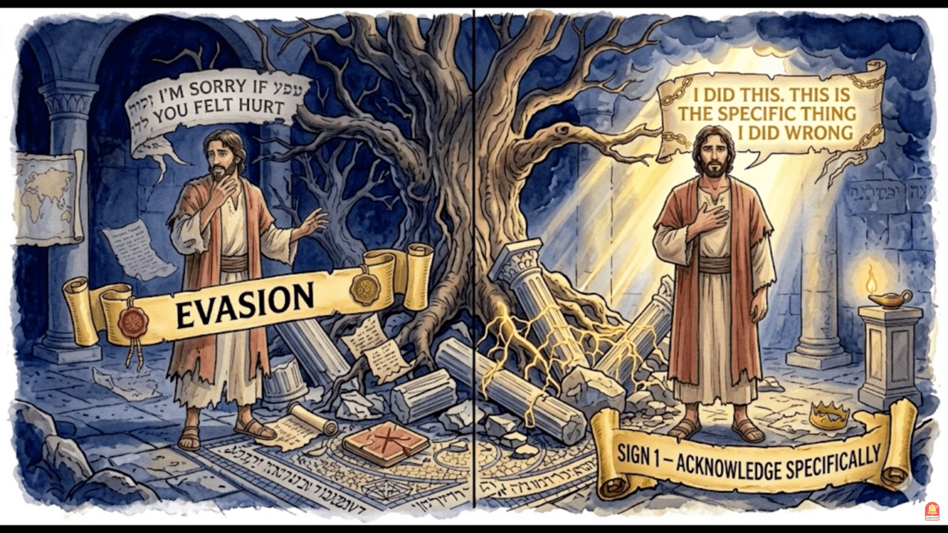

Slide 48
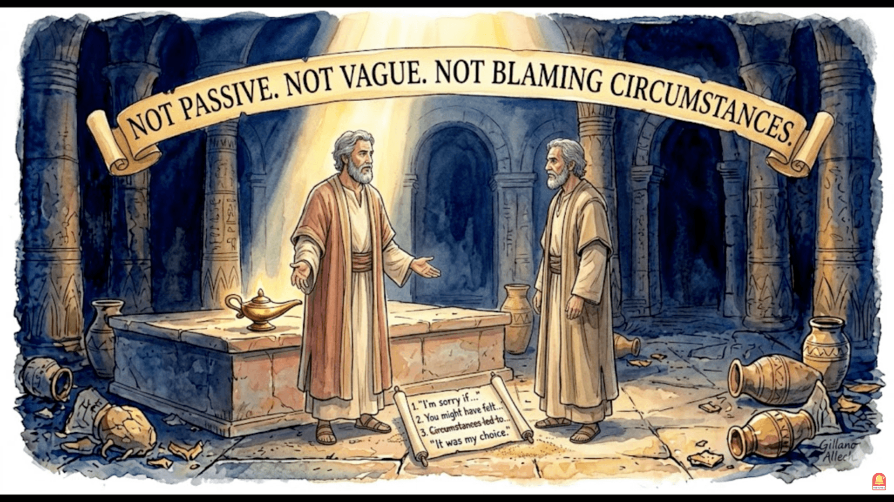

Slide 49
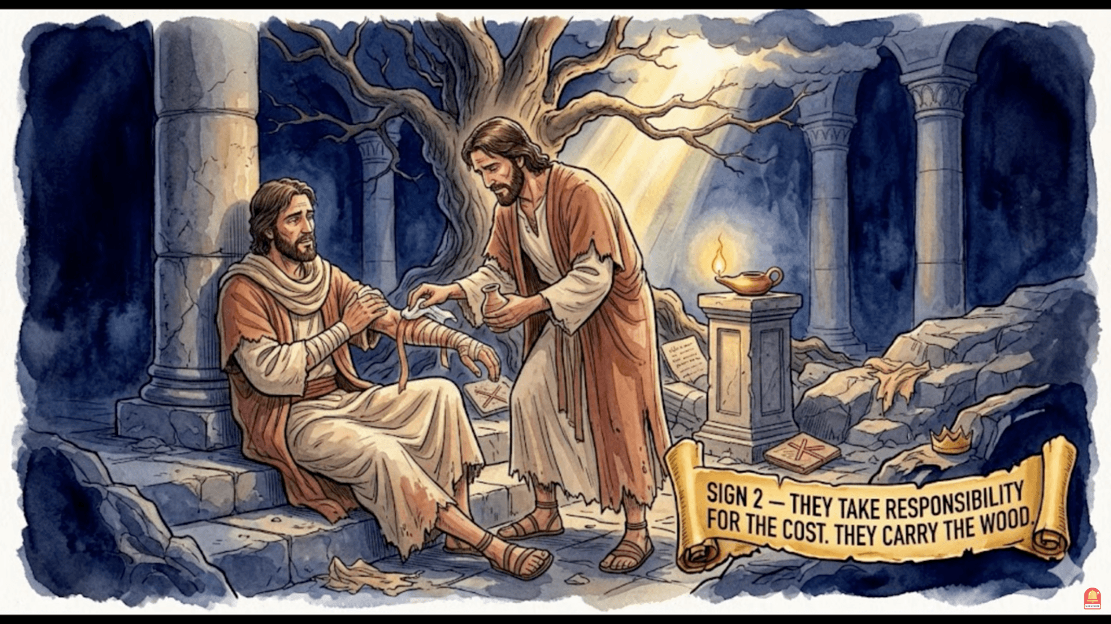

Slide 50
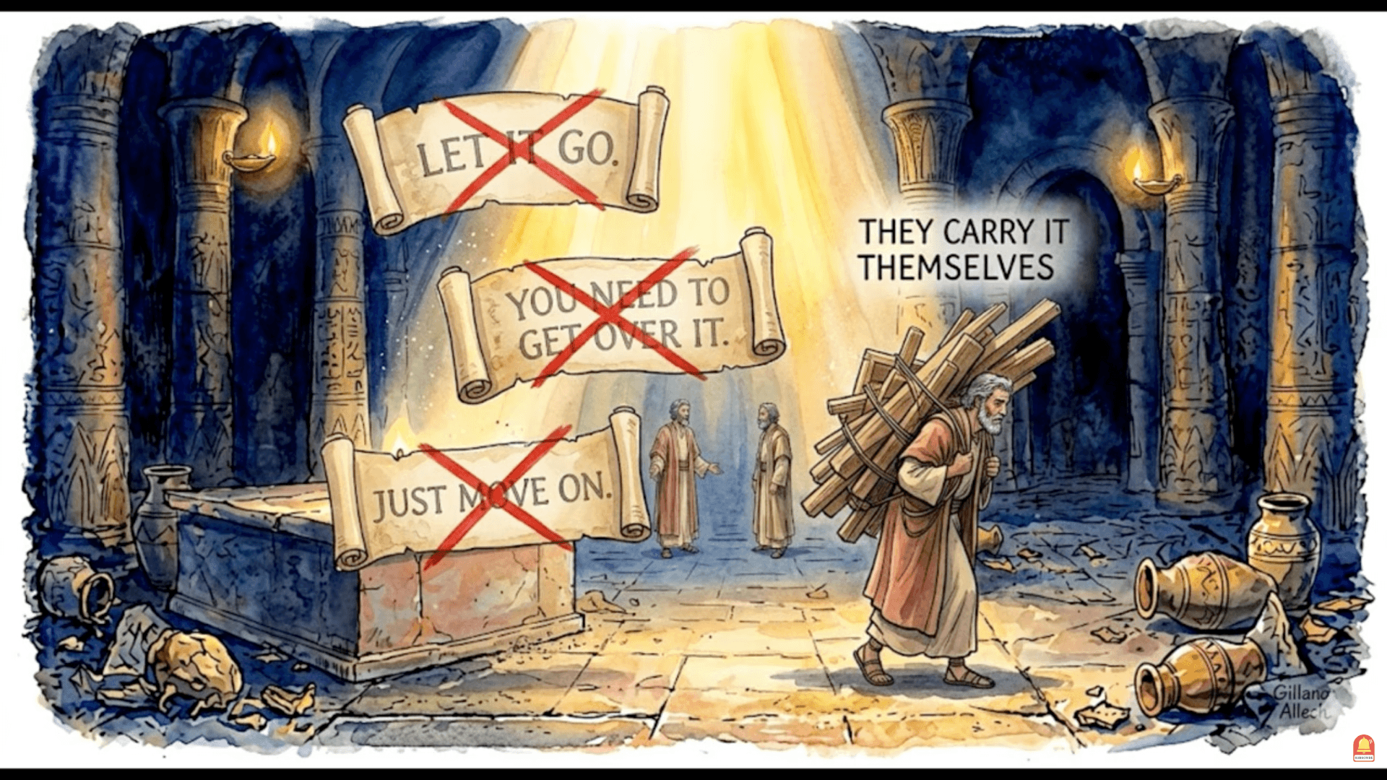

Slide 51
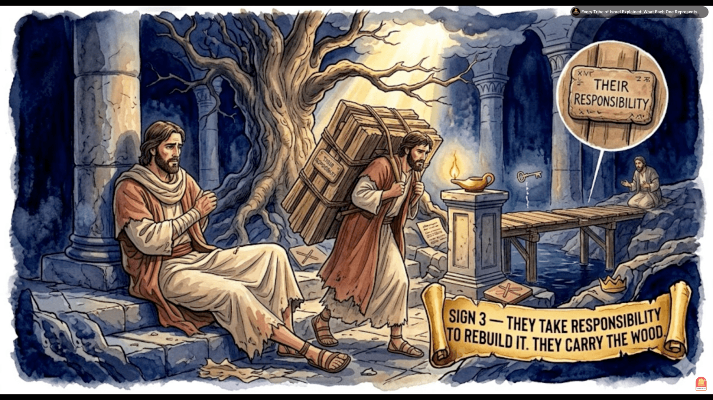

Slide 52
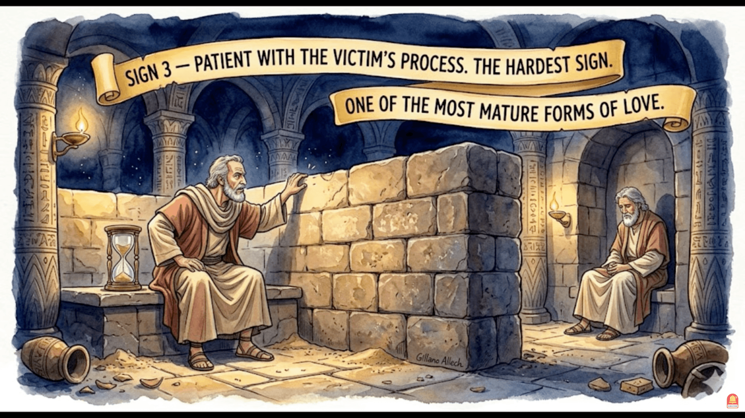

Slide 53
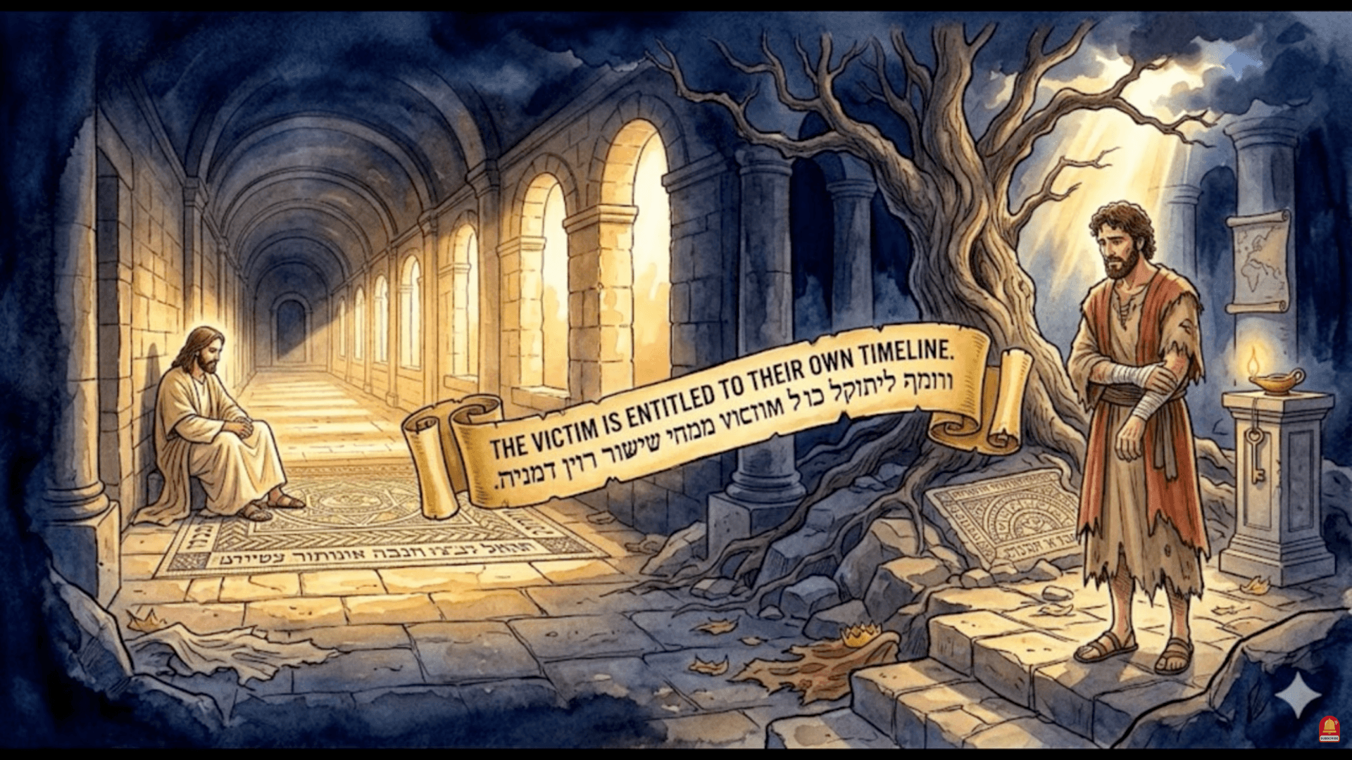

Slide 54
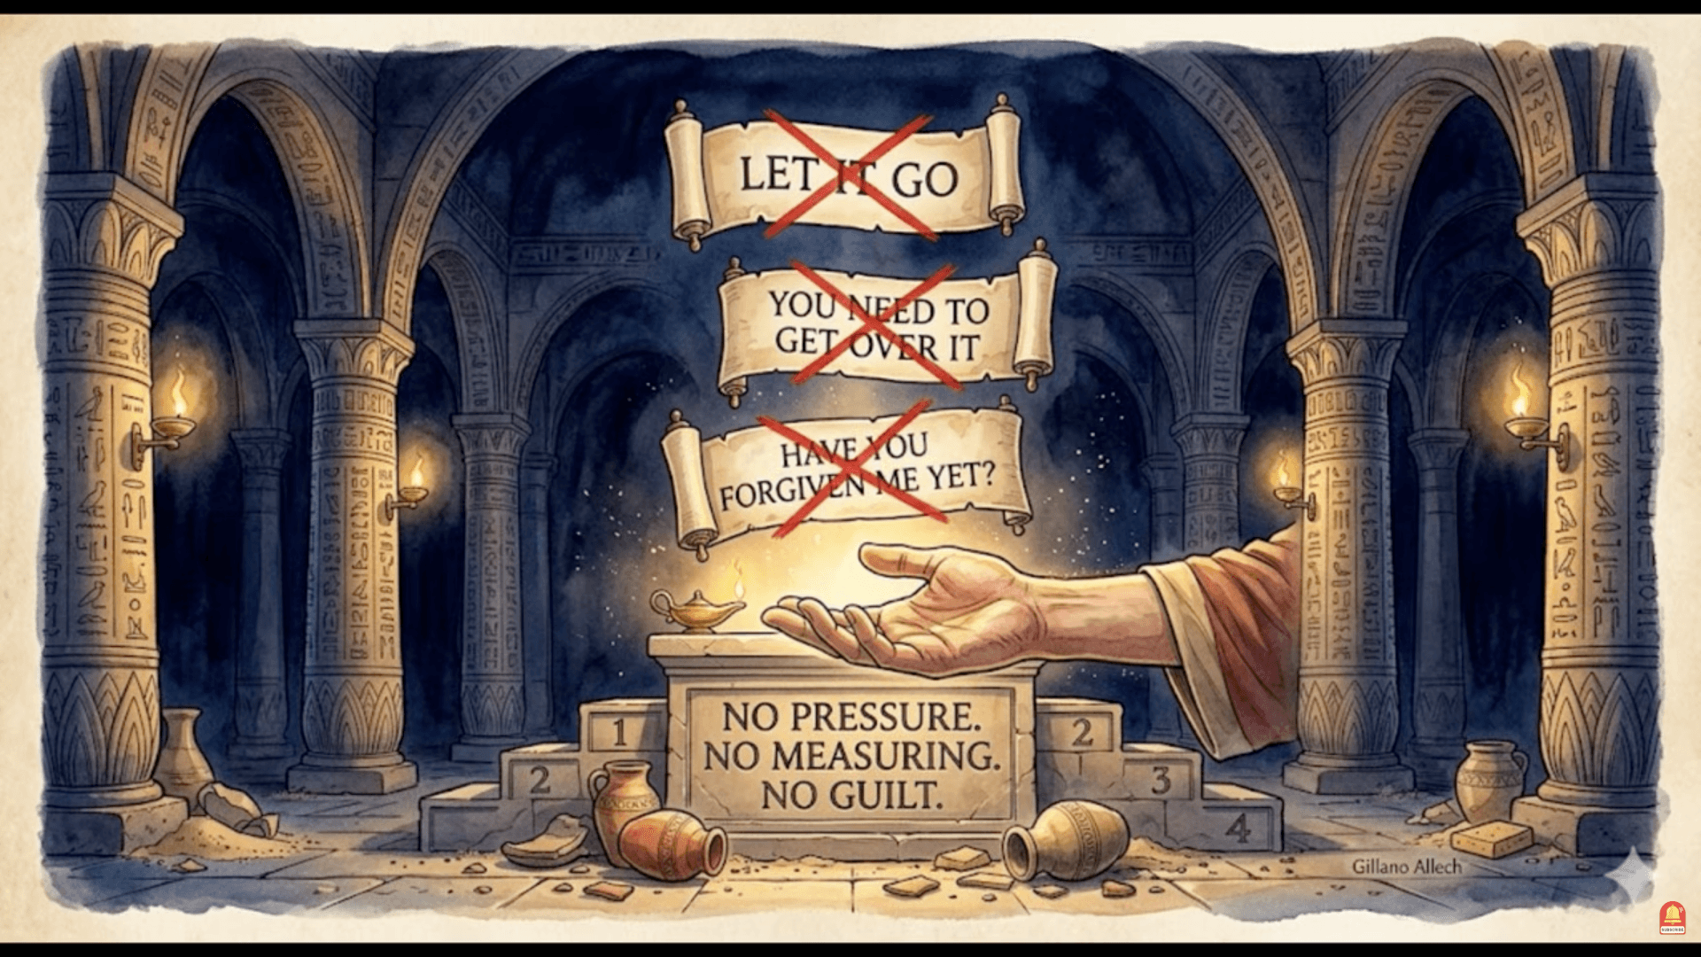

Slide 55
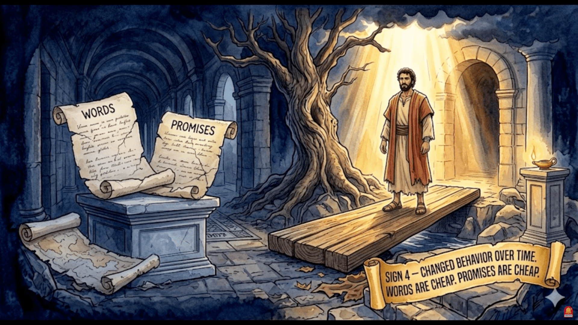

Slide 56
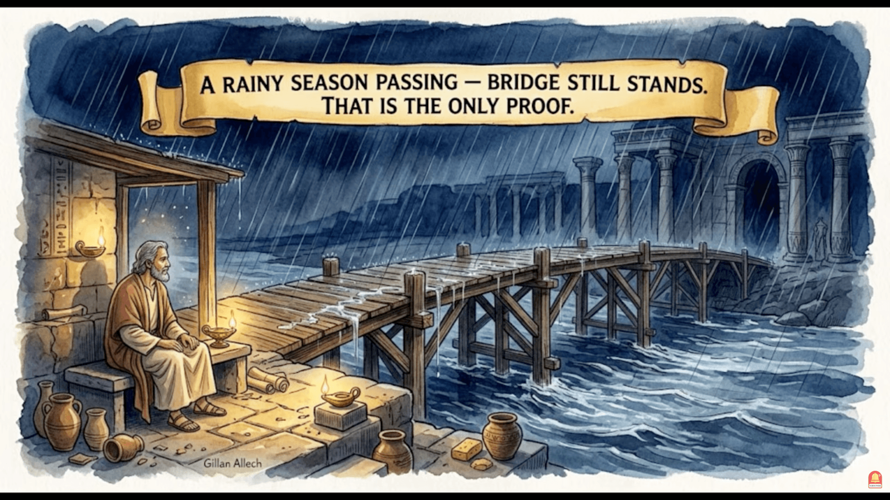

Slide 57
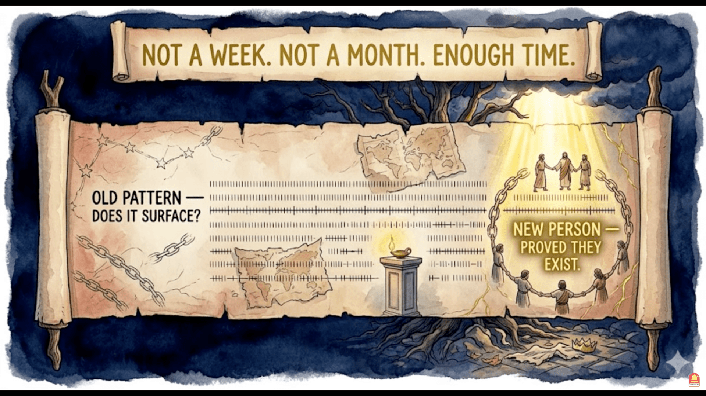

Slide 58
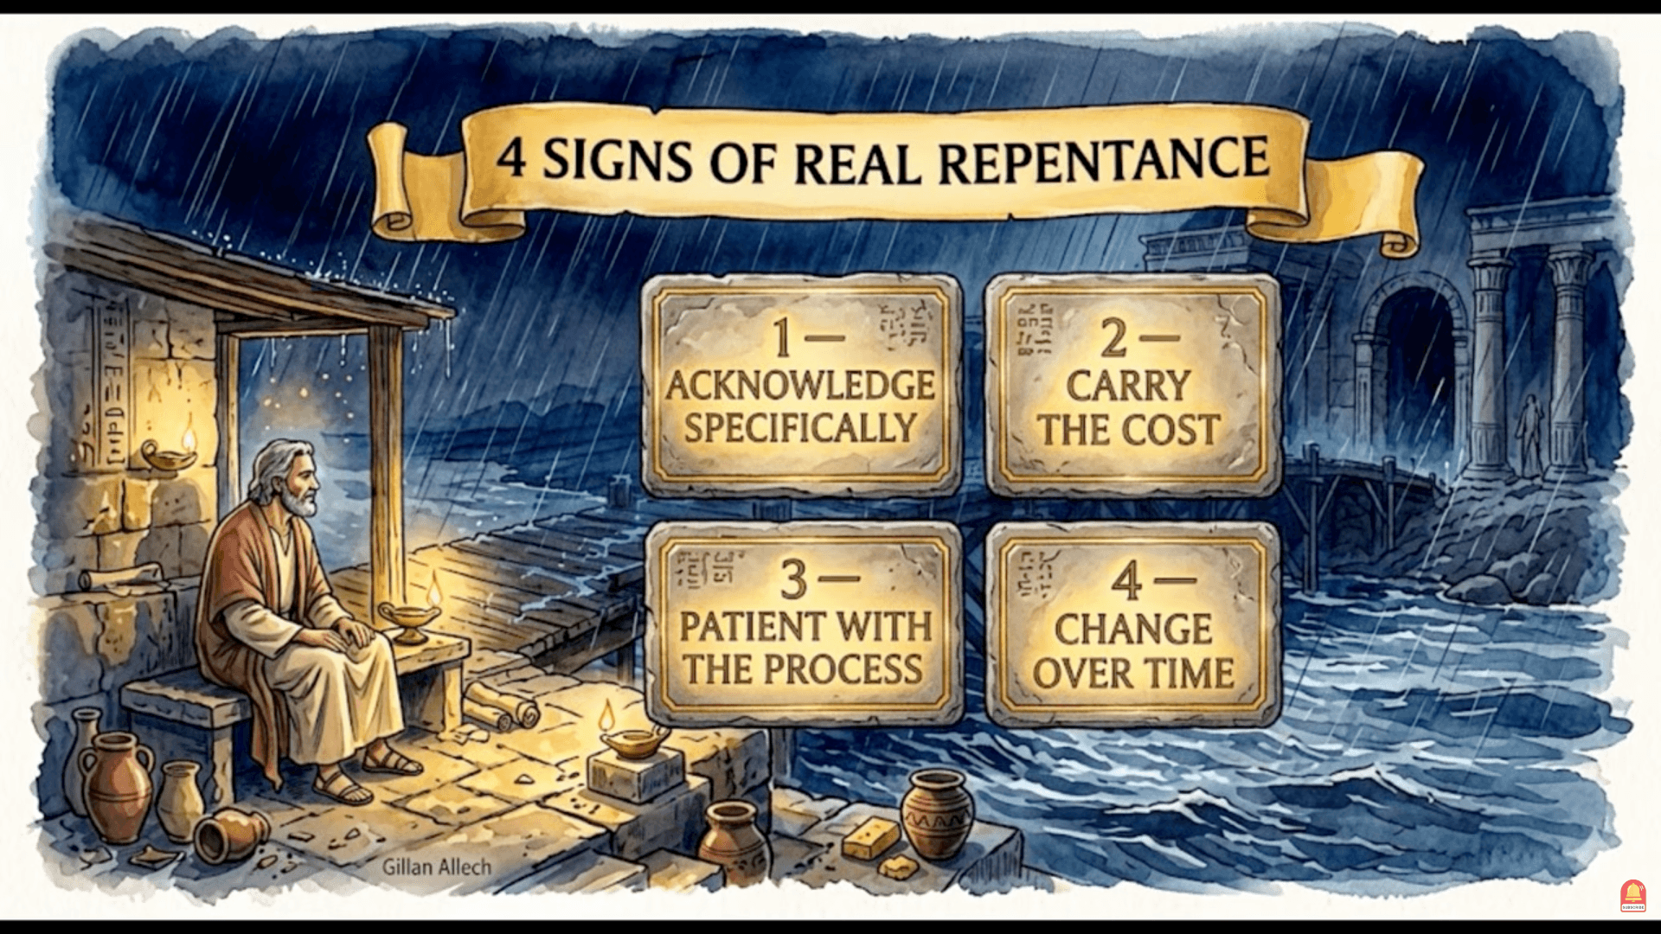

Slide 59
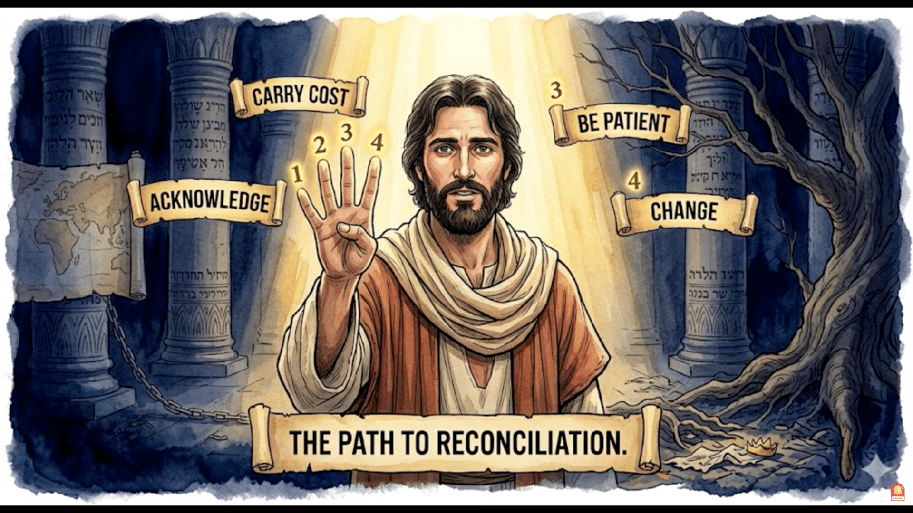

Slide 60
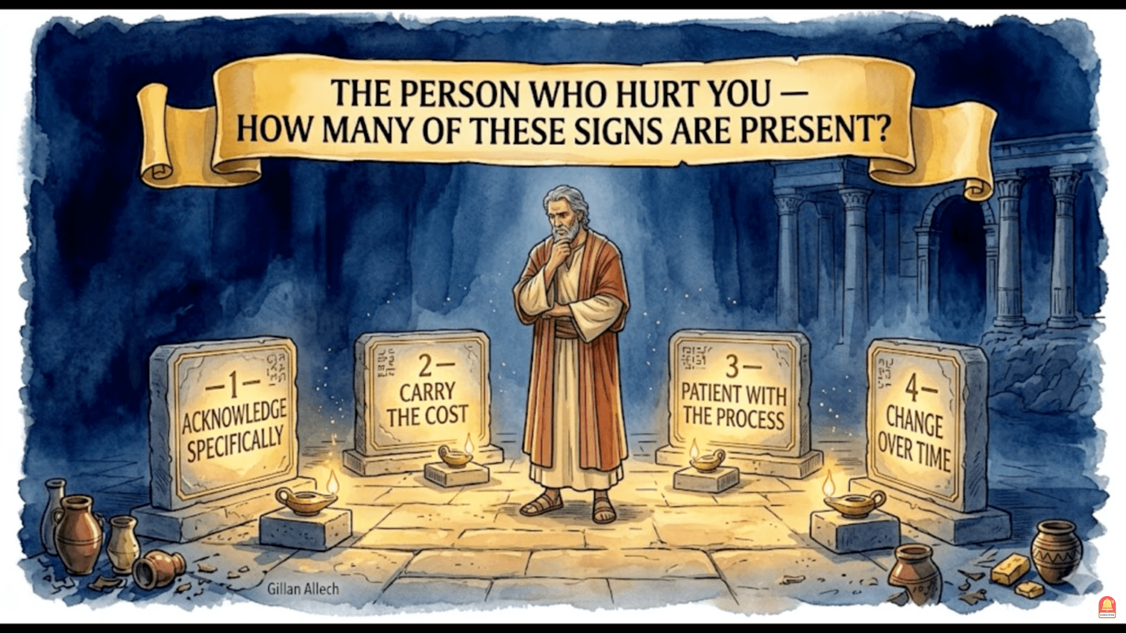

Slide 61
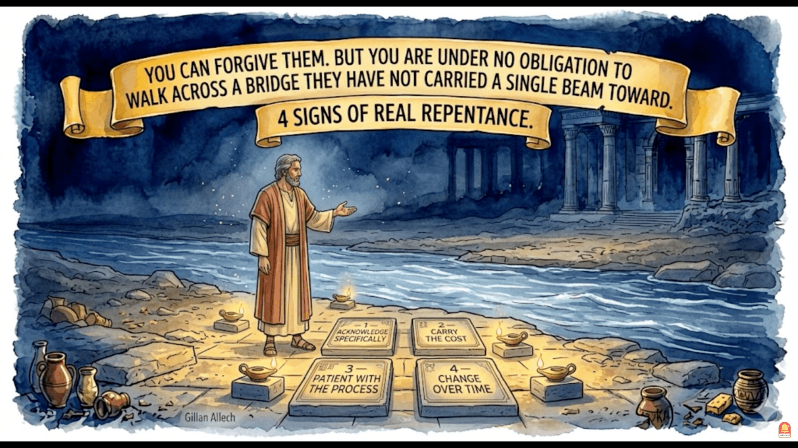

Slide 62
RECONCILIATION
PART 2

Slide 64
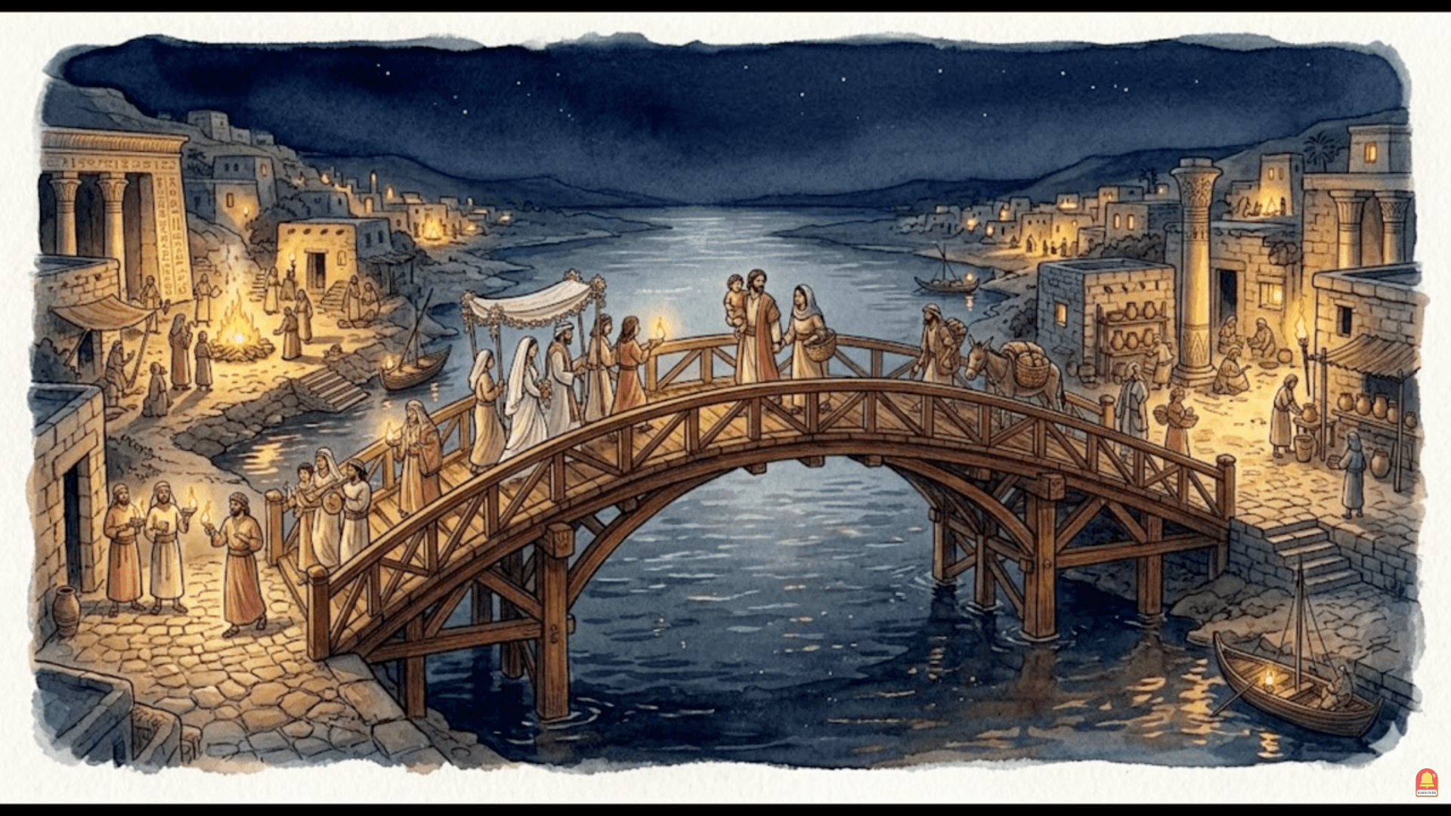

Slide 65
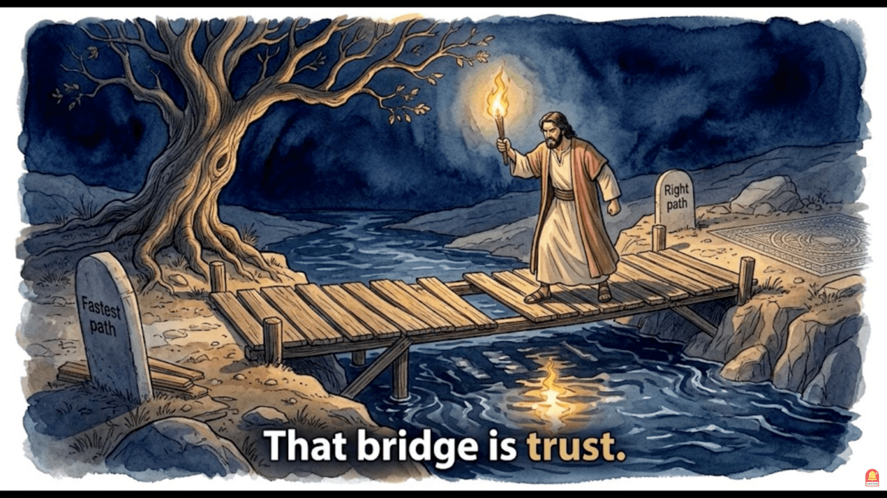

Slide 66
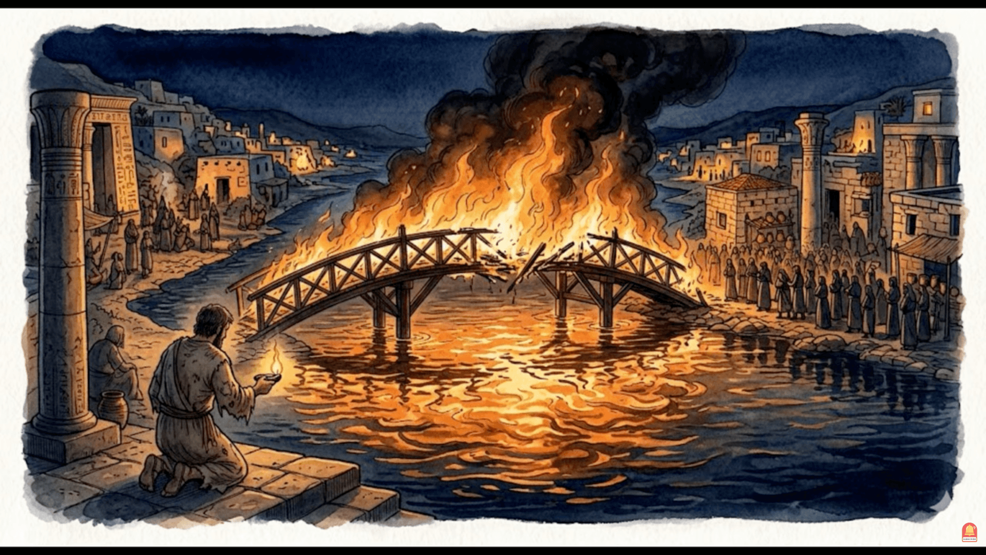

Slide 67
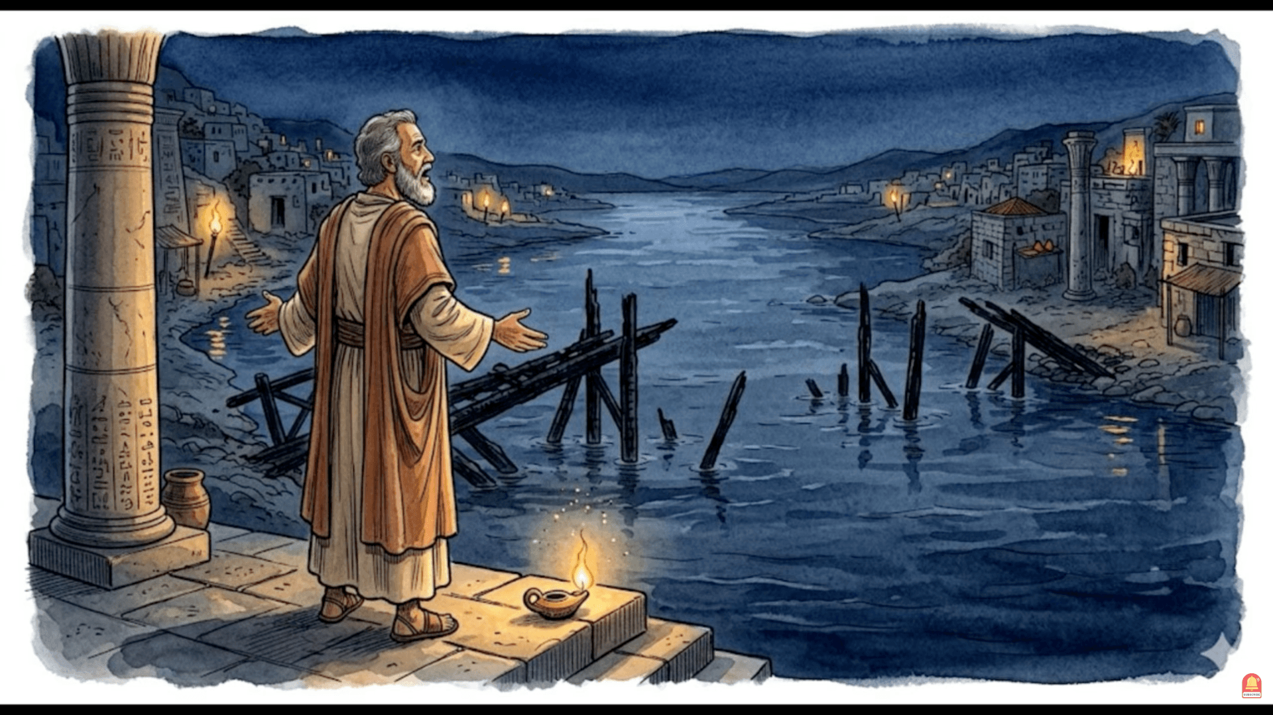
Sin burned the bridge

Slide 68
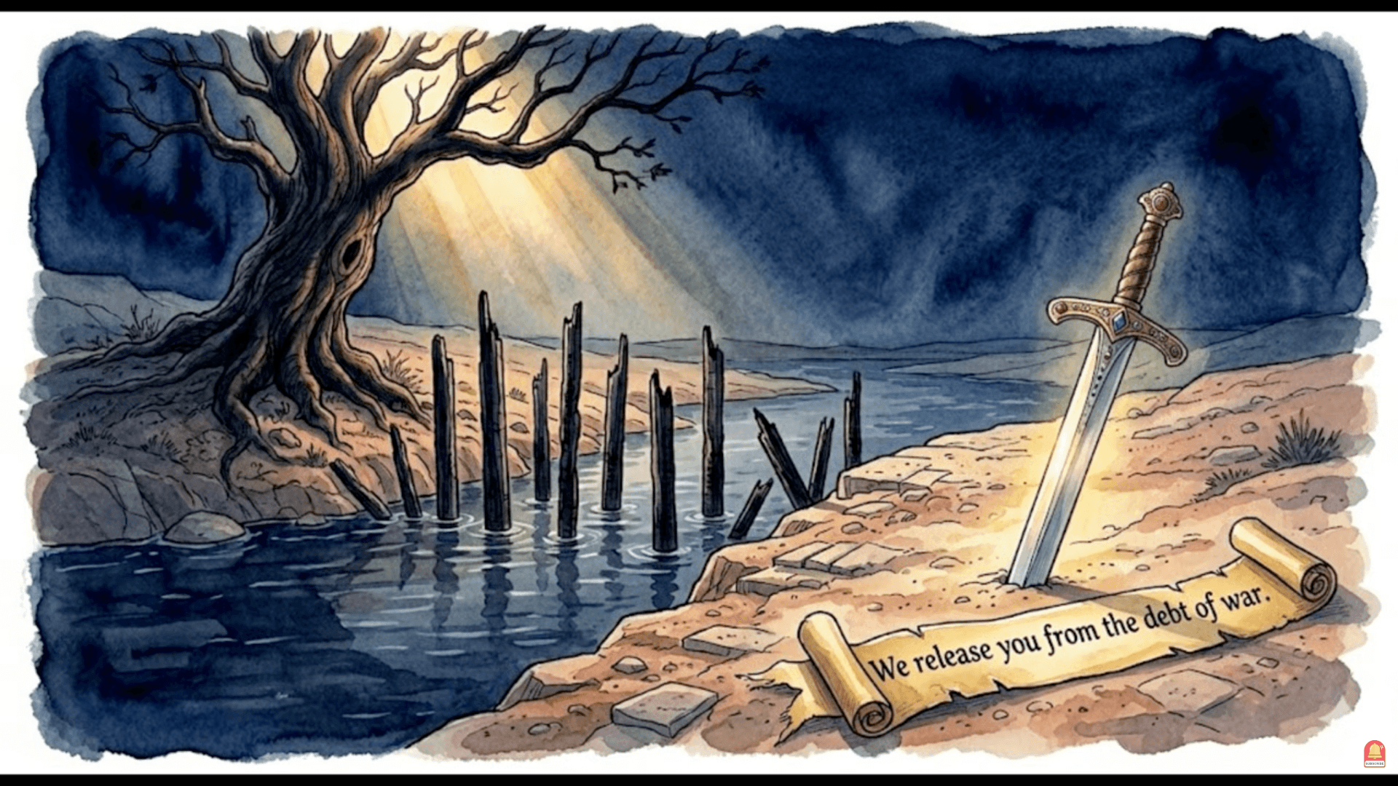

Slide 69
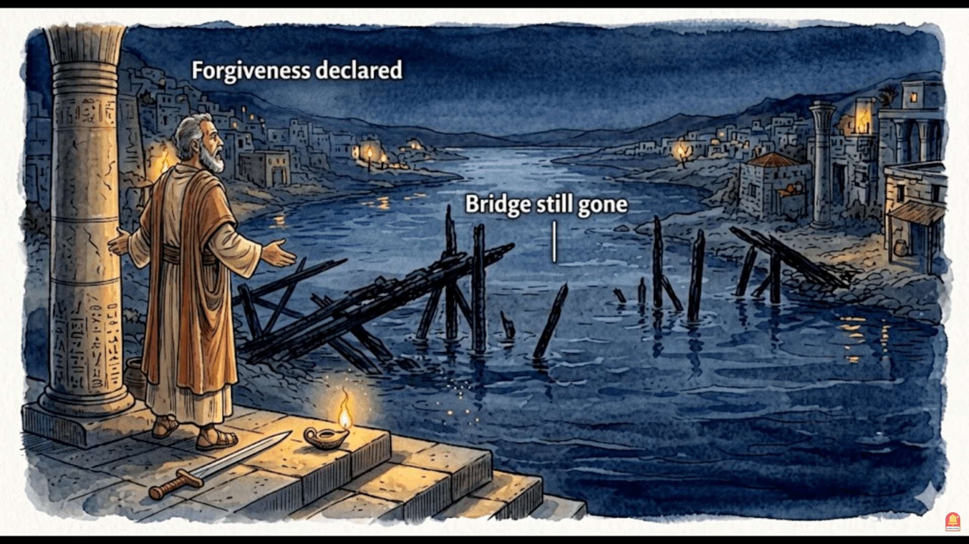
— the debt is removed.

Slide 70
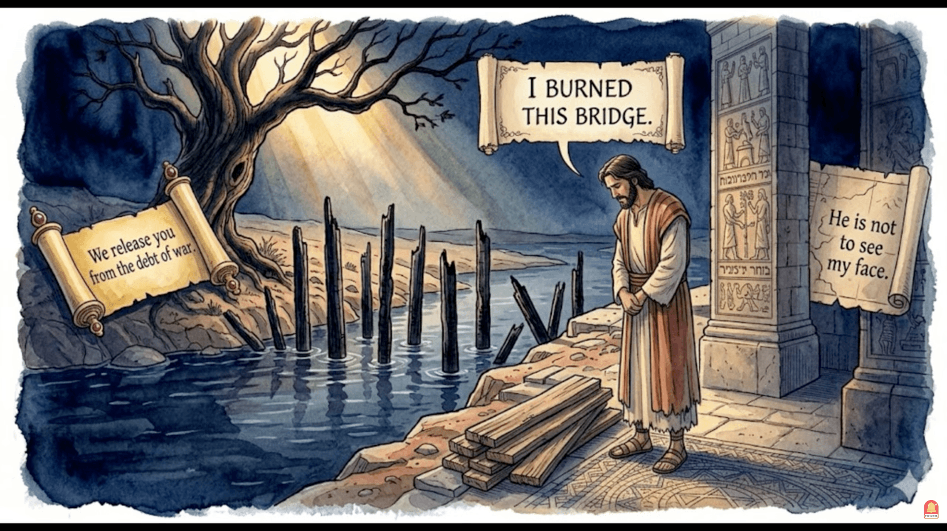

Slide 71
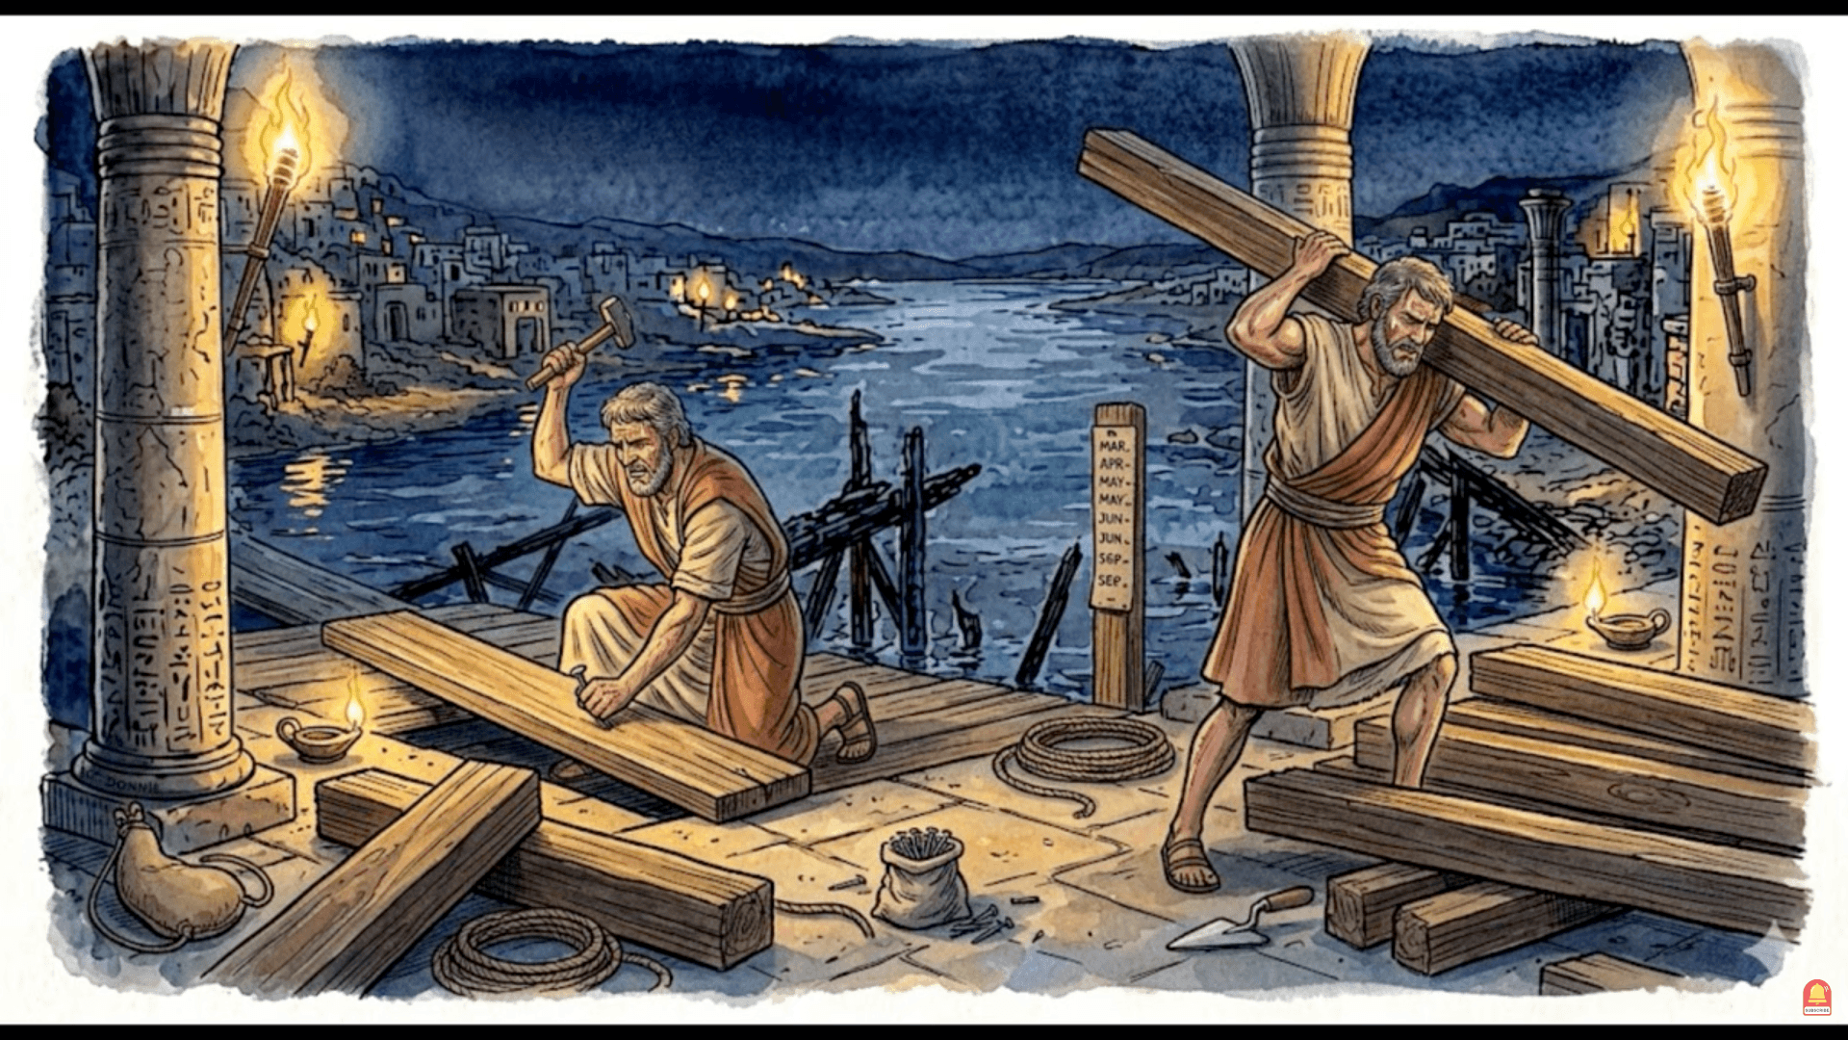

Slide 72
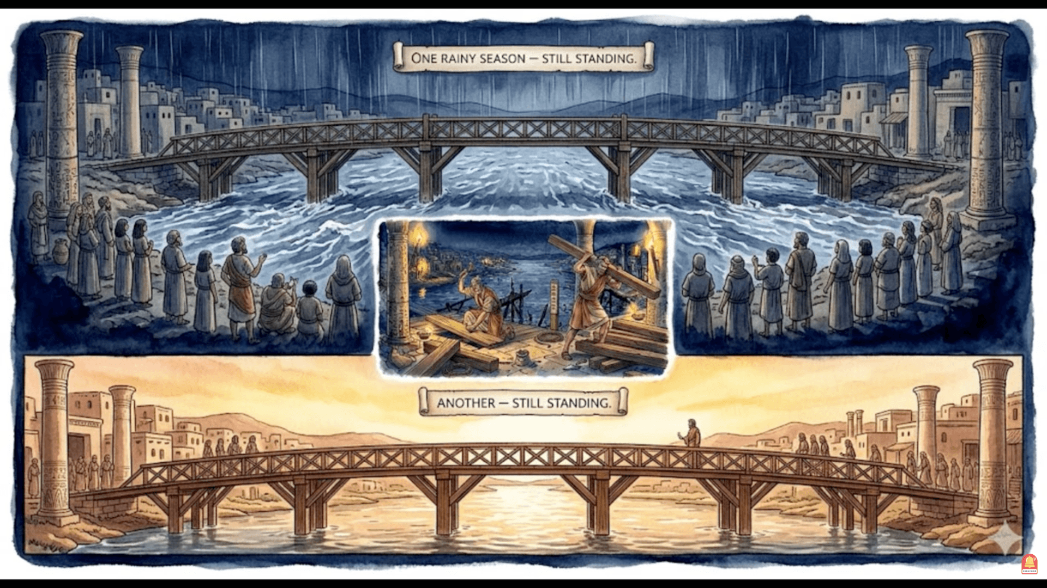

Slide 73
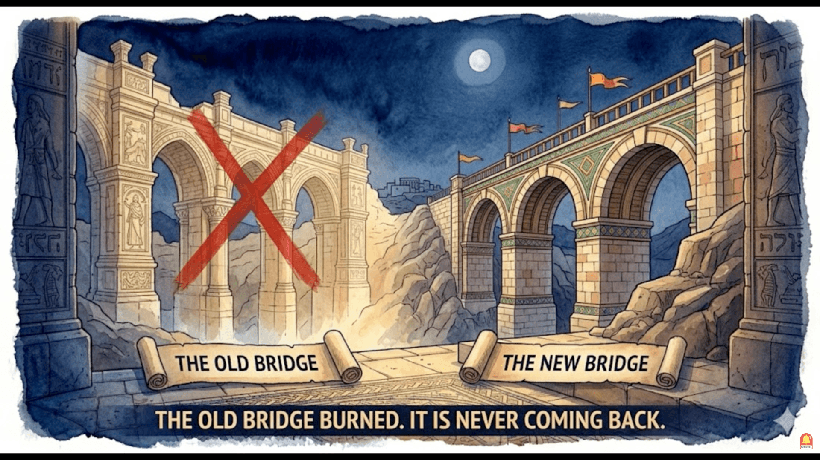

Slide 74
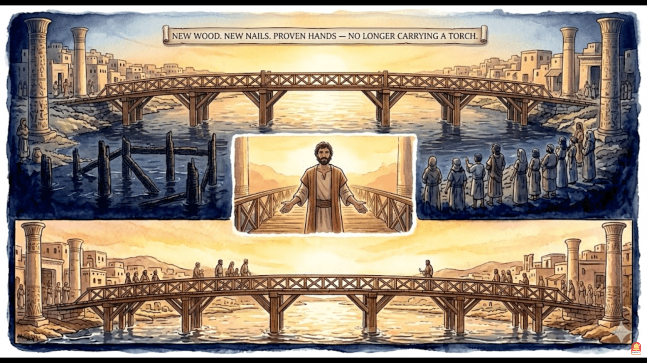

Slide 75
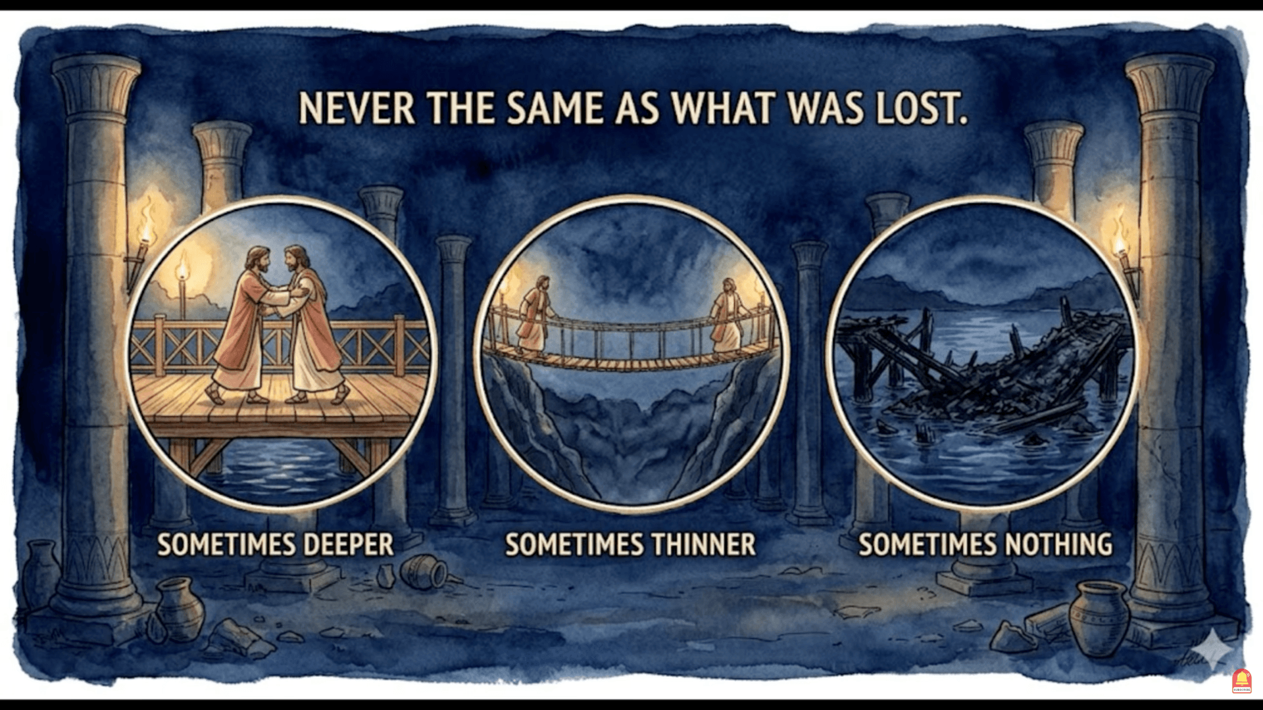

Slide 76
SUMMARY
PART 3

Slide 77
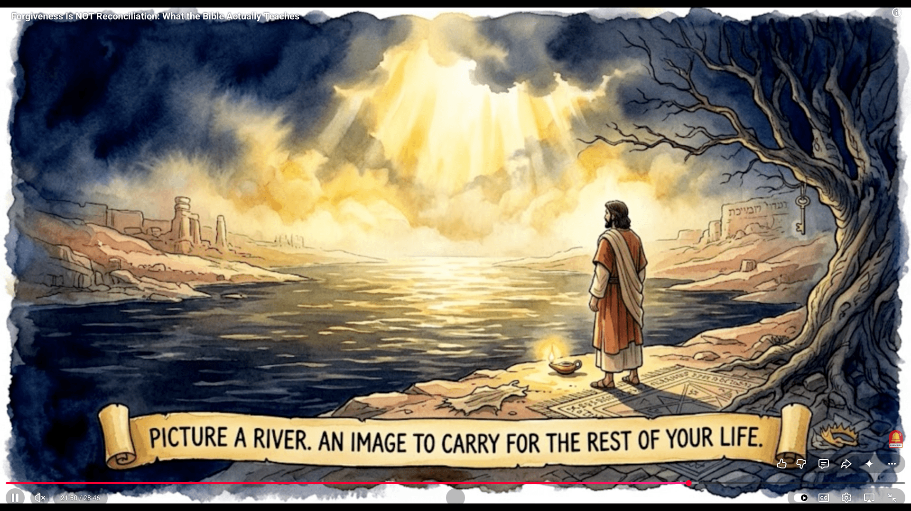

Slide 78
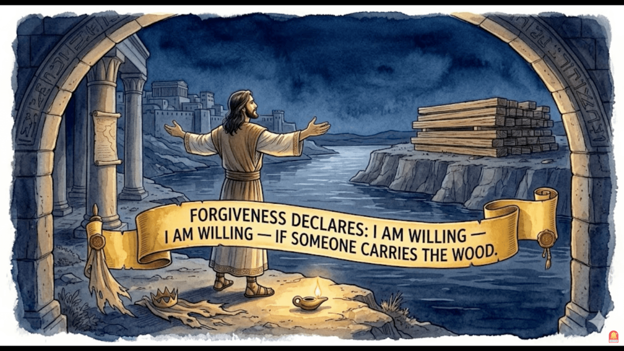

Slide 79
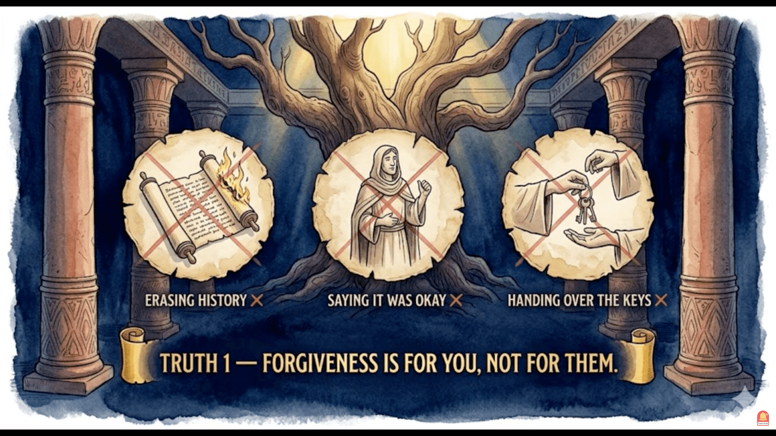

Slide 80
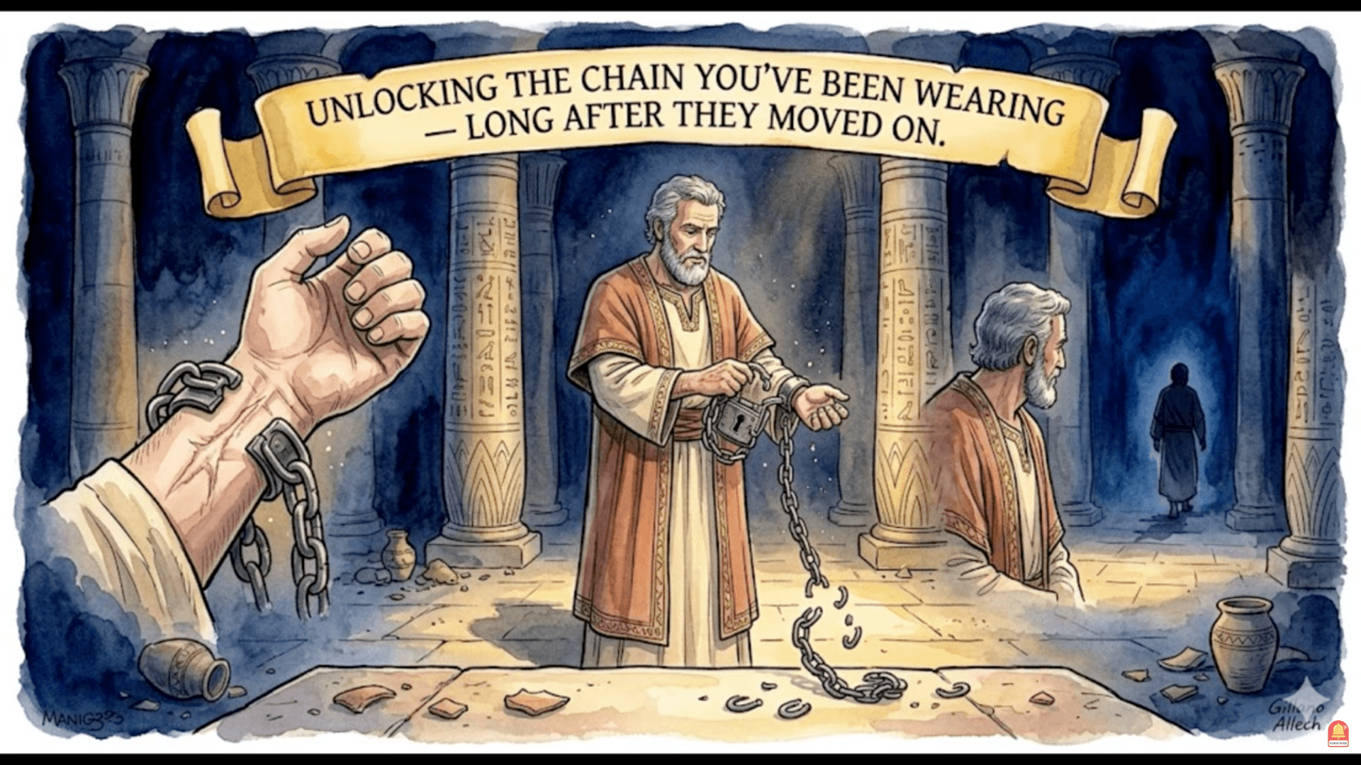

Slide 81
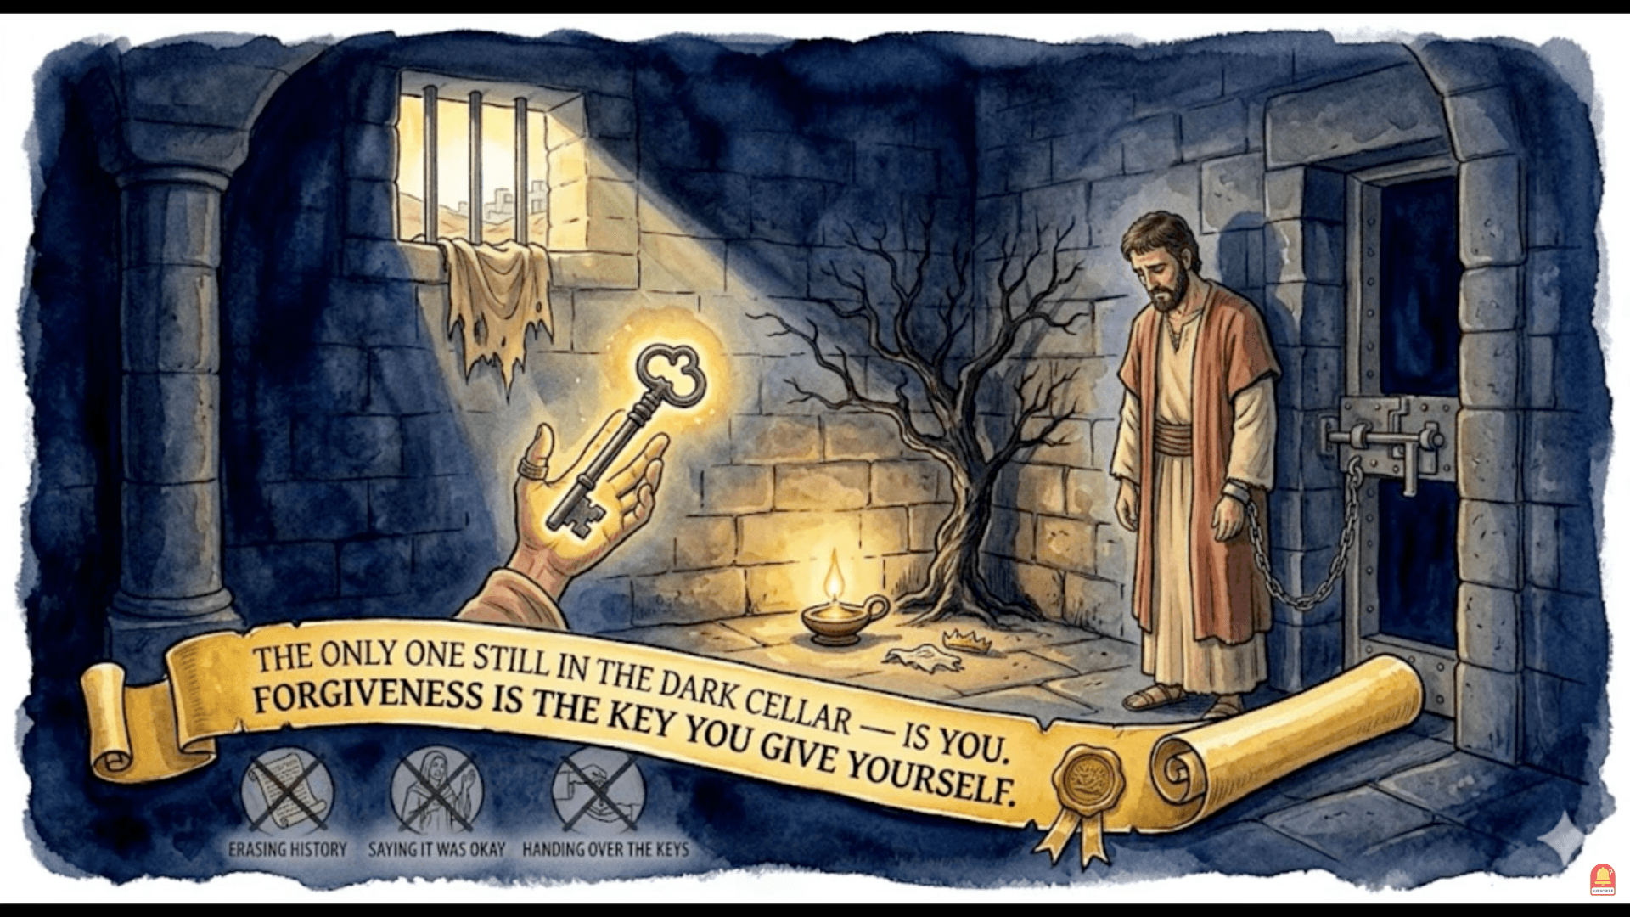

Slide 82
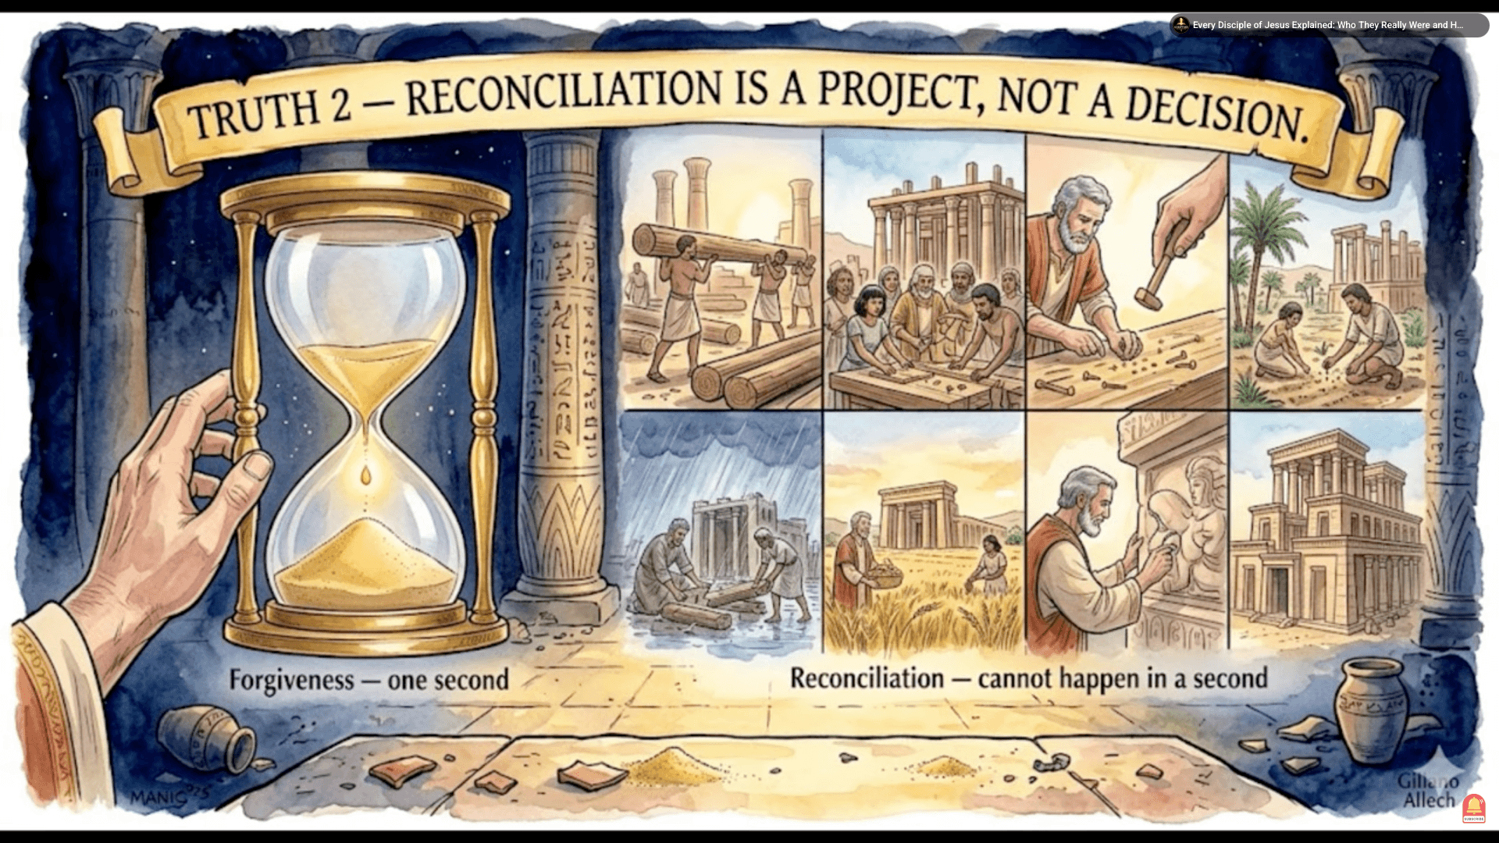

Slide 83
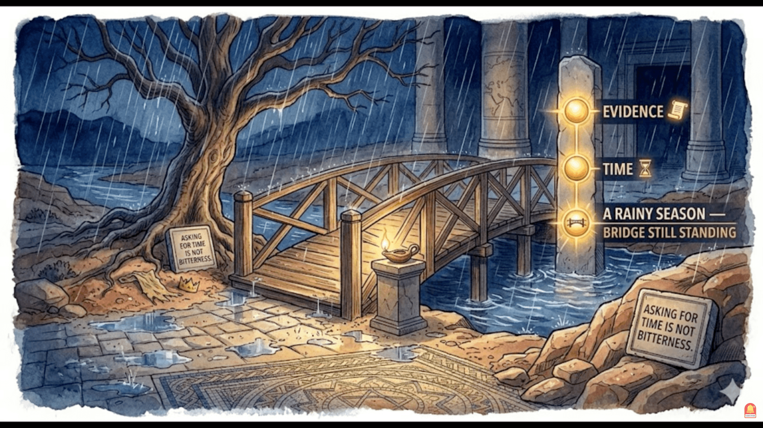

Slide 84
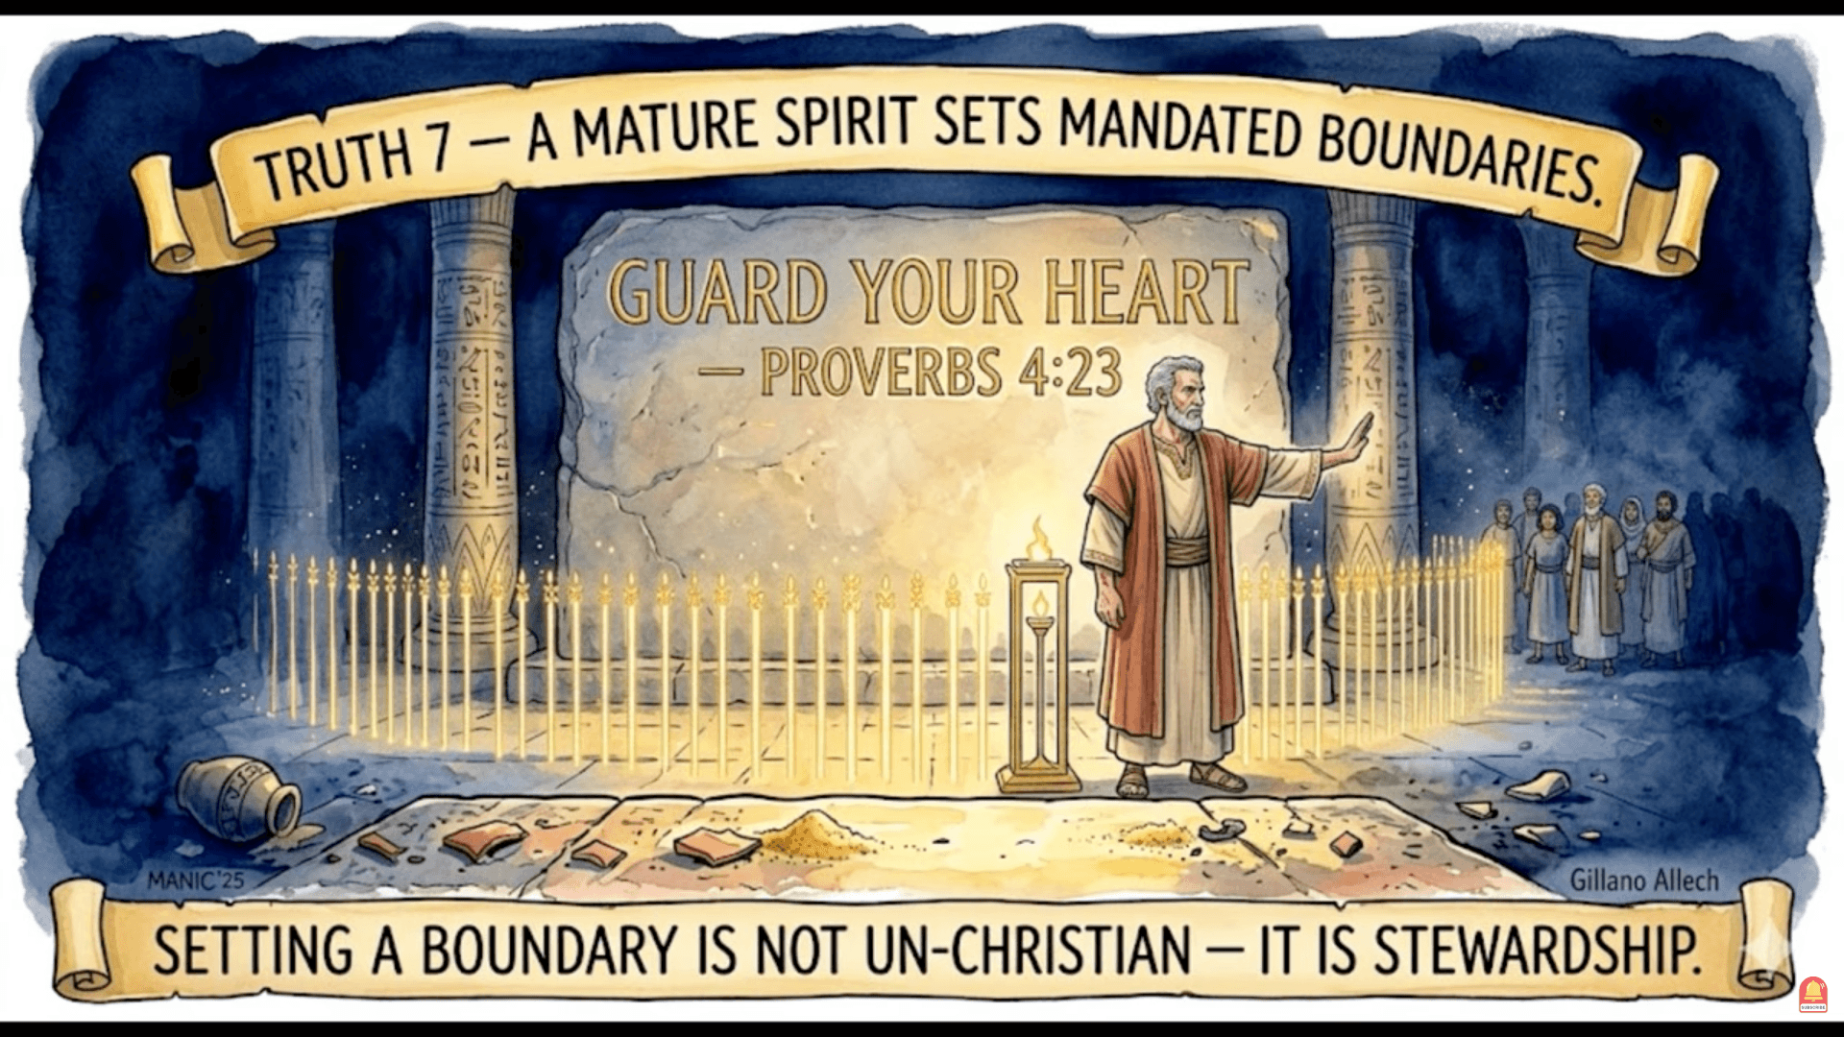

Slide 85
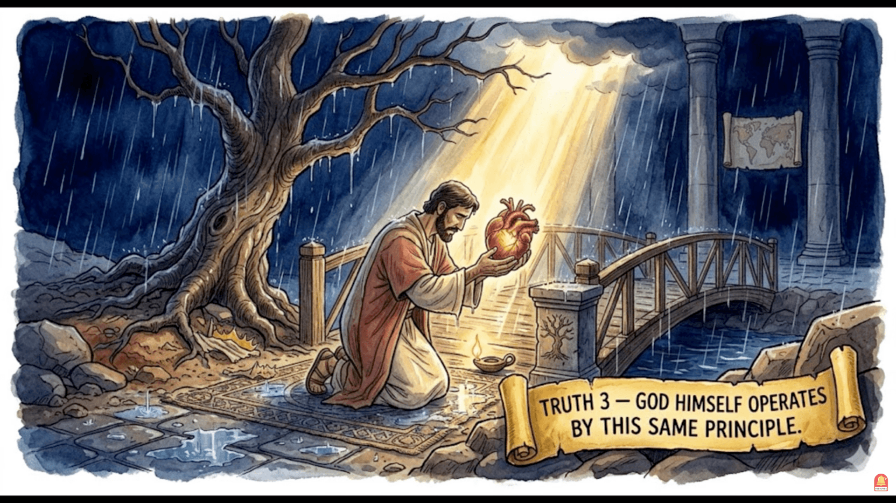

Slide 86
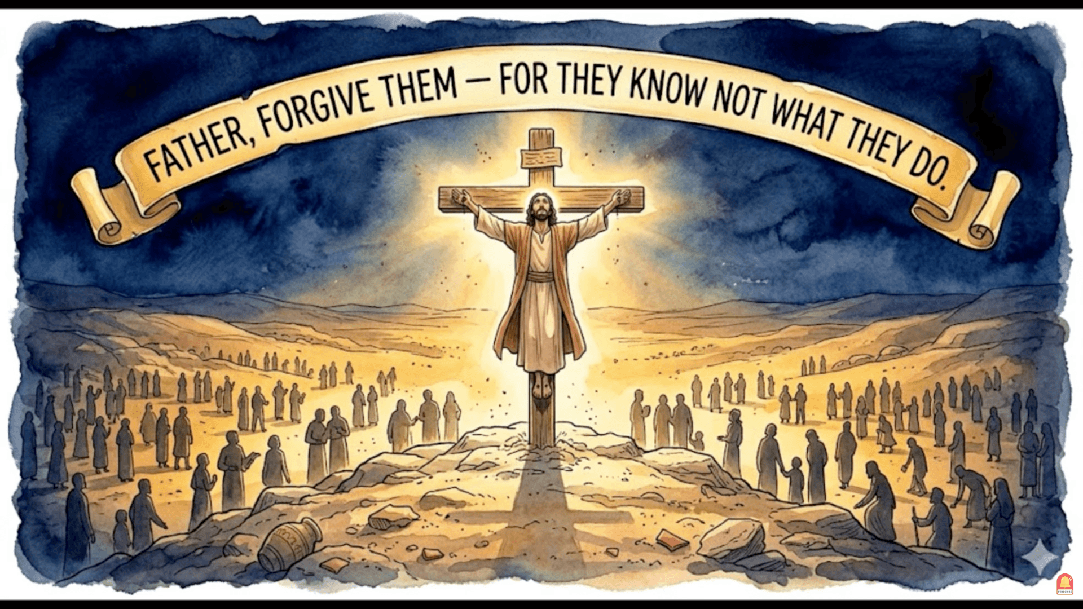

Slide 87
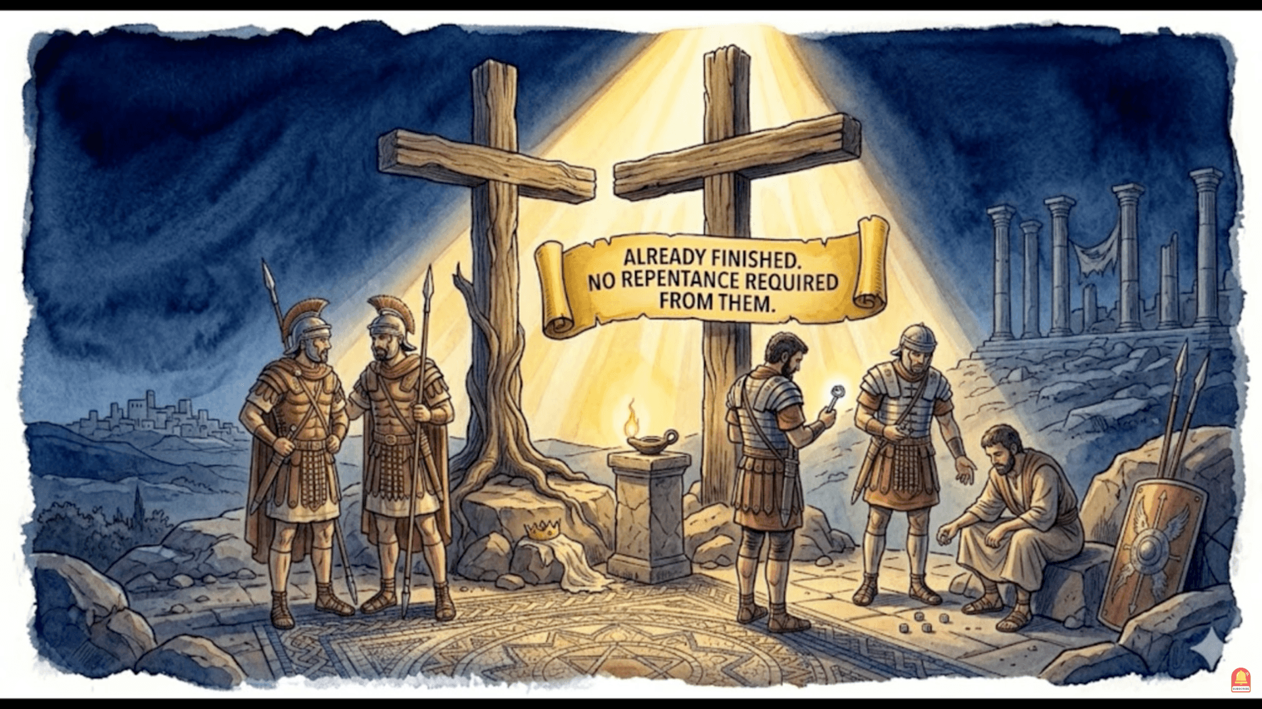

Slide 88
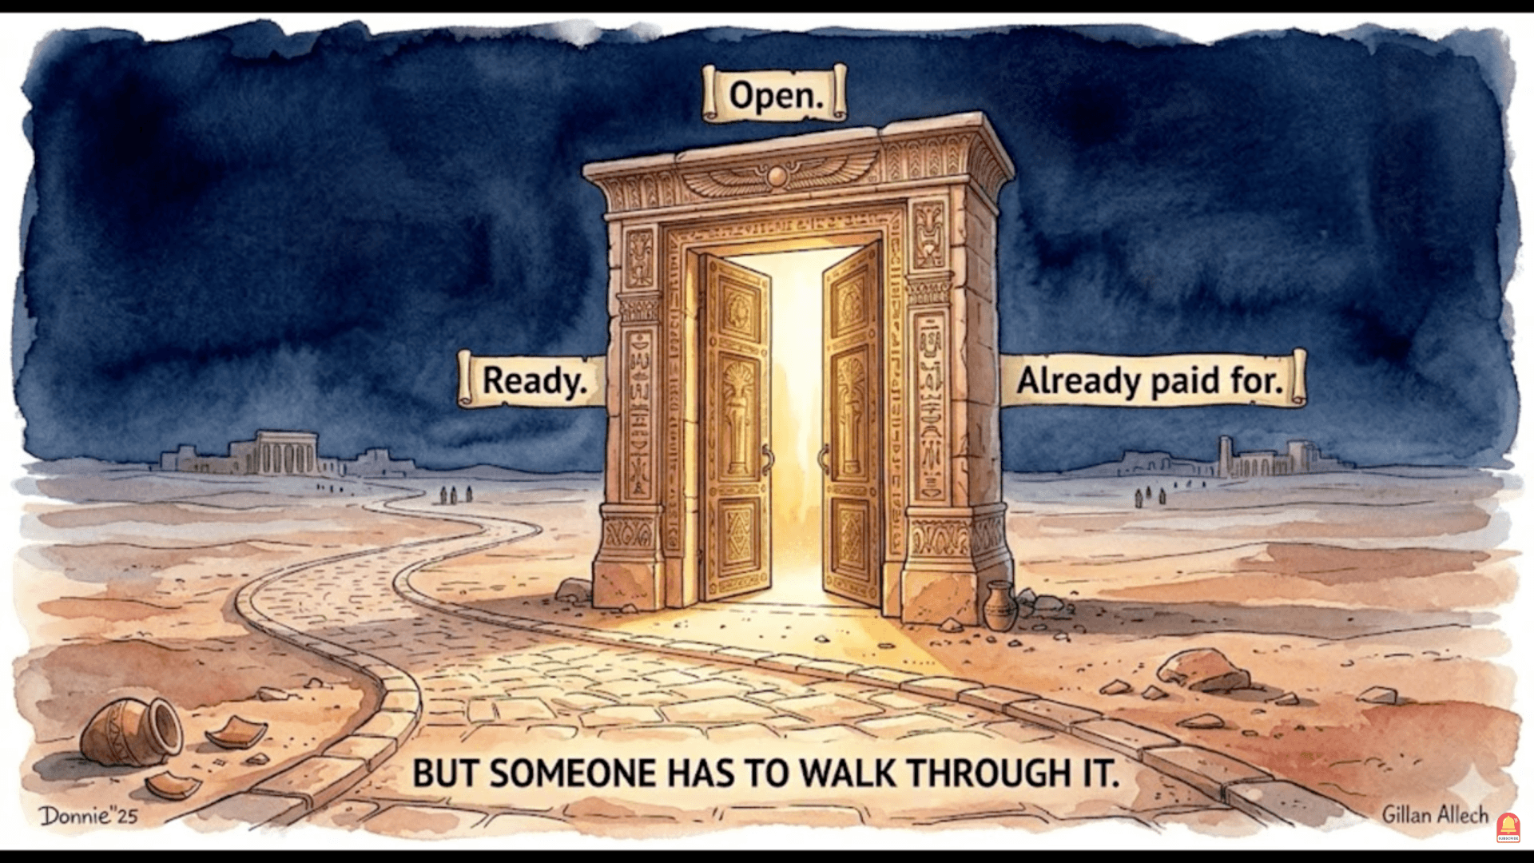

Slide 89
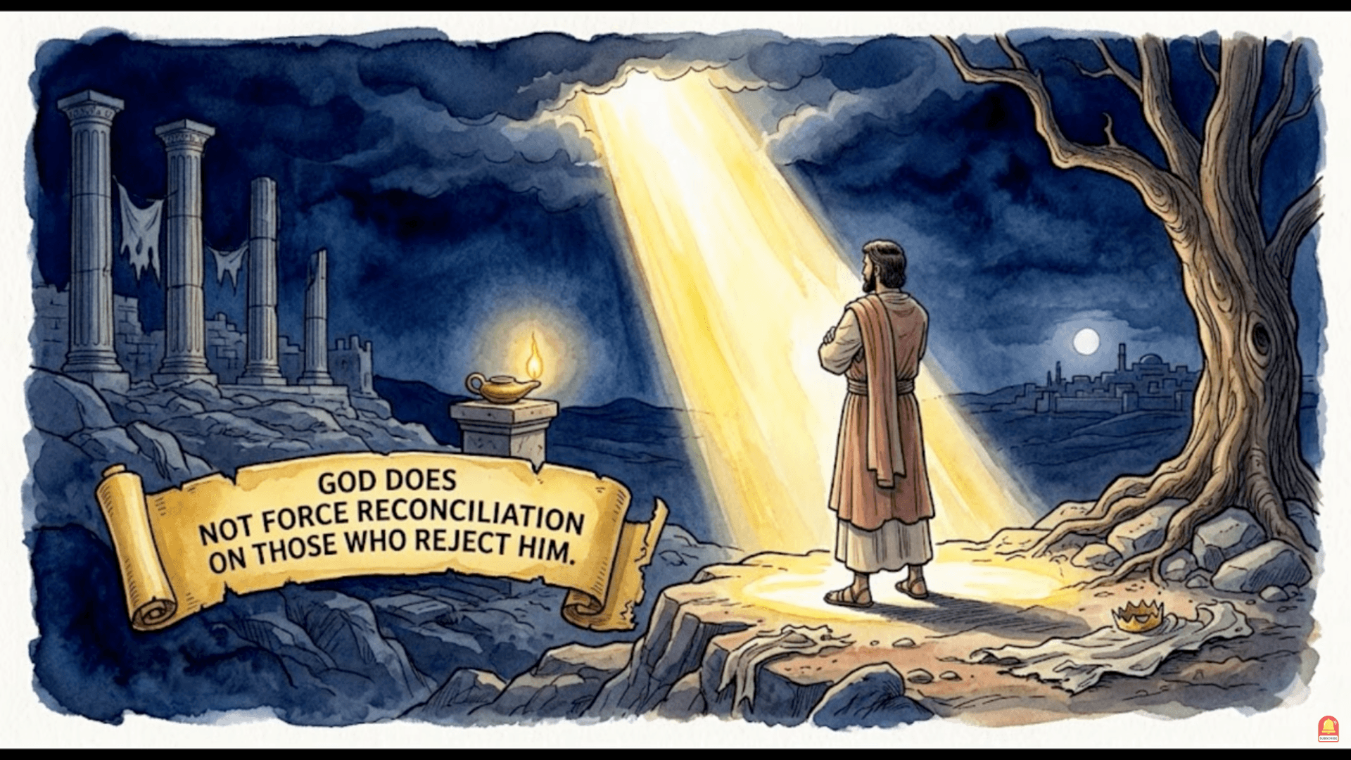

Slide 90
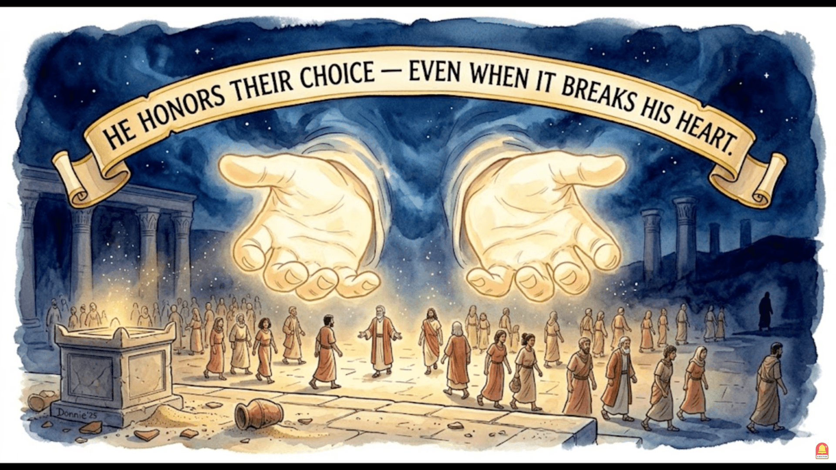

Slide 91
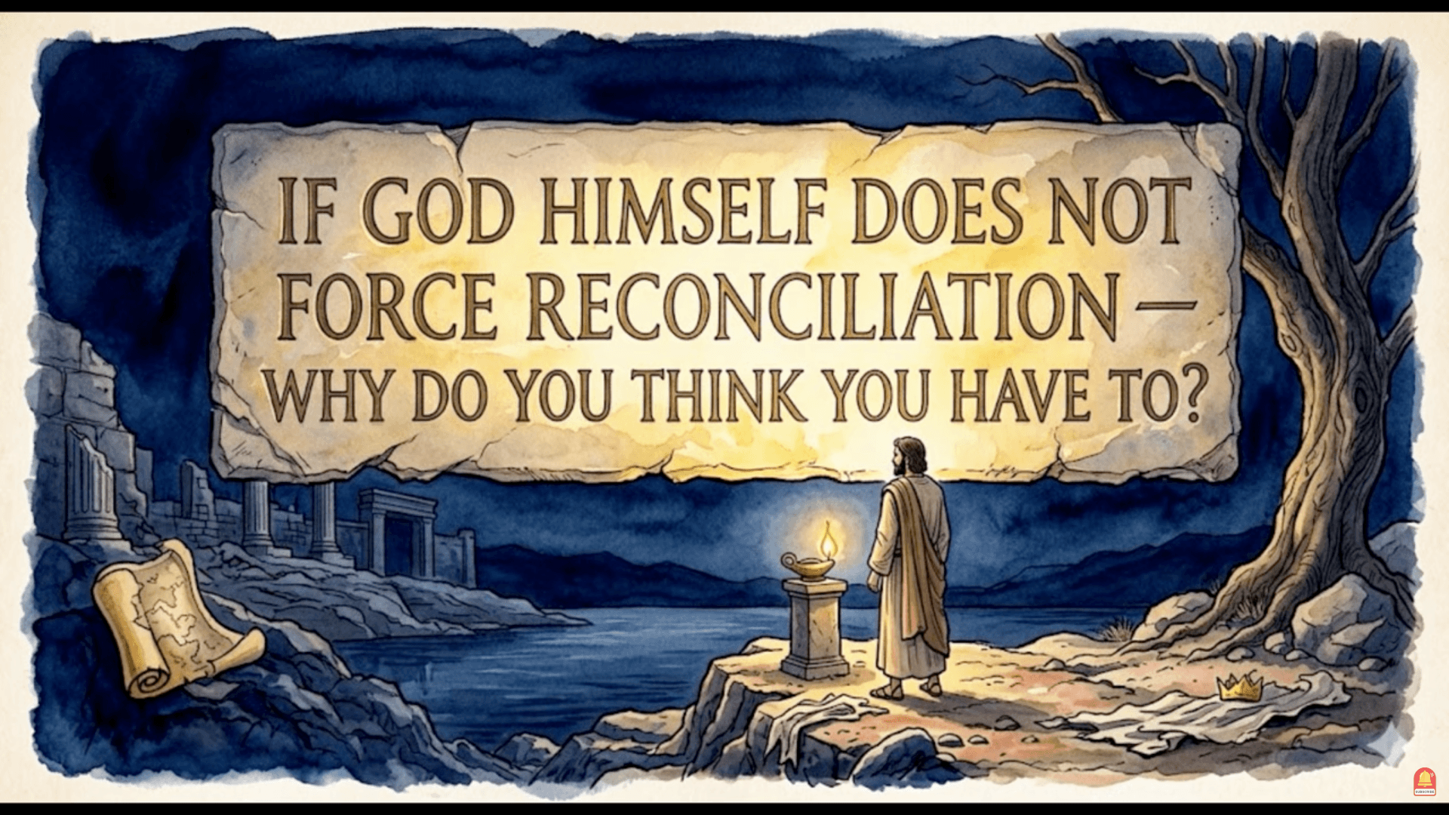

Slide 92
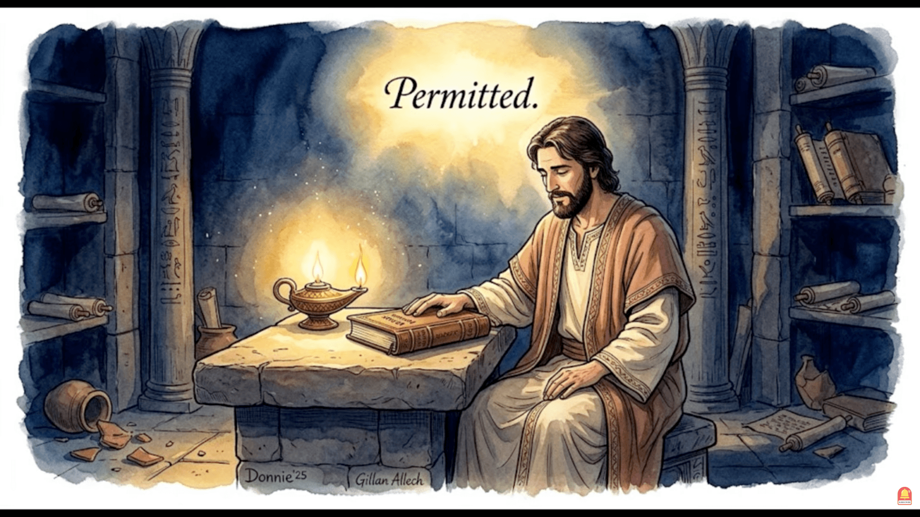

Slide 93
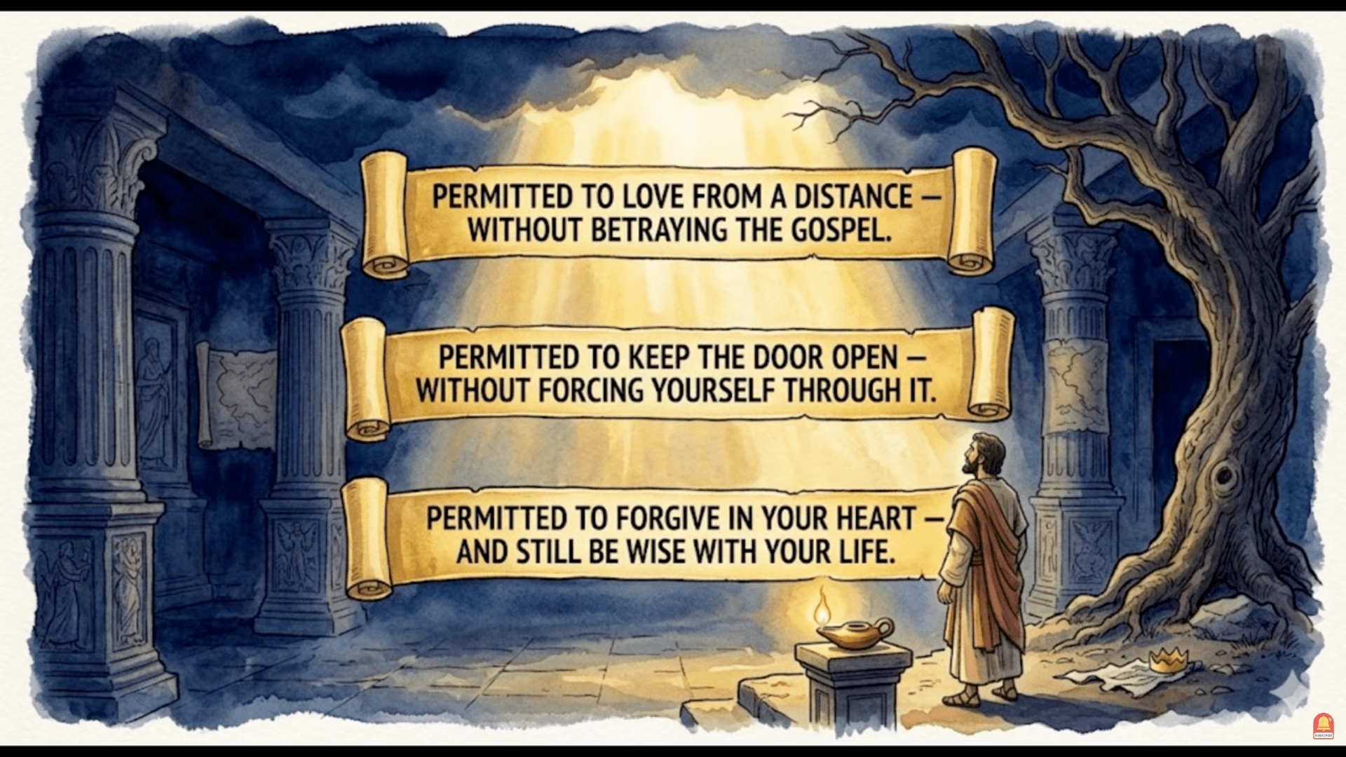

Slide 94
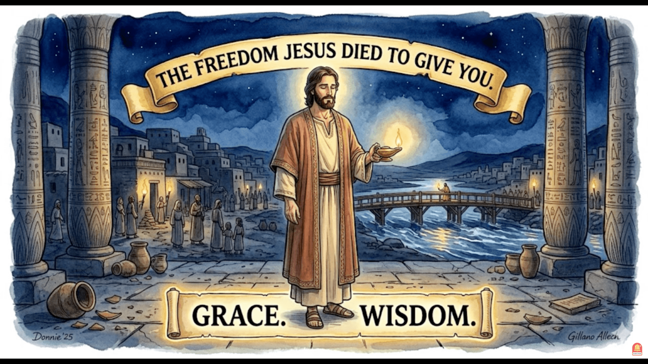

Slide 95
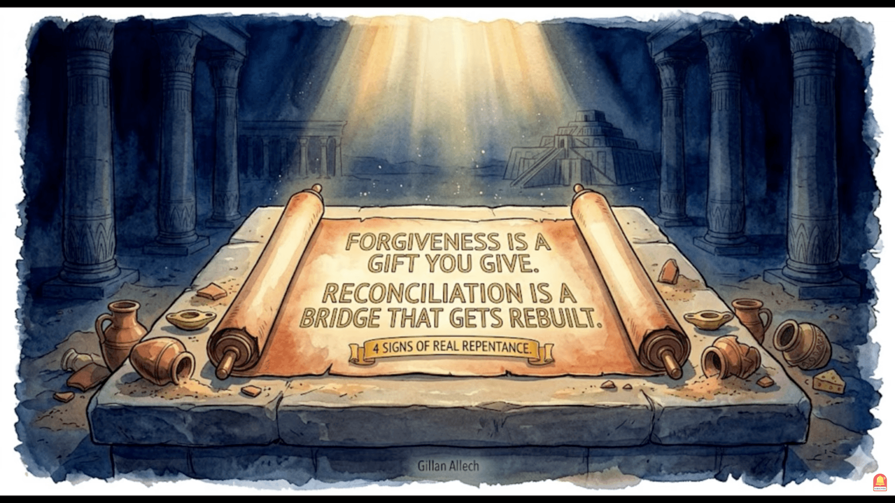

Slide 96
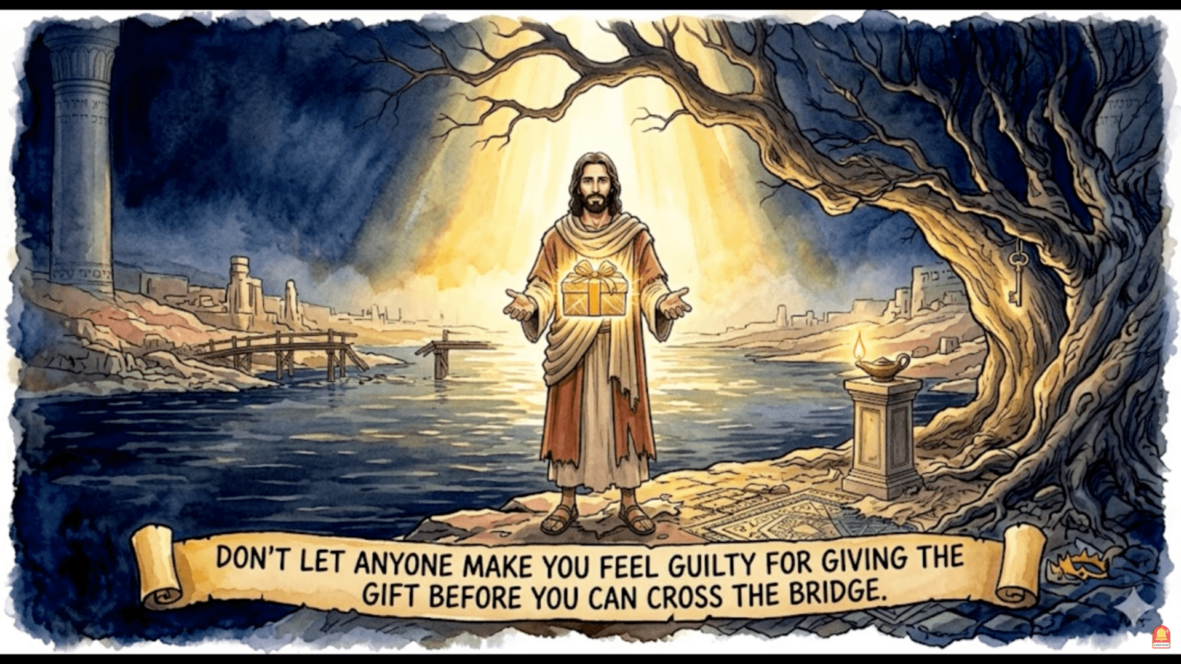

Slide 97


Slide 98


Slide 99


Slide 100


Slide 101


Slide 102


