Slide 1
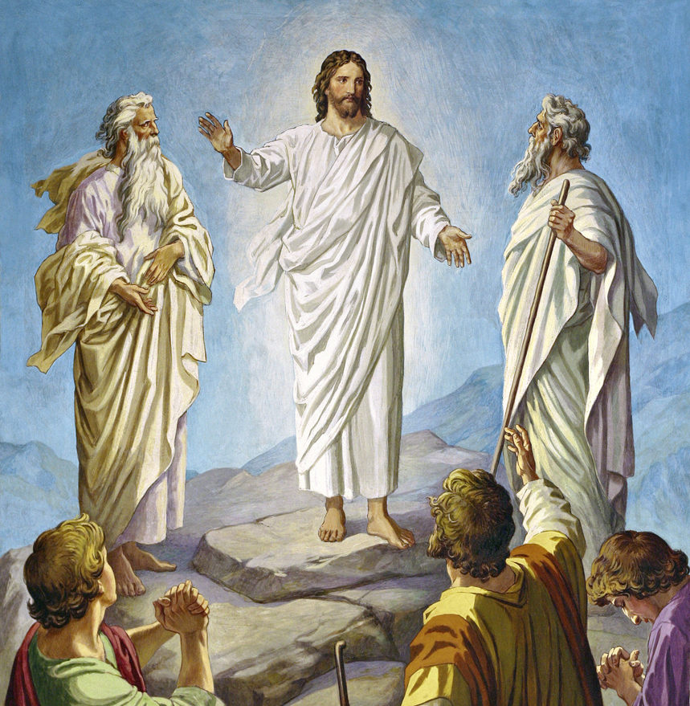
Mount of Transfiguration
Matthew 17:1-8
Mark 9:2-8
Luke 9:28-36

Slide 2
Purpose
To strengthen disciples’ hope and faith
While Satan was laying his plans, Jesus was carefully opening to His disciples the sufferings through which He must pass—that He would be crucified and that He would rise again the third day. But their understanding seemed dull, and they could not comprehend what He told them.
The faith of the disciples was greatly strengthened at the transfiguration, when they were permitted to behold

Slide 3
Christ's glory and to hear the voice from heaven testifying to His divine character. God chose to give the followers of Jesus strong proof that He was the promised Messiah, that in their bitter sorrow and disappointment at His crucifixion, they would not entirely cast away their confidence. At the transfiguration the Lord sent Moses and Elijah to talk with Jesus concerning His sufferings and death. Instead of choosing angels to converse with His Son, God chose those who had themselves experienced the trials of earth.

Slide 4
Moses
Moses passed under the dominion of death, but he was not to remain in the tomb. Christ Himself called him forth to life. Satan the tempter had claimed the body of Moses because of sin; but Christ the Saviour brought him forth from the grave. Jude 9
A witness to Christ’s victory over sin and death. He represented those who shall come forth from the grave at the resurrection of the just.

Slide 5
Elijah
Elijah had been translated to heaven without seeing death.
Represented those who will be living upon the earth at Christ’s second coming, and who will be “changed in a moment, in the twinkling of an eye, at the last trump;” when “this mortal must put on immortality,” and “this corruptible must put on incorruption.” 1 Corinthians 15:51-53

