Slide 1
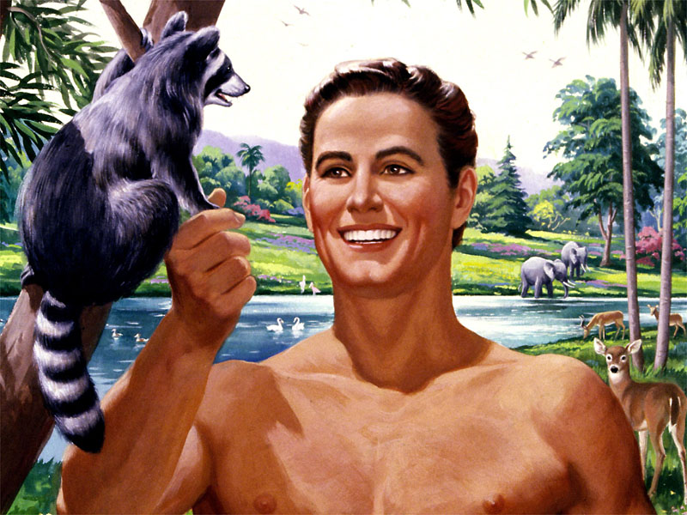
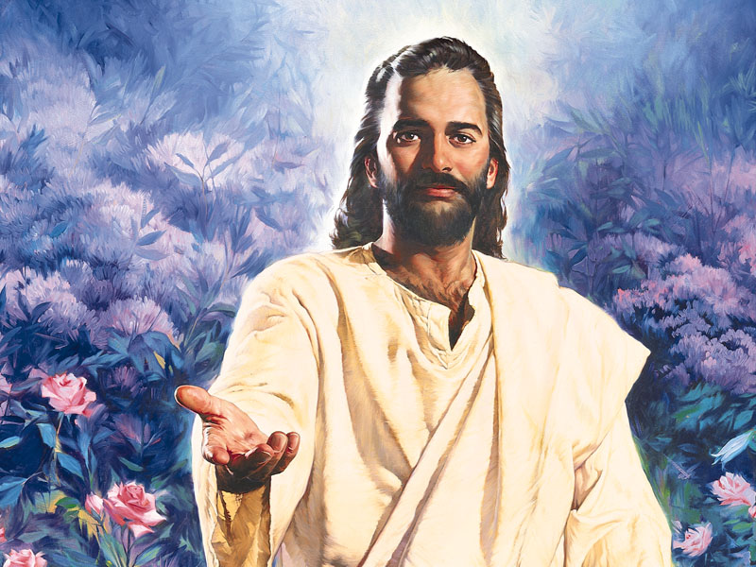
The Two Adams

Slide 2
1 Corinthians 15:45
NLT
The first man, Adam
The Scriptures tell us, “The first man, Adam, became a living person.” But the last Adam—that is, Christ—is a life-giving Spirit.
the last Adam
    There are only 2 Adams in Scripture –
              “the first man Adam” and “the last Adam”.

Slide 3
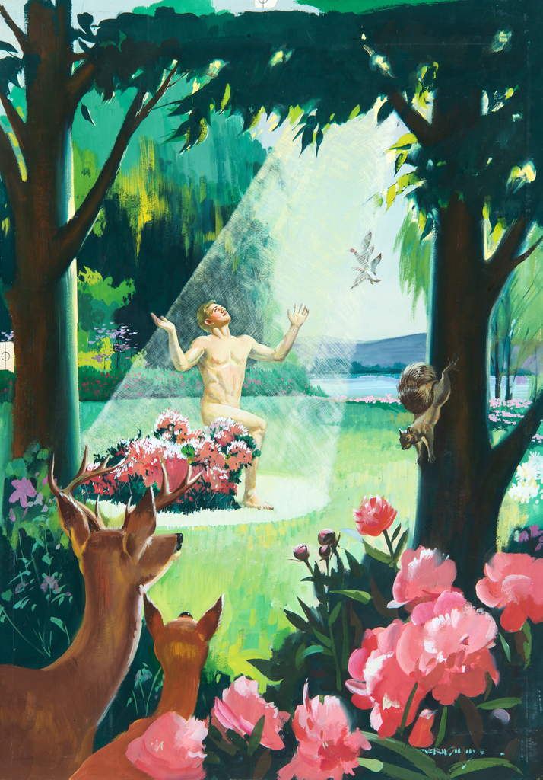
The first man
Adam
    “The first man Adam” is the first man created on earth, in the Garden of Eden.

Slide 4
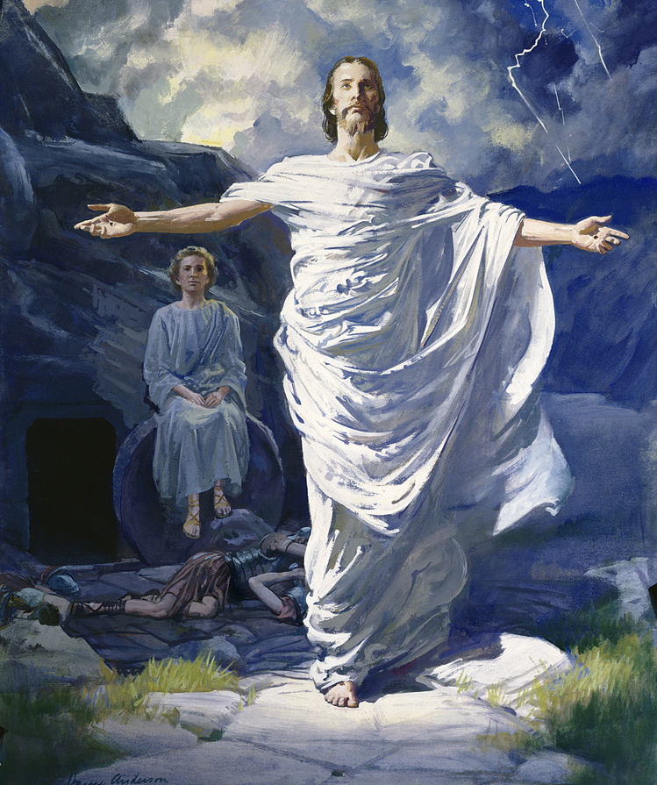
The last Adam
    The last Adam is ”the Lord from heaven.“
    1 Corinthians 15:47 NKJV

Slide 5
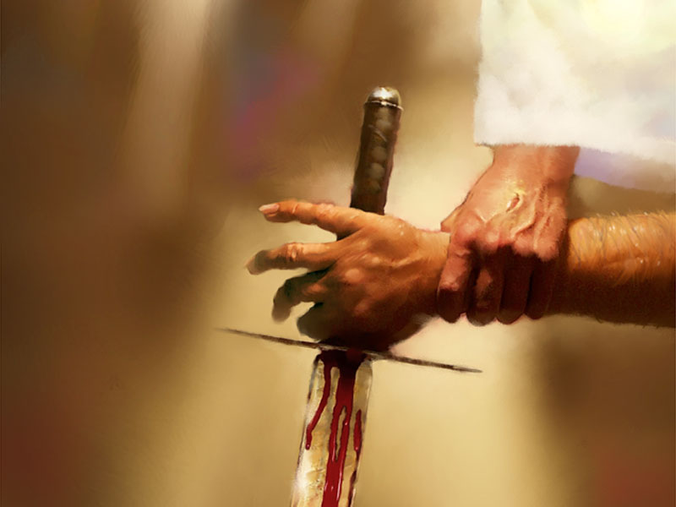
Jesus is NOT called the 2nd Adam, but He is called “the LAST Adam” because there wouldn’t be another one if Christ failed. But praise God He didn’t.

Slide 6
Let us first look at some
P
A
R
A
L
L
E
L
S
between the Two Adams

Slide 7
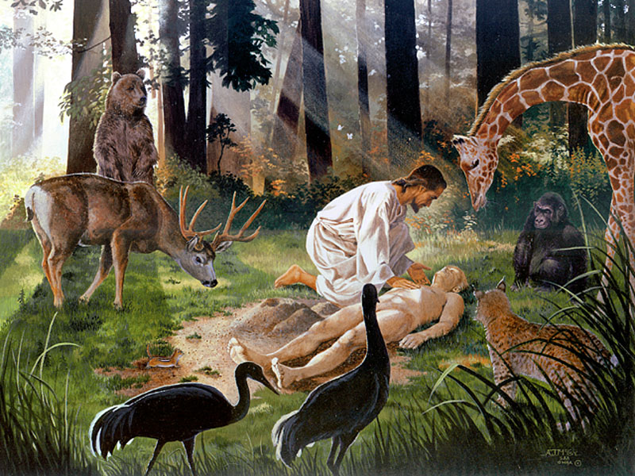
Unlike us, both the Adams were supernaturally created.
The first Adam was miraculously created by God–he had no earthly parents.

Slide 8
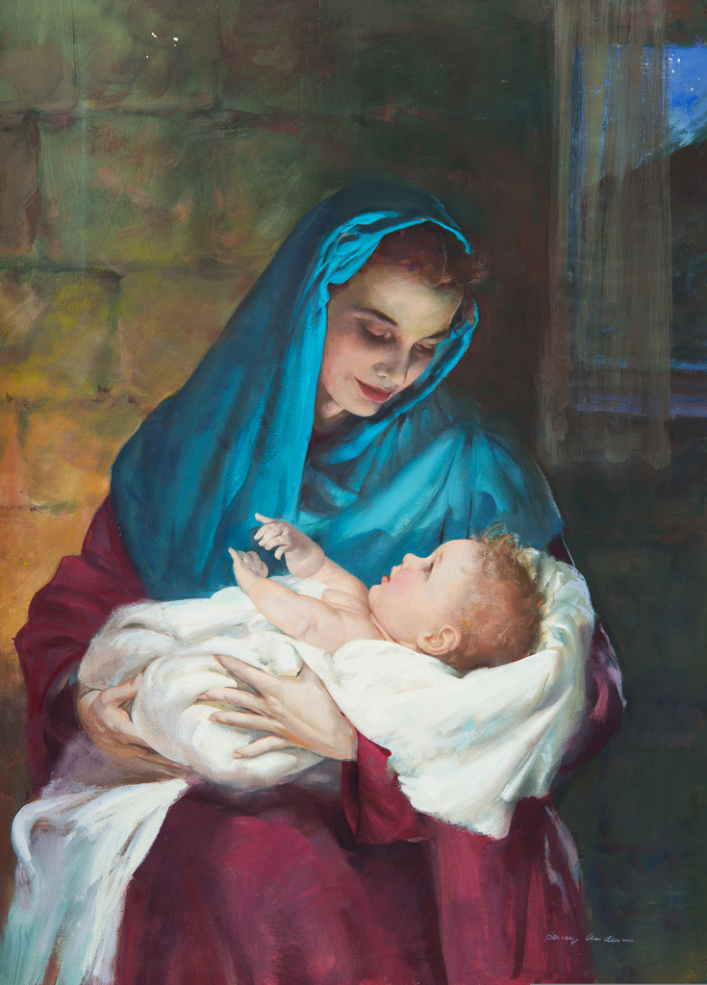
Unlike us, both the Adams were supernaturally created.
The last Adam was miraculously created by God again—He had no earthly father.

Slide 9
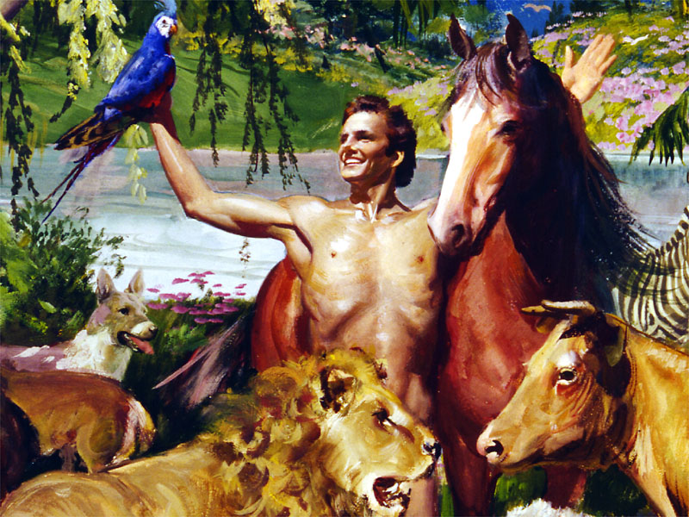
Both had a common title—the “son of God.”
Luke 3:38 KJV “ … Adam, which was the son of God.”

Slide 10
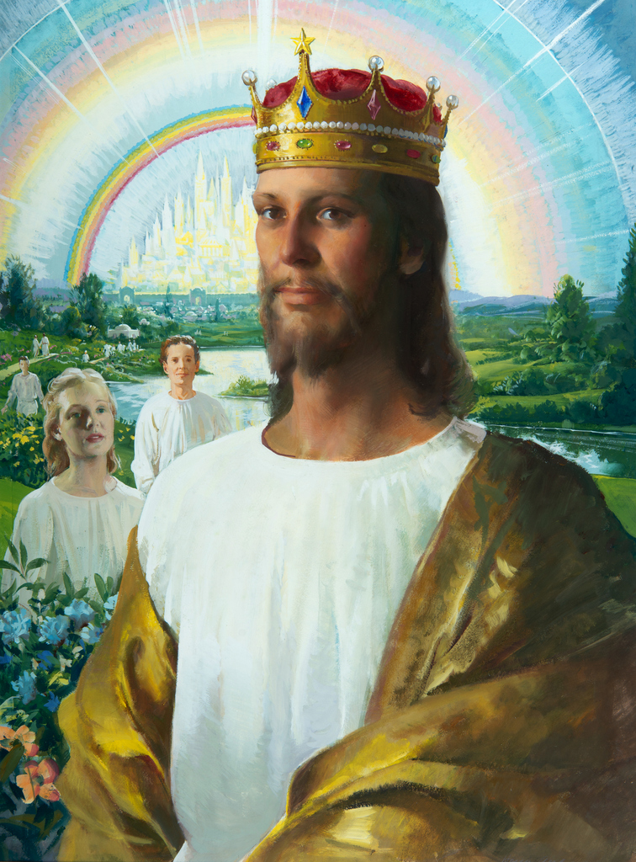
Both had a common title—the “son of God.”
Luke 1:35 NLT ”the baby to be born will be holy, and he will be called the Son of God.”

Slide 11
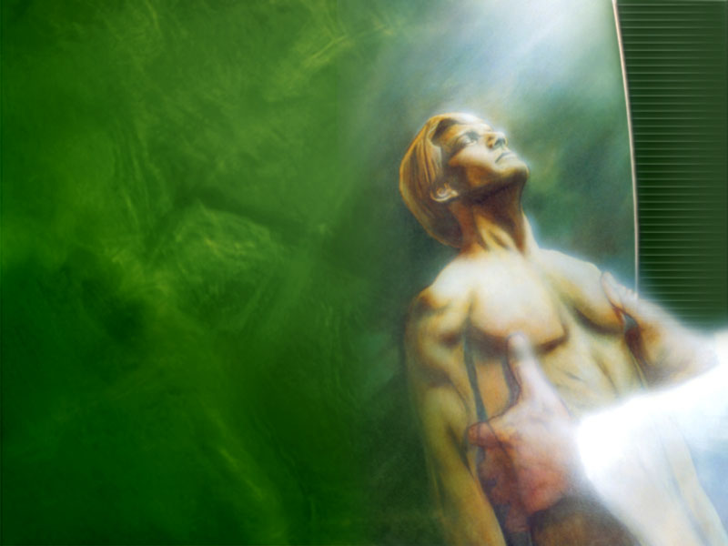
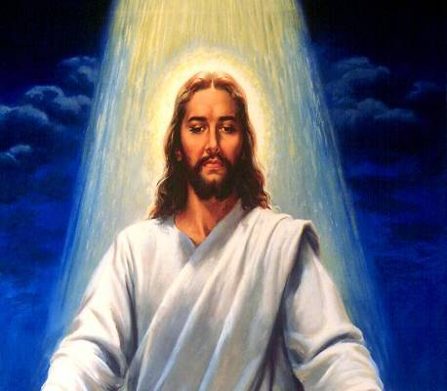
One the image, the other the express image.
Genesis 1:27 “So God created man in his own image, in the image of God created he him”
Hebrews 1:3 NKJV “who being the brightness of His glory and the express image of His person”

Slide 12
Both were heads of the human race—one natural, another spiritual
1 Corinthians 15: 44, 45 NKJV “There is a natural body, and there is a spiritual body. And so it is written, The first man Adam became a living being. The last Adam became a life-giving spirit.”

Slide 13
Both were heads of the human race—one natural, another spiritual
One created from the ground
The other resurrected from the ground

Slide 14

Both were representative men—their acts affected ALL people.
Romans 5:18 NLT “Adam’s one sin brings condemnation for everyone,

Slide 15
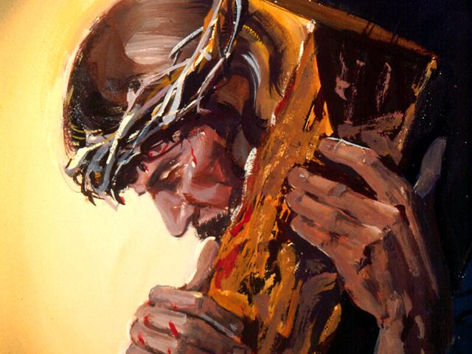
Both were representative men—their acts affected ALL people.
Romans 5:18 NLT “Adam’s one sin brings condemnation for everyone,
but Christ’s one act of righteousness brings a right relationship with God and new life for everyone.”

Slide 16
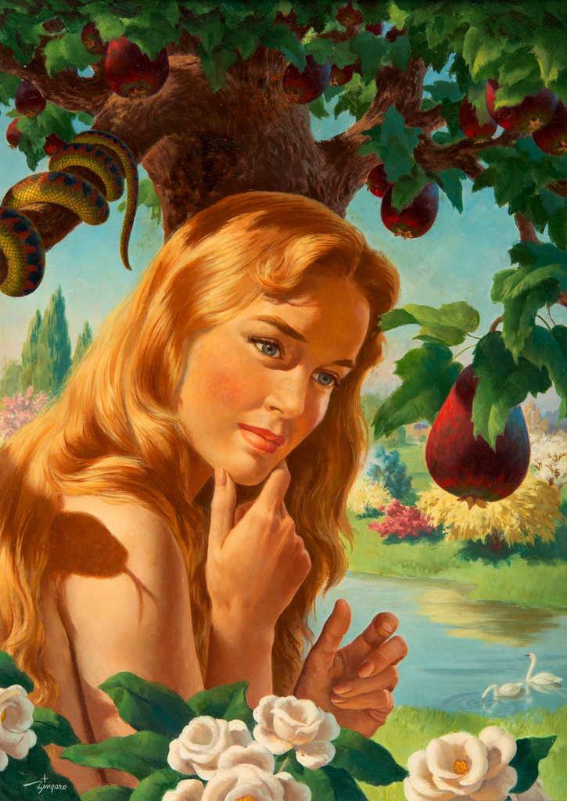
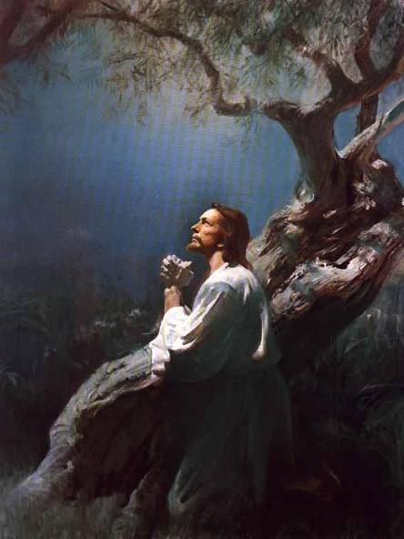
Both were tested in a Garden.
The Garden of Eden and the Garden of Gethsemane

Slide 17
Both their tests had to do with a tree.
One was NOT to EAT of a TREE
“The tree of knowledge of good and evil” Genesis 2:17

Slide 18
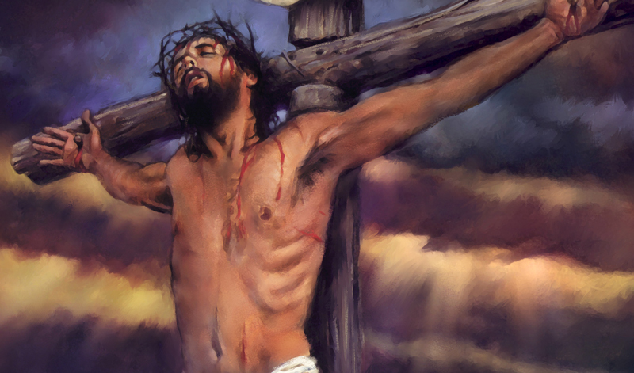
Both their tests had to do with a tree.
The other had to die on a tree.
“… Jesus whom you murdered by hanging on a tree.” Acts 5:30 NKJV

Slide 19

On the sixth day of the week the first Adam was created, and on the same sixth day of the week the last Adam died.

Slide 20
Both had the appetite test.
Genesis 2:17 KJV “But of the tree of the knowledge of good and evil, thou shalt not eat of it”

Slide 21
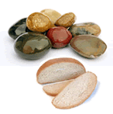
Both had the appetite test.
Matthew 4:2, 3 NKJV “And when he had fasted forty days and forty nights, afterward He was hungry. Now when the tempter came to Him, he said, “If You are the Son of God, command that these stones become bread.”

Slide 22
Both were tempted by the devil who made a physical appearance in disguise.

Slide 23
Both were with beasts while they were tempted.
Genesis 2:19 NKJV “Out of the ground the Lord God formed every beast of the field and every bird of the air, and brought them to Adam to see what he would call them.”

Slide 24
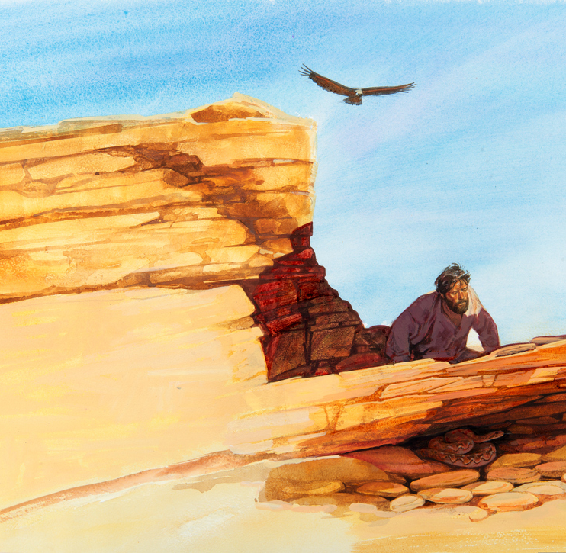
Both were with beasts while they were tempted.
Mark 1:13 NKJV “And He was there in the wilderness forty days, tempted by Satan, and was with the wild beasts.”

Slide 25
Both their sides were opened-up.
Genesis 2:21 NKJV “And the LORD God caused a deep sleep to fall on Adam, and he slept; and He took one of his ribs, and closed up the flesh in its place.”

Slide 26
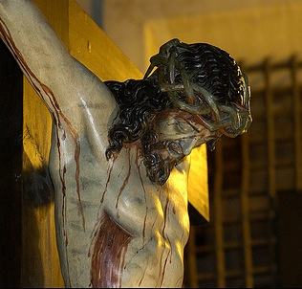
Both their sides were opened-up.
John 19:34 NKJV “But one of the soldiers with a spear pierced His side”

Slide 27
Let us first look at some
CONTRASTS
between the Two Adams

Slide 28
The first Adam was created.
The last Adam is the Creator.
Genesis 1:27 NKJV “So God created man in His own image; in the image of God He created him;”

Slide 29
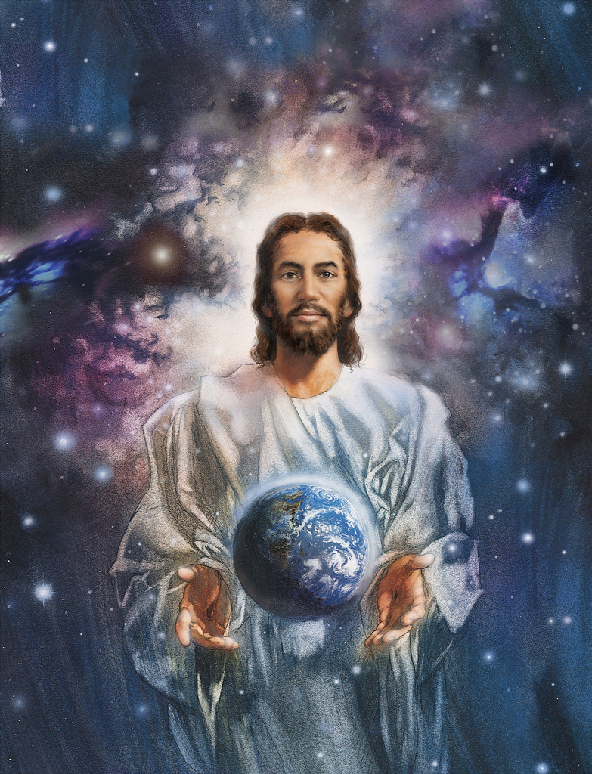
The first Adam was created.
The last Adam is the Creator.
Colossians 1:16 KJV “For by him were all things created, that are in heaven, and that are in earth, visible and invisible, whether they be thrones, or dominions, or principalities, or powers: all things were created by him, and for him”

Slide 30
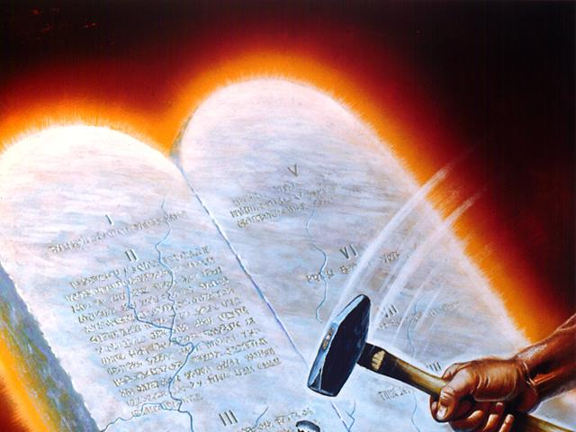
The first Adam disobeyed.
The last Adam obeyed.
Romans 5:19 NKJV “For as by one man's disobedience many were made sinners

Slide 31
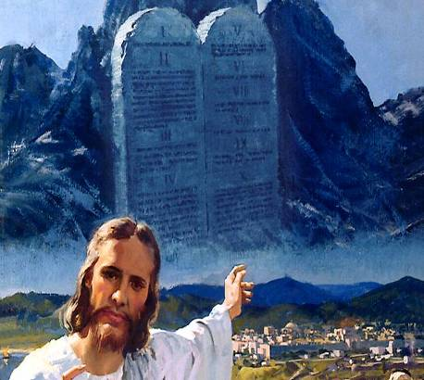
The first Adam disobeyed.
The last Adam obeyed.
Romans 5:19 NKJV “For as by one man's disobedience many were made sinners,
so by the obedience of one shall many be made righteous.”

Slide 32
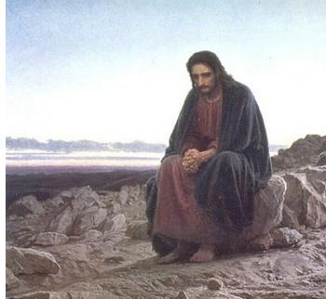
The first Adam was not hungry when he failed the appetite test.
The last Adam was fasting for 40 days when He passed the appetite test.

Slide 33
The first Adam was in a blessed surrounding of his home when he was tested.
The last Adam was in a cursed surrounding of a wilderness when He was tested.

Slide 34
The first Adam had sinless human nature and fell when tempted.
The last Adam had a sinful nature and overcame when tempted.

Slide 35
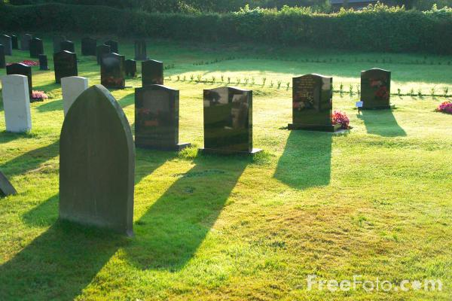
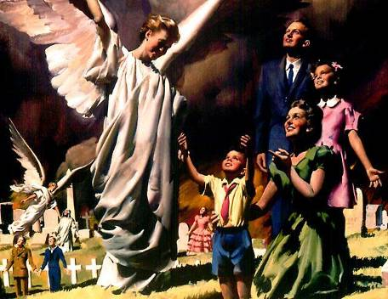
The first Adam brought death to the living.
The last Adam brought life to the dying.
Romans 5:17 NKJV “For if by the one man’s offense death reigned through the one, much more those who receive abundance of grace and of the gift of righteousness will reign in life through the One, Jesus Christ.”

Slide 36

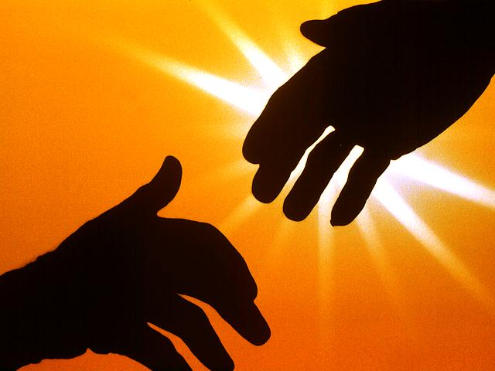
The problem—Man desired to be God.
The solution—God descended to be man.

Slide 37
The problem—Man desired to be God.
The solution—God descended to be man.
Genesis 3:5 NKJV “… you will be like God.”

Slide 38
The problem—Man desired to be God.
The solution—God descended to be man.
Philippians 2:6 RSV “Who, though he was in the form of God, did not count equality with God a thing to be grasped,”

Slide 39
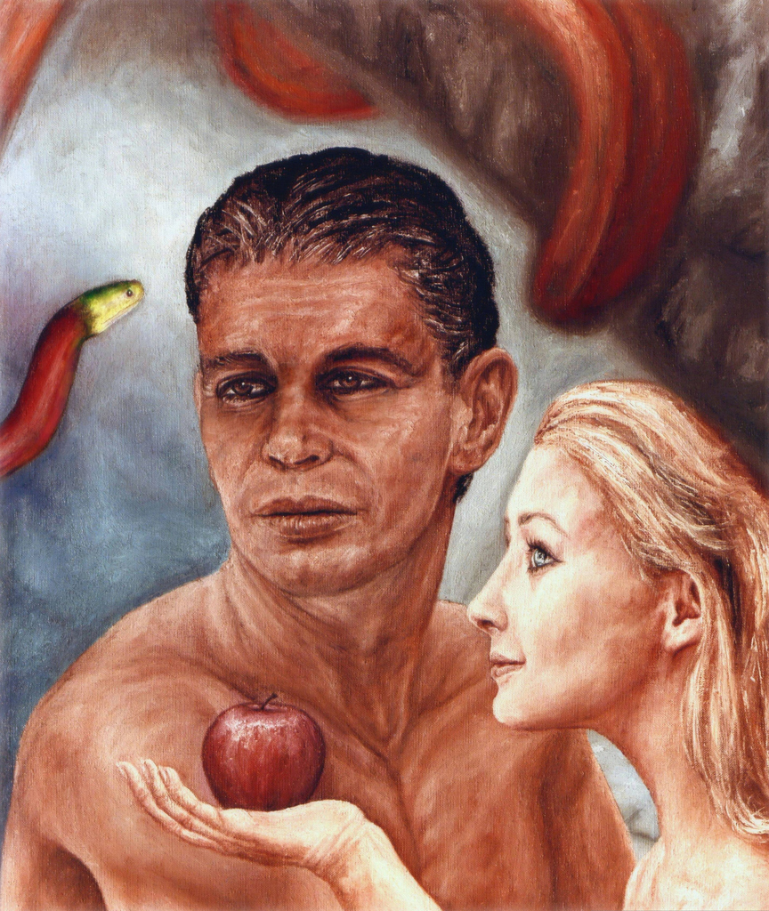
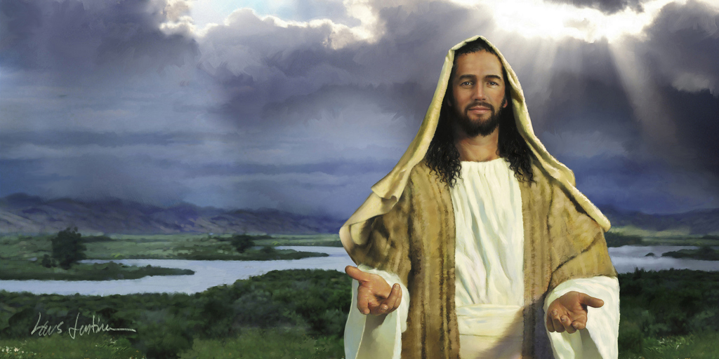
One believed a Lie, the other is the Truth

Slide 40
One believed a Lie, the other is the Truth
Adam got trapped with the lies of the devil.
John 8:44 NKJV “… the devil, … from the beginning, and does not stand in the truth, because there is no truth in him. When he speaks a lie, he speaks from his own resources, for he is a liar and the father of it.”

Slide 41
One believed a Lie, the other is the Truth
Jesus triumphed being the Truth Himself.
John 14:6 KJV “Jesus saith unto him, I am the way, the truth, and the life.”

Slide 42
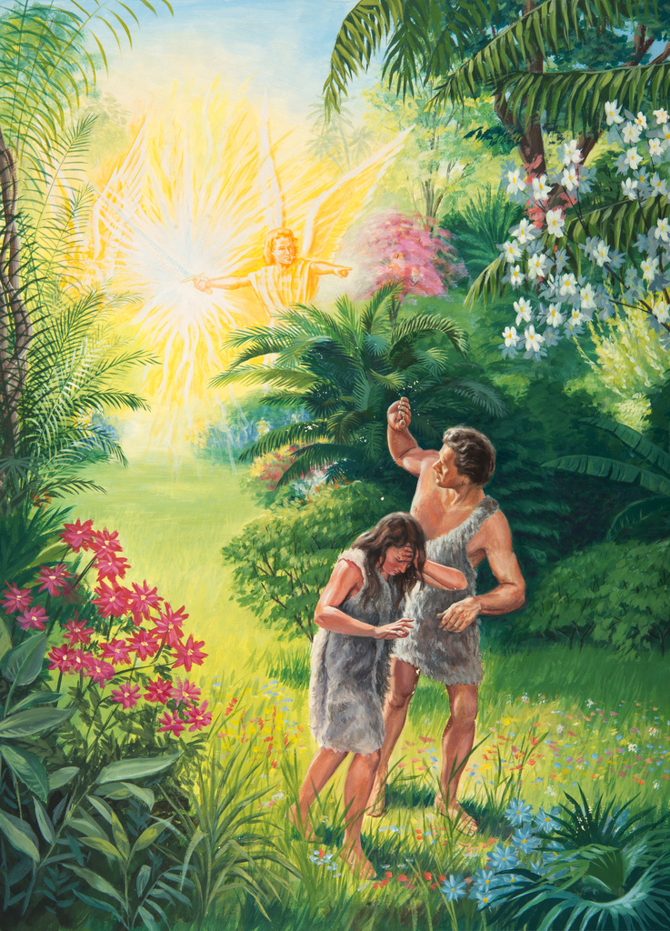
One was sent away.
The other was sent to pay.

Slide 43
One was sent away.
The other was sent to pay.
Genesis 3:23 NKJV “Therefore the Lord God sent him out of the garden of Eden.”

Slide 44
One was sent away.
The other was sent to pay.
John 3:17 KJV “For God sent not his Son into the world to condemn the world; but the world through Him might be saved.”

Slide 45
The two Adams faced the THREE-fold Test

Slide 46
1 John 2:16 KJV “For all that is in the world, the lust of the flesh, and the lust of the eyes, and the pride of life, is not of the Father, but is of the world.”
1 John 2:16 NLT For the world offers only a craving for physical pleasure, a craving for everything we see, and pride in our achievements and possessions. These are not from the Father, but are from this world.

Slide 47
Genesis 3:6 KJV “…saw that the tree was good for food, and that it was pleasant to the eyes, and a tree to be desired to make one wise.”

Slide 48
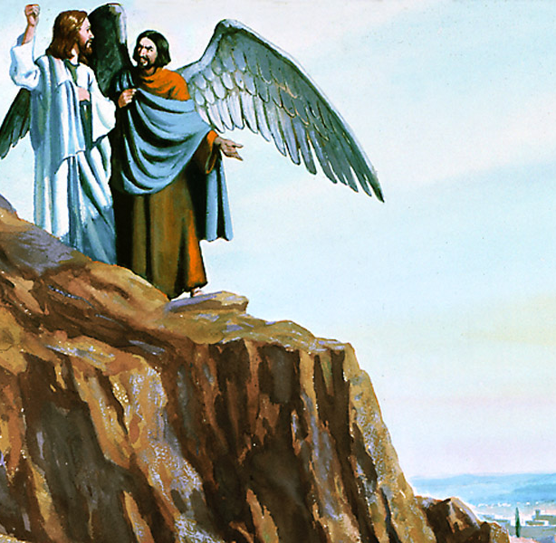
Luke 4:3 KJV “…command this stone that it be made bread … shewed unto him all the kingdoms of the world in a moment of time …cast thyself down from hence: For it is written, He shall give his angels charge over thee, to keep thee”

Slide 49
The Two Families

Slide 50
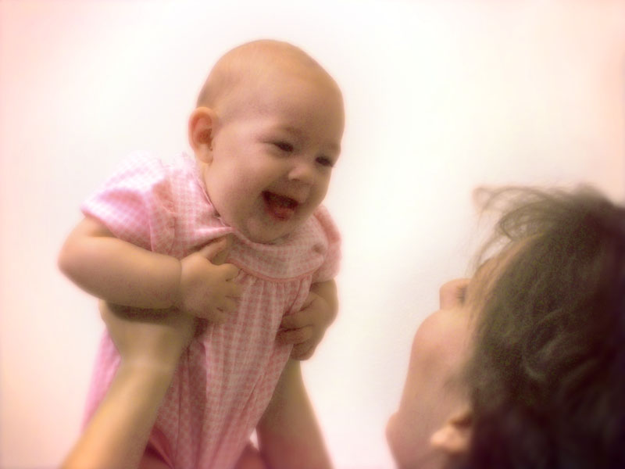
When we are all born into this world we are born into the first Adam’s family. Since we are all his children, we share his legacy as well.

Slide 51
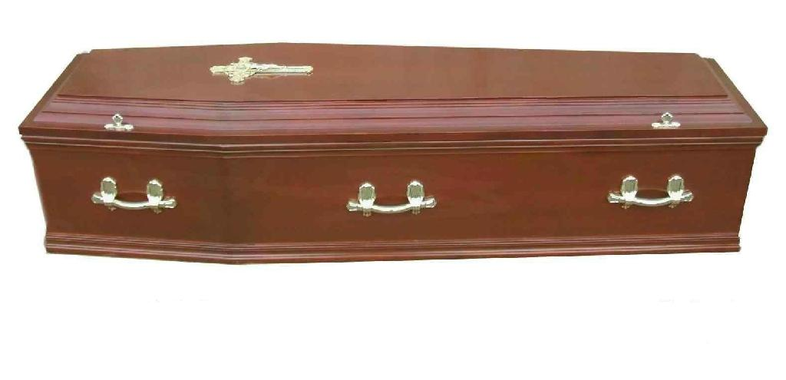
And Adam has left for us only one legacy—death, along with it, a package of pain and suffering. The death decree looms over all the children of Adam. The penalty of Adam is our penalty as well, as he was a representative man.

Slide 52
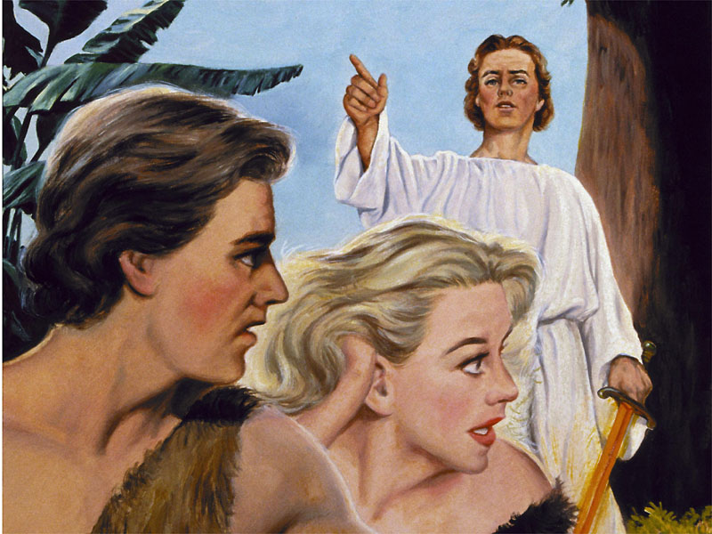
God told Adam, that if he sinned,
Genesis 2:17 “… thou shalt surely die.”

Slide 53
And to us is the message as well.
1 Corinthians 15:22 “For as in Adam all die”

Slide 54
And to us is the message as well.
Romans 5:17 “For if by one man's offence death reigned by one”

Slide 55
Adam and all humanity, whether a innocent, just-born baby or a grown-up sinner, we have no escape from the eternal death penalty. It is ours by inheritance.

Slide 56
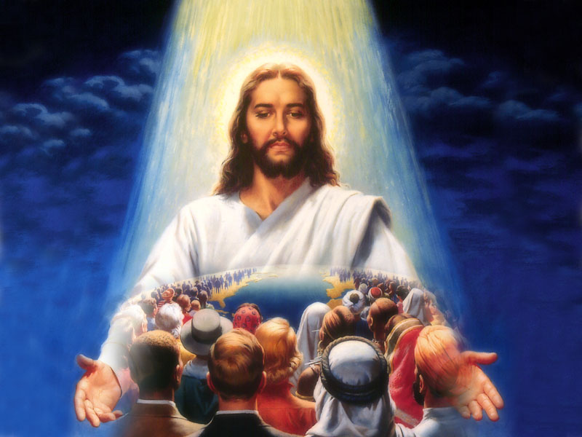
But God did not leave Adam and the human family alone to destruction, whom He created in His own image. He wanted to re-create humanity again in His own image.

Slide 57
It was an easy process to make man in His image in the beginning. He had to only take clay and design all the organs and breathe His life into it. That was pretty simple, at least for the great Creator.

Slide 58
But to re-create humanity again, not making another humanity, but re-creating sinful humanity into God’s perfect image was a challenging process.

Slide 59
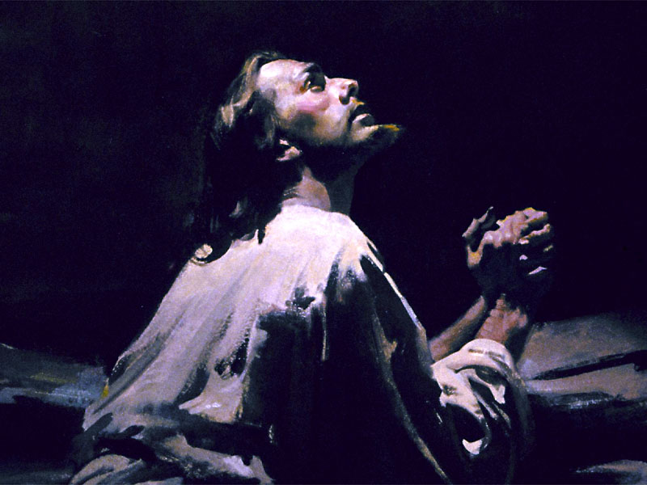
In fact it was so risky and tough for the Creator Himself, that He was thinking of giving up the whole idea.
Matthew 26:38, 39 “Then saith he unto them, My soul is exceeding sorrowful, even unto death: tarry ye here, and watch with me. And he went a little further, and fell on his face, and prayed, saying, O my Father, if it be possible, let this cup pass from me: nevertheless not as I will, but as thou wilt.”

Slide 60
Saving humanity hurt Him so much that he cried with pain that is unexplainable.
Matthew 27:46 “And about the ninth hour Jesus cried with a loud voice, saying, Eli, Eli, lama sabachthani? that is to say, My God, my God, why hast thou forsaken me?”

Slide 61
It was easy for God to give life to man in the beginning. He had to just shape him, bow his head down and breathe His own breath into man.
Genesis 2:7 “And the LORD God formed man of the dust of the ground, and breathed into his nostrils the breath of life; and man became a living soul.”

Slide 62
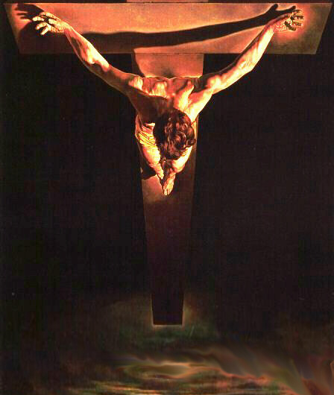
How hard it was to give man life again. Again He had to give His breath for man, He had to give all His breath away, to breathe the breath of life for the whole of humanity. He gave all His breath away and died!
John 19:30 “He said, It is finished: and he bowed his head, and gave up the ghost.”

Slide 63
The death penalty that came to Adam and all his children, and all sins that each child of Adam committed, and will commit, Christ paid it in full on the cross.
Adam and his children won’t have to die eternally for the mistake committed in the Garden of Eden

Slide 64
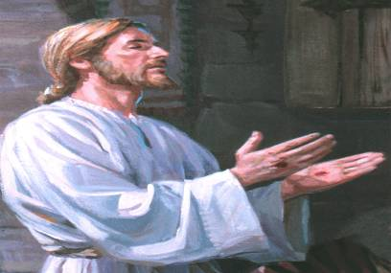
All who will finally die the
“second death” (Revelation 20:14) will die,
not because Adam transgressed, but because
they refused God’s plan of salvation through
the last Adam!
John 16:9 “Of sin, because they believe not on me”

Slide 65
Joining
The Two Families

Slide 66
When do we join the family of first Adam?
It’s at birth

Slide 67
When do we leave the family of the first Adam?
It’s at death

Slide 68
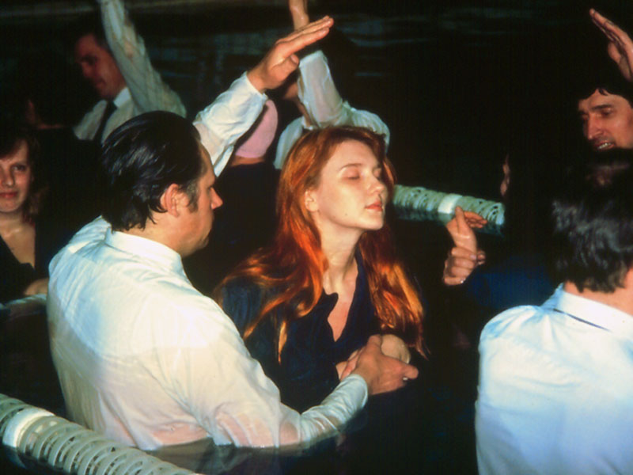
When do we join the family of the last Adam?
At second birth!
John 3:3 “Jesus answered and said unto him, Verily, verily, I say unto thee, Except a man be born again, he cannot see the kingdom of God.”

Slide 69
Romans 6:11 “Likewise reckon ye also yourselves to be dead indeed unto sin, but alive unto God through Jesus Christ our Lord.”
But to be born again, into the last Adam’s family, one has to leave the first Adam’s family. We need to die to the first Adam’s family.

Slide 70
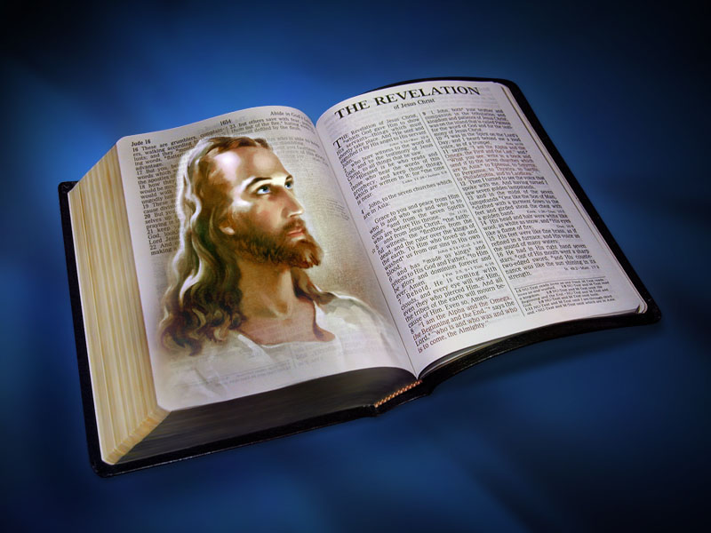
1 Peter 1:23 “Being born again, not of corruptible seed, but of incorruptible, by the word of God, which liveth and abideth for ever.”
The first Adam disobeyed the word of God, the last Adam fully obeyed the word of God.

Slide 71
Then we can count ourselves as born again into the last Adam’s family
Are we living by every word of God?

Slide 72
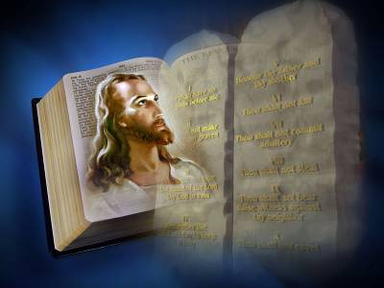
John 15:10 “If ye keep my commandments, ye shall abide in my love; even as I have kept my Father's commandments, and abide in his love.”
The first Adam disobeyed the commandments of God. The last Adam obeyed all the commandments of God.

Slide 73
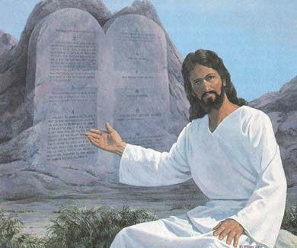
Are we keeping ALL of God’s commandments?
Then we can count ourselves as born again into the last Adam’s family

Slide 74
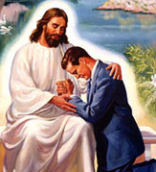
2 Corinthians 5:17 “Therefore if any man be in Christ, he is a new creature: old things are passed away; behold, all things are become new.”
Is our life the same as it was before, or is there a complete change? The life of a Christian is not a modification or an improvement of the old, but brand new one!

Slide 75
When we are truly born again the restoration process begins, taking us back to Adam before the fall—in God’s image.
Colossians 3:10 “And have put on the new man, which is renewed in knowledge after the image of him that created him” We have to be renewed in “knowledge”.

Slide 76
We have to be renewed in “knowledge”.
Remember Adam lost it all when he ate of the tree of “knowledge” of good and evil?

Slide 77
Hosea 4:6 “My people are destroyed for lack of knowledge: because thou hast rejected knowledge, I will also reject thee, that thou shalt be no priest to me: seeing thou hast forgotten the law of thy God, I will also forget thy children

Slide 78
God wants us to get the knowledge back, The knowledge of God that comes from obeying His law.

Slide 79
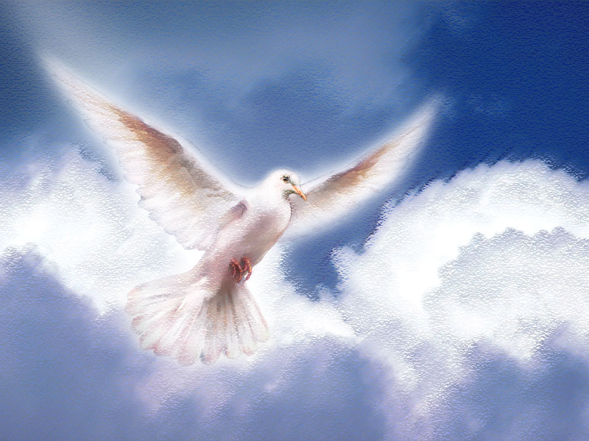
As Christ was born of the Spirit at His birth, we are to be born again of the Spirit to begin a new life.
John 3:6 “That which is born of the flesh is flesh; and that which is born of the Spirit is spirit.”

Slide 80
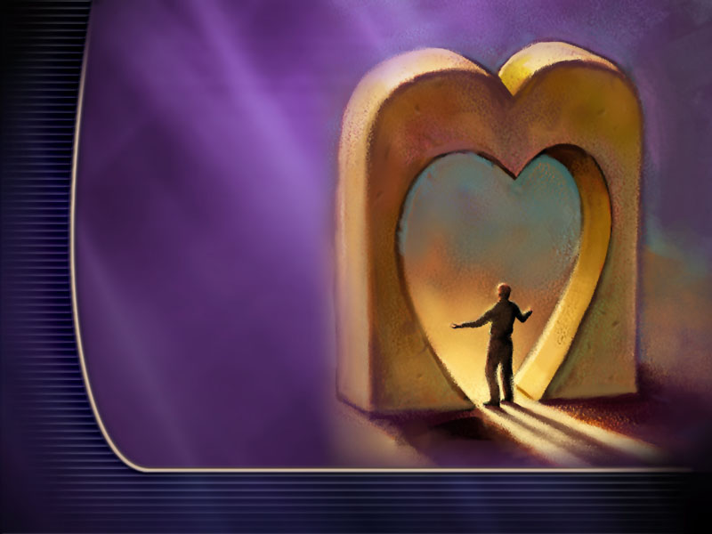
Joining the last Adam’s family is a Spirit filled life—a life of obedience to the law of God.
Ezekiel 36:26, 27 “A new heart also will I give you, and a new spirit will I put within you:… And I will put my spirit within you, and cause you to walk in my statutes, and ye shall keep my judgments, and do them.”

Slide 81
Hebrews 10:15-17 “Whereof the Holy Ghost also is a Witness to us: for after that he had said before, This is the covenant that I will make with them after those days, saith the Lord, I will put my laws into their hearts, and in their minds will I write them; And their sins and iniquities will I remember no more

Slide 82
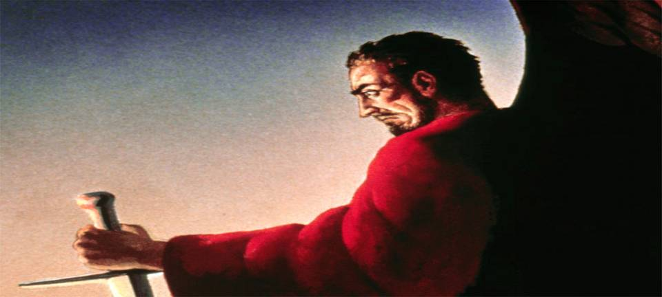
For every truth of the Bible Satan has come up with a counterfeit. He has come up with a counterfeit of the “new life” and “new birth” and “born again” experiences as well.

Slide 83
There are many who talk about being born again, having a new life, but they still live the same old life, with some modifications only. They claim to have the Holy Spirit and new birth experience but have not the law of God in their heart or minds. Rather they speak against the law of God!

Slide 84
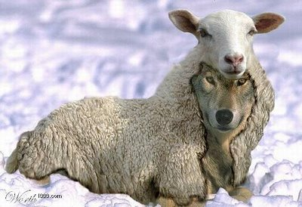
This is not surprising. The Bible and the Holy Spirit has warned us about it.
1 Timothy 4:1 “Now the Spirit speaketh expressly, that in the latter times some shall depart from the faith, giving heed to seducing spirits, and doctrines of devils; Speaking lies in hypocrisy; having their conscience seared with a hot iron”

Slide 85
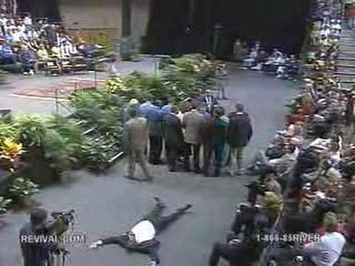
This is a world-wide counterfeit movement just before the coming of Jesus.
Revelation 16:14, 15 “For they are the spirits of devils, working miracles, which go forth unto the kings of the earth and of the whole world, to gather them to the battle of that great day of God Almighty. Behold, I come as a thief. Blessed is he that watcheth, and keepeth his garments, lest he walk naked, and they see his shame.”

Slide 86
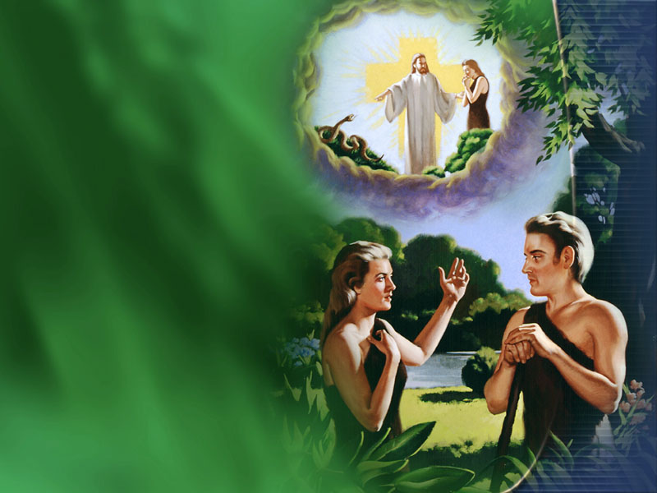
The first Adam found himself naked after being deceived of the devil in the Garden of Eden.

Slide 87
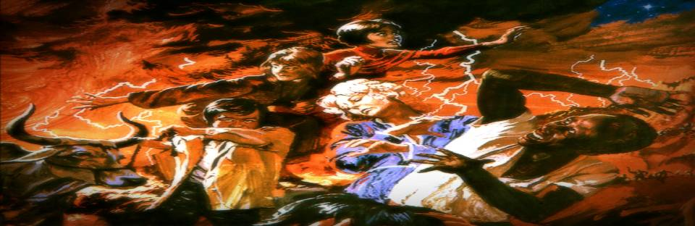
The same state of deception is taking place again in a world-wide scale. Thinking that they are spirit-filled, and born again, all of these counterfeiters will find themselves “naked” at the end.
Rev 16:13 “Blessed is he that watcheth, and keepeth his garments, lest he walk naked, and they see his shame.”

Slide 88
Before it is too late, let us make our stand [belief] clear, and
our destiny [future] secure.

Slide 89
To Which Adam do You want to belong?

Slide 90
The End

